Slide 1

examples
.NET

Slide 2
R1 | R2 | Diff
300 | 3 | 297
209 | 29 | 180
30 | 3 | 27

Slide 3



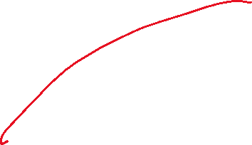






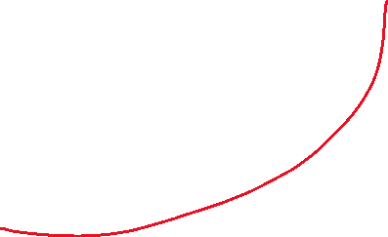






Slide 4












































Slide 5















User Interface
Business Layer
Models Library
Customer
Product
Store
Viewmodel(a special model used for users viewing)
Repository Layer
MapperClass
ADO.NET
Q
R
Azure Db

Slide 6
Select * from Stores
Left join inventory on stores.storeId = inventory.storeId
Left join products on inventory.productid = Products.productid
EX……
select * from _Members
Left join _Families on Family = FamilyId
Left join _Origins on Origin = OriginId
where FamilyId = 13;

Slide 7
