Slide 1
Four Eleven Inc
A Software developed By Dynamics 365 Batch 04/11/2022

Slide 2
Overview
Objective / Goal: Our client, the Four Eleven Company currently uses SalesForce for Marketing and developing leads, but also uses various other types of software for sales, customer service, and field service.
Today, we will demonstrate how Dynamics 365 allows the Four Eleven Company to integrate all of their business needs into one platform, thus allowing them to be more cost effective and time efficient, without sacrificing performance and scalability.

Slide 3

Marketing Division
Tariq Saddler, Alec Galo,
Jasiel Quezada, Whitney Raven
"Dynamics 365 Marketing elevates customer experiences, allowing you to orchestrate personalized journeys across all touchpoints to strengthen relationships and earn loyalty."
Using tools such as segments, email designer, customer journeys, insights, event management, and lead scoring, our division makes a personalized customer experience based on their interactions with our marketing.

Slide 4
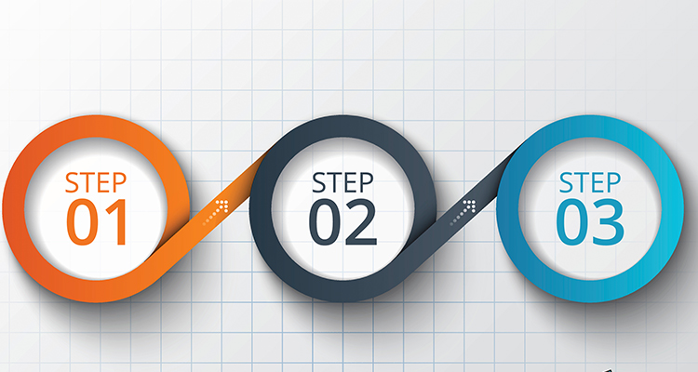
Our Marketing Process Overview
3 simple steps to how the marketing division makes a contact into a Sales-Ready-Lead.
1: Blast an email to a list of email-addresses. In FourEleven's case, they're looking at arcade business owners and associates. (Andretti, Dave & Buster's, Main Event, etc.)
2: Potential customer interacts with the portal website, events, and emails. The customer's interactions increase their individual lead scores.
3: Once a lead score meets or surpasses the 50-point-threshhold, the BPF pushes the lead to Sales.

Slide 5
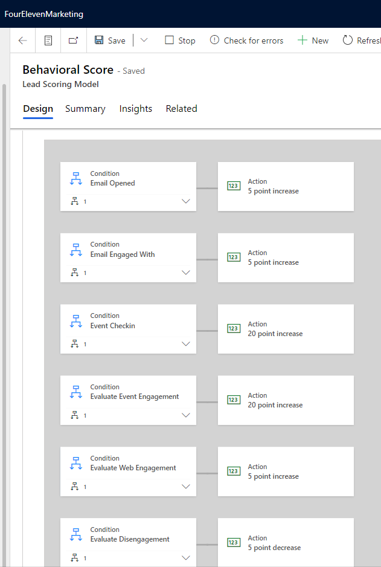
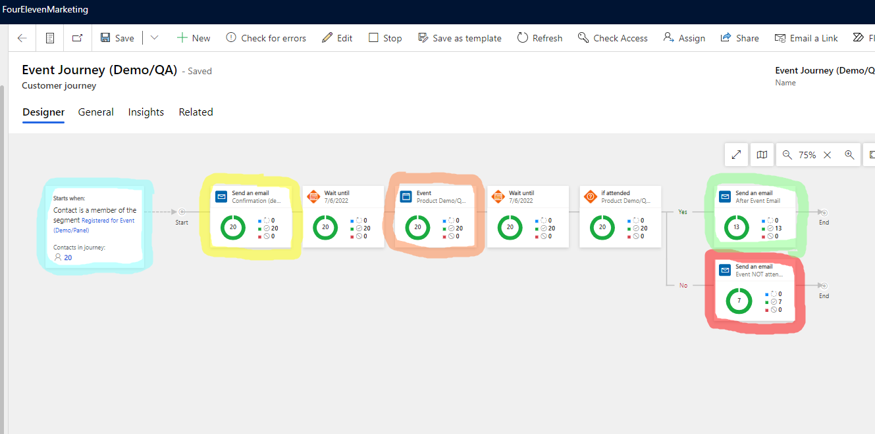
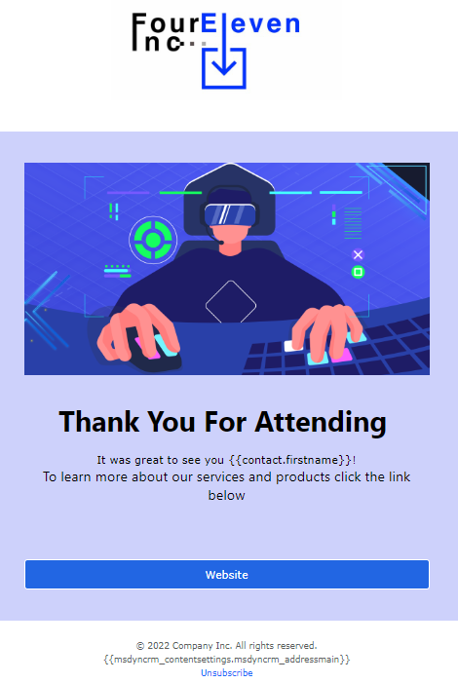
Our Marketing process overview (example)
When a customer signs up for the event, this customer journey is initiated.
*An automated marketing campaign intended for a specific target audience.
Customer interactions with the event show their interest, which increments their lead score by set amounts each time.
"Thanks for attending" email with button-link.
If the contact attended the event...
"Thank you for signing up" email includes a button-link to the portal.
Event takes place.
Segment based on contacts who signed up for this event.
"Sorry you couldn't make it" email with button-link.

Slide 6
Sales Division Tim chialastri, tyler white, wint aung
Client Needs
Implement different security levels for sales employees
New contacts / leads should be auto-assigned to the sales team and must not be able to qualify a lead until user has either email or phone number.
BPF – Qualify stage: Must collect customer's timeframe, budget, and purchase process to move forward
Sales team member must be able to complete the entire sales process.
Optional Note: The Four Eleven Company also prefers the ability to have manager's approve quotes and VP's to approve orders. These features are possible but due to time constraints are intentionally left out of the demo.

Slide 7
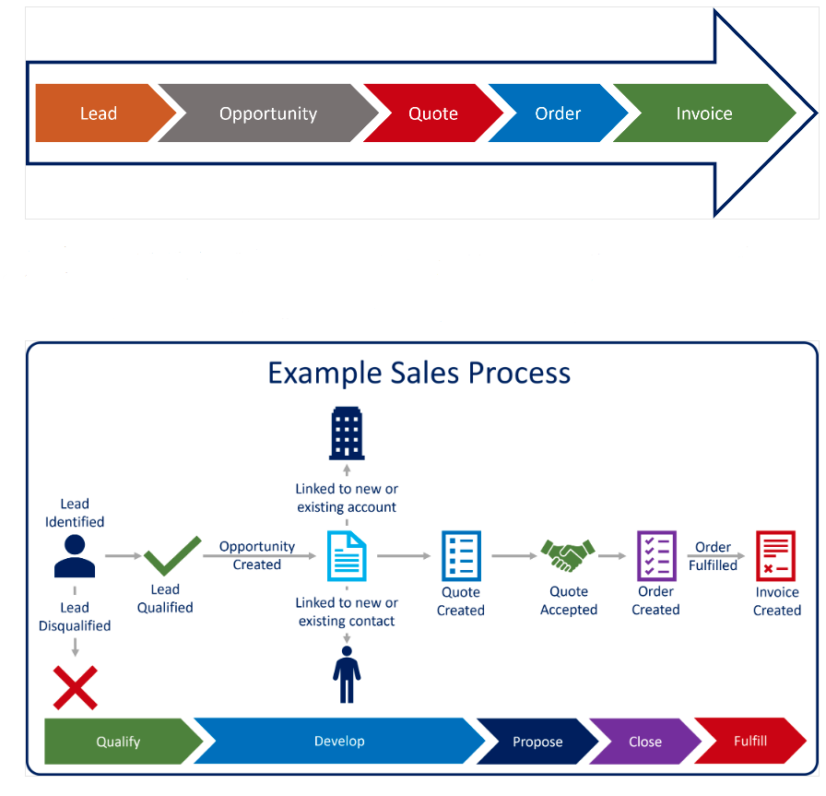

Slide 8
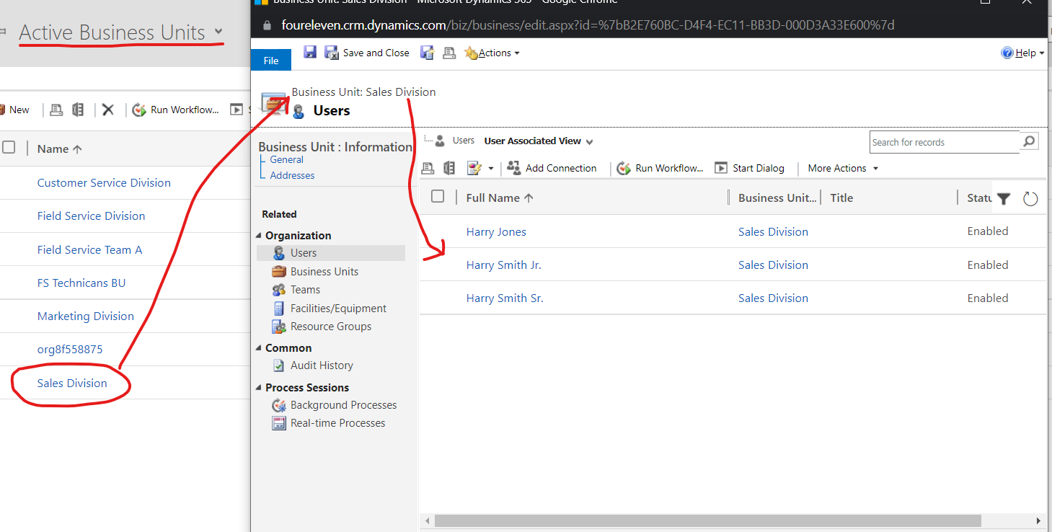
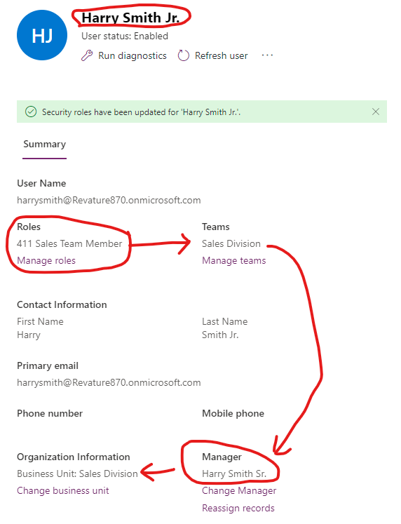

Slide 9
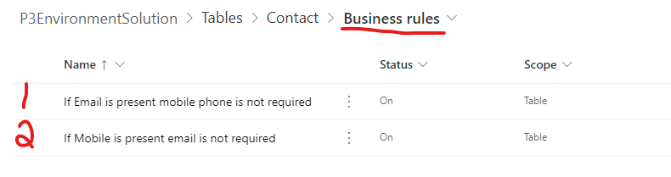
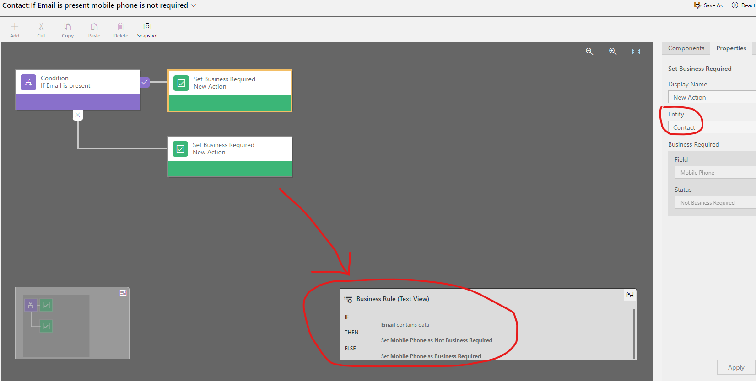

Slide 10
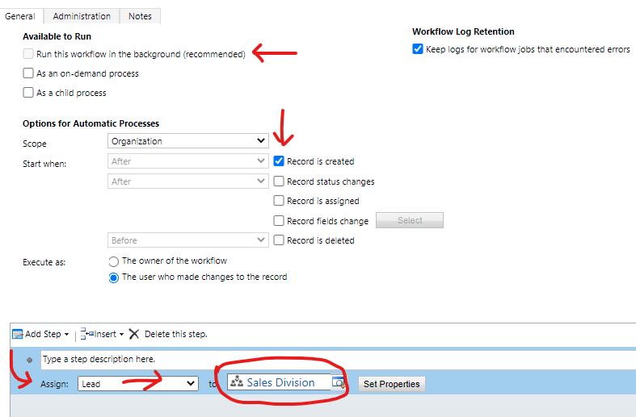

Slide 11
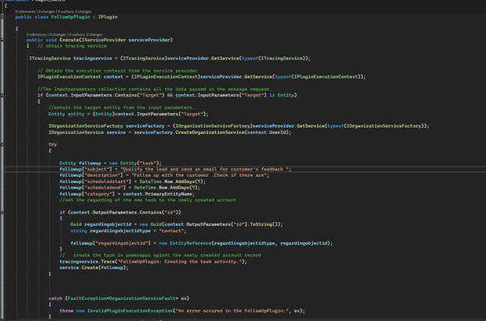
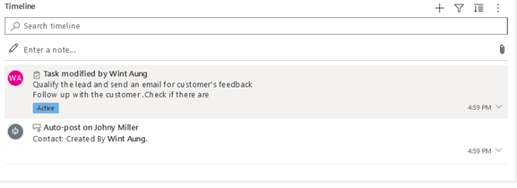

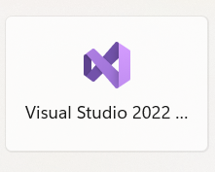
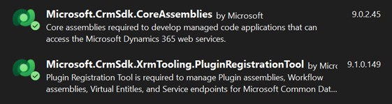
Sales - Plug-in
install
Tools for plugin
Visual Studio 2022
PluginRegistration.exe

Slide 12


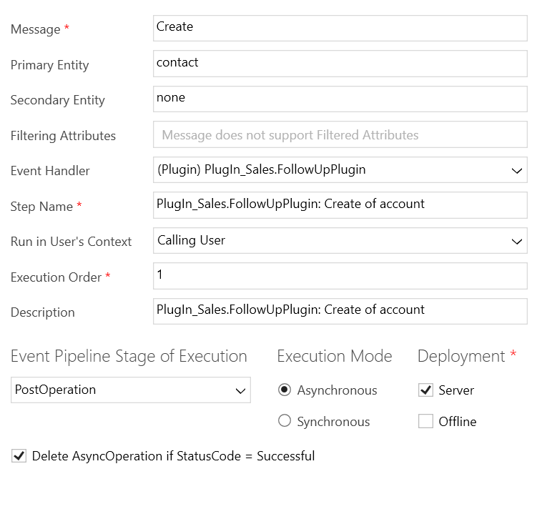
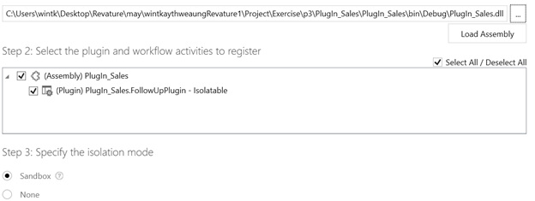
Login under the environment:
Register a new assembly
Register step
Choose the action and entity

Slide 13
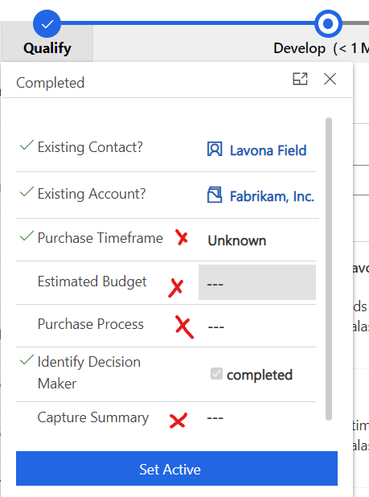
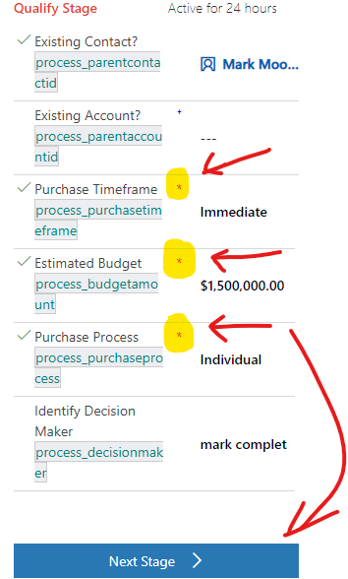
Standard BPF: Qualify Stage
Custom BPF: Qualify Stage

Slide 14
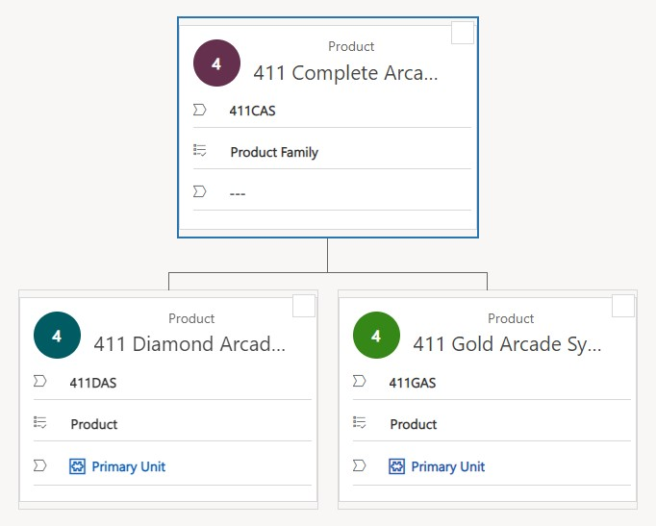
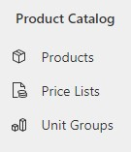
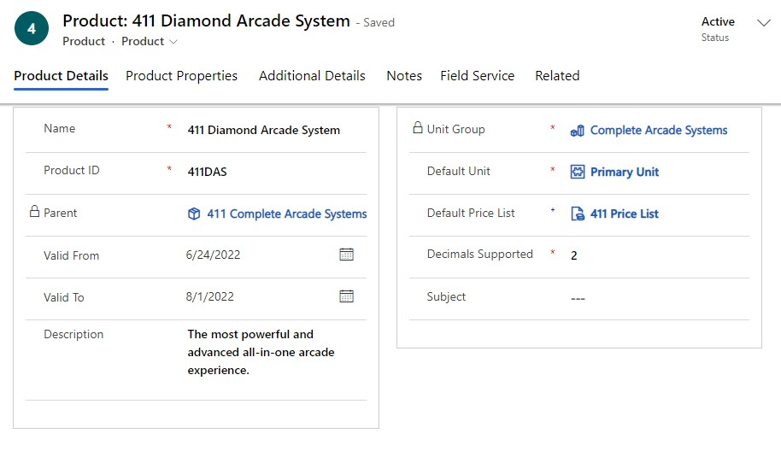
Sales – Product Catalog
Robust product management system
Need was for serviceable products
Product hierarchy and families
Selling relationships – upsell options, out of stock
Unit Groups – quantity allotments
Primary Unit, wholesale vs retail
Price Lists
For unique markets or price changes

Slide 15
Salina yung, angela thiessen, leekira smith, marcel english CUSTOMER SERVICE Process
After Sales, Customer has a problem with their arcade system.
The customer reaches out to Customer Service through the chat-box.
Chat-box will notify a customer service agent.
CS Agent will review customer entitlement and service level agreement.
CS Agent then creates a Case.
CS Agent researches case by keywords for knowledge articles.
CS Agent resolves Case to Work Order!

Slide 16
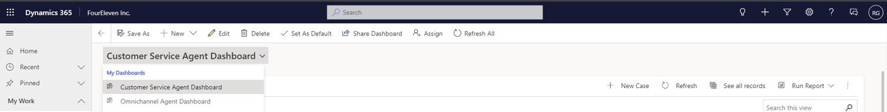
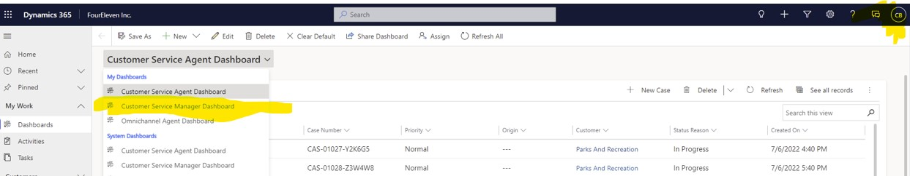
CUSTOMER SERVICE SECURITY ROLES & VIEWS
Ross Geller – Customer Service Representative
Chandler Bing – Customer Service Manager

Slide 17
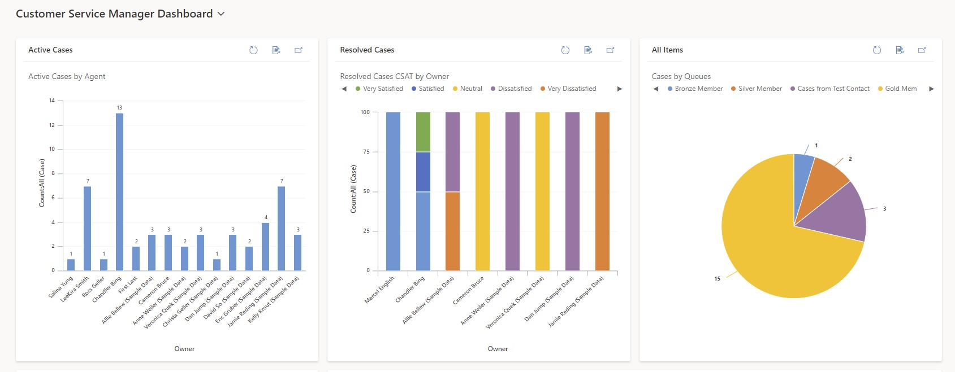
ANALYTICS
Viewable by Manager Chandler Bing
Active Cases
Customer Satisfaction Metrics
Queues

Slide 18
and now onto the
Customer Service Portal
Demo!

Slide 19
Field Service Division Cameron Bruce, Vadym Rohachko, Narmeen Abdullah, Garen Powers
Equip workers with the right tools.
Provide real-time recommendations
Build article knowledge
Track and streamline tasks
Boost first-time fix rates
Deliver relevant work order data.
Offer predictive maintenance.
Avoid service calls.
Improve service accuracy
Trigger alerts with IoT sensors.
Dispatch the right technician.
Optimize service schedules
Automate workflows and scheduling.
Monitor progress.
Accelerate resolutions

Slide 20
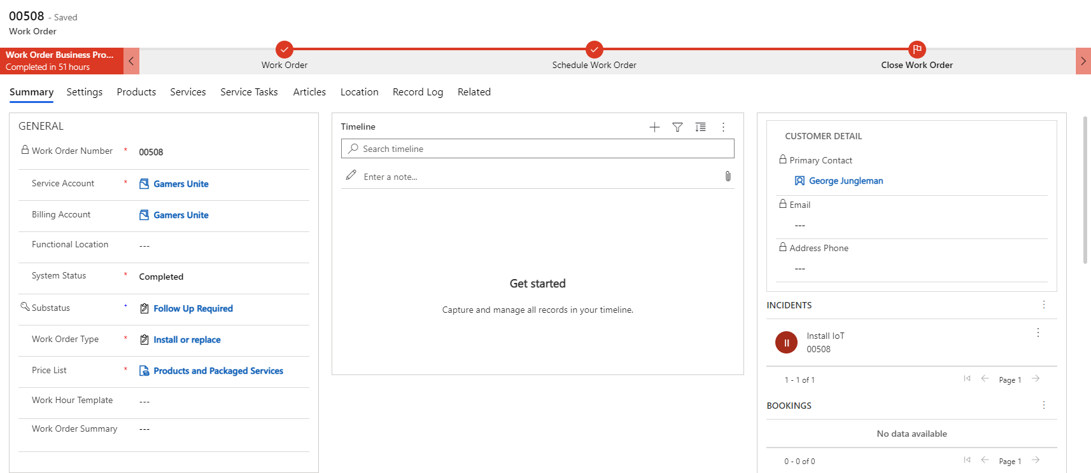
Work Order Business Process Flow

Slide 21
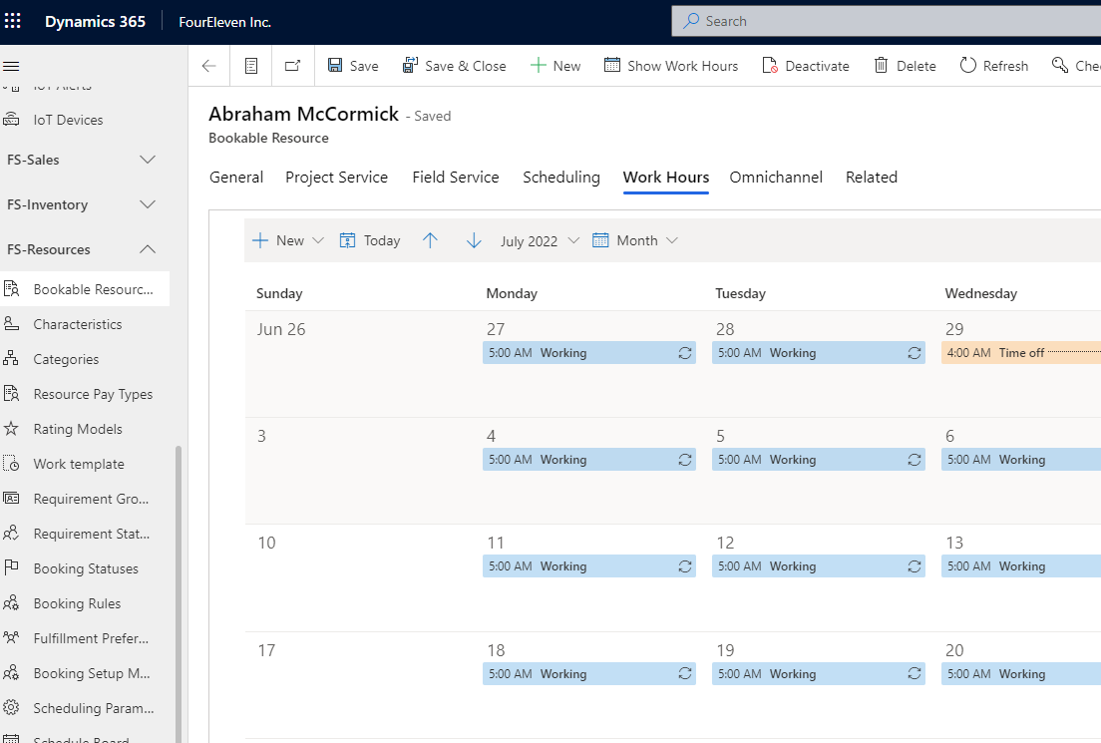
Bookable Resources

Slide 22
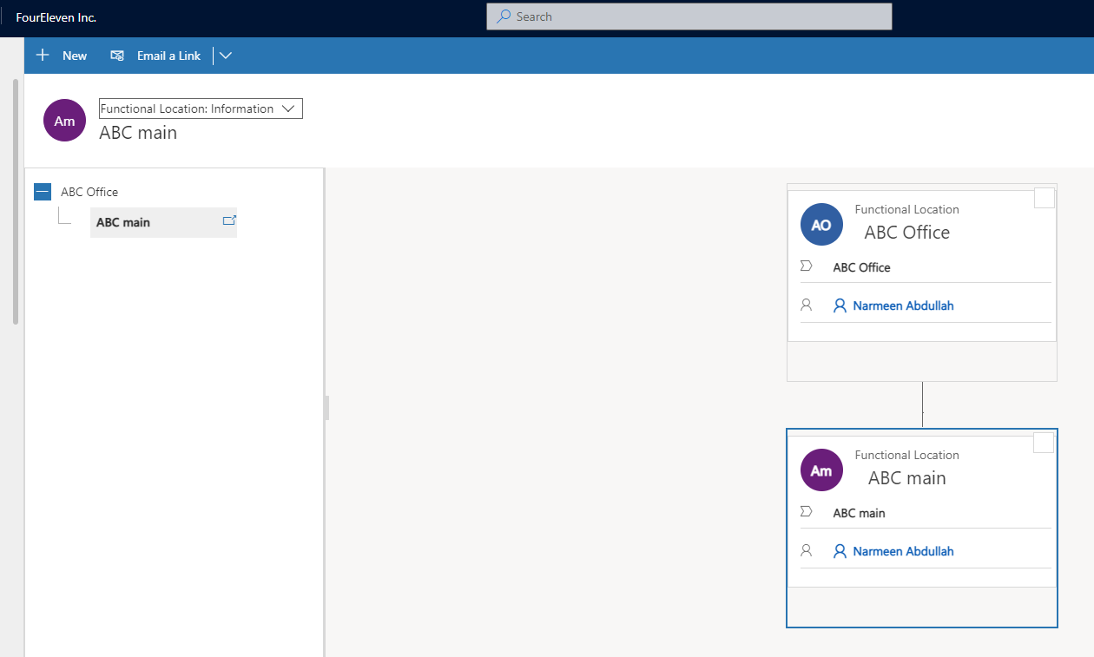
Functional Locations

