Slide 1
Sector-ETF momentum with a volatility-state gate
Question: do sector-ETF trends predict next-month returns in calm markets, and does ML beat a momentum rule?
23 ETFs: 11 sector SPDRs + QQQ, IBB, ITA, ITB, KRE, OIH, SOXX, XBI, XME, XRT, USO, GLD; 2020-2026
Answer: no. Mechanism falsified on validation; fresh 2026 holdout Sharpe 0.07 vs equal weight 1.88
Pattern: never resolved
Notes:
開場 30 秒:一句話講結論。我們的策略在全新的 2026 年資料上,沒有贏過把 23 檔等權重全部抱著。

Slide 2
1. Mechanism and falsification
Industry momentum: information diffuses slowly across sectors; money rotates gradually
Rotation crashes when volatility spikes -> trade only when SPY vol percentile < 0.80
Stop if: (1) momentum IC <= 0 in calm states, (2) gate does not help the rule, (3) holdout test fails
Result: all three triggered
Notes:
組員1。強調機制先行:三個證偽條件在看任何結果之前就寫進 setup.yaml 並 commit。

Slide 3
2. Setup v1 and protocol (committed before any backtest)
Fixed list of 23 ETFs, no de-duplication (QQQ kept); BIL = cash
Month-end close signal -> next-open fill; top-5 equal weight, long-only
Label: next open -> open +21; costs $0.0035/share + tiered half-spread
Walk-forward: 8 half-year folds 2022-2025, 21-session purge
Holdout 2026-01..10: data nobody had seen, read once after the freeze
60 variants (906 incl. earlier versions)
Notes:
組員1。為什麼 holdout 是 2026:2024、2025 在之前的版本已經看過,不能再當期末考。2026 用 Yahoo 下載,凍結設定後才讀一次。

Slide 4
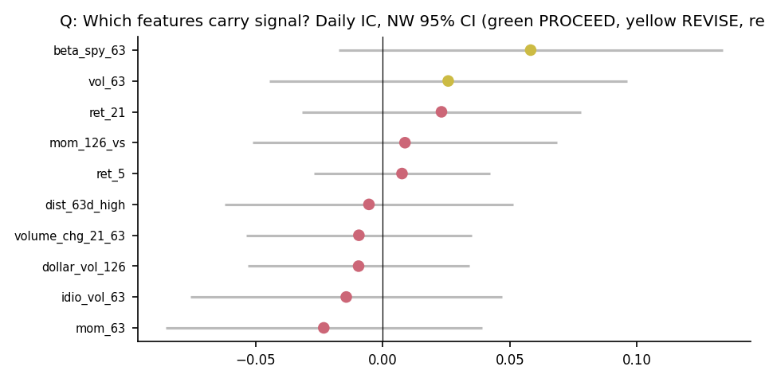
3. Data and features
0 missing, 0 duplicates, 0 OHLC violations; matches textbook bars (corr 0.99999999)
15 signals + 4 states; 5 merged by correlation clustering
Five gates: 0 PROCEED, 2 REVISE, 13 STOP; nothing survives BH
Momentum IC: calm -0.013, volatile +0.089 - opposite of the story
Strongest feature is market beta (risk compensation), not trend
Notes:
組員2、3。動能在平靜時期反而是負的,第一個證偽條件被觸發。

Slide 5
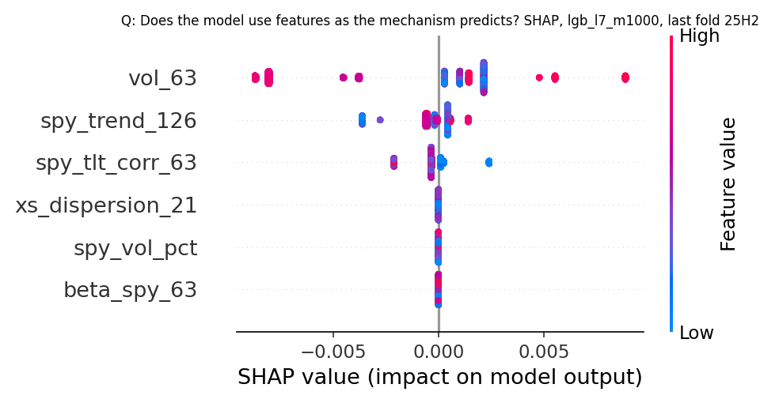
4. Model ladder (yardstick: daily IC, Newey-West 95% CI)
Rule +0.010 | Ridge -0.011 | LightGBM -0.039 | Ensemble -0.013
No interval excludes zero -> no signal established
Deployed by pre-registered rule: the non-ML momentum rule
ML adds nothing: LightGBM learns market timing from state variables, not the cross-section
Notes:
組員4。Figure 5 SHAP:LightGBM 最依賴 vol 和市場狀態變數,但狀態變數同一天對所有 ETF 都一樣,沒辦法拿來排序,所以 IC 是負的。

Slide 6
5. Headline table (Ch. 20 gates)
Stage | Metric | Validation (2022-2025) | Holdout (2026-01..2026-10) | Benchmark (val / holdout)
Signal | Daily IC [NW 95% CI]; ICIR; share of positive folds (val) / months (holdout) | +0.010 [-0.057, +0.078]; 0.16; 4/8 | -0.037 [-0.174, +0.099]; -; 44.4% | -
Portfolio (top-5 EW + gate, before costs and overlay) | Gross excess Sharpe [CI]; max DD; 2-way turnover/yr | 0.29 [-0.55, 1.16]; -14.1%; 11.4x | 0.13 [-1.94, 1.50]; -10.8%; 15.9x | EW universe 0.44 / 1.88; SPY 0.46 / 0.89; 60/40 0.29 / 0.61
Costs | Net excess Sharpe at assumed cost; break-even (bp per leg) | 0.28; 31 (with overlay 36) | 0.11; 5 (with overlay 4) | -
Risk overlay (10% vol target) | Net excess Sharpe; max DD | 0.36; -7.9% | 0.07; -6.4% | -
Inference | Deflated Sharpe (N=60 / N=906); minimum track record (years) | 0.63 / 0.58; 49 | 0.46 / 0.43; 1242 | -
Confirmatory test (minus equal weight): -1.82 [-3.60, +0.50] -> not passed. Pattern: never resolved.
Notes:
組員5。逐列講:訊號、投組、成本、風險覆蓋、推論。DSR 和最短紀錄長度一定要提:要 49 年才能確認驗證期的 Sharpe。

Slide 7
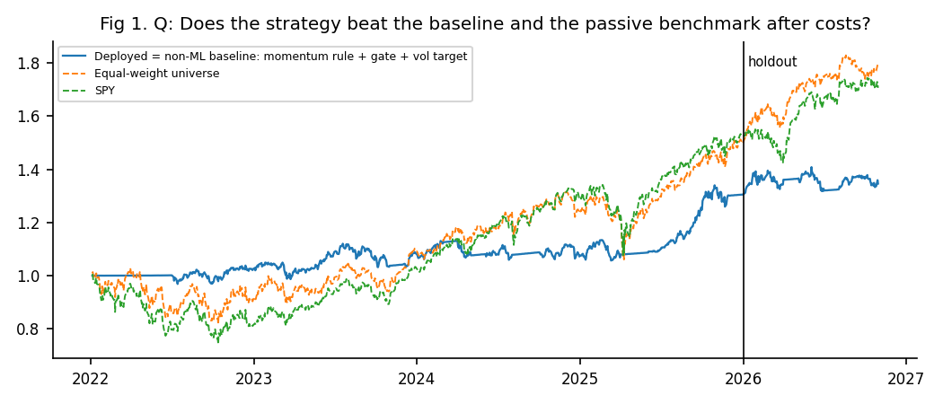
6. Equity curves: validation | holdout
Validation excess Sharpe: deployed 0.36, no-gate rule 0.41, EW 0.44
Holdout 2026: deployed 0.07, no-gate rule 0.42, EW 1.88, SPY 0.89
Overlay keeps max DD small (-6.4%) but holds about half in BIL
Notes:
組員5。Figure 1:2026 年所有產業一起漲,只挑 5 檔、一半放現金的策略追不上。

Slide 8
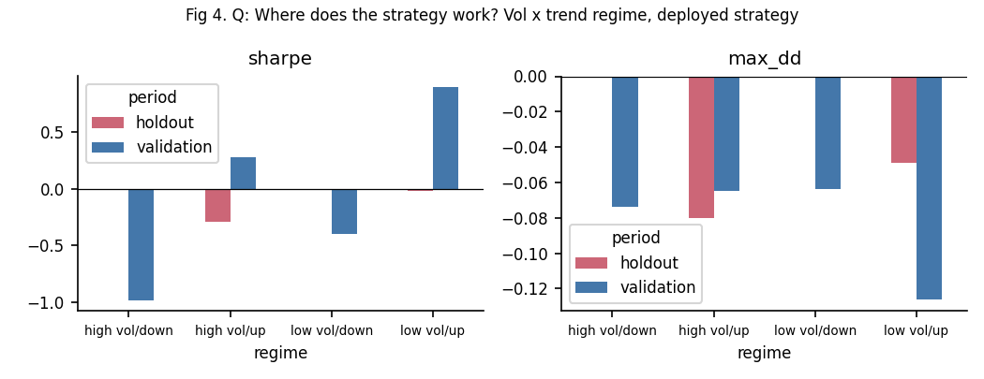
7. Where it works: regime slice
Validation: works only in low-vol / up-trend months
Loses in down-trends; flat or negative in every 2026 regime
Gate + overlay stayed flat in 2022 and April 2025, but the gate lowered Sharpe
Notes:
組員6。Figure 4:門檻用當時資訊算,不是事後挑。閘門有防守價值,但不是好訊號。

Slide 9
8. Diagnosis
Value lost at the signal gate: IC never clears zero (holdout -0.037)
Gate hurt the rule on validation -> mechanism falsified
2026 rewarded owning every sector; costs were not the problem
Binding constraint: 23 correlated names, about 70 independent months
Notes:
組員6。誠實歸類比數字重要。毛報酬和淨報酬差不多,所以不是成本也不是程式錯誤。

Slide 10
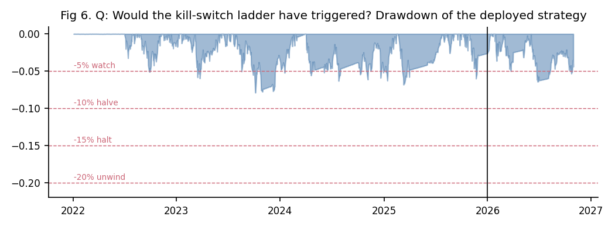
9. Next step and monitoring
Next step (one): same 23 ETFs, add 2006-2019 history (~25 more folds), drop the gate; new 2027 holdout
Monitor: 30/60/90-day Sharpe, IC, drawdown; PSI on momentum, beta, vol (retrain > 0.25)
Kill switch: -5% watch, -10% halve, -15% halt, -20% unwind
Not deployed to capital
Notes:
組員6。Figure 6:只觸發 -5% 警戒。然後進入 Q&A。

