Slide 1
Revature p1 mvc app
By: Enbai Kuang

Slide 2
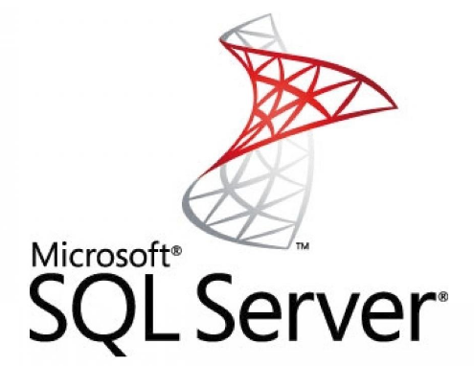

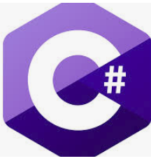



Tech Used

Slide 3
P1 features and goals
Followed a code first approach to design and create the database
Uses a local SQL Server database instead of SQLite.
Main goal is to help clients look up store locations, store inventory/stock, and place orders.

Slide 4
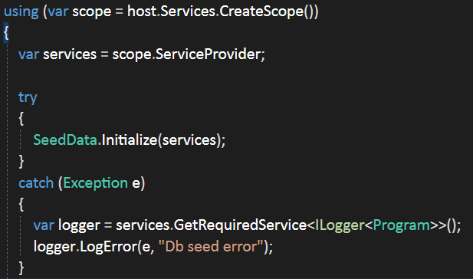
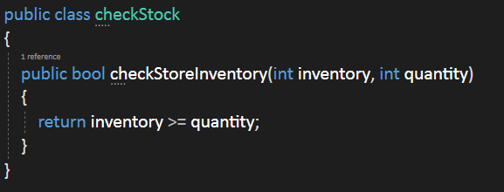
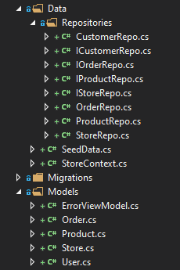
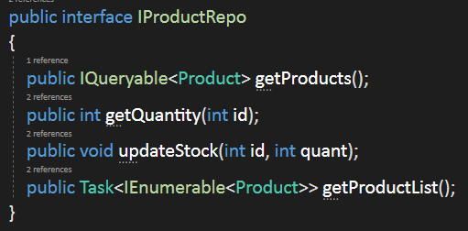
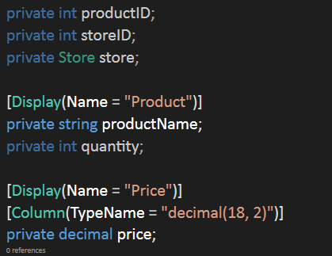
Data structure and code

Slide 5

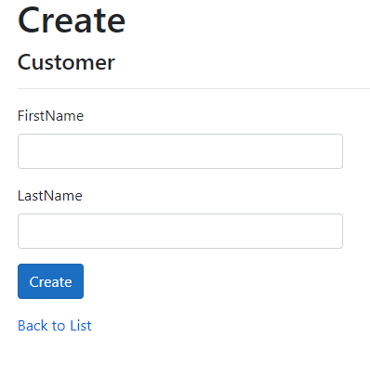

Working Features

