Slide 1
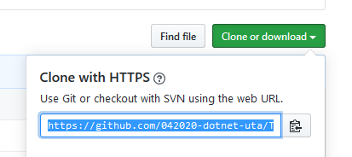

Clone the Repo to your local computer
Shared Github repo

Slide 2

Make sure you are actually on the right repo
Assumptions at this point:
A repo has already bee created on GitHub.com
You have already cloned this repo to your local computer
You are making commands from the file that has your .git folder

Slide 3
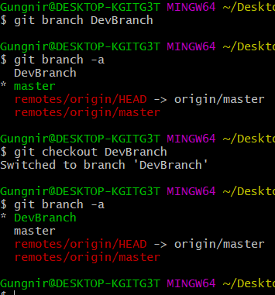
Make some changes … Add files/change code in existing files/whatever
Make a new branch … Any changes you make here are totally different than the master branch
git branch <branchName> Creates a new branch
See all available branches git branch -a
Notice the * … we are still in the master
git checkout <branchName> This switches us to the branch we are asking for
See all available branches git branch -a
Notice the * … we are now in “DevBranch”

Slide 4
Commit the changes … stage the changes
Add changes to the staging area
Commit your changes
Push my changes to remote repo
Assumptions at this point:
We have made some changes to something
Therefore, our local repo is different than the (shared) remote repo

