Slide 1
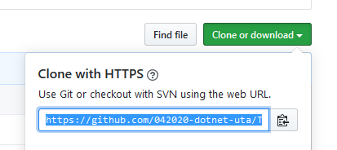

Clone the Repo to your local computer
Shared Github repo

Slide 2

Make sure you are actually on the right repo
Assumptions at this point:
A repo has already bee created on GitHub.com
You have already cloned this repo to your local computer
You are making commands from the file that has your .git folder

Slide 3
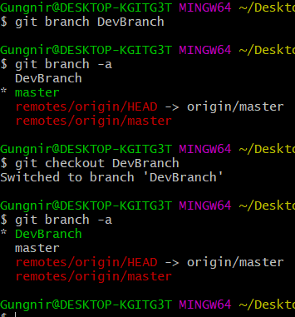
Make some changes … Add files/change code in existing files/whatever
Make a new branch … Any changes you make here are totally different than the master branch
git branch <branchName> Creates a new branch
See all available branches git branch -a
Notice the * … we are still in the master
git checkout <branchName> This switches us to the branch we are asking for
See all available branches git branch -a
Notice the * … we are now in “DevBranch”

Slide 4
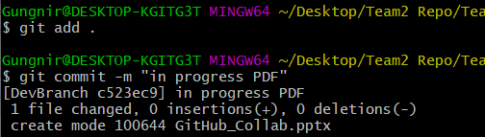
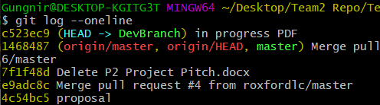
Commit the changes … stage the changes
Add changes to the staging area
Commit your changes
Push my changes to remote repo
Assumptions at this point:
We have made some changes to something
Therefore, our local repo is different than the (shared) remote repo
We want the changes on our local repo applied to the “remote” repo (the one we are sharing)
Each commit has a sha#. Here I can see my commit “in progress PDF” but,
I can also see all of the commits that were made before me

Slide 5
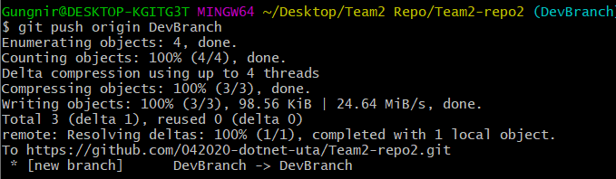
Push the staged changes to the remote repo
I am pushing my local changes from my “DevBranch”. This should now exist on the github.com site

Slide 6
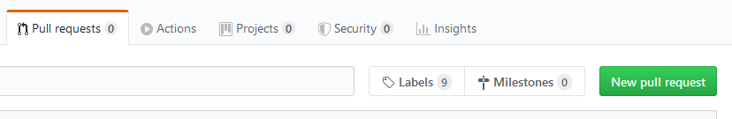
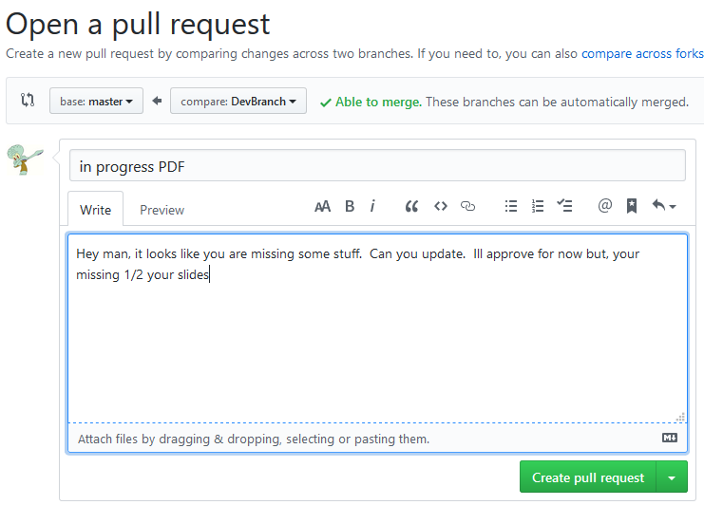

Slide 7
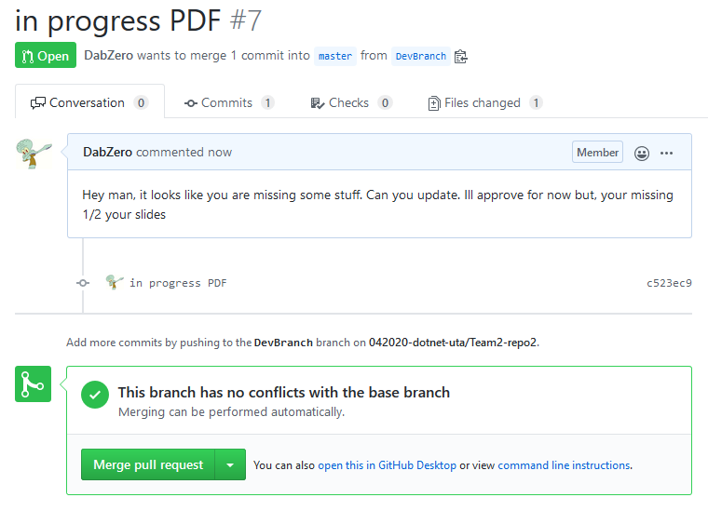
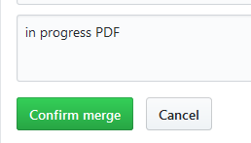
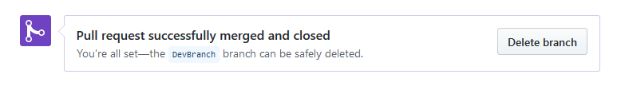
This is just a timeline of comments
I do not need this anymore so, I can just delete

