Slide 1

Store Font : MVC Web App
Purpose:
To mimic a virtual store front
Users can place orders from different locations
Choose from multiple products
Have their orders fulfilled + Display user history
Stores can mange inventory of products by location
ShopHub

Slide 2






Slide 3
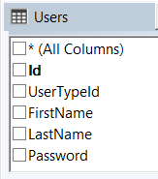
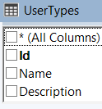
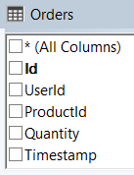
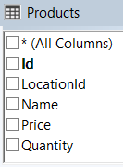
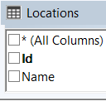
Table Structure of models:
Presentation Layer
Business Layer
Data Layer
SQL

