Slide 1

.NET Architectural Components
.NEt

Slide 2
A .NET app runs in one or more implementations of .NET (.NET7, .NET Core, Mono, or Xamarin). There is an API specification common to all implementations of .NET called the .NET Standard.
https://docs.microsoft.com/en-us/dotnet/standard/components#applicable-standards

Slide 3

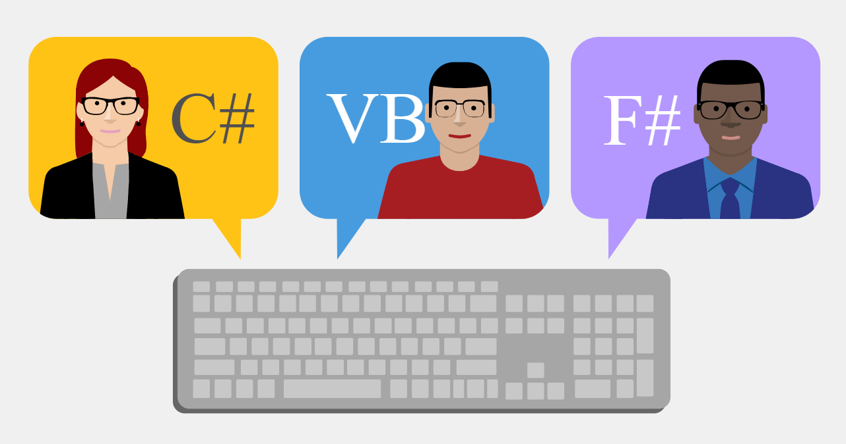
What is .NET? https://dotnet.microsoft.com/learn/dotnet/what-is-dotnet https://dotnet.microsoft.com/learn/dotnet/what-is-dotnet-framework
.NET is a free, open-source developer platform made up of tools, programming languages, and libraries for building many types of applications on different programming platforms.
With .NET, you can use multiple languages, editors (IDE), and libraries to build for web, mobile, desktop, games, and IoT.

Slide 4

.NET Implementations https://docs.microsoft.com/en-us/dotnet/standard/components#net-implementations
There are four .NET implementations that Microsoft actively develops/maintains:
.NET 7
.NET Framework(deemphasized)
Mono
Universal Windows Platform (UWP)
Each implementation includes these components:
One or more runtimes.
CLR for .NET Framework,
CoreCLR & CoreRT for .NET Core.
A Base Class Library implementing .NET Standard (possibly additional APIs).
One or more application frameworks.
.NET6 and .NET Core have ASP.NET, Windows Forms, and Windows Presentation Foundation (WPF)
Development tools.

Slide 5
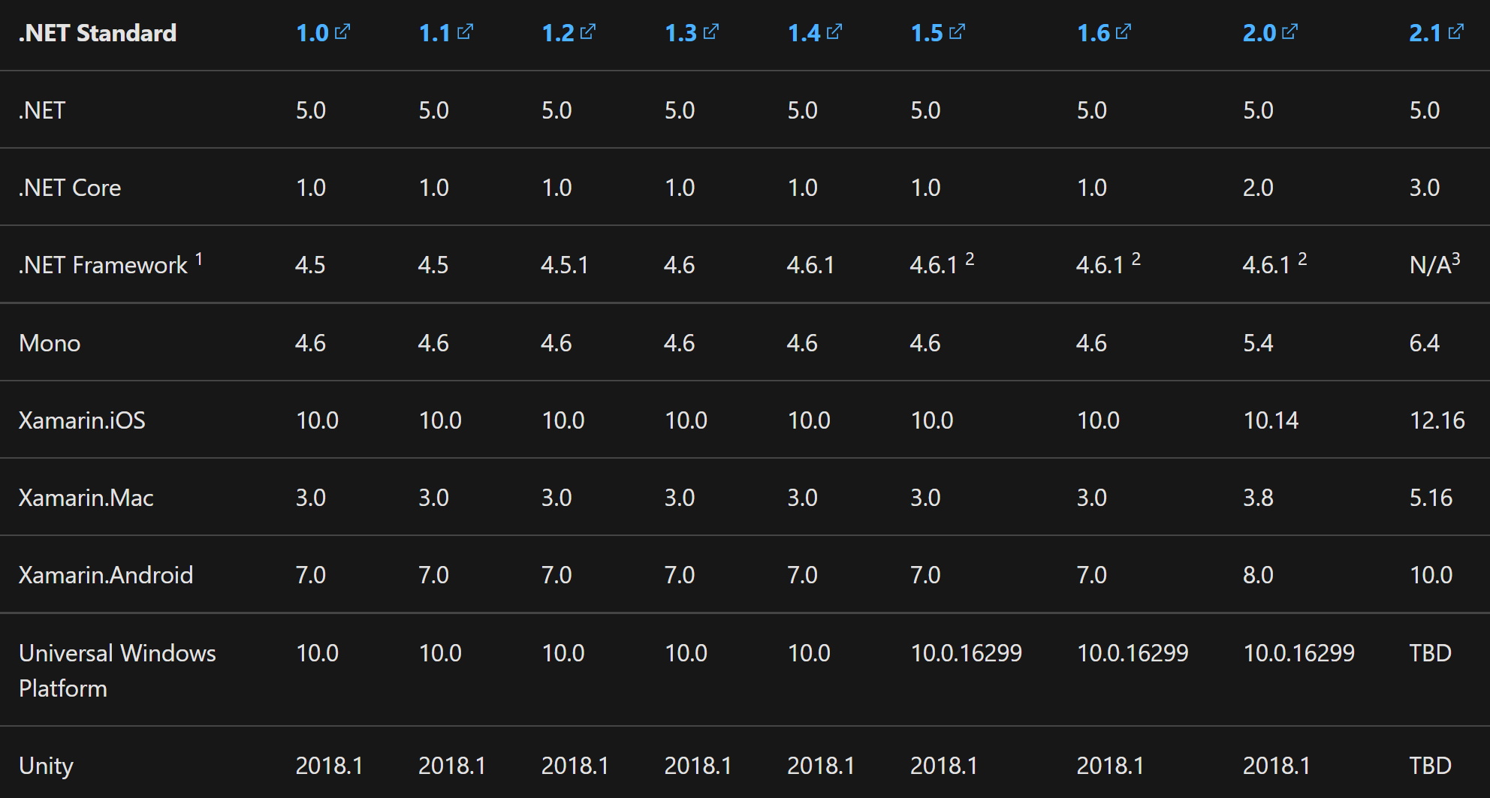
.NET Standard https://docs.microsoft.com/en-us/dotnet/standard/components#net-standard https://docs.microsoft.com/en-us/dotnet/standard/net-standard#net-implementation-support
The .NET Standard is a specification of .NET APIs that make up a uniform set of contracts that any code can be compiled against.
This enables portability across different .NET implementations which allows the code to run everywhere.
If code “targets” a version of the .NET Standard, it can run on any .NET implementation which supports that version of the .NET Standard.

Slide 6
.NET Standard https://docs.microsoft.com/en-us/dotnet/standard/net-standard#net-implementation-support
To find the highest version of .NET Standard that you can target, do the following steps:
Find the row with the .NET implementation you want to run.
Find the column in that row with the version you will code to.
The column header indicates the .NET Standard version that your target supports. Higher .NET Standard versions will support your implementation.
If you have more than one target platform, pick the smaller version. So if you want to run on .NET Framework 4.5 and .NET Core 1.0, the highest .NET Standard version you can use is .NET Standard 1.1.

Slide 7
.NET Standard - Facts https://docs.microsoft.com/en-us/dotnet/standard/net-standard https://en.wikipedia.org/wiki/NuGet
.NET Standard versions are additive. Higher versions incorporate all APIs from previous versions.
No ‘breaking’ changes between versions.
The higher the .NET Standard version, the more APIs are available to you.
The lower the version, the more platforms implement it.
Versions are immutable: Once finalized, .NET Standard versions are frozen.
.NET Standard reference assemblies are distributed with NuGet packages.
The NETStandard.Library metapackage references the complete set of NuGet packages that define .NET Standard.
The most common way to target netstandard is by referencing this metapackage.
It describes and provides access to the ~40 .NET libraries and associated APIs that define .NET Standard.
.NET Standard is the replacement for Portable Class Libraries (PCL).

Slide 8
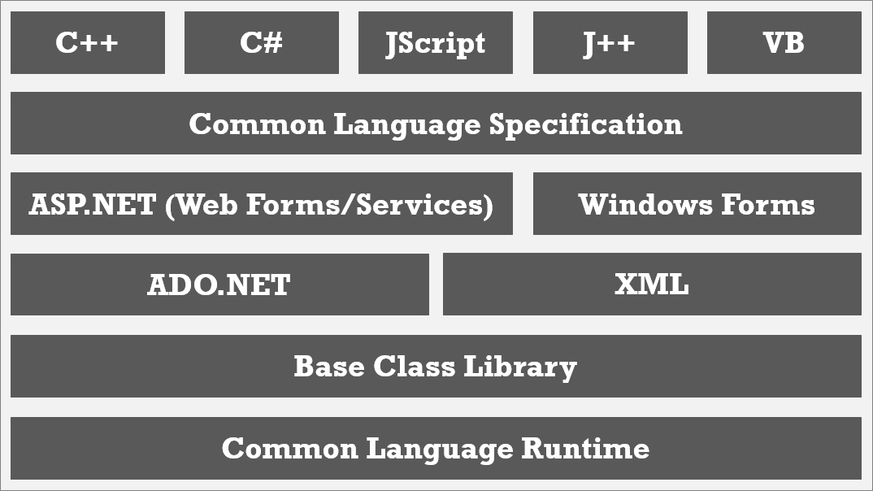
.NET Framework (traditional) http://thedotnetproject.blogspot.com/2015/11/the-net-framework.html
At the bottom of the .NET Framework structure is the Common Language Runtime (CLR)which handles code execution.

Slide 9
.NET Framework (traditional) http://thedotnetproject.blogspot.com/2015/11/the-net-framework.html
.NET Base Class Library contains ‘runtime libraries’ that support common functions like file reading and writing, XML document manipulation, exception handling, application globalization, network communication, threading and reflection.

Slide 10
.NET Framework (traditional) http://thedotnetproject.blogspot.com/2015/11/the-net-framework.html
ADO.NET library and XML support tasks related to data access, parsing, manipulation and generating XML.

Slide 11
.NET Framework (traditional) http://thedotnetproject.blogspot.com/2015/11/the-net-framework.html
ASP.NET and Windows Forms build web applications, standard Windows applications, and develop and consume web services (API).

Slide 12
.NET Framework (traditional) http://thedotnetproject.blogspot.com/2015/11/the-net-framework.html
The Common Language Specification (CLS) defines a subset of the Common Type System (CTS). The CTS defines the shared data type that facilitates cross-language integration. The flexibility of CTS helps many languages adapt to the .NET platform.

Slide 13
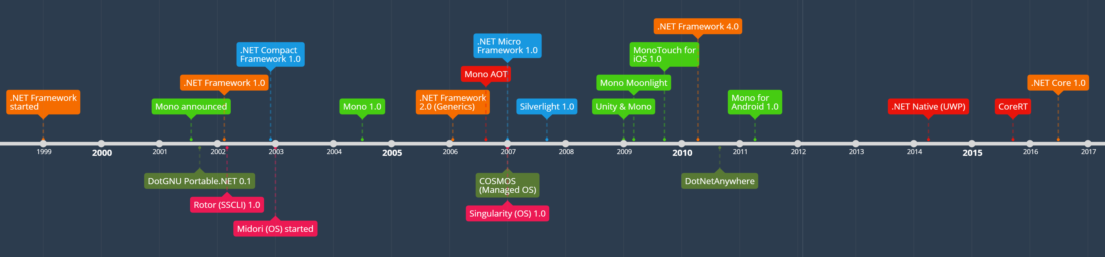
.NET Runtimes https://docs.microsoft.com/en-us/dotnet/standard/components#net-runtimes https://mattwarren.org/2018/10/02/A-History-of-.NET-Runtimes/
A ‘runtime’ is the execution environment for a managed program. The OS is part of the ‘runtime environment’ but is NOT part of the ‘.NET runtime’. Here are some examples of ‘.NET runtimes’.
Common Language Runtime (CLR) for the .NET Framework | .NET Native for Universal Windows Platform
Core Common Language Runtime (CoreCLR) for .NET Core | The Mono runtime for Xamarin.iOS, Xamarin.Android, Xamarin.Mac, and the Mono desktop framework

Slide 14
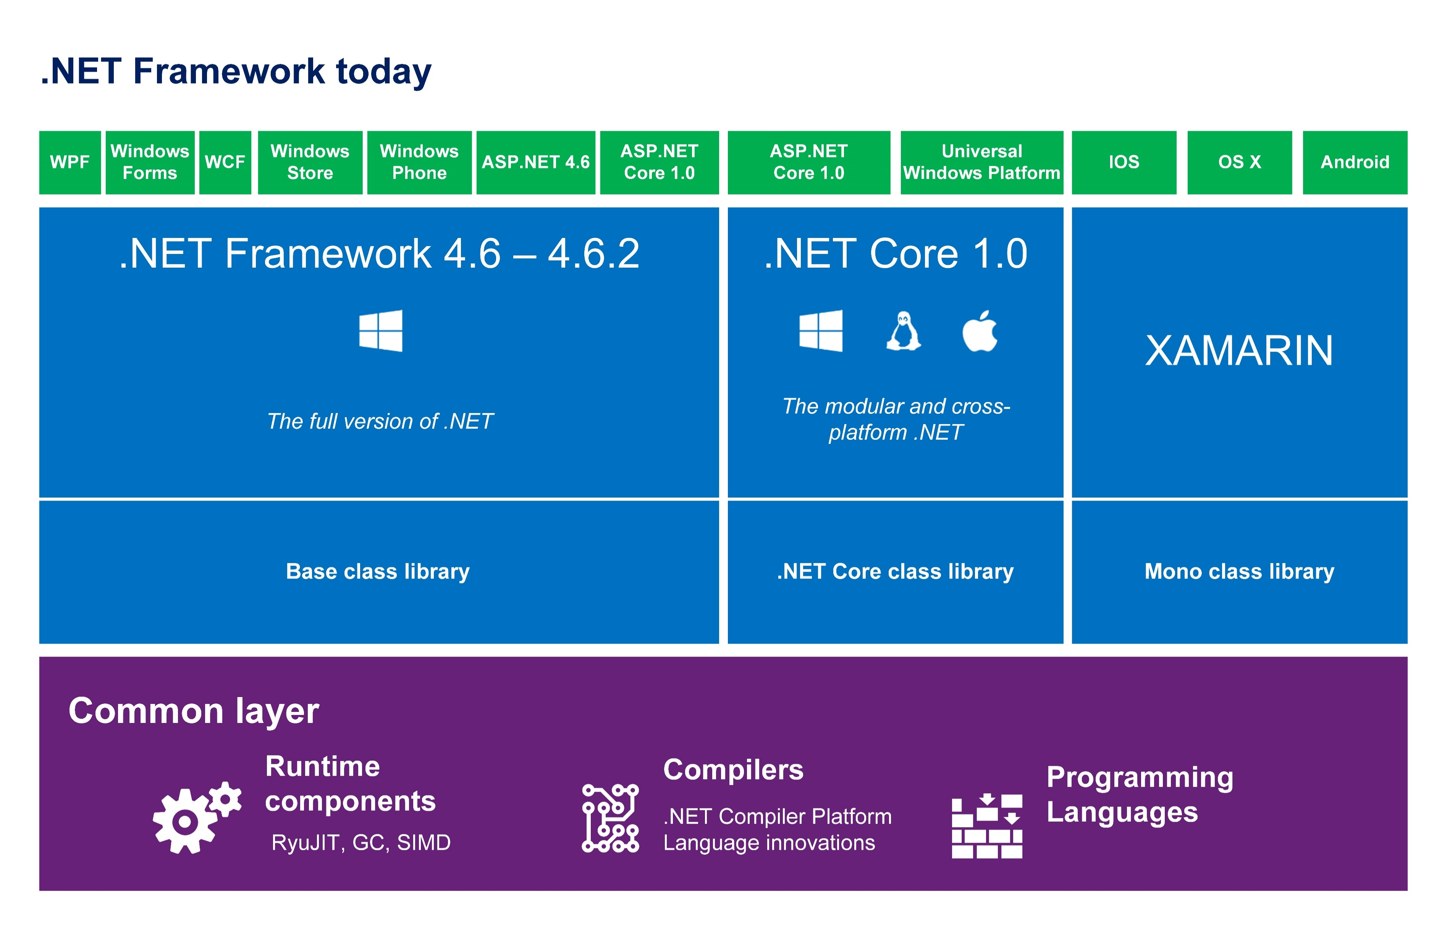
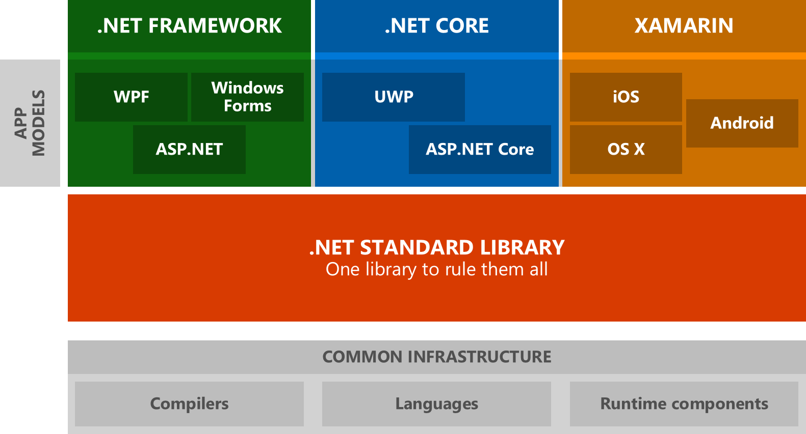

.NET Framework(newer) https://docs.microsoft.com/en-us/dotnet/standard/components#net-framework
The .NET Framework is the original .NET implementation that has existed since 2002.
Versions 4.5 and later implement the .NET Standard
It contains additional Windows-specific APIs. Like APIs for:
Windows desktop development with Windows Forms and WPF.
The .NET Framework is optimized for building Windows desktop applications.
.NET Framework Guide

Slide 15
.NET 5 https://docs.microsoft.com/en-us/dotnet/standard/components#net-core https://docs.microsoft.com/en-us/dotnet/core/about
Since 2016 .NET Core has been a cross-platform implementation of .NET. It’s designed to handle server and cloud workloads at scale.
It runs on Windows, macOS, and Linux.
It implements the .NET Standard.
Code that targets .NET Standard can run on:
.NET Core.
ASP.NET Core,
Windows Forms, and
Windows Presentation Foundation (WPF)
.NET Docs

Slide 16
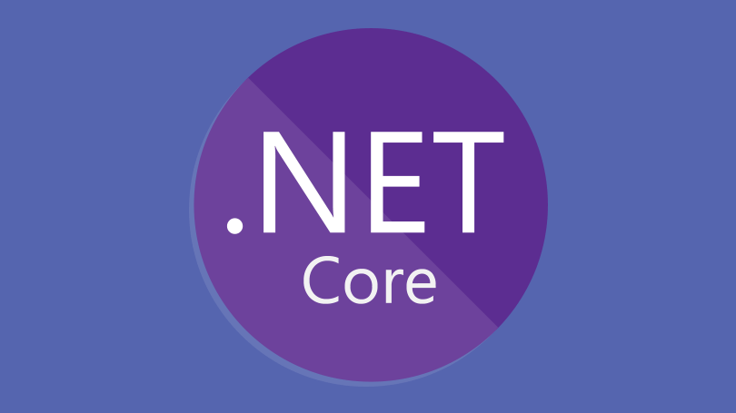
ASP.NET Core https://docs.microsoft.com/en-us/aspnet/core/introduction-to-aspnet-core?view=aspnetcore-3.1 https://docs.microsoft.com/en-us/aspnet/core/fundamentals/?view=aspnetcore-3.1&tabs=windows
ASP.NET Core is a cross-platform, high-performance, open-source framework for building modern, cloud-based, Internet-connected applications.
With ASP.NET Core, you can:
Build web apps and services, IoT apps, and mobile backends.
Use your favorite development tools on Windows, macOS, and Linux.
Deploy to the cloud or on-premises.
Run on .NET Core or .NET Framework
ASP.NET Core is a redesign of ASP.NET 4.x, with architectural changes that result in a leaner, more modular framework.

Slide 17
ASP.NET Core - Benefits https://docs.microsoft.com/en-us/aspnet/core/introduction-to-aspnet-core?view=aspnetcore-3.1
Integrated testing, web UI, and web APIs.
Develop and run on Windows, macOS, and Linux.
Support for hosting Remote Procedure Call (RPC) services using gRPC.
A cloud-ready, environment-based configuration system.
Built-in dependency injection.
A lightweight, modular HTTP request pipeline.
Ability to host on Docker, IIS, Kestrel and many more.
ASP.NET Core integrates with client-side frameworks and libraries like Angular, React, and Bootstrap.

Slide 18
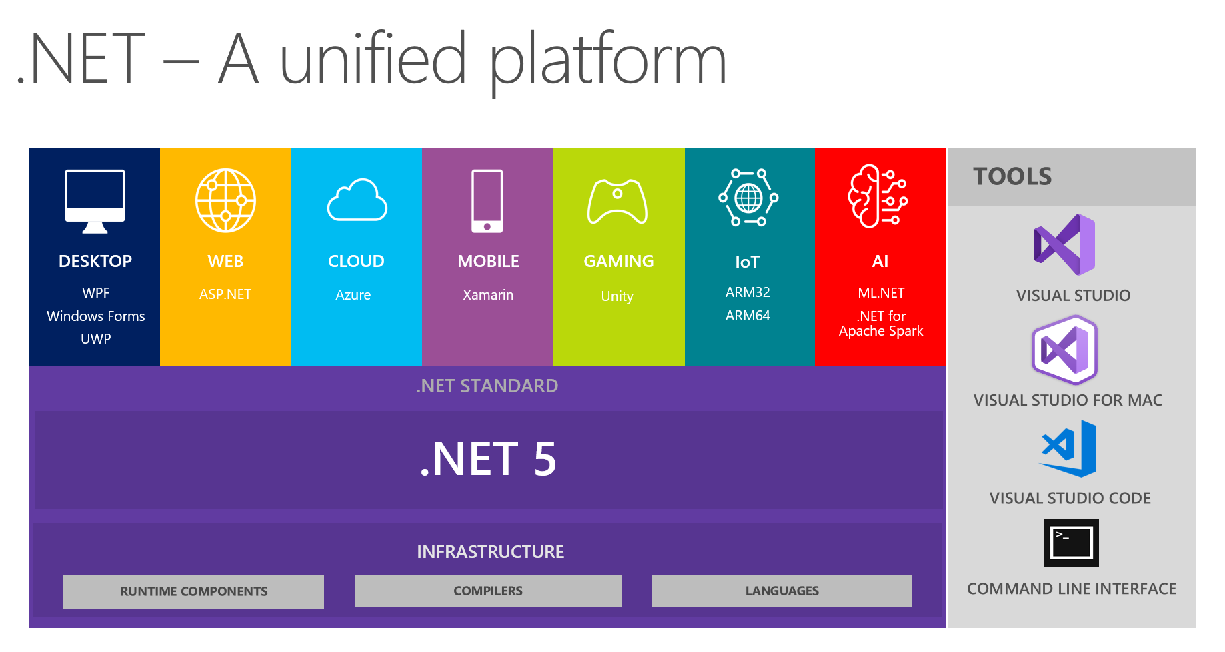
.NET 6 https://docs.microsoft.com/en-us/dotnet/core/whats-new/dotnet-6
.NET 6 is the next major release of .NET following .NET 5. We named .NET 5 a 5 instead of .NET Core 4.0 for two reasons:
Microsoft skipped version numbers 4.x to avoid confusion with .NET Framework 4.x and “Core: was dropped from the name to emphasize that this is the main implementation of .NET going forward.
.NET 5.0 supports more types of apps and more platforms than .NET Core or .NET Framework.
ASP.NET Core 5.0 is based on .NET 5.0 but retains the name "Core" to avoid confusing it with ASP.NET MVC 5.
Entity Framework Core 5.0 retains the name "Core" to avoid confusing it with Entity Framework 5 and 6.

Slide 19
UWP – Universal Windows Platform https://docs.microsoft.com/en-us/dotnet/standard/components#mono
UWP is an implementation of .NET that is used for building, touch-enabled Windows apps and software for the IoT.
It's designed to unify different devices including PCs, tablets, phablets, phones, and Xbox.
UWP provides:
a centralized app store,
an execution environment (AppContainer)
a set of Windows APIs.
Apps can be written in C++, C#, Visual Basic, and JavaScript.
When using C# and Visual Basic, the .NET APIs are provided by .NET Core.

Slide 20
Mono https://docs.microsoft.com/en-us/dotnet/standard/components#mono https://www.mono-project.com/docs/about-mono/
Mono is focused primarily on a small footprint.
It’s mainly used when a small runtime is required.
Mono powers Xamarin applications on
Mono powers games built using the Unity engine.
It supports all .NET Standard versions.
It’s used to run .NET applications that rely on Unix.
Is used with a Just-In-Time compiler.
Features a full static compiler (ahead-of-time compilation) used on platforms like iOS.
Android | macOS | iOS | tvOS | watchOS

Slide 21

Xamarin https://docs.microsoft.com/en-us/xamarin/get-started/what-is-xamarin
Xamarin is an open-source platform for building applications for iOS, Android, and Windows with .NET.
Xamarin is an abstraction layer that manages communication of shared code with underlying platform code.
Xamarin runs in a managed environment that provides memory allocation and garbage collection.
Xamarin enables developers to share an average of 80% of their application across platforms.
Xamarin applications can be written on PC or Mac and compile into native application packages

Slide 22
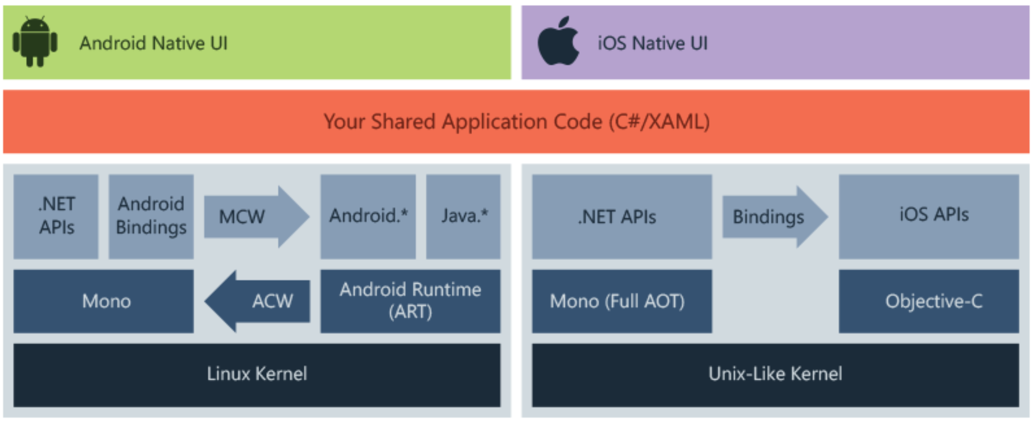
Xamarin https://docs.microsoft.com/en-us/xamarin/get-started/what-is-xamarin
Xamarin allows you to create native UI on each platform and write business logic in C# that is shared across platforms. In most cases, 80% of application code is sharable using Xamarin.
Xamarin is built on top of Mono. Mono runs on most platforms including Linux, Unix, FreeBSD, and macOS. The Mono execution environment automatically handles tasks such as memory allocation, garbage collection and interoperability with underlying platforms.
Xamarin is for developers with the following goals:
Share code, test and business logic across platforms.
Write cross-platform applications in C# with Visual Studio.

