Slide 1

Datatypes
.NET

Slide 2
In computer science and computer programming, a data type is an attribute of data which tells the compiler how the programmer intends to use the data.
https://en.wikipedia.org/wiki/Data_type

Slide 3
Primitive Types in C# vs Java https://medium.com/omarelgabrys-blog/primitive-data-types-in-c-vs-java-5b8a597eef05#:~:text= https://docs.microsoft.com/en-us/dotnet/csharp/language-reference/builtin-types/built-in-types
Typically, the most familiar primitive data types are: int, object, short, float, double, char, bool. These are called primitive because they are the types used to build other, more complex, data types.
What are considered primitive data types in other languages are objects in C#.
When you write:
int foo = 7;
string myString = “Caravan”;
The variables foo and myString are Objects. They have helper functions built into C# to manipulate the data. C# is Strongly Typed. The compiler must know the type to be able to supply the helper functions.

Slide 4
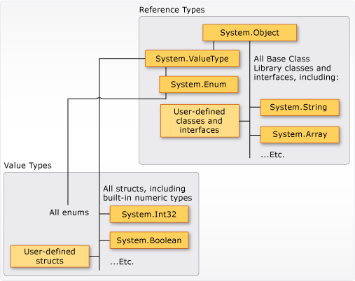
C# Datatypes Structure https://docs.microsoft.com/en-us/dotnet/csharp/programming-guide/types/
All data types inherit from the base Class Object.
When an int is declared, you are declaring:
an instance of the struct (an object) of type ‘int’,
which inherits from System.ValueType.
System.ValueType inherits from System.Object

Slide 5
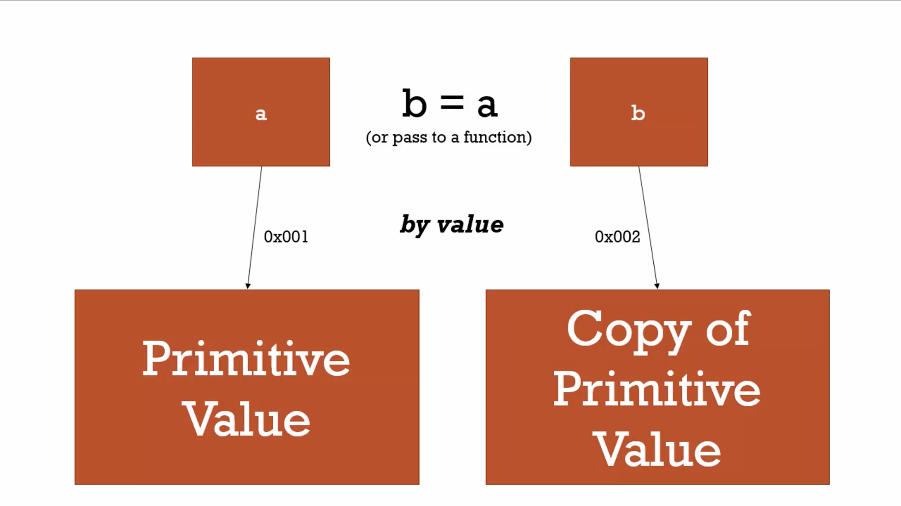
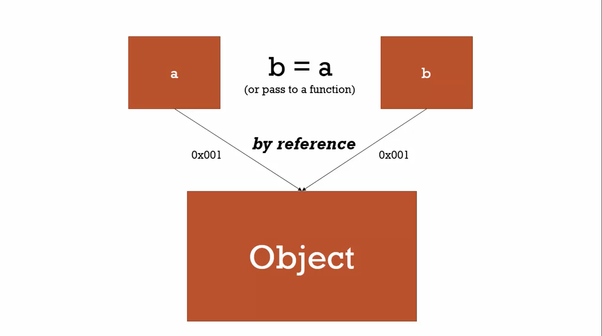
DataTypes https://docs.microsoft.com/en-us/dotnet/csharp/tour-of-csharp/types-and-variables
Value types:
These are the built-in data types:
char, int, bool, float, double
and user-defined types declared with struct.
Variables of value types directly contain their data on the stack .
Reference types:
Class, Interface, array, collection and delegate types contain other types.
Variables of reference type do not contain an instance of the type, but merely a reference to an instance stored on the heap.

Slide 6
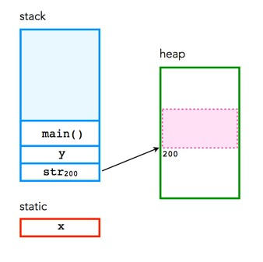
Value Type vs reference type https://learn.microsoft.com/en-us/dotnet/visual-basic/programming-guide/language-features/data-types/value-types-and-reference-types
There are two kinds of types in C#: reference types and value types.
Variables of value types:
directly contain their data.
Have their own copy of the data
It's not possible for operations on one variable to affect the other
Variables of reference types:
store references to their data (objects).
Two variables can reference the same object.
Operations on one variable can affect the object referenced by the other variable.

Slide 7
Value Types – Integral https://docs.microsoft.com/en-us/dotnet/csharp/language-reference/builtin-types/integral-numeric-types
Integral (numeric) types represent integer numbers. All integral types are value types. They are also simple types and can be initialized with literals.
Signed Integral | Size | Range
Sbyte | Signed 8-bit | -128 thru 127 (255)
Short | Signed 16-bit integer | -32768 thru 32767
Int | Signed 32-bit integer | -2,147,483,648 thru 2147483647
Long | Signed 64-bit integer | -9223372036854775808 thru 9223372036854775807

Slide 8
Value Types – Integral https://docs.microsoft.com/en-us/dotnet/csharp/language-reference/builtin-types/integral-numeric-types
Integral numeric types represent integer numbers. All integral numeric types are value types. They are also simple types and can be initialized with literals.
Unsigned Integral | Size | Range
Byte | Unsigned 8-bit integer | 0 thru 255
Ushort | Unsigned 16-bit integer | 0 thru 65535
Uint | Unsigned 32-bit integer | 0 thru 4,294,967,295
Ulong | Unsigned 64-bit integer | 0 thru 18446744073709551615

Slide 9
Signed vs Unsigned values
Unsigned int
0
5,000,000,000,000
-5,000,000,000,000
signed int

Slide 10
Value Types https://docs.microsoft.com/en-us/dotnet/csharp/language-reference/builtin-types/value-types#built-in-value-types
Unicode Characters | Size | Range
char | 16 bit | 0 - 65535
boolean | Value
bool | true and false (NOT 0/1)
IEEE binary floating-point | Size | values
float | 4 bytes | Approx. 1.5 * 10^-45 - 3.4 * 10^38 with precision of 7 digits.
double | 8 bytes | Approx. 5.0 * 10^-324 - 1.7 × 10^308 with precision of 15-16 digits.
High-precision decimal floating-point | Size | Values
decimal | 16 bytes | 1.0 * 10^-28 - approx. 7.9 * 10^28 with 28-29 significant digits

Slide 11
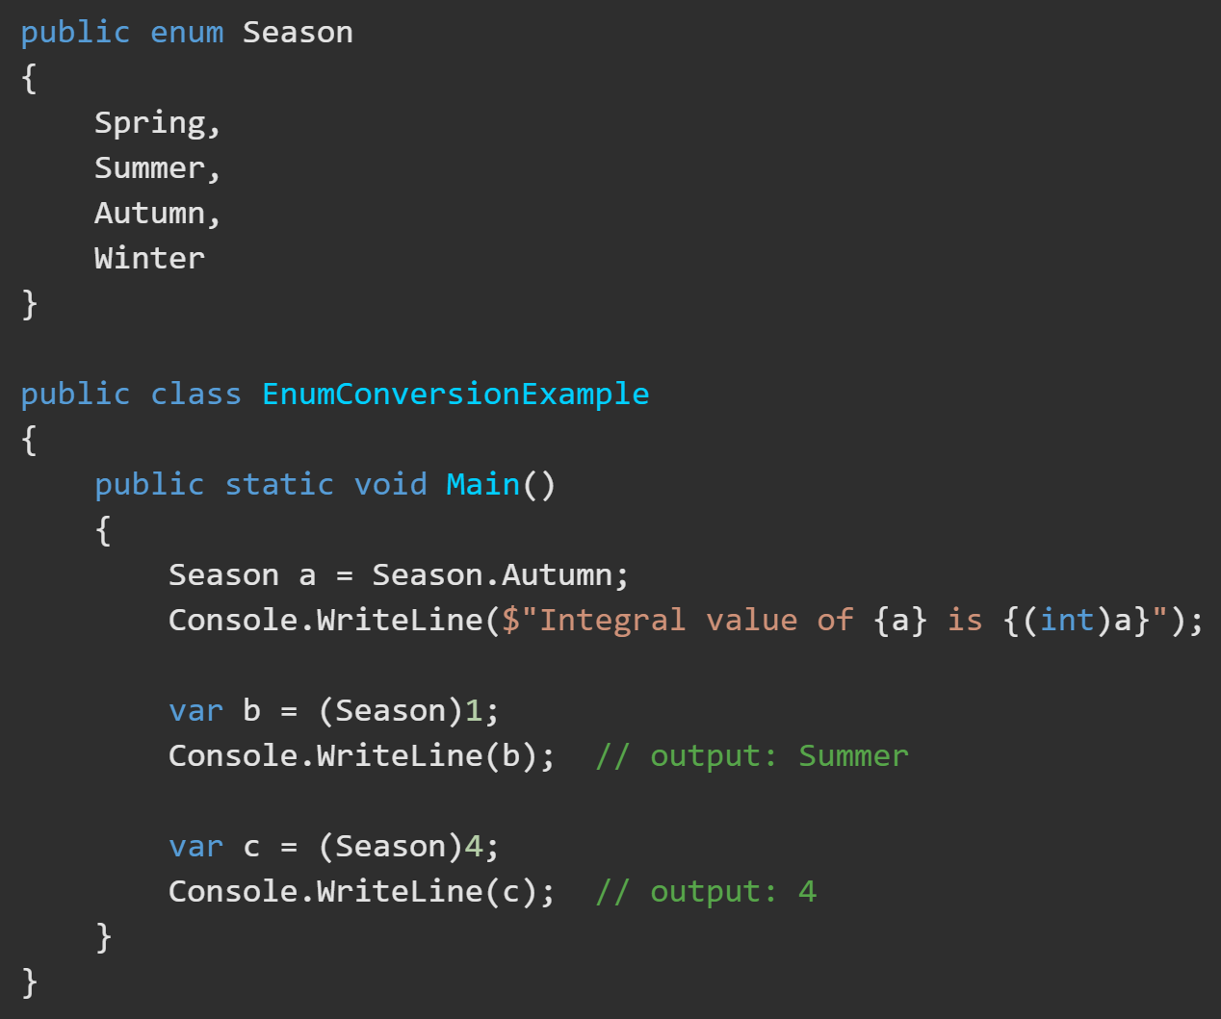
Value Types – Enum https://docs.microsoft.com/en-us/dotnet/csharp/language-reference/builtin-types/enum
An Enumeration (enum) is a value type defined by a set of named constants of the underlying integral numeric type.
It is a type that are custom created. You define the valid examples of the enum.
To define an enum, use the enum keyword and specify the names of the enum members.
There exist explicit conversions between the enum type and its underlying integral type. If you cast an enum value to its underlying type, the result is the associated integral value of an enum member.
Enums are immutable.

Slide 12
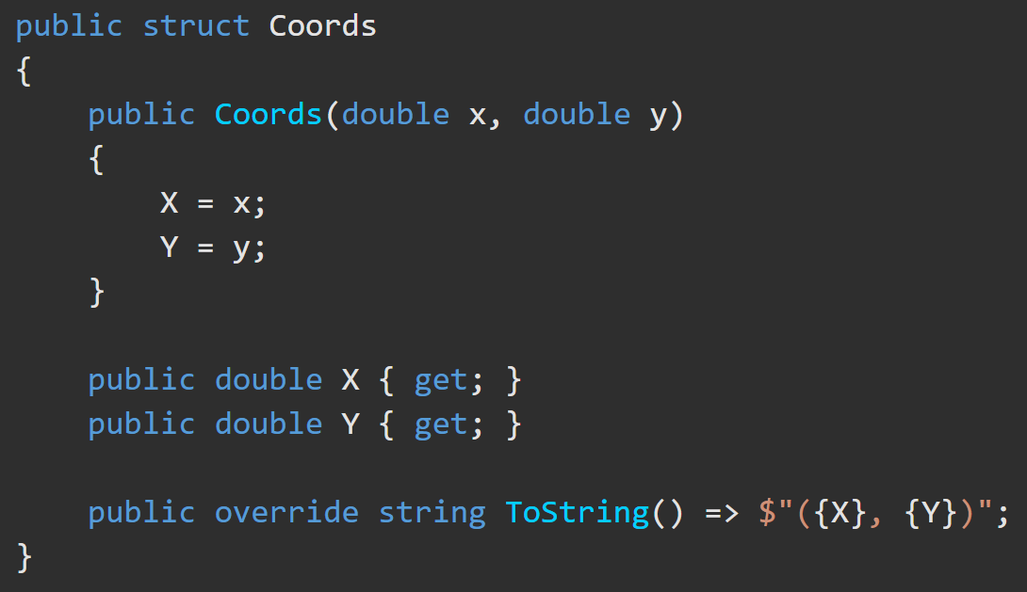
Value Types – Struct https://docs.microsoft.com/en-us/dotnet/csharp/language-reference/builtin-types/struct
A Structure type (struct) is a value type that can encapsulate data and related functionality.
Structs are typically used to design small data-centric types that provide little or no behavior.

Slide 13
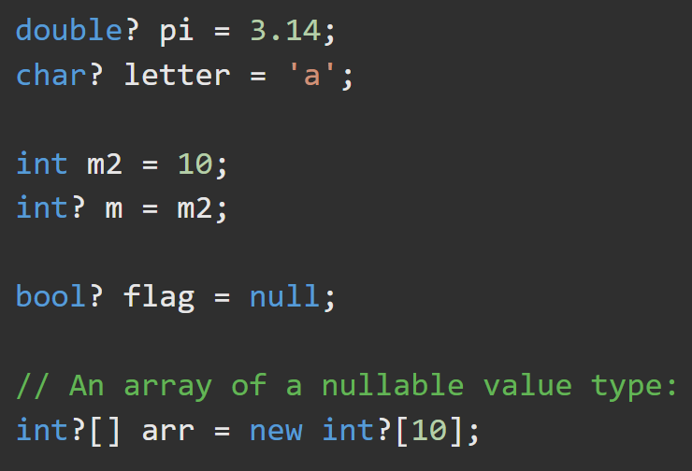
Nullable Values and Reference Types https://docs.microsoft.com/en-us/dotnet/csharp/language-reference/builtin-types/nullable-value-types https://docs.microsoft.com/en-us/dotnet/csharp/language-reference/builtin-types/nullable-reference-types
In C#, value types aren’t allowed to be null. To allow a normally non-nullable type to be NULL, add ? to the type declaration.
For example, if you retrieve a database field that may contain no value (NULL), you can use bool? or int? in the declaration to allow the variable to be NULL.
Reference types can always be null but there is special syntax that allows the compiler to check reference values and avoid runtime errors. Click the link above for more details.
To check if a nullable type has a value you can use:
myVar.HasValue = true/false
If(myvar == null || myVar.HasValue) { }

Slide 14
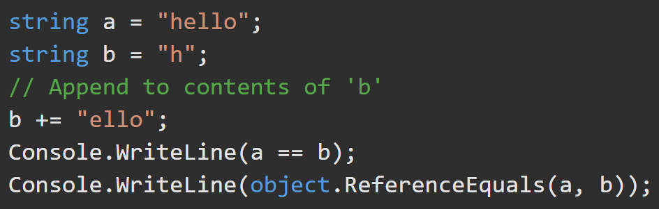
Reference Type – String https://docs.microsoft.com/en-us/dotnet/csharp/language-reference/builtin-types/reference-types
The string type represents a sequence of zero or more Unicode characters. string is an alias for System.String.
The addition operator ‘+’ and the equality operators ‘==‘ and ‘!=‘ are defined to concatenate and compare the values of string objects (not the references).
Strings are immutable, meaning the contents of a string object cannot be changed after the object is created, although the syntax makes it appear as if you can.
This example displays "True" and then "False" because the content of the strings are equivalent. a and b do not refer to the same string instance.
// True
// False

Slide 15
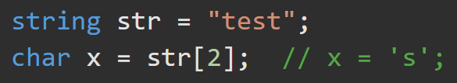
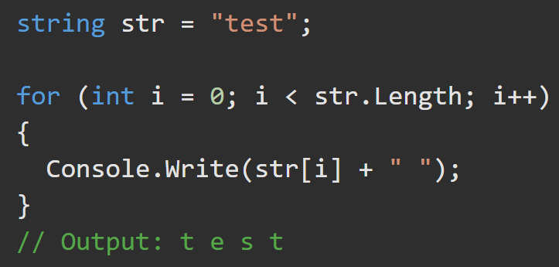
Reference Type – String https://docs.microsoft.com/en-us/dotnet/csharp/language-reference/builtin-types/reference-types
The [ ] operator can be used for readonly access to the zero-indexed individual characters of a string or iterating over them in a loop.

Slide 16
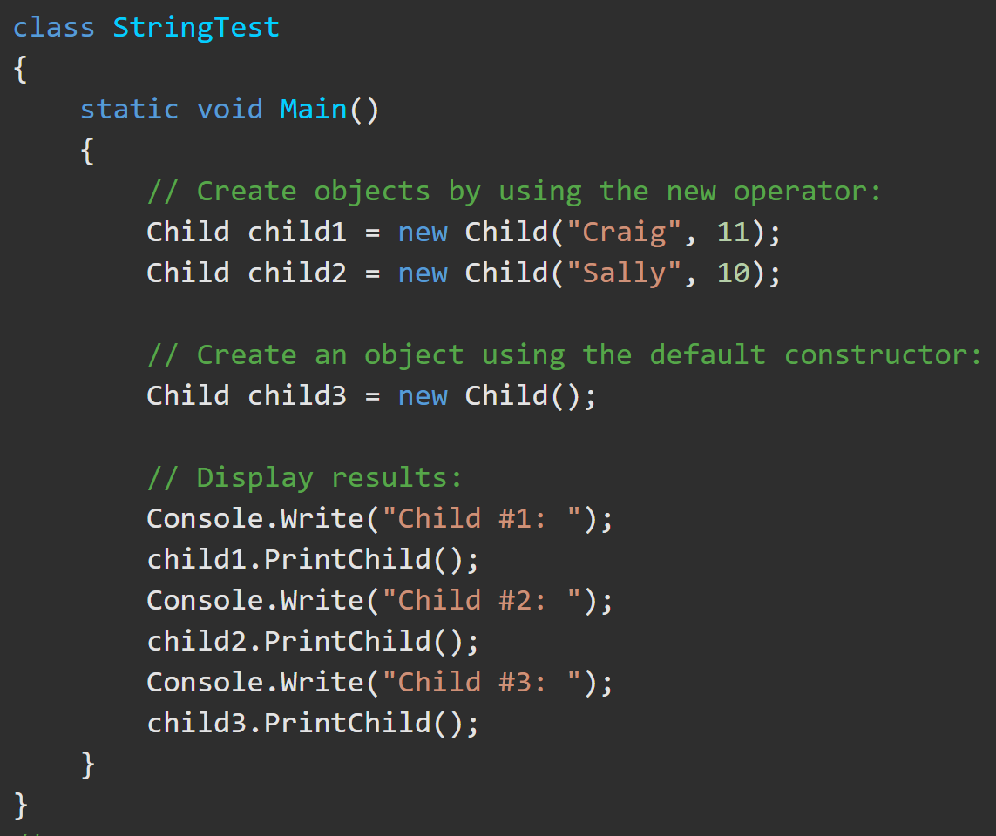
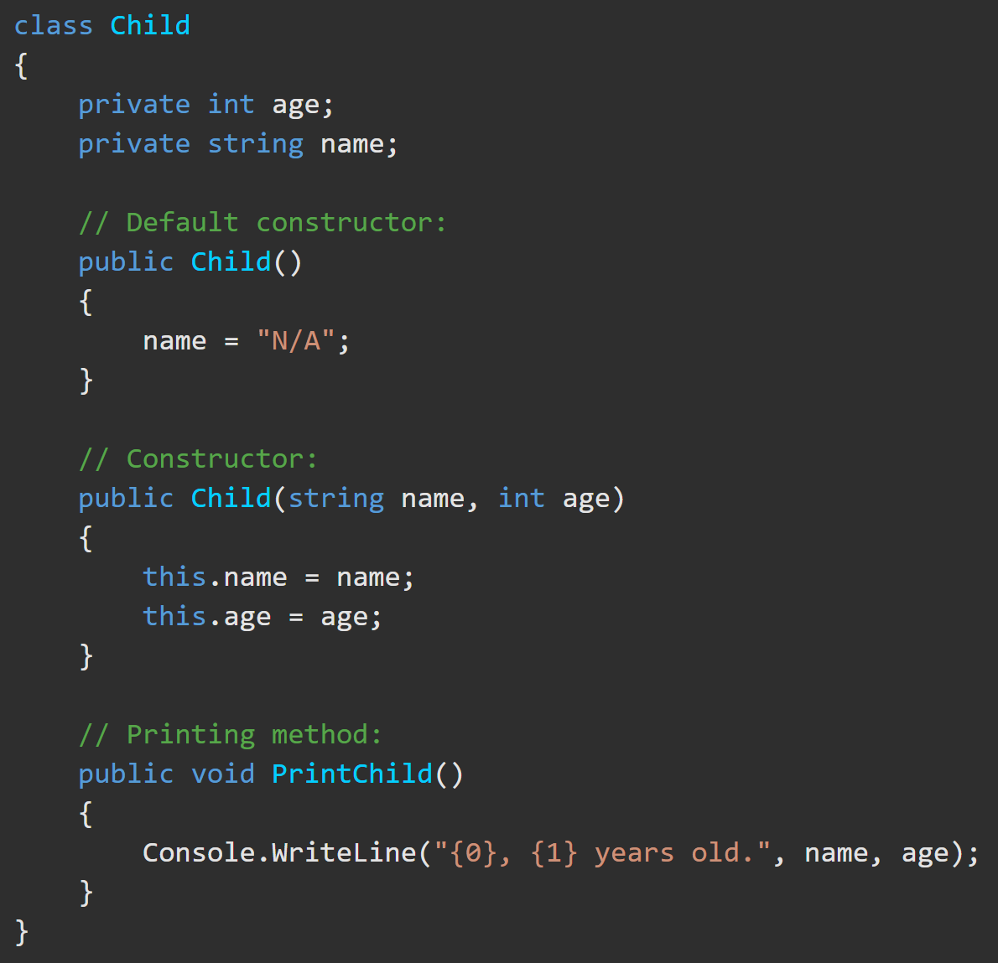
Reference Type – Class https://docs.microsoft.com/en-us/dotnet/csharp/language-reference/keywords/class
Classes are declared using the keyword class. A class can declare class fields, constructors, and methods.

Slide 17
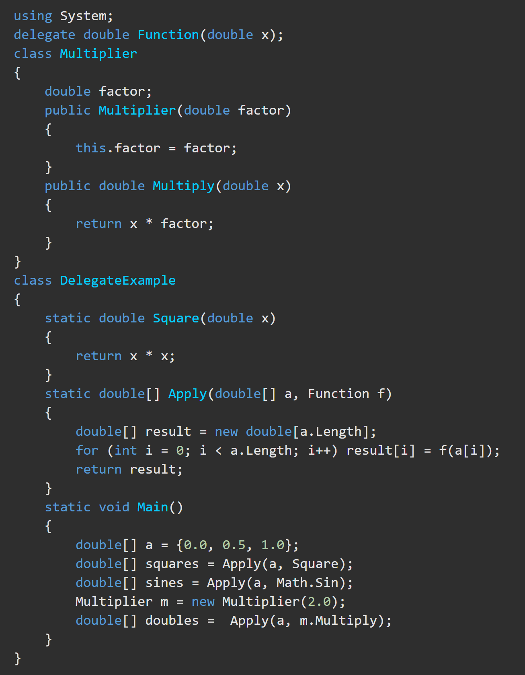
Reference Type – Delegate https://docs.microsoft.com/en-us/dotnet/csharp/tour-of-csharp/delegates https://docs.microsoft.com/en-us/dotnet/csharp/language-reference/builtin-types/reference-types
A delegate type represents references to methods. Delegates make it possible to treat methods as entities that can be assigned to variables and passed as parameters.
Delegates are similar to function pointers in other programming languages. Unlike function pointers, delegates are object-oriented and type-safe.

Slide 18
Reference Type – Object https://docs.microsoft.com/en-us/dotnet/csharp/language-reference/builtin-types/reference-types
In C#’s Unified Type System (UTS), all types inherit (directly or indirectly) from System.Object.
You can assign values of any type to variables of type Object. Any Object variable can be assigned to its default value using null.
When a variable of a value type is converted to Object, it is boxed*. When a variable of type Object is converted to a value type, it is unboxed*.
*More on boxing and unboxing later

Slide 19
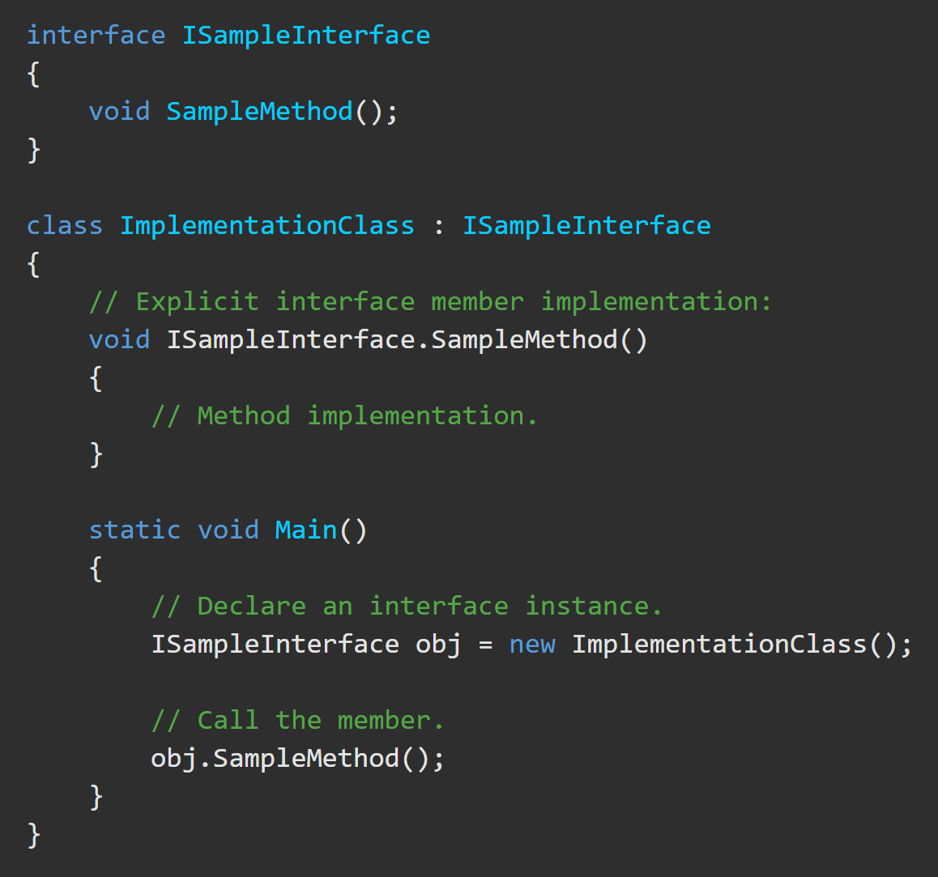
Interface https://docs.microsoft.com/en-us/dotnet/csharp/language-reference/keywords/interface
An interface contains definitions for a group of related functionalities that a non-abstract class or a struct must implement.
An interface defines a “contract”. Any class or struct that implements that contract agrees to provide an implementation of the members defined in the interface.

