Slide 1


FINAL YEAR PROJECT PRESENTATION
Satyanaam-Food
A Food Ordering Web Application
SUBMITTED BY
Aman Raj
BCA 6th Semester
INSTITUTION
NIBM / MLSU
Nathdwara, Rajasthan
PROJECT GUIDE
Mr. Kailash Purbia
BCA Department

Slide 2
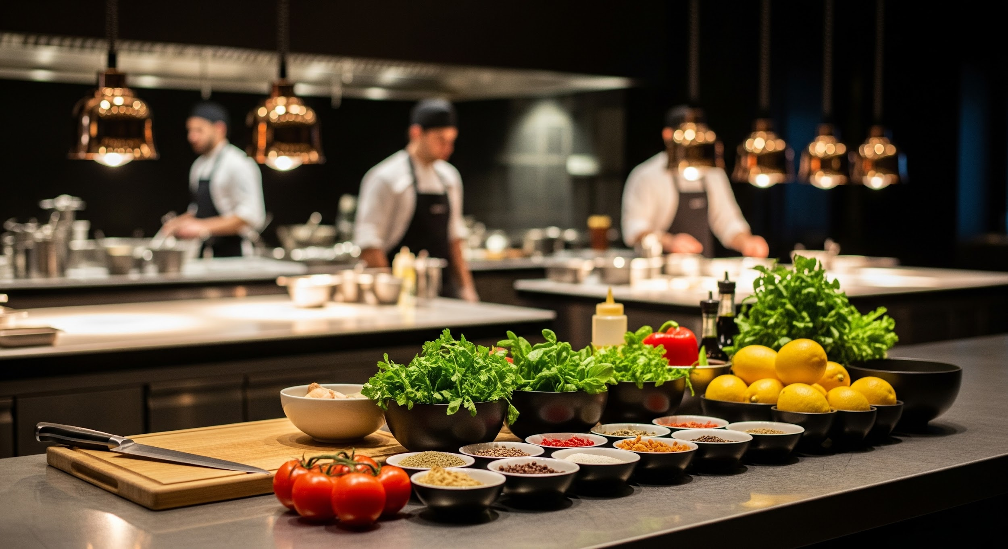
k
Project Introduction & Overview
This project, Satyanaam-Food, is an independent, full-stack, responsive e-commerce web platform.
Its core aim is to create a modern, high-performance digital bridge between culinary providers and their clients.
It moves beyond simple static menus to offer a premium, tailored digital ordering ecosystem.
devices
Fully Responsive Design
speed
High Performance
restaurant_menu
Tailored Digital Ordering

Slide 3
Problem?
phone_missed
sync_problem
trending_down
Human Errors & Friction
Manual telephone bookings often result in miscommunication and preparation errors. Engaged lines lead to direct loss of potential business.
Sync Challenges
Legacy systems struggle with real-time menu synchronization. Outdated physical menus fail to reflect price changes or stock availability instantly.
Aggregator Drain
Third-party aggregators drain 15–30% in financial commissions. Restaurants lose direct customer contact and vital data control.

Slide 4

Tech Stack
Layer
Technology Used
Architectural Purpose
Frontend
HTML, CSS, JS, Bootstrap
Premium, zero-bloat, highly responsive SPA experience.
Backend
Node.js, Express.js
Event-driven, asynchronous REST API ecosystem.
Database
MongoDB Atlas, Mongoose
Flexible, schema-validated NoSQL document architecture.
Caching
Redis (In-Memory Store)
Low-latency catalog caching dropping response times below 50ms.

Slide 5





System Architecture & Workflow
Serve Immediately
YES (HIT)
Client Request
Express Routing
Redis Cache Check?
Populate Redis
Vanilla JS / Axios
Node.js Server
Fetch from MongoDB
NO (MISS)

Slide 6
Database Schema & Security
storage Core Mongoose Collections
security Security Protocols
Users
Unique email indexing, bcrypt hashed credentials, and RBAC (User/Admin roles).
Data Protection
Bcrypt algorithm for robust salted password hashing, preventing plain-text exposure.
Stateless Auth (JWT)
Secure token-based session management eliminating server-side memory overhead.
Threat Mitigation
Rate-limiting middleware and schema-level input sanitization to block DDoS and Injection attacks.
Menus
Optimized for high-read performance with category filtering and visual image mapping.
Orders
Transactional documents linking users, items, and real-time fulfillment status.

Slide 7

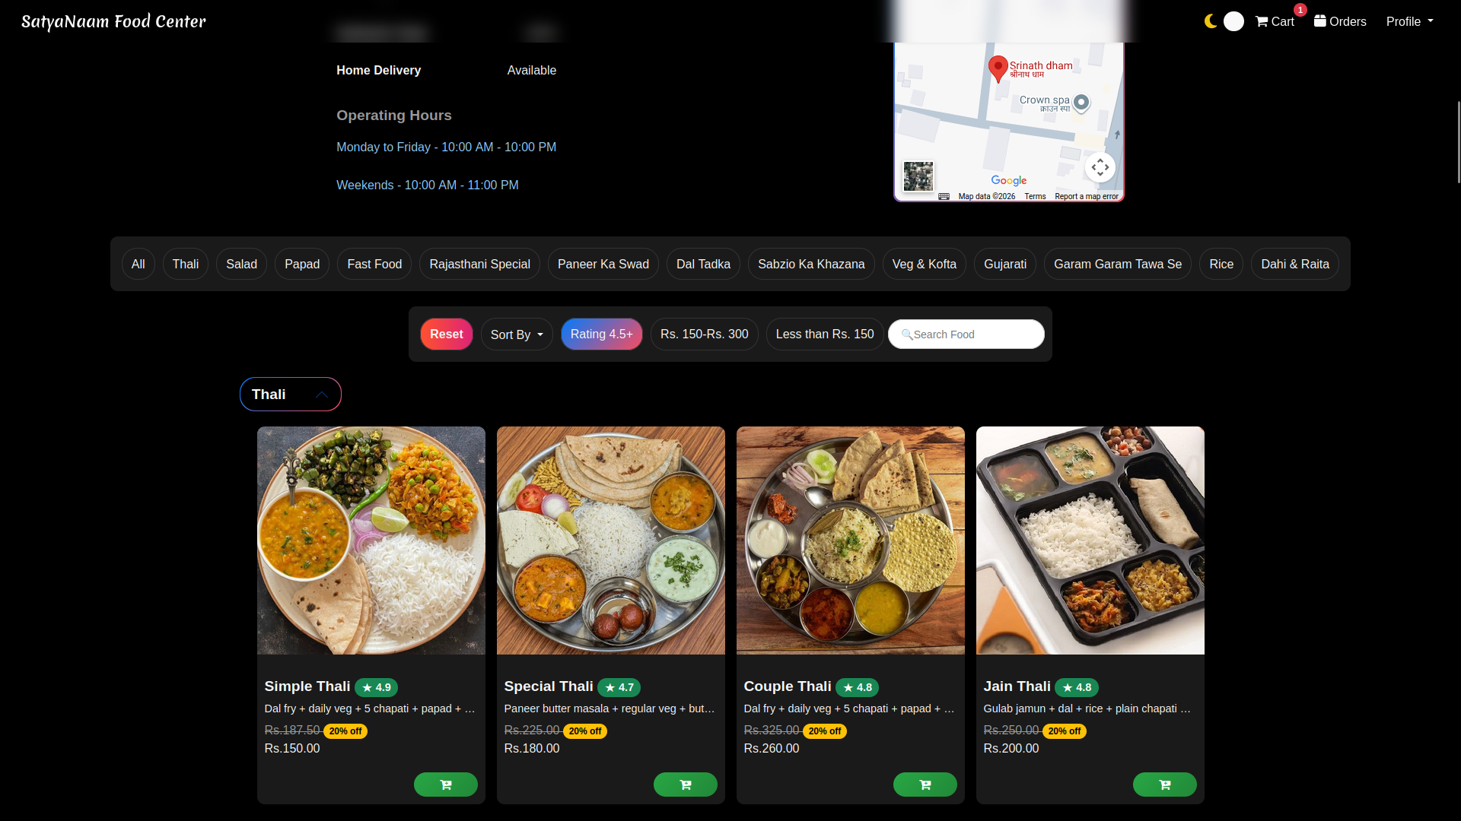
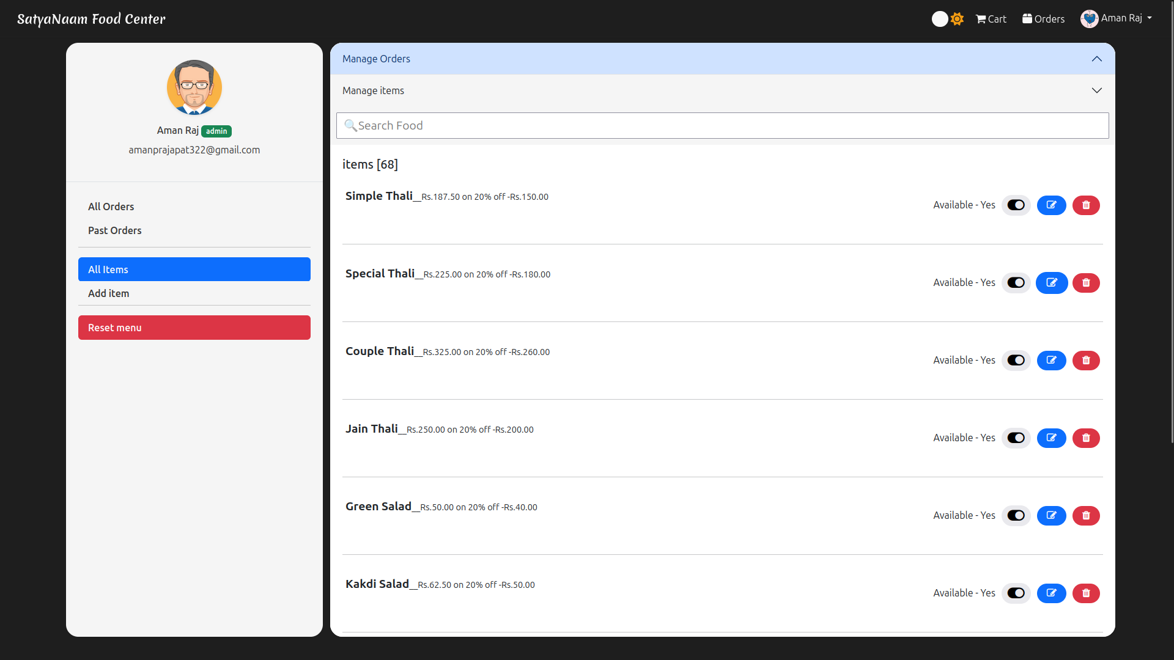
Live Demo: Core Features Walkthrough
Customer Experience
Dynamic Ordering SPA
Single-page interface with instant cart updates and secure checkout summary.
Admin Control
Operational Dashboard
Real-time fulfillment tracking (Pending ➔ Preparing ➔ Delivered) and CRUD menu management.

Slide 8
Software Testing Strategy
Testing Methodology
Execution Details & Verification
Unit Testing
Validating JWT middleware parsing. Verifying that back-end utility functions and Express middlewares reject invalid tokens while correctly passing valid requests to controllers.
White Box Testing
Executing automated Postman routes to test API edge cases independently. Simulating internal data flow by sending raw POST/GET/PUT/DELETE requests to verify price validation, MongoDB insertions, and Redis caching algorithms.
Black Box Testing
Simulating end-to-end integration workflows directly via the browser interface. Manual verification of critical scenarios like user authentication, cart persistency, and the full checkout lifecycle with automated email triggers.

Slide 9
Future Scope & Conclusion
Future Architecture Expansions
Secure Payment Gateway Integration Stripe, Razorpay
Real-time Tracking via WebSockets Socket.io integration
AI-Driven Recommendations Personalized food suggestions
Native Mobile Application React Native / Flutter expansion
Conclusion
The "Satyanaam-Food" platform successfully bridges the gap between culinary providers and clientele through a robust, scalable MERN-style architecture.
By implementing Redis caching and JWT authentication, the system achieves sub-50ms latency and stateless session security.
Ultimately, it provides a commission-free, tailored digital ordering ecosystem for independent restaurants.

