Slide 1


LearnSphere
Empowering Students with AI-driven Smart Study Planning
LearnSphere is an AI-powered study planner designed to help students learn more effectively. By leveraging AI, Machine Learning, and NLP, it creates personalized study schedules that enhance study habits and provides tailored advice for each subject.

Slide 2

Project Overview
Key Objective:
Analyze student behavior & performance using AI.
Predict academic outcomes based on study habits.
Provide personalized learning insights for better retention.
Empower educators & parents with real-time analytics.
Enhance student engagement & motivation with tailored recommendations.
What is LearnSphere?
LearnSphere is an intelligent learning analytics system that helps students and educators understand study behaviors, monitor progress, and optimize learning strategies. By analyzing engagement metrics like participation, resource usage, and assessments, LearnSphere offers personalized insights to improve student outcomes.
Solution we Offer:
Identify students at risk early.
Track engagement & learning behavior.
Adaptive study plans & tips.
Actionable insights for better support
Real-time progress tracking
Why create LearnSphere?
Many students struggle due to ineffective study habits, lack of guidance, and unstructured learning paths. LearnSphere aims to bridge this gap by offering data-driven insights, helping students optimize study time, track progress, and improve academic performance efficiently.

Slide 3



Tech Stack
Frontend
Backend
Machine Learning & NLP
React & Next.js – For a dynamic, responsive UI with fast performance.
HTML/CSS – Ensures a clean, modern design for an intuitive user experience.
Flask – A lightweight, efficient API server to process data and handle ML requests.
Node.js – Manages API integration, especially for Google Calendar synchronization.
LangChain – AI-driven timetable generation and conversational tutoring.
Scikit-learn – Student performance analysis using machine learning models.
NLTK – Natural language processing for understanding study behaviors.
TensorFlow – Deep learning for pattern recognition and personalized insights.

Slide 4



Project Approach
Data-Driven Personalization
Seamless AI Integration
User-Centric Design
Analyze student performance using ML & NLP to identify strengths and weaknesses.
Use AI-powered reasoning to optimize study schedules based on difficulty and time availability.
LangChain + Llama 2-7B generates personalized study plans and provides AI tutoring.
Google Calendar Sync ensures real-time schedule management.
Intuitive UI (React, Next.js) for easy navigation.
Interactive dashboard with progress tracking & subject-wise insights.

Slide 5
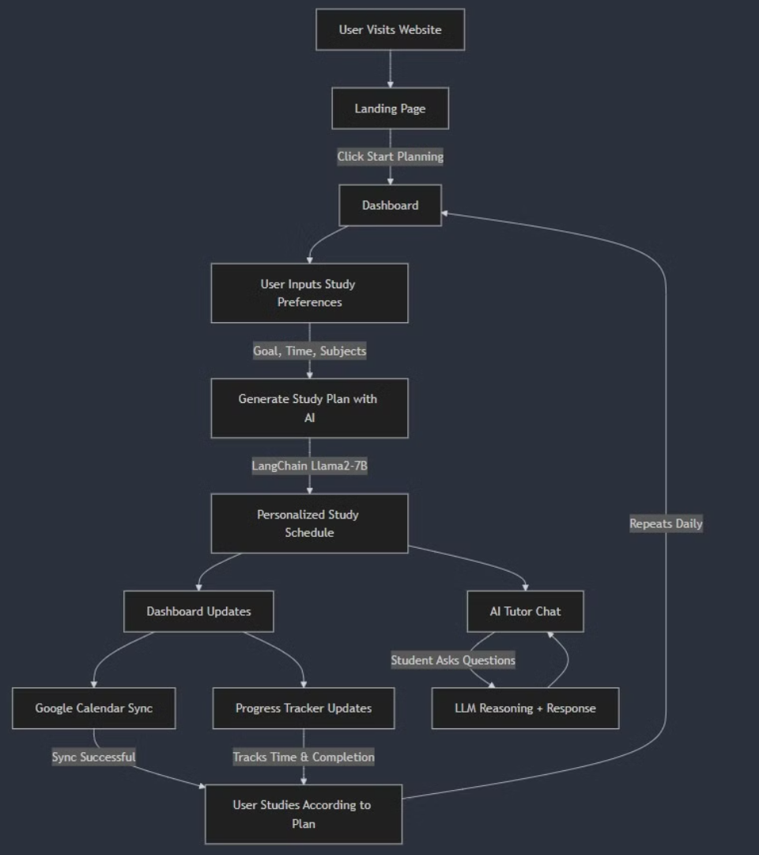
Key Features & Architecture
AI-Driven Study Planner
Uses LangChain + Llama 2-7B to generate personalized study
schedules.
Performance Analytics
ML models analyze student data to identify strengths and
weaknesses.
Google Calendar Sync
Seamless integration for real-time schedule updates and
reminders.
AI Tutoring Chatbot
Conversational AI provides subject-wise study guidance and
answers queries.
Scalable & Modular Backend
Flask APIs + Node.js handle AI processing, data analysis, and
integrations.

Slide 6
Innovation & Impact
Personalized Learning
Positive Student Impact
Seamless Organization
Leverages LLMs & ML to create dynamic, adaptive study plans tailored to each student’s strengths, weaknesses, and available time. AI-driven schedules adapt to each student’s strengths, weaknesses, and available time, ensuring efficient study plans.
We expect students to study better and get better grades with LearnSphere. It helps them manage time and focus on weak areas, leading to academic success.
Google Calendar integration reduces stress, helping students manage their workload effectively and build better study habits. We plan to add features like adaptive learning and games to make studying more fun and effective, further enhancing the platform's impact.

Slide 7
Next Steps &
Approach we’ll follow
Data Collection & Preprocessing
1
Gather student performance data (engagement,
attendance, grades).
Clean, normalize, and transform the data for analysis.
2
Model Development & AI Integration
Train models to analyze student strengths & weaknesses using Scikit-learn & TensorFlow.
Implement LangChain for AI-driven timetable generation & tutoring.
Backend & API Development
3
Develop a Flask API to serve predictions & schedules.
Integrate Node.js for Google Calendar sync.
4
UI/UX Development & Deployment
Build a React + Next.js frontend for a seamless student experience.
Ensure mobile-friendly, intuitive design & deploy the full-stack app.

Slide 8

Thank You!
LearnSphere is designed to empower students and revolutionize learning. Your feedback is crucial as we enhance the platform. We’re excited to transform education and improve student outcomes worldwide.
Let’s shape the future of personalized learning together!

