Slide 1


Threats and attacks on endpoints
Presented by: Briah Graves
University of the Incarnate Word
Professor: Dr. Gonzalo D. Parra

Slide 2
Objective/why this project
Define the different types of threats and attacks and explain what they are, how to protect against them, and what can be done to prevent them from happening again in the future
To also expand my knowledge on this topic so when I am working in the Cyber Security field, I’ll know what to do and it won’t come as a surprise.

Slide 3
Deliverables
Gantt chart
Trello board-https://trello.com/b/dZ7SuoWZ/f22-bg-threats-and-attacks-on-endpoints
Github- https://github.com/04bri17/css-final-project

Slide 4
Trello board

Slide 5
Milestones
Different threats and attacks that can happen to endpoints
How to protect against those threats and attacks
How to prevent them from happening in the future

Slide 6
Different types of threats and attacks on endpoints
There are numerous types of threats and attacks on endpoints, but the some of the main and popular ones are as follows: malware, ransomware, and viruses. Malware is a software that enters a computer system without the user’s knowledge or consent and then performs an unwanted and harmful action
Ransomware prevents a user’s endpoint from properly and fully functioning until a fee is paid; some ransomware pretends to come from a law enforcement agency while others pretend to come from a software vendor and displays a fictitious warning that a license has expired

Slide 7
Different types of threats and attacks on endpoints(cont.)
Viruses are another type of threats and there are two types, and they are as follows: file-based virus (attached to a file that reproduces itself on the same computer without human interaction) and fileless virus (does not attach itself to a file but takes advantage of native services and processes that are part of the OS to avoid detection and carry out its attacks).

Slide 8
How to protect against threats and attacks
Back up your important data-it’s important to always have more than one copy of your most important data
Limit sensitive personal info on social media-only provide the basic information, adding anything extra could put you at a higher risk
Enable privacy and security settings-find out what privacy and security settings are available for social networks and enable them
Use a password manager-by doing this, you are able to keep track of an age of a password so if you need to change it, you can

Slide 9
How to prevent threats and attacks
Secure the perimeter-use Next-Generation firewalls, integrate Advanced Malware Protection, Next-Generation Intrusion Prevention System, etc.
Protect users wherever they work-nowadays, 50% of employees are mobile and are working anywhere that they want using a mobile device. Use VPNs and user verification and device trust
Find and control problems fast-breaches will happen so it’s important to identify and remove them as fast as possible. This requires extensive visibility and control as well as a well-prepared IT staff

Slide 10
Challenges Faced
The challenges I faced while completing this project was finding a tool that will help me explain how threats and attacks can happen on various endpoints
Also, creating and finishing the Gantt chart was an issue, I kept experiencing technical difficulties

Slide 11
Conclusion
By completing this project, I was able to identify different threats and attacks on endpoints, how to protect against them, and how to prevent them happening again in the future.
I also learned the different methods of how to protect against threats and attacks

Slide 12
Sources
10 Ways to protect yourself from Cyber Security Threats-https://moneyinc.com/10-ways-to-protect-yourself-from-cyber-security-threats/#:~:text=10%20Ways%20to%20Protect%20Yourself%20from%20Cyber%20Security,and%20Access%20to%20Social%20Media%20...%20More%20items
Threat Prevention-How to stop Cyber Threats-https://www.cisco.com/c/en/us/products/security/what-is-threat-prevention.html#:~:text=Four%20steps%20for%20threat%20prevention%201%20Secure%20the,control%20problems%20fast%20Security%20breaches%20will%20happen.%20
Module 3-Part 1(Lecture slides)

Slide 13
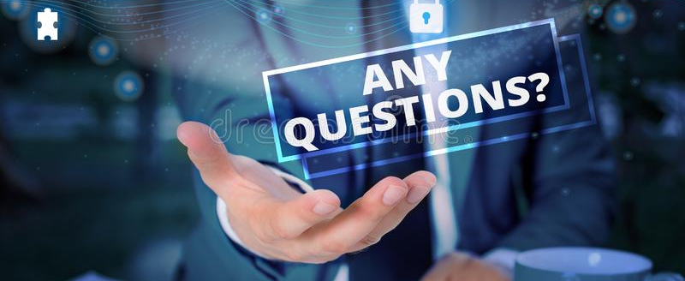
Thanks for listening!

