Slide 1
Re-analysis for METABRIC
jmzeng1314@163.com

Slide 2
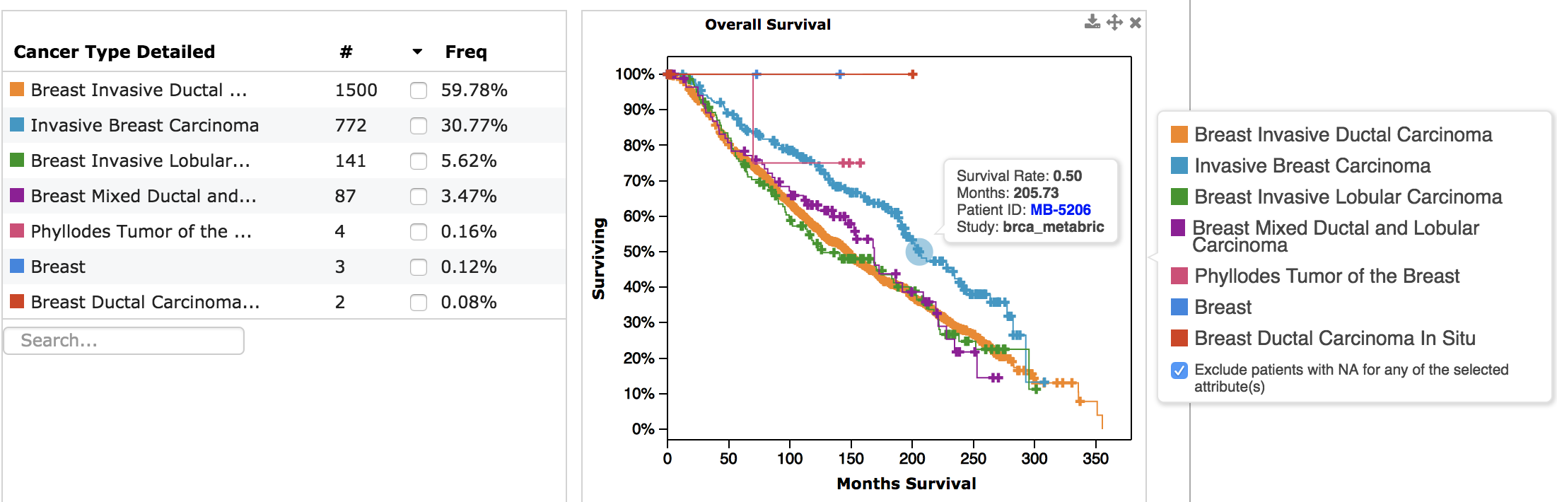

Slide 3
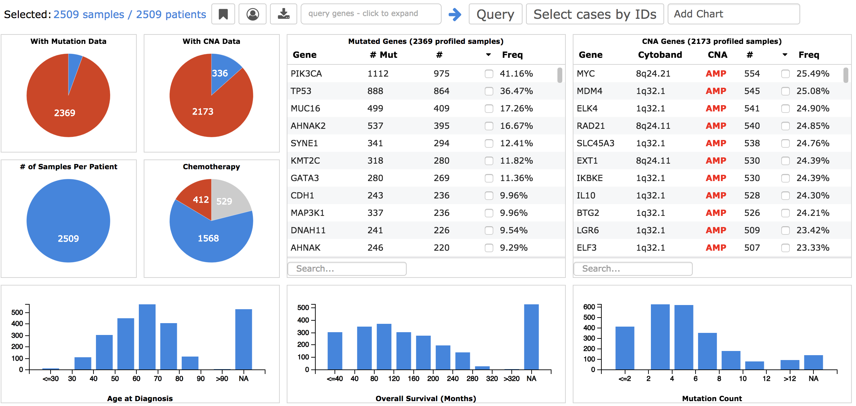

Slide 4
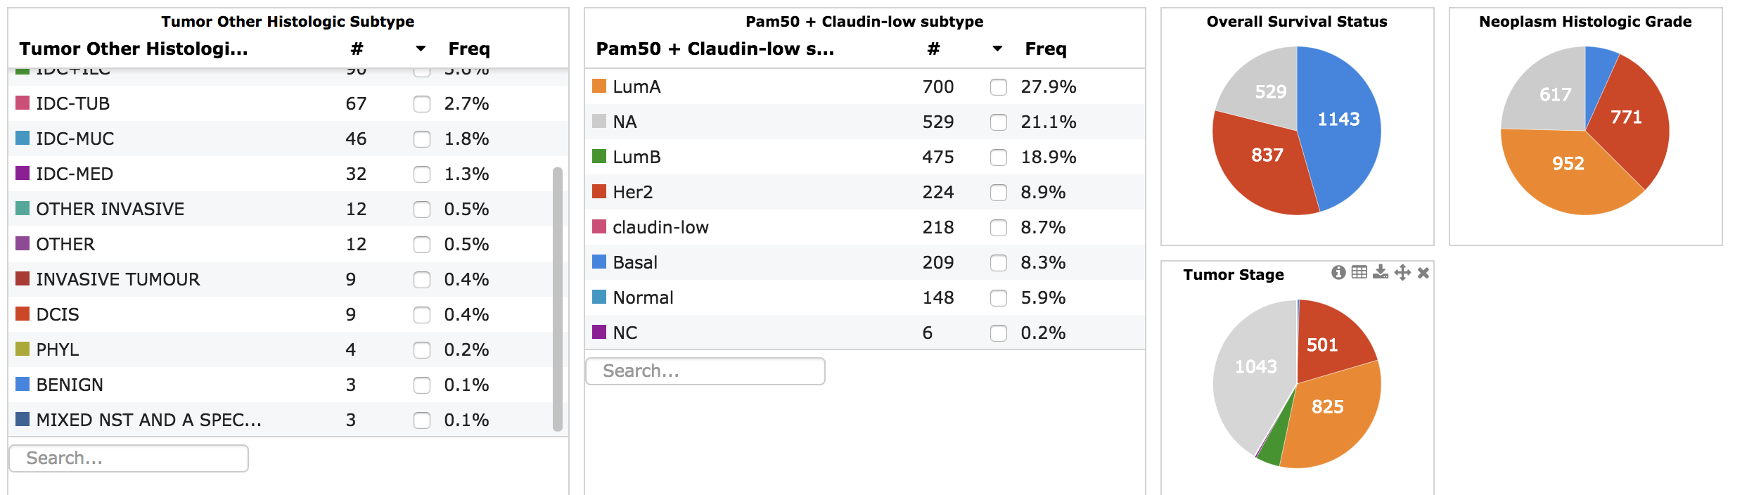

Slide 5
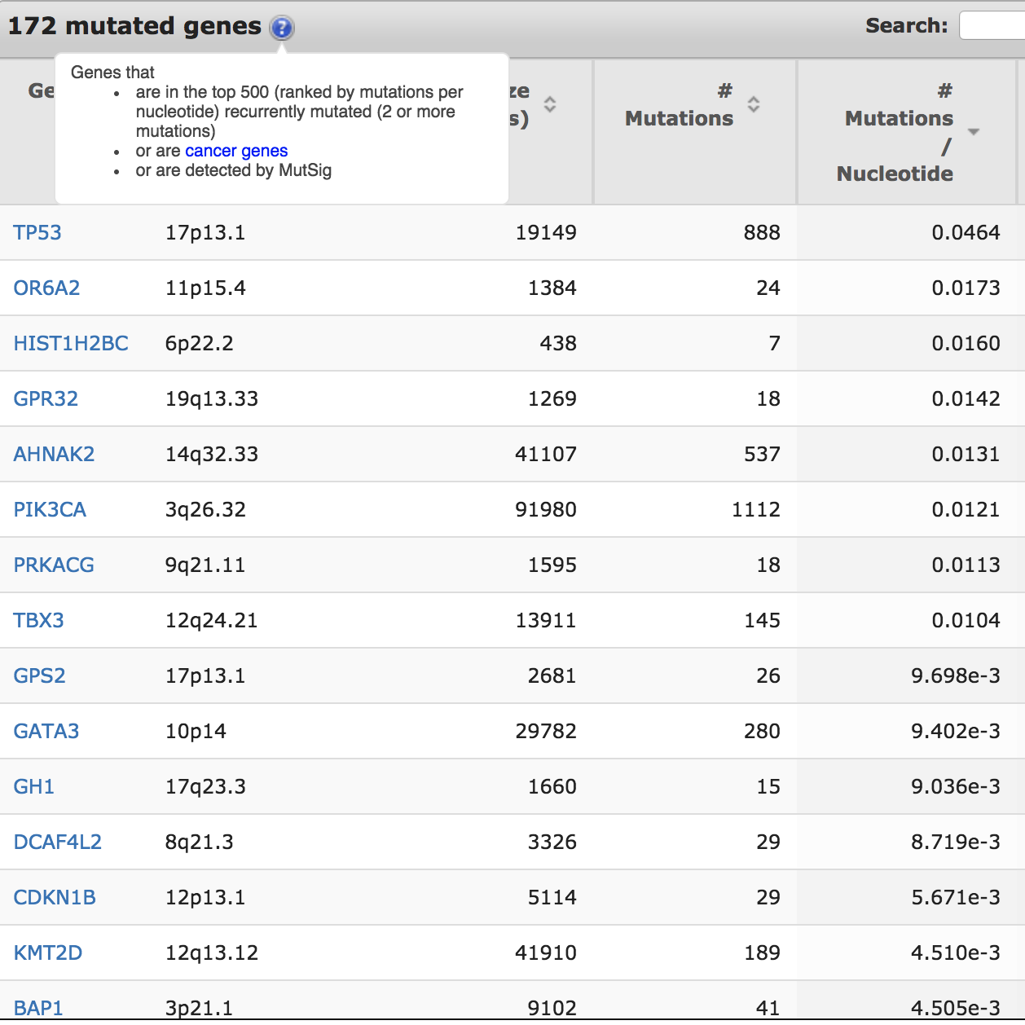

Slide 6
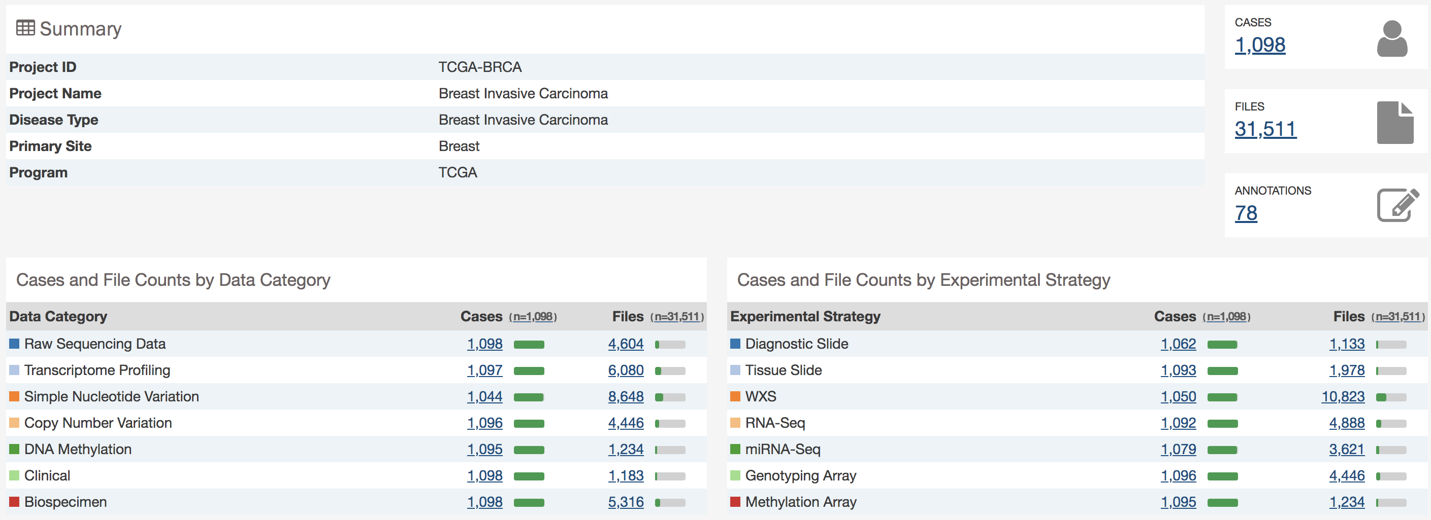
https://portal.gdc.cancer.gov/projects/TCGA-BRCA

