Slide 1
How Can a Wellness Technology Company Play It Smart?
Dataset: FitBit (Duration: 12 Mar, 2016 to 12 May, 2016, No. of Users: 35)
NOVEMBER 2024

Slide 2
Identify patterns, health improvements, and daily activities from Bellabeat products to optimize marketing strategies and drive growth in the wellness technology market.
OBJECTIVE

Slide 3
ANALYTICAL GOALS
Determine HOW health improves before and while using Bellabeat.
Determine HIGH-LEVEL recommendations for Bellabeat’s marketing strategy.

Slide 4
ANALYTICAL GOALS
Determine HOW health improves before and while using Bellabeat.
Determine HIGH-LEVEL recommendations for Bellabeat’s marketing strategy.

Slide 5
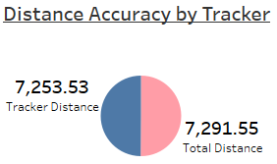
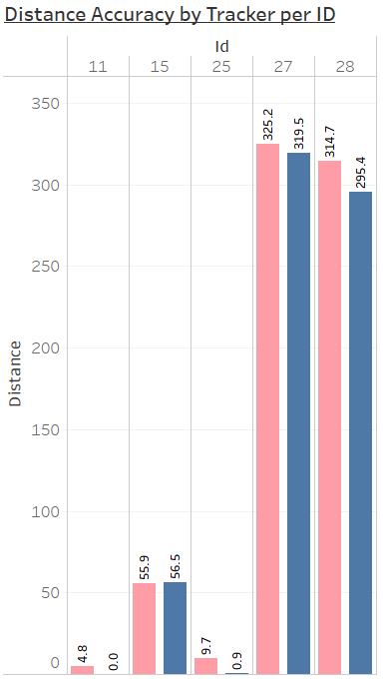
ID’s with <100% accuracy
Accuracy Matters
Bellabeat trackers show 85% overall accuracy across users, 99.9% accuracy across distance.
Out of 35 users, 5 user’s tracker accuracy is reduced.

Slide 6
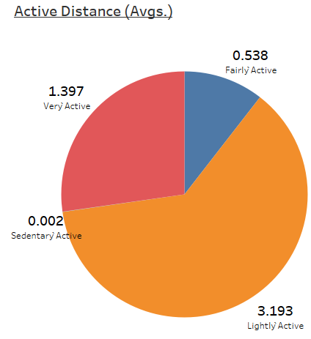
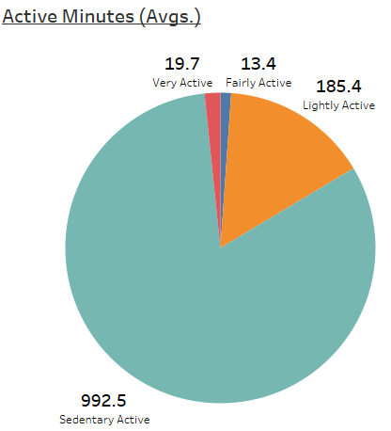
ACTIVITY SUMMARY
High Sedentary Behavior
Women spend over 75% of their time sitting without physical activity, about 15% lightly active, and less than 5% very active.

Slide 7
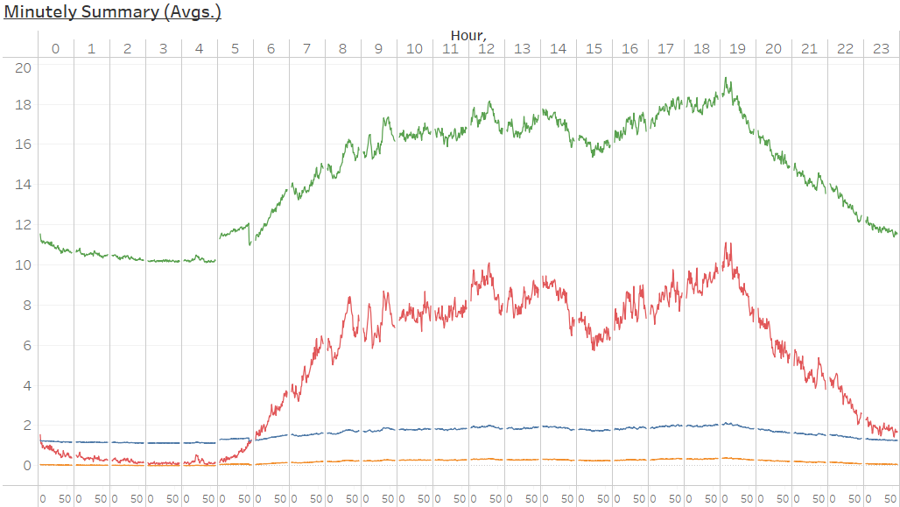
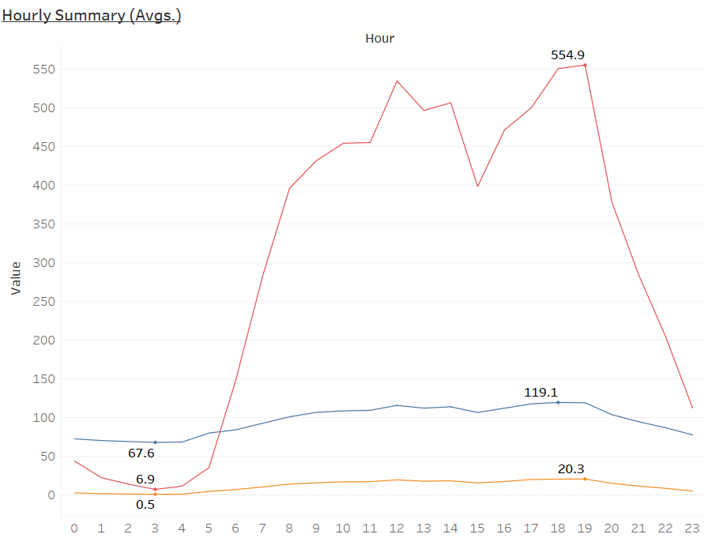
ACTIVITY SUMMARY
METs
Peak Activity Hours
Activity levels, including steps, calories burned, intensity, and METs, peak between 7 AM and 7 PM, indicating higher engagement during these hours.
Avg. Steps
Avg. Calories
Avg. Intensity
Avg. Steps
Avg. Calories
Avg. Intensity

Slide 8
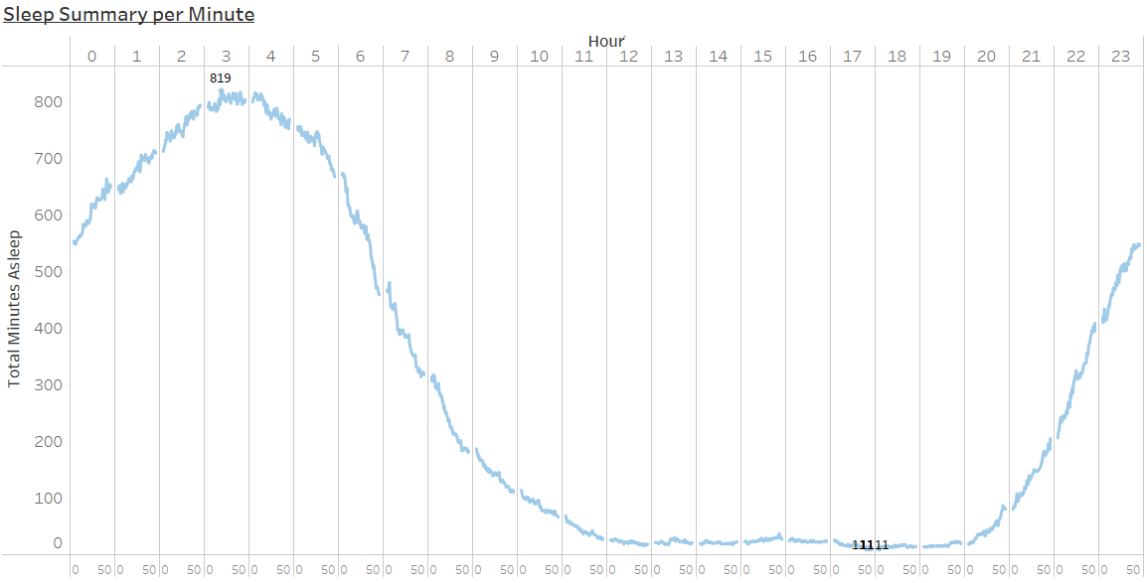
PATTERNS
Sleep Hours
The average sleep duration is approximately 8-10 hours, as most women sleep between 8-10 PM and wake around 6-8 AM.
Minutes

Slide 9
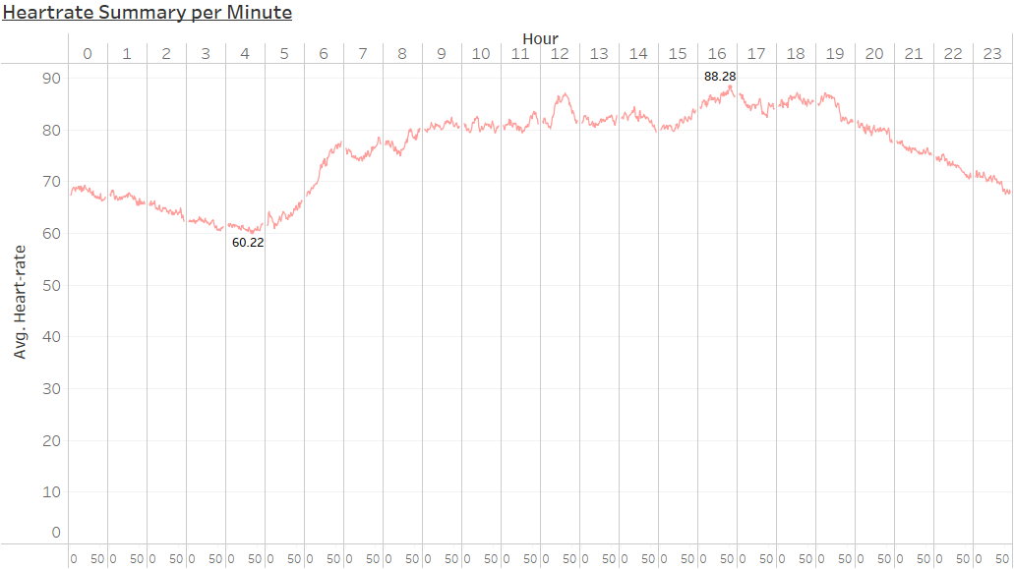
PATTERNS
Heart Rate relation to Sleep
Heart rate ranges from 60 to 90 BPM daily, lower during sleep (60–70 BPM) and higher when awake (70–90 BPM).
Minutes

Slide 10
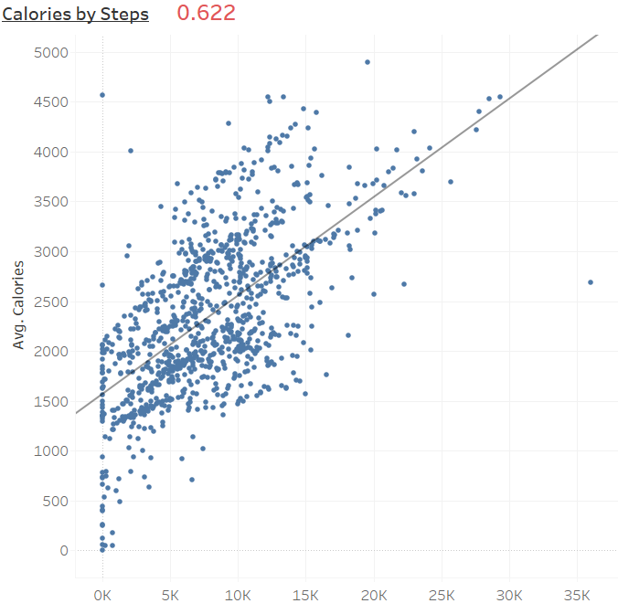
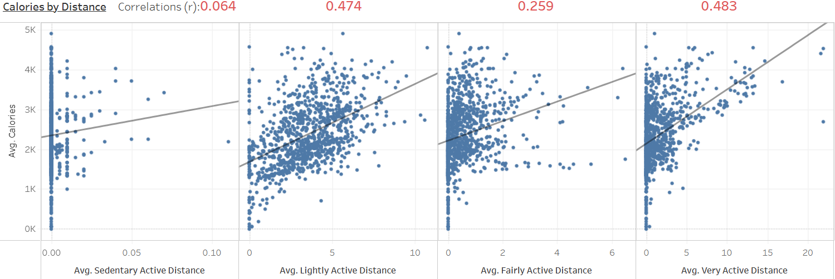
CORRELATIONS
Error in Calories, Activity
Even with 0 distance/steps, thousands of calories are burned, indicating a weak relation between distance/steps and calorie burn.
This means women are burning calories through activities other than walking, jogging, or running.
Avg. Steps

Slide 11
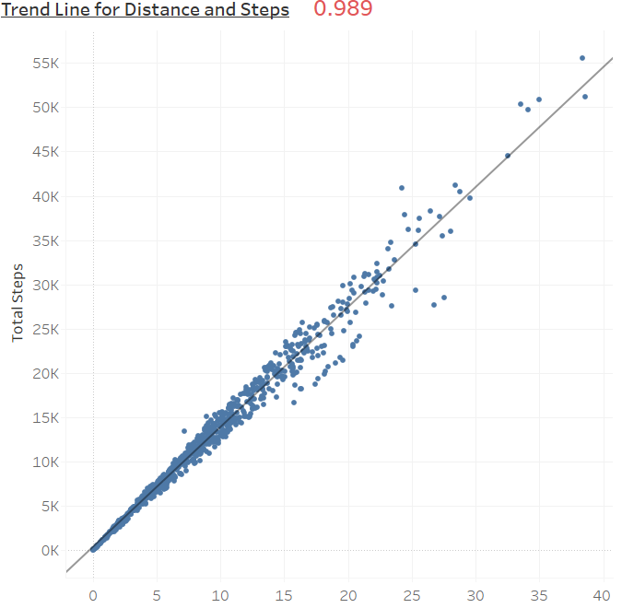
CORRELATIONS
Steps and Distance
There is a very strong correlation (0.989) between average steps and average distance, indicating a close relationship.
Avg. Distance

Slide 12
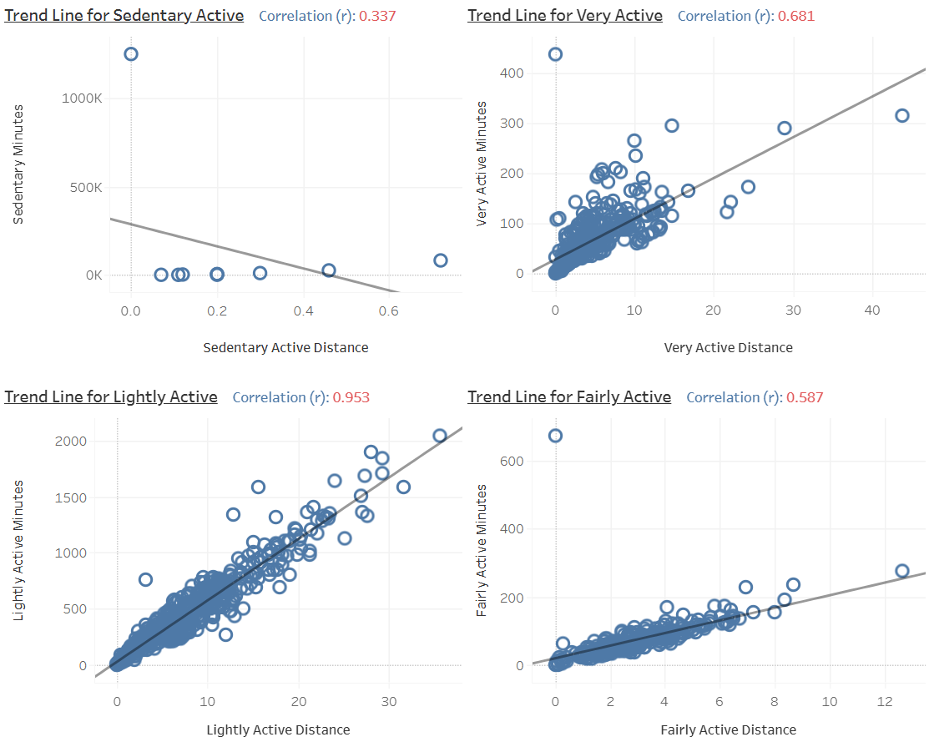
CORRELATIONS
Activity Distance Correlation
Women’s activity patterns are consistent with the expected behavior: more intense activities are associated with greater distances, while sedentary behavior involves minimal movement and low distances.
Sedentary Active:
Women are mostly inactive or spending time in minimal physical activity (e.g., sitting or light movements).
A weak negative correlation suggests that the more time someone spends sedentary, the less distance they cover.
Very Active:
Women are engaging in high-intensity activities like running or vigorous workouts.
A strong positive correlation indicates that as the distance covered increases, the time spent in very active intensity also increases.
Lightly Active:
Women are involved in mild activities like slow walking or light household chores.
The strongest positive correlation shows that as distance increases, so does time spent lightly active.
Fairly Active:
This involves moderate activity levels, such as brisk walking or cycling.
A moderate positive correlation indicates that an increase in fairly active distance corresponds to an increase in time spent at this intensity.

Slide 13
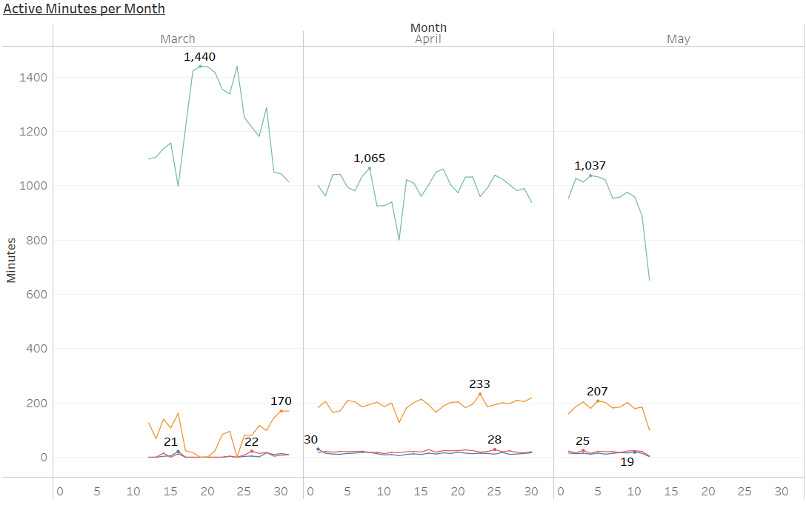
MONTHLY ANALYSIS
Women are getting more Active
March to April:
Significant decrease in sedentary minutes.
Lightly Active minutes increases and consistent over April.
Slight increase in Very Active minutes.
April to May:
Maintained consistency in Active minutes, but a slight drop at the end.
Still higher than March.
Sedentary
Lightly Active
Very Active
Fairly Active
Day

Slide 14
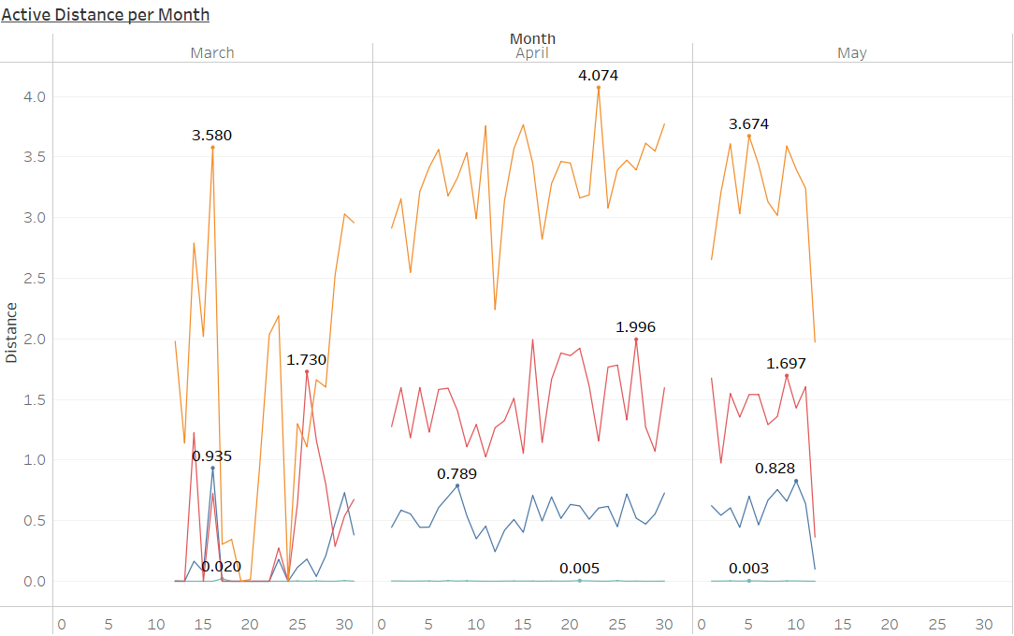
MONTHLY ANALYSIS
Step Count Improvement
March to April:
Total Active Distance improved significantly:
Distances across activity intensities (lightly, fairly, and very active) increased in April, with consistent trends.
April to May:
A slight decline in overall active distance suggests reduced activity compared to April, though still higher than March.
Lightly Active
Very Active
Fairly Active
Sedentary
Day

Slide 15
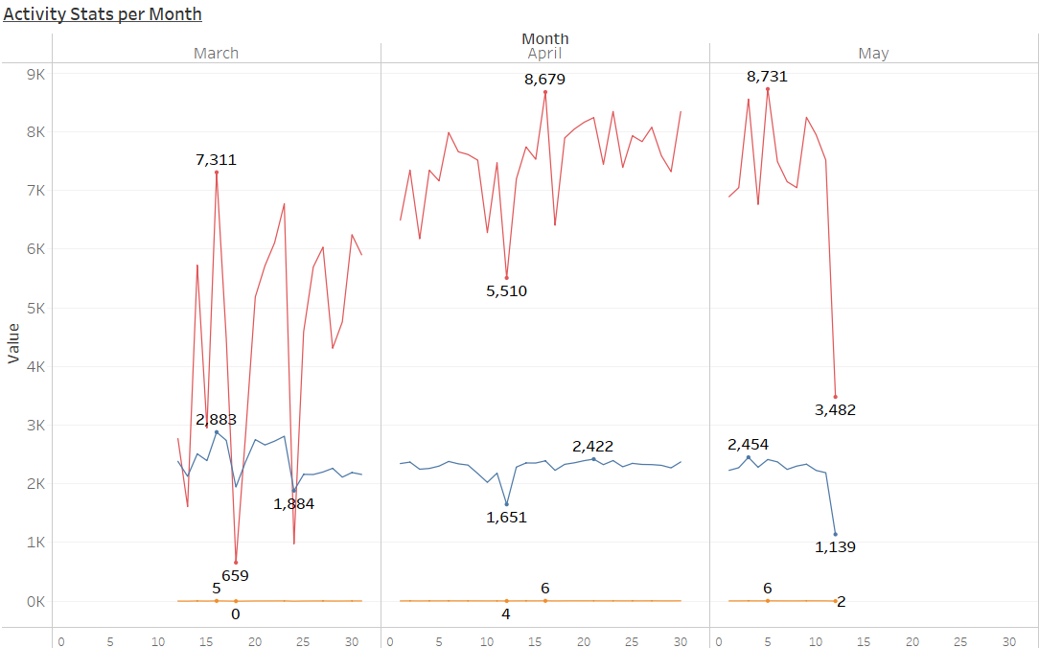
MONTHLY ANALYSIS
Activity Levels Increased
March to April:
Significant increase in steps and distance covered.
Slight decrease in calories burned, but consistent number of calories burned during April.
April to May:
A slight decline in the activity during last days, but maintained consistency throughout April and May.
Still higher than March.
Avg. Steps
Avg. Calories
Avg. Distance
Day

Slide 16
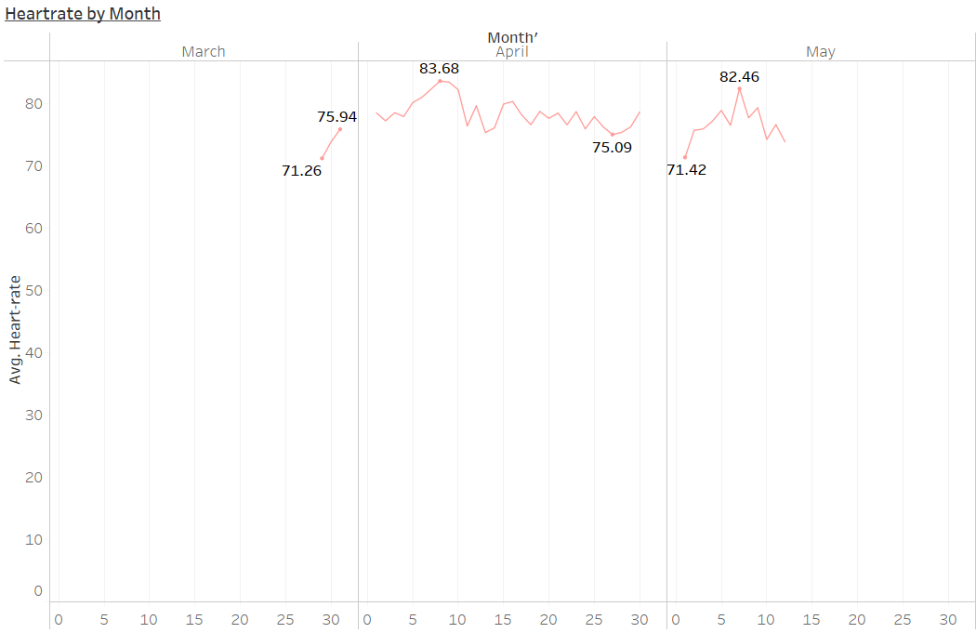
MONTHLY ANALYSIS
Heartrate Improvement
Heart rate improved from March to April, remained consistent in April, with slight fluctuations in May.
Heart rate performs optimally during active periods, reflecting the positive impact of physical activity.
Day

Slide 17
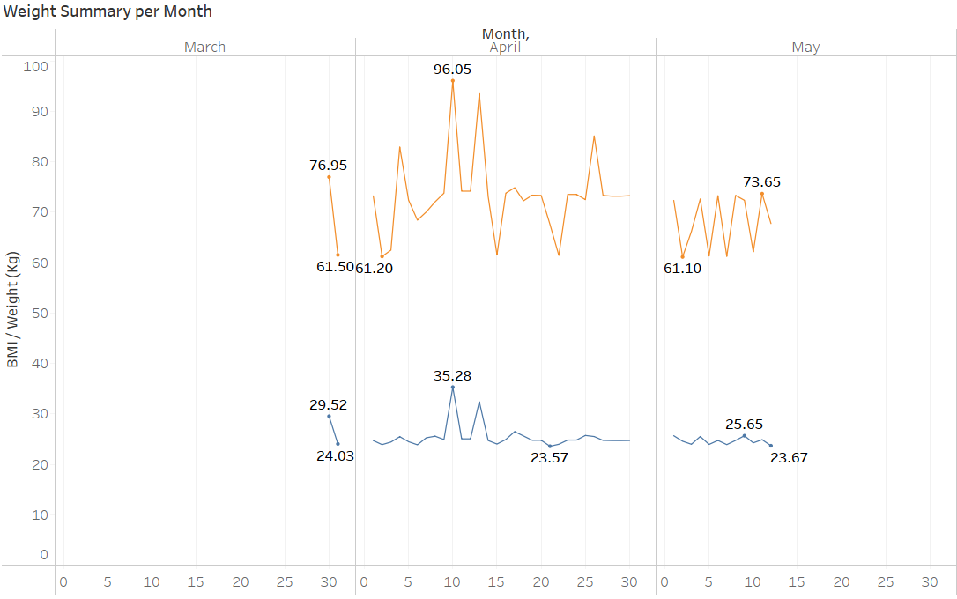
MONTHLY ANALYSIS
Healthier Weight Changes
Weights and BMI fluctuated during March and April but stabilized by May, with weight loss observed during active periods.
Weight (Kg)
BMI
Day

Slide 18
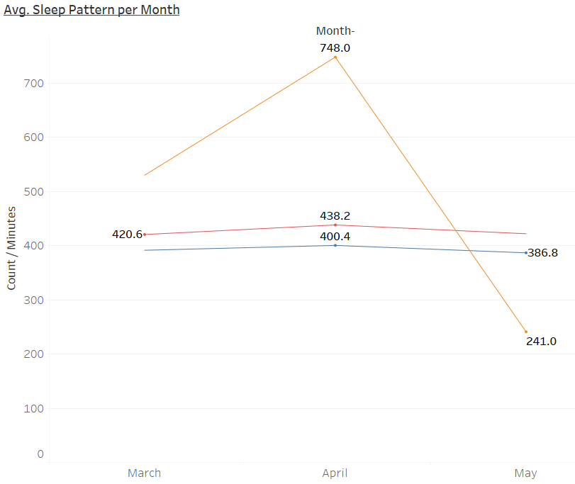
MONTHLY ANALYSIS
Improved Sleep Quality
Throughout the months, the average time in bed and minutes asleep were consistent. But during March and April, there are more sleep records which indicates disturbed sleep.
During May, total sleep records decreased, which indicates the sleep quality has increased
Avg Time in Bed
Avg Minutes Asleep
Total sleep records

Slide 19
ANALYTICAL GOALS
Determine HOW health improves before and while using Bellabeat.
Determine HIGH-LEVEL recommendations for Bellabeat’s marketing strategy.

Slide 20
Improve distance accuracy for enhanced user tracking precision.
Introduce workout, exercise, yoga, and gym modes to identify activities contributing to calorie burn accurately.
Highlight Bellabeat membership benefits, including personalized 24/7 guidance on nutrition, activity, sleep, health, and mindfulness.
Promote Bellabeat products by highlighting their impact on health improvement through activity, sleep, and wellness tracking.
Provide users with detailed insights into their health to help them make informed, healthier decisions.
Enable the app to suggest new goals based on previous activity or allow users to create customizable, personalized goals.
Send appreciation messages when users complete goals, and reward women with offers or gifts for long-term consistency to encourage dedication.
Introduce Menstrual Cycle tracking system.
RECOMMENDATIONS

Slide 21
Thank You

