Slide 1
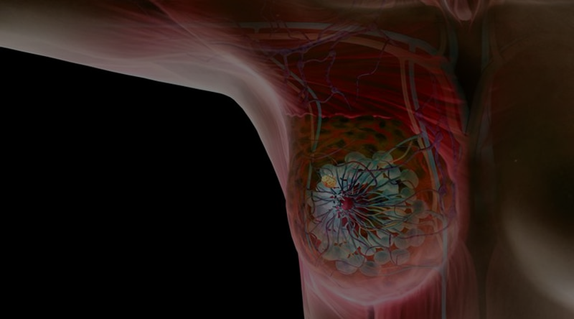

Introduction to Deep Learning
DL classifiers to diagnose the state (benign/malignant) from Breast Cancer Histopathological Database
By Payal, Renk & Leon (Group 10)
Notes:
Morning everyone
Today we are gonna talk about Image classification using deep learning classifiers for the breast cancer histopathological dataset.

Slide 2
Introduction
Notes:
lets just quickly recap on what is the concept of Deep learning? deep learning is like teaching a computer to learn from examples. Just as we learn to recognize objects by seeing many examples- in technical terms lets say- is a subset of machine learning that uses neural networks with multiple layers (hence "deep") to model complex patterns in data
Each layer in the network learns to detect different features.
Why the histopathological data? histopathological images provide microscopic views of tissue, which can reveal critical details about whether a tumor is benign or malignant.
Why deep learning used here- These images contain a high level of detail and complexity, with subtle differences between tissues. Traditional machine learning methods require manual feature extraction, which is both time-consuming and may miss intricate features critical for accurate classification.
DL networks can - can automatically learn and extract hierarchical features from images.

Slide 3
Dataset Overview
Source: The data was collected from the BreakHis database developed by Spanhol et al., consists of 82 patients using different magnifying factors (40X, 100X, 200X, and 400X)
Dataset Composition:
-Sample Collection: Collected via SOB method (partial mastectomy or excisional biopsy).
-Image Types: Includes 2480 benign and 5429 malignant tumor samples. Total: 7909
-Subtypes: Four benign types (A, F, PT, TA) and four malignant types (DC, LC, MC, PC).
https://web.inf.ufpr.br/vri/databases/breast-cancer-histopathological-database-breakhis/
Notes:
Sample collection- using done using SOB(Segmental Biopsy) OR partial mastectomy - this method yields larger tissue samples, it provides a more comprehensive view of the tumor structure, making it ideal for detailed histopathological analysis. (optional)
Source-
This dataset was created in collaboration with the P&D Laboratory for Pathological Anatomy and Cytopathology in Brazil. (reliable data)
Image types- numbers
Subtypes: The dataset currently contains four histological distinct types of benign breast tumors: adenosis (A), fibroadenoma (F), phyllodes tumor (PT), and tubular adenona (TA); and four malignant tumors (breast cancer): carcinoma (DC), lobular carcinoma (LC), mucinous carcinoma (MC) and papillary carcinoma (PC).
dataset offers a robust foundation for deep learning applications in medical image classification, specifically for distinguishing benign and malignant breast tumors.

Slide 4
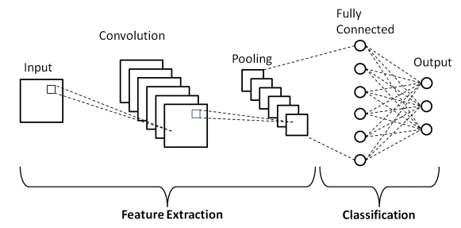
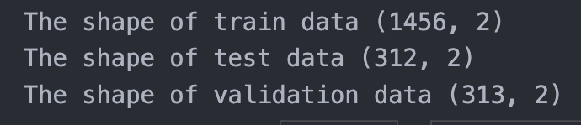
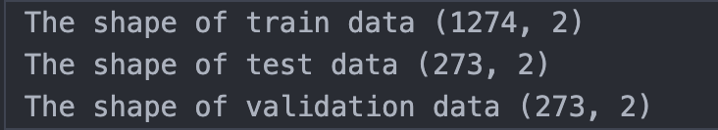
DL Classifiers Overview
CNN
SNN
ResNet50
Magnification 100x
Magnification 400x
Notes:
Explain the image?-
The CNN architecture consists of two main parts:
Feature Extraction: Using convolution and pooling layers to extract meaningful features from the image.
Classification: Using fully connected layers to classify the image based on the extracted features.
CNN (Convolutional Neural Network): A CNN uses filters to automatically extract important features from the BreakHis dataset, identifying complex patterns between benign and malignant tissue. This is useful as it learns features directly from the data, but training CNNs on high-resolution images can be computationally expensive.
SNN (Shallow Neural Network): An SNN has fewer layers and is simpler, making it suitable for basic pattern recognition in smaller datasets. For this dataset, it offers faster training but may miss subtle details that are essential for accurate tumor classification due to its limited depth.
ResNet50: ResNet50 is a deep CNN with 50 layers,
This model was launched in 2015 by Microsoft Research for the purpose of visual recognition, it allows to capture fine details in BreakHis images. Its depth enables high accuracy for complex image features,
though it requires significant computational power and longer training times.
Data Splitting for Model Evaluation:
This is what the shape of data looks like for 100 & 400X
100x Magnification- observed to have Better performance and offers a balanced view.
400x Magnification- observed to have comparatively Worse performance and Likely causes overfitting.
Which we will also see in the following slides!

Slide 5
Results

Slide 6
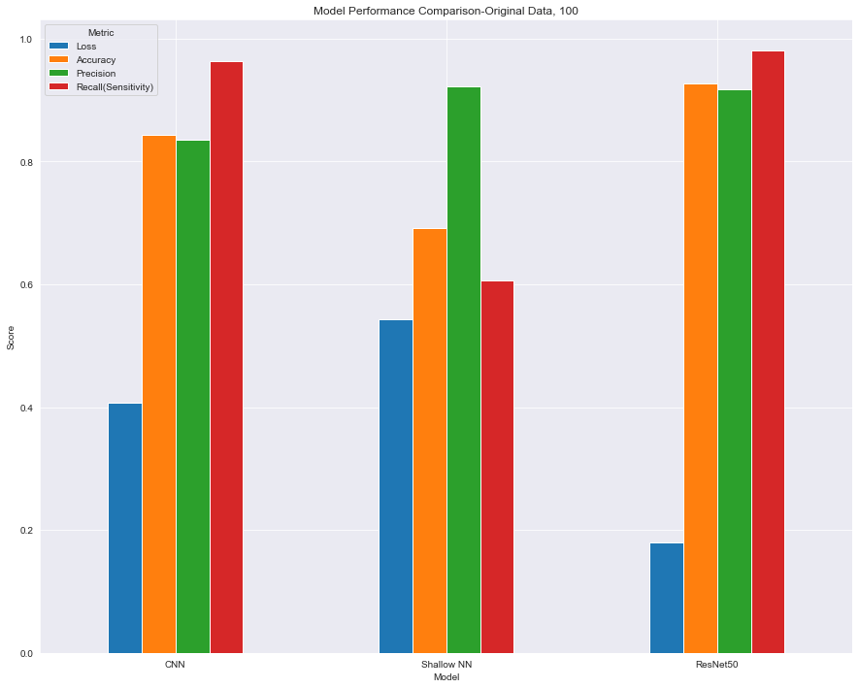
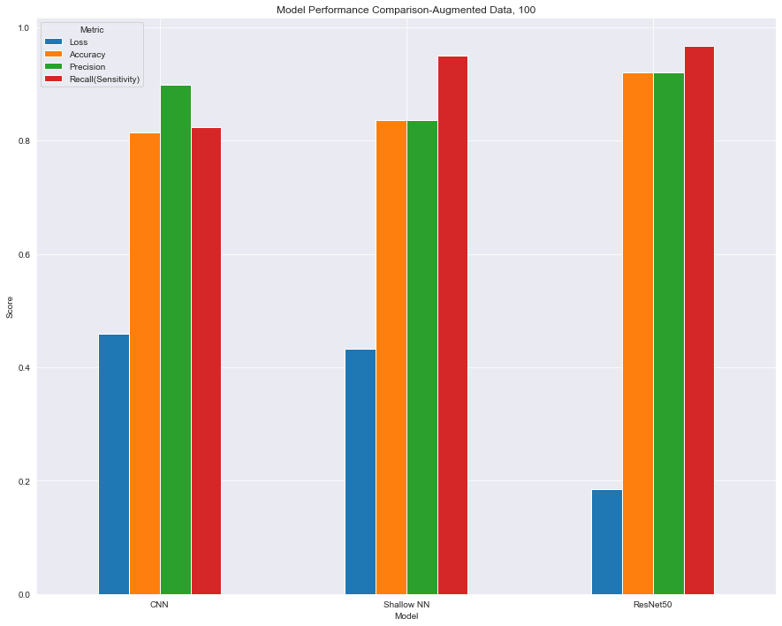
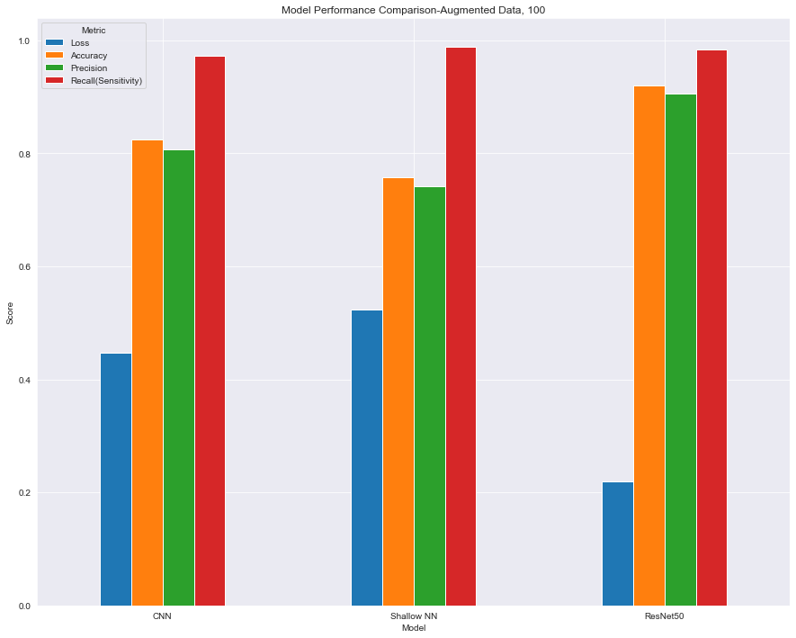
Metric comparison
4
Notes:
Recall is the metric that measures the proportion of actual positive cases correctly identified by the model out of all true positives in the data.
Precision is the metric that measures the proportion of correctly identified positive cases out of all cases the model predicted as positive.
On all datasets, resnet50 performs better than CNN and Shallow NN overall on all metrics.
CNN performs significantly better than Shallow NN for non-augmented data. However, for augmented data this difference is reduced.
All classifiers perform a bit worse for 400x magnification.
Recall rate of the Shallow NN is significantly more for augmented data than non-augmented.

Slide 7
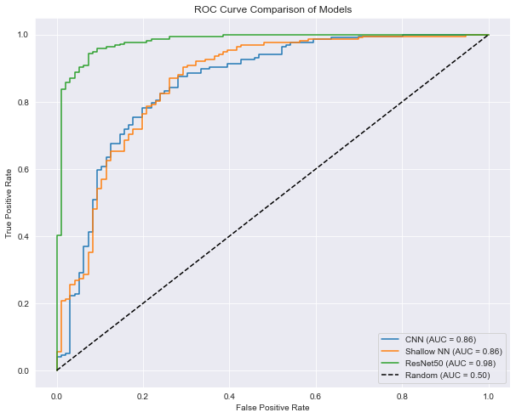
ROC Curve- Original Data
Notes:
Area under curve

Slide 8
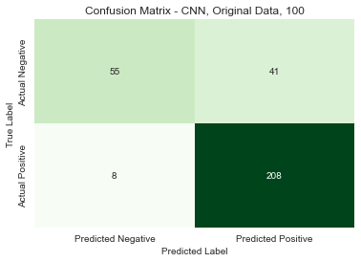
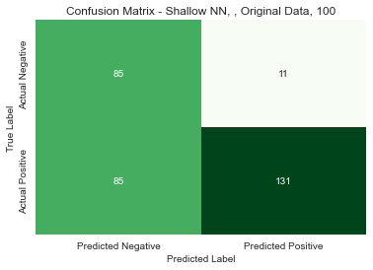
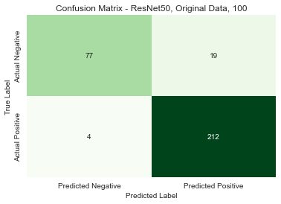
Confusion matrix - Original Data
Notes:
Precision: TP/TP+FP
Recall: TP/TP+FN
CNN:
Precision: 0.835
Recall(Sensitivity): 0.962
SNN:
Precision: 0.922
Recall(Sensitivity): 0.606
ResNet50:
Precision: 0.917
Recall(Sensitivity): 0.981

Slide 9
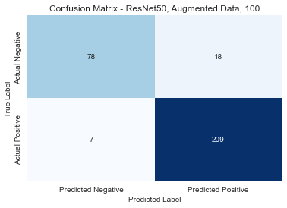
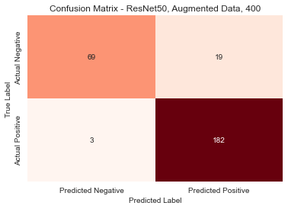
Confusion Matrix- ResNet50
Notes:
Original:
Precision: 0.917
Recall(Sensitivity): 0.981
Mag 100:
Precision: 0.92
Recall(Sensitivity): 0.967
Mag 400:
Precision: 0.899
Recall(Sensitivity): 0.972

Slide 10
Conclusion
Overall ResNet50 performed better than Shallow NN and CNN
400x magnification seems to cause worse performance than 100x
Data augmentation increases the performance of Shallow NN significantly
Notes:
Augmentation: data variety, increase robustness
ResNet50, with its superior performance, may be ideal for deployment in clinical settings, while Shallow NN with data augmentation can serve as a lightweight alternative for situations with limited computational resources.

Slide 11
Any questions?

Slide 12
References
1.https://web.inf.ufpr.br/vri/databases/breast-cancer-histopathological-database-breakhis/
2. https://cloud.google.com/discover/deep-learning-vs-machine-learning
3. https://viso.ai/deep-learning/resnet-residual-neural-network/
4. https://link.springer.com/article/10.1007/s42452-019-1903-4
5.https://medium.com/@sssspppp/image-classification-using-cnn-0fad8367acfd

