Slide 1
AI Generated Smart Contract
Submitted By:-
Ujjwal Pal – 19030141CSE081
Shailender Kumar – 19030141CSE075
Akanksha Choudhary – 19030141CSE040

Slide 2

Roles
Mostly the coding part is done by UJJWAL
Login and registration page part is done by AKANKSHA
Database storage and UI is done by SHAILENDER

Slide 3
Why this Topic?
Traditionally Smart contracts, which are auto-executing have predefined agreements with stored in blockchain and requires human intervention or supervision.
The aim of our project is to create AI-generated smart contracts to automate and improve the process by using artificial intelligence.

Slide 4
USE of AI-generated Smart Contract
Some of the benefits are:-
Accuracy and Reliability
Interpretability and Explain-ability
Legal Compliance
Security and Privacy
Human-Machine Collaboration

Slide 5


Our project
We have mainly use typescript for developing user interface, Node.js, chat API for the project.
For environment setup you need Node.js and NPM (node package manager)
Code is written in typescript and Next.js
We have used some modules of React.js
Lastly for the front-end part we have used HTML and for styling we have used CSS.
The most important component of our project is Chat API, it is used to run the code.
For the data storage we have used the mongoDB.

Slide 6
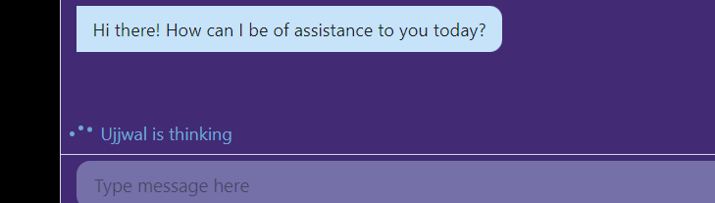
Result
Here we are adding some screenshots of the project:-

Slide 7
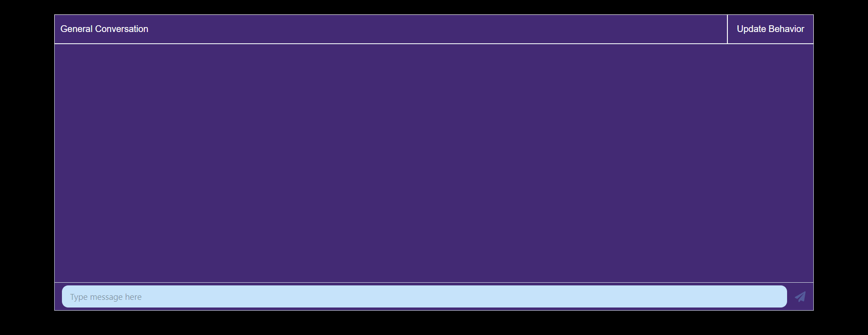
Continue..

Slide 8
Conclusion
Traditionally, the contracts might contain some hidden terms and condition which is not known by either of the parties, included by the third party.
AI-generated smart contracts overcome this situation.
Nothing is hidden, because of the use of blockchain.
It (smart contract) is created by keeping the legal terms in mind (legal data stored in the system).
Direct transaction, without the involvement of any trusted third party.
Notes:
Smart contracts is an agreement between two people or entities in the form of computer code programmed to execute automatically. Basic difference between smart contract and the traditional contract is the involvement of the third party.

Slide 9
Learning outcomes
We as a team learnt the importance of teamwork.
Why smart contracts are needed, their benefits and use in the real life.
Learnt about the solidity, how this is different from any other language.
Working principle of chat API.
Importance of HTML and CSS in the project (their cover page).

Slide 10


