Slide 1
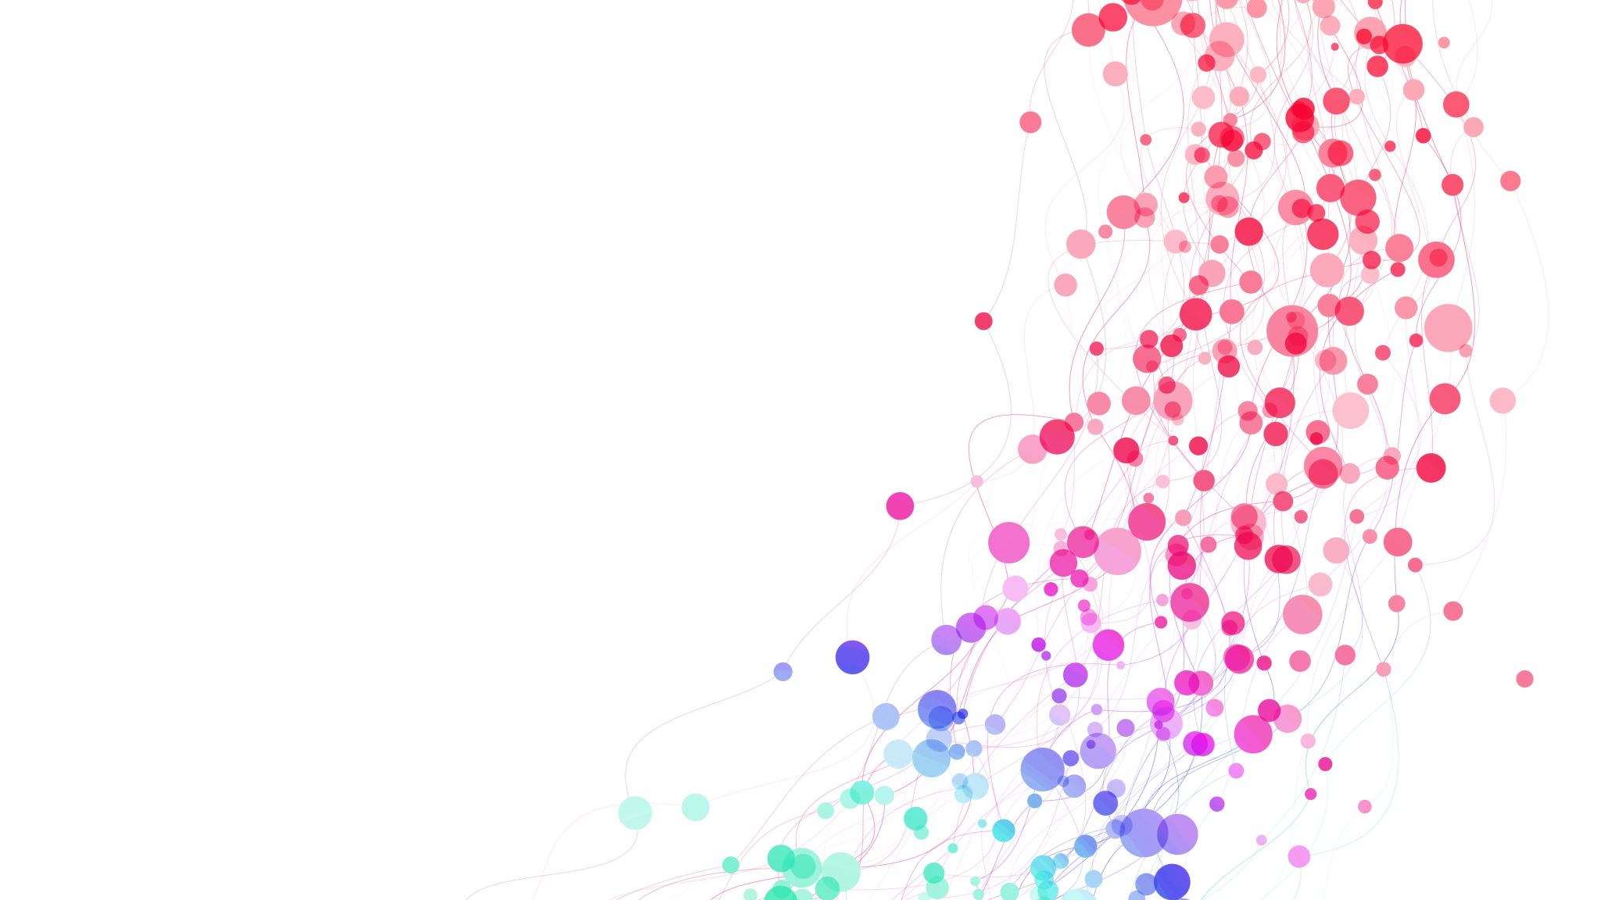
GENETIC ALGORITHM FOR TEXT SUMMARIZATION

Slide 2
ABOUT
Introduction to Genetic Algorithm for Text Summarization Presentation
Welcome to the introduction to Genetic Algorithm for Text Summarization presentation. In this session, we will explore the fascinating intersection of genetic algorithms and text summarization, where we are using genetic algorithm to summarize a text to automatically generate shorter and informative summaries from large volume of text

Slide 3
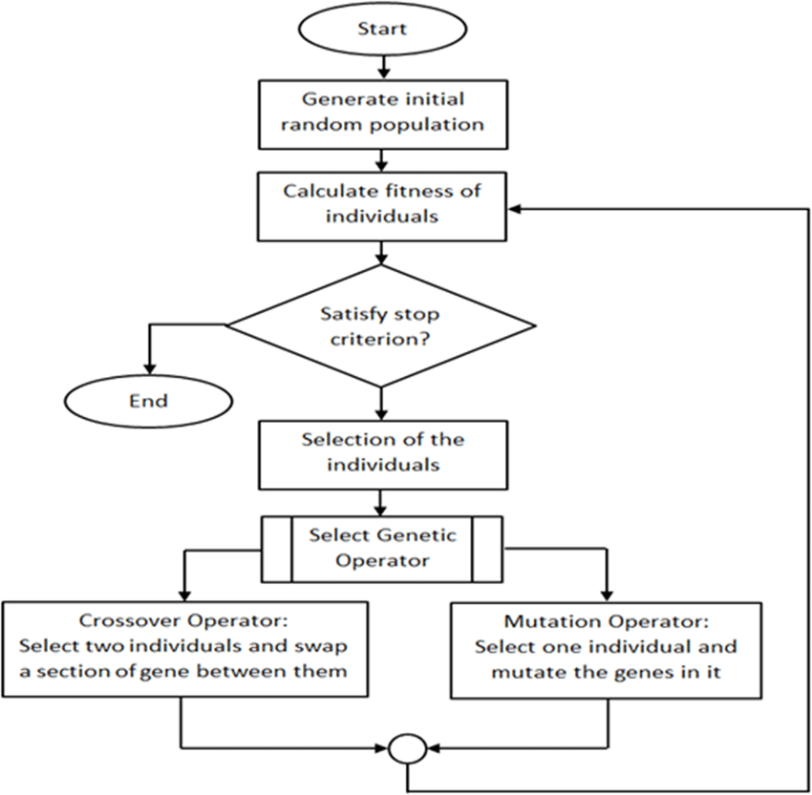

GENETIC ALGORITHM
Genetic algorithms (GAs) are optimization techniques inspired by the process of natural selection and genetics. They are used to find approximate solutions to optimization and search problems.

Slide 4
1.Initialization:
Generate an initial population of candidate summaries. Each candidate summary could be a subset of sentences from the original text or a combination of sentences from different parts of the text.
2.Evaluation:
Each individual in the population is evaluated using a fitness function. This function assigns a score that reflects how well the individual solves the problem. Higher scores indicate better solutions. Designing a good fitness function is crucial for the success of the GA.
3.Selection:
From the current population, you select a subset of individuals to become parents for the next generation. This selection process favors individuals with higher fitness scores. There are different selection techniques commonly
4.Crossover (Recombination):
Parents are used to create offspring for the next generation. This allows for the exploration of new solutions that might be better than the parents. Different crossover operators can be used, such as single-point crossover or two-point crossover

Slide 5
5.Replacement
& MUTATION:
A new generation of individuals is formed, typically by replacing a portion of the older population with the newly created offspring.
With a small probability, some bits or elements in the offspring's solution representation are randomly changed.
6.Termination:
The GA loop iterates through these steps (evaluation, selection, reproduction, mutation, replacement) for a predefined number of generations or until a satisfactory solution is found.
7.Final Selection:
Once the termination condition is met, select the best summary from the final population based on the fitness scores.

Slide 6
STEPS INVOLVED FOR TEXT SUMMARIZATION
Genetic Algorithm Functions:
Generate initial population: Creates a population of individuals (summaries) represented as binary strings. Each bit represents whether the corresponding word should be included in the summary (1) or not (0).
Evaluate fitness: Calculates the fitness score of each summary based on the overlap between the summary words and the original text words.
Selection: In each generation, the code selects "parents" for reproduction. It uses a huristic approach technique. Parents with higher fitness scores (better summaries) have a higher chance of being chosen.
Crossover: Parents' summaries are used to create "offspring" (new summaries). The code employs a single-point crossover strategy. It randomly picks a point in the binary strings of the parents and swaps the remaining bits to create two child summaries.
Mutation: To introduce diversity and prevent getting stuck in local optima, a small random chance of mutation exists. Each bit in the child summaries has a probability of being flipped (changing from 1 to 0 or vice versa). This injects some randomness and allows the exploration of new potential summaries.
.

Slide 7

After the final generation, the code identifies the best summary in the final population. This is the summary with the highest fitness score, indicating the one that overlaps most with the original text.
Final Summary Generation: Based on the best summary's binary string, the code reconstructs the actual text summary by including only the words corresponding to bits set to 1.
Output: Finally, the code prints the best summary text and its length.
Code: https://github.com/051821/Text-Summarization/blob/main/Genetic_algorithm%20(1).ipynb

Slide 8

CONCLUSION
In summary, text summarization using genetic algorithms offers an automated approach to distil large amounts of text into concise summaries. Leveraging principles from natural selection, these algorithms iteratively refine summaries by representing them as chromosomes and applying genetic operations like selection, crossover, and mutation.
Genetic algorithms for text summarization offer a flexible approach that can generate summaries without relying on labeled training data. However, they may struggle with larger text corpora due to the complexity of the search space and the need for efficient fitness evaluation functions. As a result, other techniques like deep learning models trained on large datasets are often preferred for text summarization tasks.

Slide 9

THANK YOU

