Slide 1

AI Travel & Accommodation Chatbot
An intelligent chatbot using Natural Language Processing and Deep Learning to provide instant travel and accommodation information. Built with Python, NLTK, TensorFlow, and Keras.
Group Project By :
Soumik Mondal, Krishnendu Sarkar, Sharadindu Das, Souvik Basu

Slide 2

Problem Statement & Objectives
The Challenge
Our Solution
Travellers face difficulties finding accurate accommodation information quickly. Traditional search methods are time-consuming and lack conversational understanding.
Build an NLP-powered chatbot that understands user intents, processes natural language queries, and responds with relevant accommodation information instantly.

Slide 3






Technology Stack & Tools
Python
NLTK
Core programming language
Natural Language Toolkit
TensorFlow
Keras
Deep learning framework
Neural network API
Pickle
NumPy
Model persistence
Numerical computing
Additional resources: punkt tokenizer, wordnet lexical database, omw-1.4 multilingual wordnet.

Slide 4
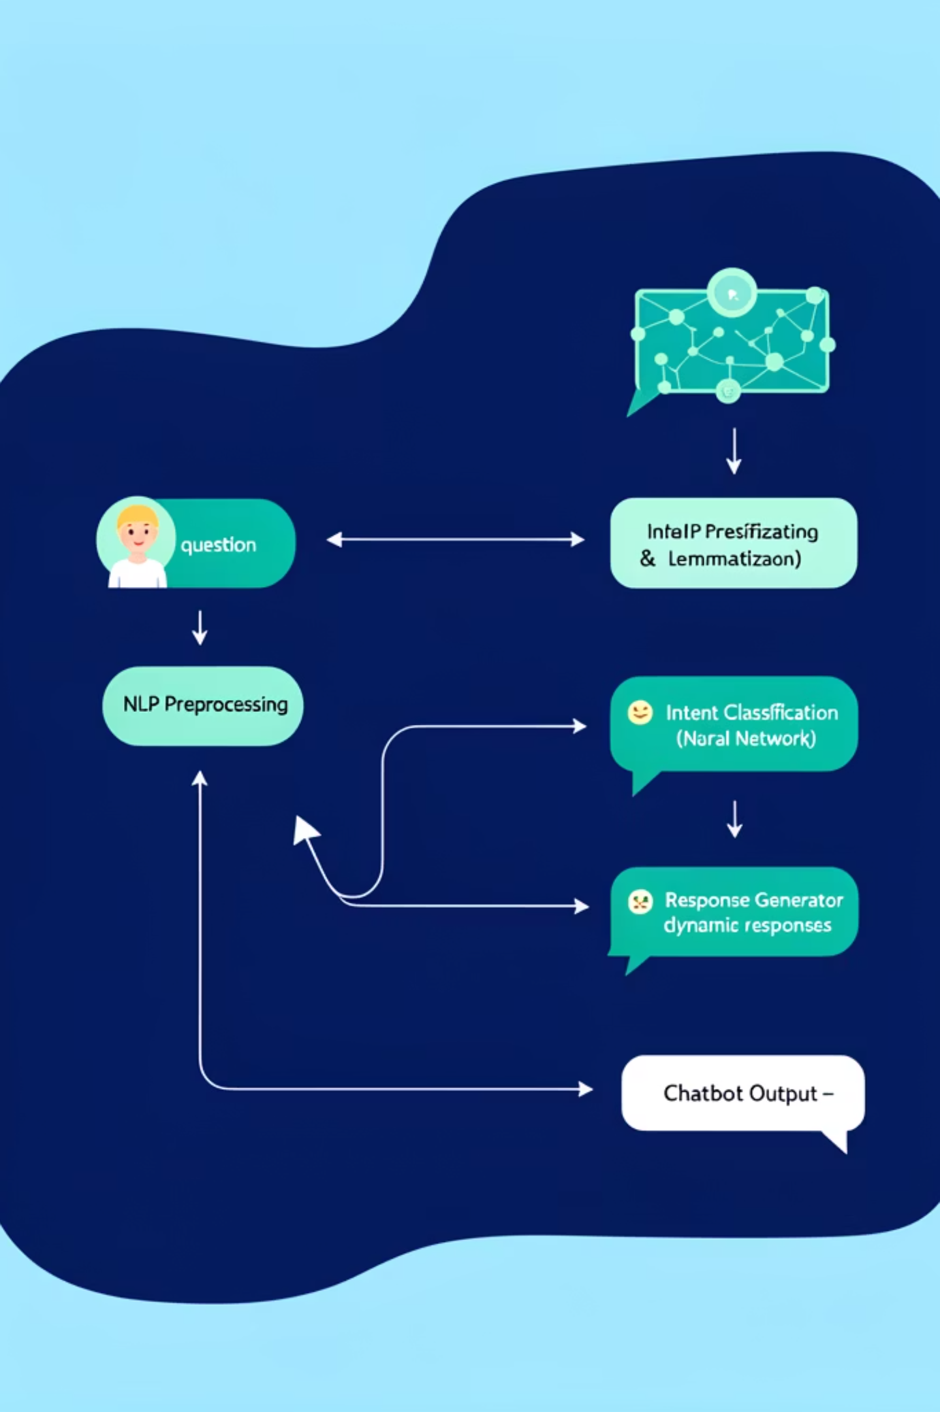





System Architecture
User Input
Natural language query
NLP Preprocessing
Tokenization & lemmatization
Intent Classification
Neural network model
Response Generator
Dynamic responses
Chatbot Output
Accommodation information

Slide 5
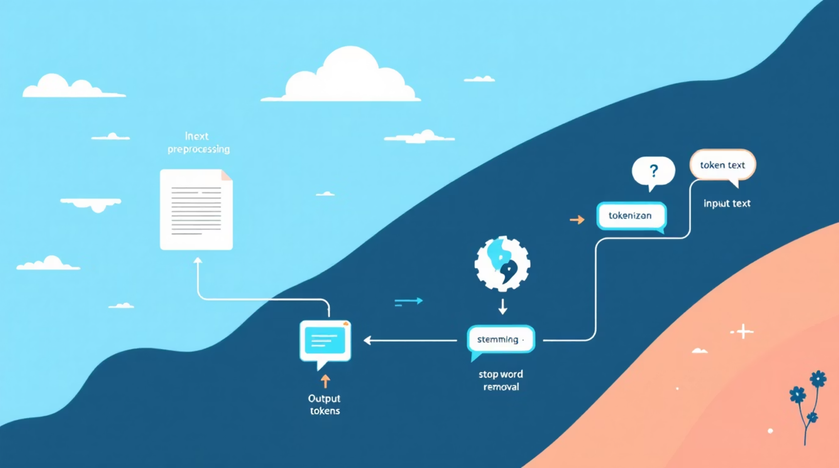
NLP Preprocessing Pipeline
Key Processing Steps
Tokenization: Split sentences into individual words
Lemmatization: Convert words to root form using WordNet
Vocabulary Creation: Build unique words list
Intent Mapping: Store patterns and responses
Output: words list, classes list, and documents with intent patterns.

Slide 6


Feature Engineering & Dataset
1
2
Bag-of-Words Representation
Training Data Creation
Generate train_x (input patterns) and train_y (intent labels)
Convert text into numerical vectors using vocabulary indices
3
Model Persistence
Save processed data using pickle files: words.pkl and classes.pkl

Slide 7





Neural Network Architecture
Input Layer
Dropout (Regularization)
Hidden Layer
Dense(128) — ReLU
Dropout(0.5)
Dense(64) — ReLU
Receives bag-of-words vectors
Reduces overfitting by randomly disabling units
Learns higher-level features
Dropout (Regularization)
Output Layer
Dropout(0.5)
Dense(num_classes) — Softmax
Improves generalization
Produces intent probability distribution
ReLU (Rectified Linear Unit): Activation function f(x) = max(0, x) that introduces non-linearity while remaining computationally efficient.
Notes:
Diagram regenerated to request: all five layer boxes are equal height, identical dimensions, vertically aligned on a common baseline, and symmetrically spaced left-to-right in a 16:9 layout. Color scheme preserved: blue for dense layers, orange for dropout layers, green for output. Accent image preserved (bookmark kept) to maintain visual consistency.

Slide 8

Training Configuration & Results
Loss Function
Optimizer
Training Epochs
categorical_crossentropy for multi-class classification
SGD with Nesterov momentum for faster convergence
200 epochs with validation to prevent overfitting
Model Output
Saved as chatbot_model.h5 for deployment

Slide 9
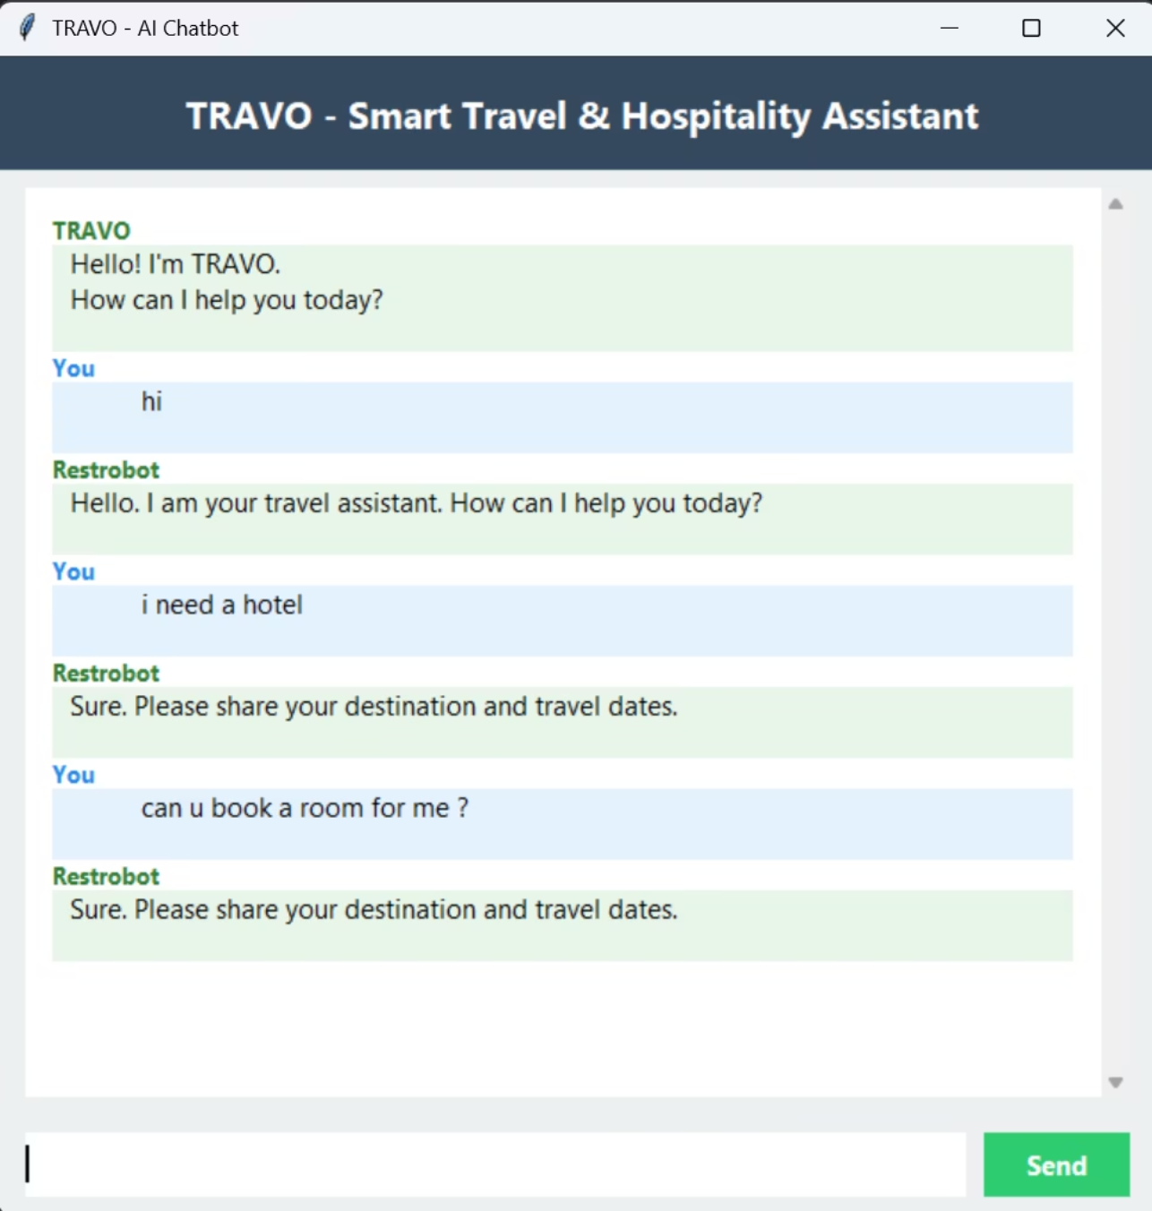
Response Generation / Demo
01
predict_class()
Classify user input into intent categories using trained model
02
getResponse()
Retrieve appropriate response based on predicted intent
03
chatbot_response()
Generate final response with formatted output for user

Slide 10
Advantages, Limitations & Future Scope
✓ Advantages
→ Future Enhancements
Lightweight and efficient architecture
Fast response times for user queries
Easily expandable with new intents
Cost-effective implementation
BERT Integration: Context-aware language understanding
API Connections: Real-time booking systems
Voice Assistant: Speech-to-text capabilities
Web Deployment: Scalable cloud infrastructure
Personalization: User preference learning
⚠ Limitations
Bag-of-words lacks context understanding
Fixed training data limits scope
No real-time API integrations

