Slide 1
Flight Delay Prediction
By Group #3: Fatima, Travers, Matt, Yunkai

Slide 2
About the Project
✓ Selected topic and the Reason why we selected the topic
✓ Description of our source of data
✓ Questions we hope to answer with the data
✓ Description of the data exploration phase of the project
✓ Description of the analysis phase of the project

Slide 3
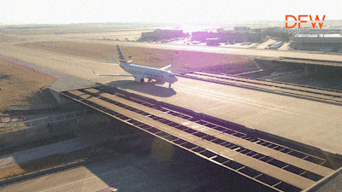
Flight Delays
In 2018, 18 % of all domestic flights were delayed.
As there were > 6 million flights in that year, that means 1,080,000 were delayed.
It is very frustrating even if you just experienced once.
What can we do?
We will use machine learning algorithms with the flight data, weather data, airport data to predict if a flight will be delayed or not. Let people have some sort of certainty with their travels.

Slide 4
Source of Data

Slide 5
Raw Data Source
https://www.transtats.bts.gov/databases.asp?Z1qr_VQ=E&Z1qr_Qr5p=N8vn6v10&f7owrp6_VQF=D
https://www.ncdc.noaa.gov/cdo-web/datasets
https://www.kaggle.com/datasets/threnjen/2019-airline-delays-and-cancellations?select=raw_data

Slide 6
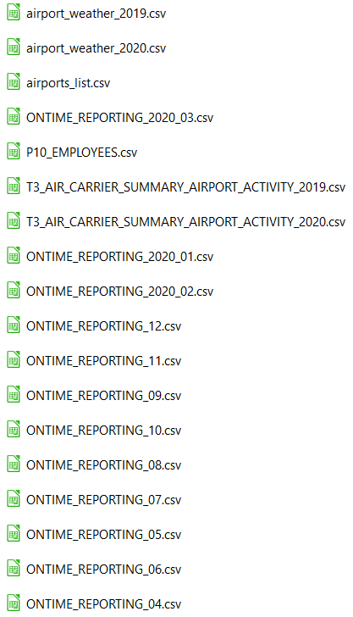
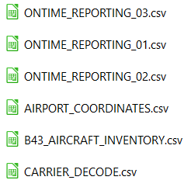
Description of Data
We will use:
Airport_weather_2019.csv
Airport_list.csv
ONTIME_REPORTing_01.csv
…

Slide 7
Questions to Answer with the data
Which carriers are most and least reliable for on-time departure?
Which airports are best and worst for on-time departures?
Which features in the data set are most correlated with a departure delay?
Use the dataset to make predictions. Can you accurately predict a departure delay?
Use the raw data files to re-tool the dataset and make our own prediction problem. Can we predict the reason for departure delay? Can we predict arrival delay?

Slide 8
Data Exploration

Slide 9
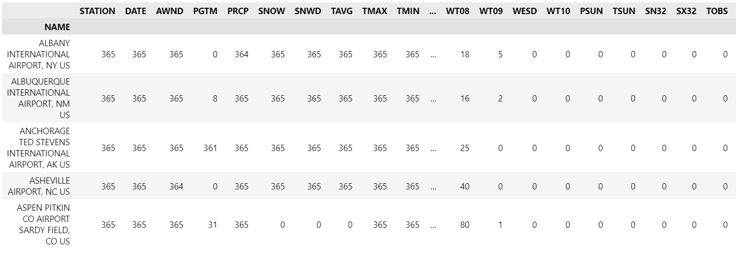
Airport_weather
_2019.csv

Slide 10
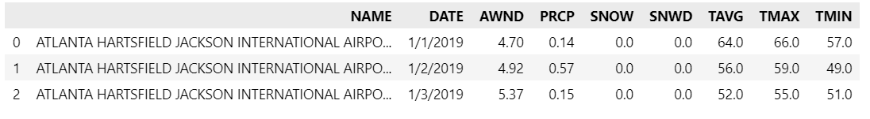
Drop Columns

Slide 11
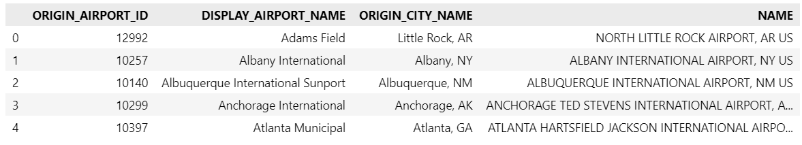
airport_list

Slide 12
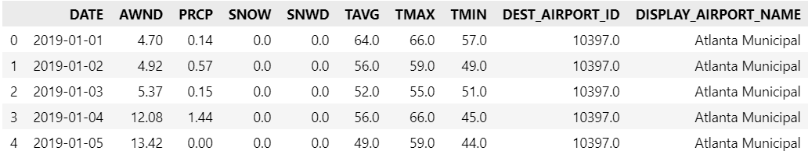
Link Weather with Airport

Slide 13
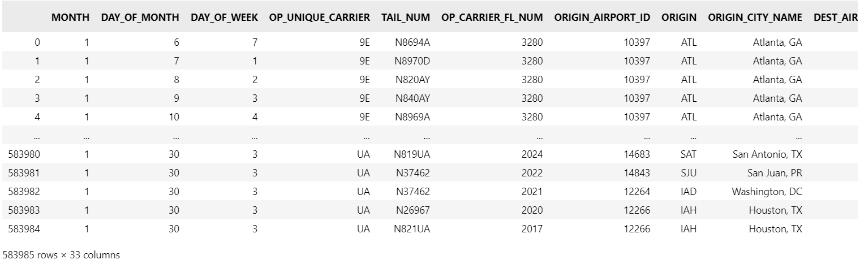
ON-TIME-REPORTING
_01.csv

Slide 14
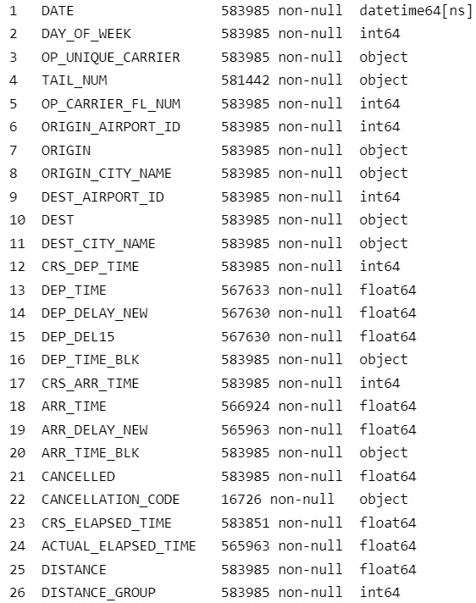
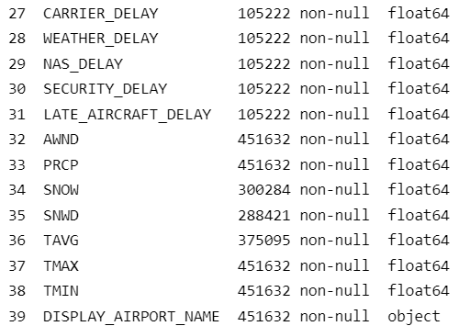
Join the data

Slide 15
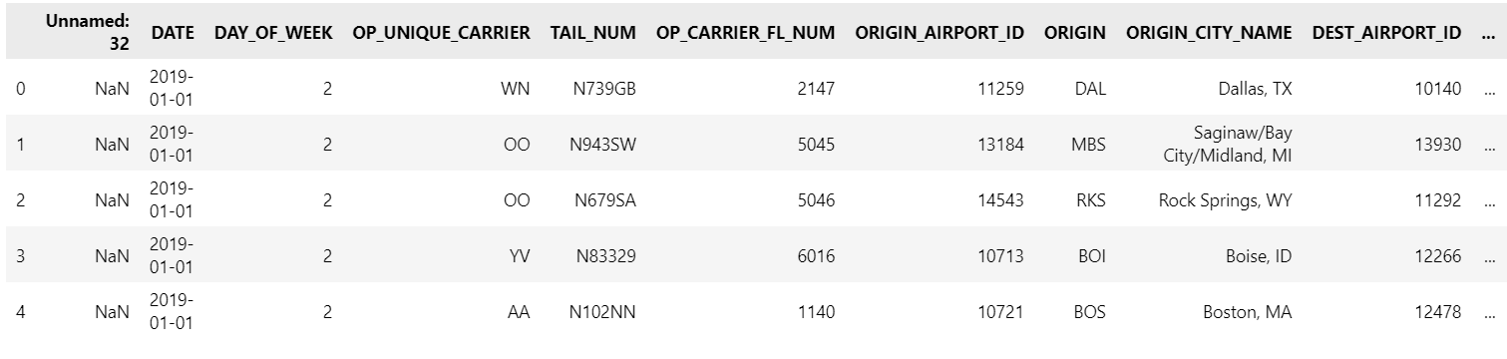
On-time-data with weather data

Slide 16
Data Analysis

Slide 17
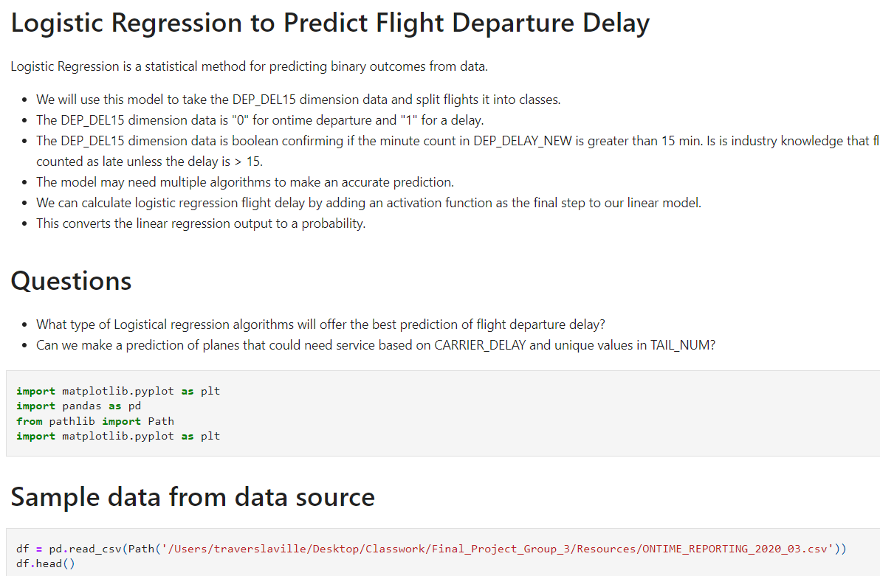
Machine Learning Model

