Slide 1

WisdomEd: Reshaping Education Through Holographic AI
The World's First Educational AI Agent for Ternary Synergy

Slide 2


01
Educational Challenges & Solution
02
Core Value Proposition
Key Innovations (Layer 1)
03
Validation Data (Layer 2)
04
Technical Foundation (Layer 3)
content
05
Vision & Call to Action
目录

Slide 3

Educational Challenges & Solution
01

Slide 4
S (Situation): Personalized teaching remains difficult, resources are unevenly distributed, and teachers face excessive administrative burdens
Personalized teaching is difficult
Uneven distribution of resources
Teachers are overburdened.
Personalized teaching is unmanageable (one-size-fits-all models fail to address student differences)
Uneven resource distribution (urban-rural/regional gaps limit access to quality content)
Overburdened teachers (admin/grading/lesson prep cuts into teaching/student support)

Slide 5




C (Complication): Traditional classrooms cannot achieve "teaching to individual needs" – teachers are overwhelmed, students lack tailored support
Teachers are overburdened.
Weak classroom interaction
Teacher burnout (hampers teaching quality/innovation)
Weak class interaction (low engagement, delayed feedback)
Insufficient support
Feedback on students' learning situation is lagging behind
Insufficient student support (no real-time tutoring/answers)
Slow learning data feedback (hard to track student differences)

Slide 6


Q (Question): Can an AI product empower teachers, students, and schools simultaneously for true ”ternary synergy”?
01
02
03
04
Integrated empowerment
Human-machine collaboration enhancement
Technical balance and integration
Personalization and Fairness
unified AI solves multiple education challenges
AI acts as a tool; teachers remain central
AI aids—not replaces—teachers
AI drives tailored support while ensuring equity

Slide 7




A (Answer): Code Catalyst introduces “WisdomEd Lingxi” – an AI agent redefining teaching workflows through intelligent collaboration
Role Definition
Knowledge Construction
Function expansion
Continuous optimization
Subject-expert partner matching teaching styles/needs
Curriculum-aligned, accurate knowledge system
Multimodal (voice/image) support for diverse teaching tasks
Data/feedback-driven iteration for stability

Slide 8
Core Value Proposition (Layer 1)
02

Slide 9



“Holographic Teaching System”: Teachers remotely generate virtual classrooms with real-time style adjustments
Virtual Presence
Real-Time Control
Style Customization
Teachers project lifelike holograms into classrooms from any location, enabling immersive remote teaching without physical presence.
Adjust voice tone, gesture speed, and facial expressions dynamically during lessons to match student engagement levels and learning pace.
Customize teaching personas with distinct styles—calm, energetic, or humorous—to align with subject matter and student preferences.

Slide 10
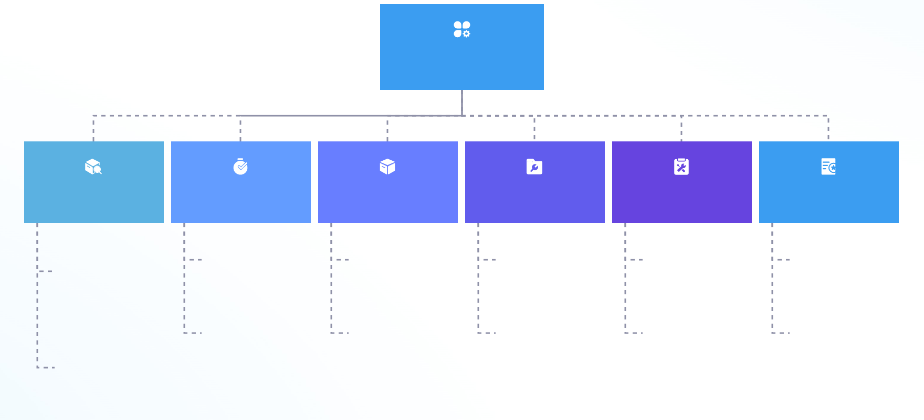
“Multimodal Digital Assistant”: Students customize assistant appearance/voice; import real teacher profiles; multilingual support (e.g., English speaking practice)
Intelligent Teaching System
Virtual Image Interaction
Teaching Style Replication
Multilingual Practice
Adaptive Interaction
Motivation Boost
Comprehension Enhancement
Personalized avatars (simulate teacher expressions) boost engagement/immersion.
Copies excellent teachers’ rhythms/methods for scalable 1-on-1 tutoring.
Real-time conversational training + instant pronunciation/grammar feedback.
Adjusts question difficulty/tone/speech speed to match student level/mood.
Positive feedback, personalized goals/rewards to sustain long-term interest.
Breaks down complex knowledge (with examples/analogies) to strengthen transferability.

Slide 11
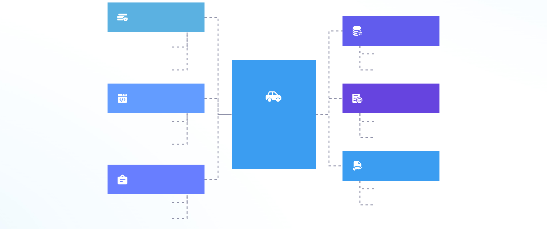
”Data-Driven Campus Platform”: Connects classroom devices to analyze student performance and proactively address discipline issues
Student behavior capture
Teacher intervention suppor
Cameras track student actions; desk sensors monitor writing/participation.
Sends customized pre-intervention advice + student data comparisons.
Analysis of Learning Patterns
Classroom Discipline Warning
智能教学系统
AI identifies focus fluctuations, analyzes answer rhythms, and locates knowledge gaps.
Detects disruptions (e.g., noise) and notifies staff in real time.
Emotional state monitoring
Identification of at-risk students
Facial recognition judges mood; combines biometrics (e.g., heart rate) to assess emotional fluctuations.
Alerts for low participation; flags abnormal behaviors (indicates potential barriers).

Slide 12
Validation Data (Layer 2)
03

Slide 13
Teachers: 50% faster lesson prep, 130% faster performance reports
1
2
3
4
Efficient Prep
Smart Reporting
Reduced Burden
Data Accuracy
AI cuts lesson planning time by 50% through automated content generation and alignment with curriculum standards.
Performance reports are generated 130% faster using real-time student data analysis and personalized insights.
Automated grading and feedback reduce administrative workload, freeing teachers for instructional design.
94% of teachers confirm high accuracy in AI-generated reports, ensuring reliable student assessment.

Slide 14




Students: 12% average grade improvement, 40% higher classroom engagement
Proven Gains
Active Learning
Motivation Boost
Consistent Progress
Pilot data from 12 schools shows students achieved a 12% average increase in academic performance within one term.
Classroom engagement rose by 40%, driven by interactive AI feedback and personalized learning pathways.
Students reported higher motivation due to real-time support and adaptive challenges tailored to their level.
Continuous assessment and instant remediation helped sustain improvement across diverse learner profiles.

Slide 15
Technical Foundation (Layer 3)
04

Slide 16
Dynamic Knowledge Graphs: RAG-powered personalized learning paths
01
02
03
Smart Knowledge Base
Adaptive Learning Paths
Real-time Content Updates
Built on authoritative sources like textbooks and curriculum standards to ensure accuracy and pedagogical alignment.
Uses RAG technology to retrieve and generate customized content based on individual student progress and understanding.
Integrates dynamic data from teaching workflows to continuously refine knowledge delivery and maintain relevance.

Slide 17




Multi-Agent Collaboration: 11 intelligent agents (academic planning, virtual mentoring, assessment)
Agent Roles
Collaborative Workflow
Adaptive Coordination
Scalable Architecture
11 specialized AI agents handle distinct educational functions including curriculum design, real-time tutoring, and automated assessment.
Agents communicate through a unified framework to coordinate tasks, ensuring seamless integration across teaching and learning activities.
The system dynamically assigns agent roles based on student needs, optimizing support for personalized learning pathways.
Modular design allows new agents to be added easily, enabling expansion into new subjects, languages, or instructional modes.

Slide 18



End-to-End Security: On-premise deployment eliminating hallucination risks
Local Deployment
Risk Prevention
All data processed on school servers, ensuring full control and compliance with privacy regulations.
On-premise architecture minimizes AI hallucinations by restricting external data access.
Stable Integration
Seamless connection with campus systems guarantees reliable performance and zero data breaches.

Slide 19
05
Vision & Call to Action

Slide 20

Vision: Transform education from "standardized" to "one-size-fits-one" – every student’s learning journey uniquely optimized
01
02
03
04
student-centered
AI Reconstructs Teaching
Personalized learning path
Intelligent Resource Recommendation
Prioritize individual growth; AI supports personalized development.
Automate/intelligize workflows to boost precision/responsiveness.
Customize learning routes; dynamically adjust content/progress.
Data-driven resource matching for independent exploration.
08
07
06
05
Promote educational equity
Improve teaching effectiveness
Unleash the potential of teachers
Collaborative innovation between teachers and students
Bridge resource gaps; expand access to high-quality content.
4. Action: Free Pilot Program
Use tech for efficient classroom management/feedback.
Reduce repetitive tasks; let teachers focus on creative teaching.
Redefine interactions to encourage cooperative creation.

Slide 21
Action: Join our free pilot program – schools get full WisdomEd Lingxi deployment at zero cost for 6 months
01
02
03
Free pilot program
Full technical support
Building a smart education ecosystem together
K-12 schools access the full system at no cost to experience intelligent teaching upgrades.
1-on-1 guidance, teacher training, and operation maintenance.
Collect feedback to optimize the product; scale personalized learning.

Slide 22
Next Step: Scan QR code to experience holographic teaching demo in real-time
---
All data validated through 12-school pilot (Q1 2025). 99.2% system stability, 0 data breaches.
Experience Now
Join Pilot Program
Trusted Performance
Scan the QR code to access a live holographic teaching simulation and interact with WisdomEd Lingxi in real time.
Schools can enroll in our free 6-month pilot, receiving full deployment with zero upfront costs or technical barriers.
Backed by verified data from 12 schools, ensuring 99.2% system reliability and complete data security.

Slide 23
THANKS

