Slide 1
Towards distributed Natural Computing with Physarum
La defense

Slide 2
Outline
Part I: Natural Computing with Physarum
Part II: Trying to learn more about Physarum
Part III: A distributed model of Physarum

Slide 3
Natural Computing with P
5 slides

Slide 4
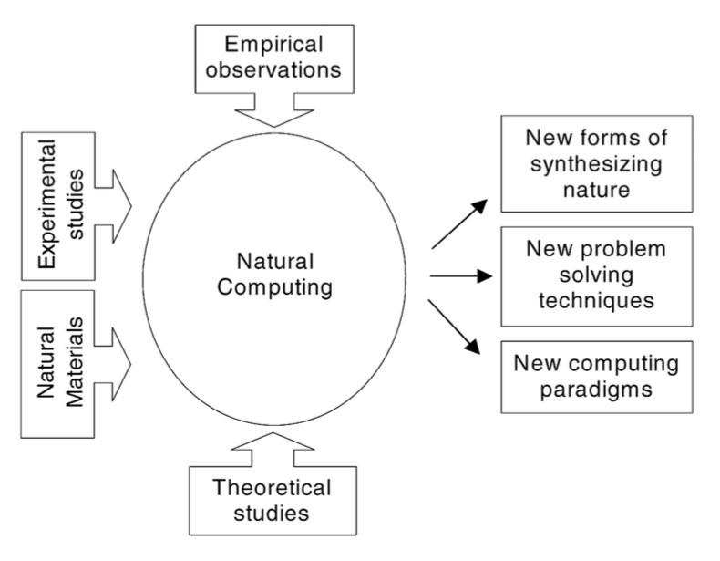
Natural Computing
Highly interdisciplinary
Computing Inspired by Nature
Synthesis of Nature by means of computing
Computing with natural materials

Slide 5
Meet Physarum
Basic facts and properties
Picture

Slide 6
Key experimental findings
Synchronisation
Maze solving
Maximization of food uptake
Minimizing risk associated with ligth exposure

Slide 7
Natural computing
Shortest path algorithms
Many body simulations
Computing with live physarum
Caveat: What about the distributed nature of P
A model would be nice
Need to learn more about networks to tackle this question

Slide 8
Our own approach to Natural Computing
Experiment design
Network extraction
Network analysis
Network modelling

Slide 9
Studying the networks formed by P
4 slides

Slide 10
Experiments
Show setup
Show video

Slide 11
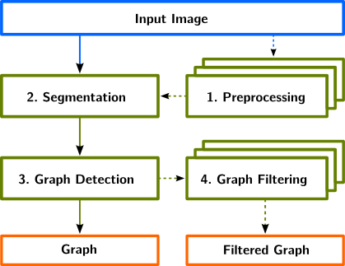
Network Extraction From Images
NEFI description
NEFI example

Slide 12
Network analysis
Various observables forming a catalogue
Path, face, cut and percolation
Example information robustness

Slide 13
Sharing is caring
SMGR repository concept
benefits

Slide 14
A distributed model of P

Slide 15
Key notes on distributed nature of P
No central control
Robust against disturbance
Key points from thesis
Look all these points are desireable for a distributed algorithm
A model is required to capture those

Slide 16
Introduction to our modelling approach
Flows and peristaltic pumps are complex
Translated to electrical regime
Physarum element

Slide 17
Physarum elements
Description
Put them on graphs

Slide 18
Example a cycle
Theoretical description and simulation results agree

Slide 19
Two linked cycles
More action and oscillations

Slide 20
summary

Slide 21
What is natural computing
What is natural computing with physarum
What are the approaches
What are the limitations
How to try to go beyond the limitations
How to learn more about Physarum
Our experiments
Data processing
Data analysis
Data sharing
Modelling distributed behaviour
Important modelling targets
Discrete and Continuous model
Studying the model on simple graphs numerical/analytical approach
Limitations of approach and further developments
Conclusions

