Slide 1
Towards distributed Natural Computing with Physarum
La defense

Slide 2
Outline
Part I: Natural Computing with Physarum
Part II: Trying to learn more about Physarum
Part III: A distributed model of Physarum

Slide 3
Natural Computing with P
5 slides

Slide 4
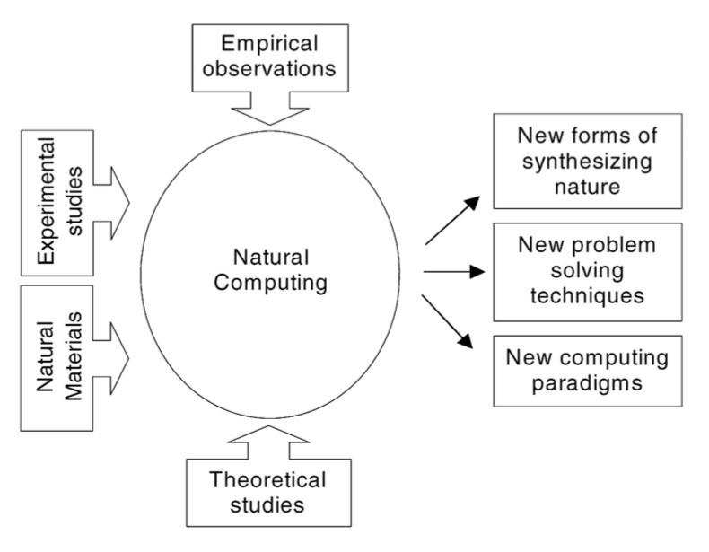
Natural Computing
Highly interdisciplinary
Computing Inspired by Nature
Synthesis of Nature by means of computing
Computing with natural materials

Slide 5
Meet Physarum
form and maintain a massive dynamic complex network of veins. highly adaptive and change drastically in response to changing environmental conditions. This extraordinary functional plasticity allows P to navigate its environment successfully in search for food.
a typical mammalian vascular network ensures the circulation of blood, the veins of the plasmodium allow protoplasmic fluid to freely flow [97].
Circulation of protoplasmic fluid is vital to the organism since it ensures that nutrients, nuclei and other relevant factors are equally available everywhere.

Slide 6
Key experimental findings
Synchronisation
Maze solving
Maximization of food uptake
Minimizing risk associated with ligth exposure

Slide 7
Natural computing
Computing inspired by P (shortest path, spanning trees)
Synthesis of P (many body simulations, Voronoi diagrams, TSP tours)
Computing with live physarum (transport network design, logic gates & computers)
Caveat: What about the distributed nature of P
A model would be nice
Need to learn more about networks to tackle this question

Slide 8
Our own approach to Natural Computing
Experiment design
Network extraction
Network analysis
Network modelling

Slide 9
Studying the networks formed by P
4 slides

Slide 10
Experiments
Show setup
Show video

Slide 11
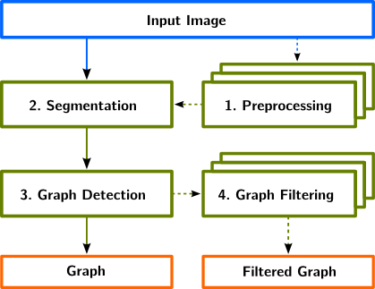
Network Extraction From Images
NEFI description
NEFI example

Slide 12
Network analysis
Various observables forming a catalogue
Path, face, cut and percolation
Example information robustness

Slide 13
Sharing is caring
SMGR repository concept
benefits

Slide 14
A distributed model of P
Should be 6 but is 8

Slide 15
Key notes on distributed nature of P
The organism maintains a dynamic circulation of flow
The organism is robust against changes in topology
The organism operates in a fully distributed manner and requires no central control
The organism has a degree of efficiency

Slide 16
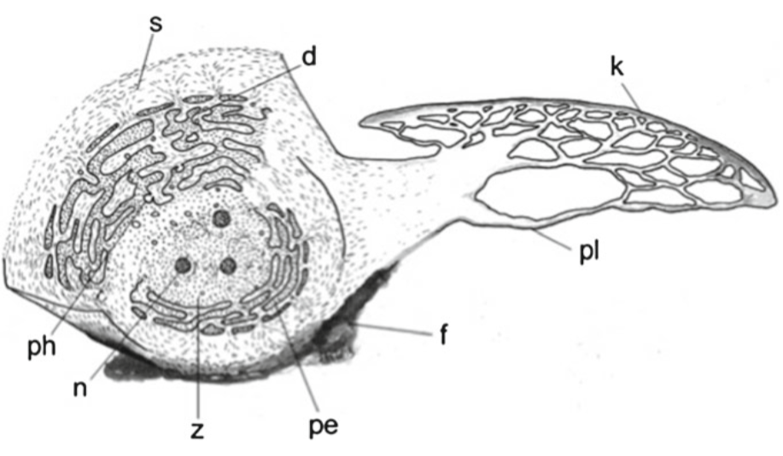
Introduction to our modelling approach
Based on Windkessel model used for human cardiovascular systems
Mimic the effect of peristaltic pumping using current controlled voltage sources.
focus on capturing the self-organized oscillatory dynamics of P → emergent flow patterns similar to the real thing.

Slide 17
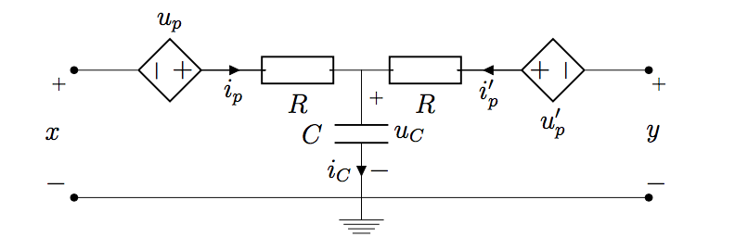
Modelling a vein segment – P elements
Description: Resistances, Capacitance, Current controlled voltage source
How strong can u_p react?
How fast can u_p react?

Slide 18
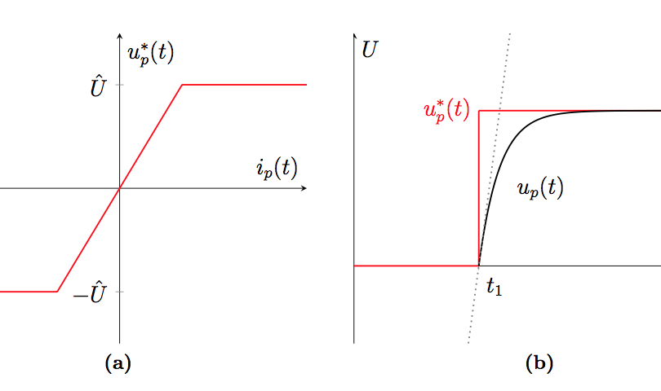
Details of P elemets

Slide 19
Physarum networks
Slap elements onto the graph
Solve the electrical system
Observe the convergence of the capacitor voltages and the resulting currents
Model can be discretized and solved numerically
Several analytical results available

Slide 20
Example tree
If capacitor voltages converge, no flows are possible, the network flow dies
If capacitor voltages do not converge, oscillations in the flows are observed numerically
Numerically we always see oscillations for trees

Slide 21
Example a cycle
For cyles we always have convergence
If capacitor voltages converge, either a circulatory flow happens or it dies
4-cycle can be forced into oscillations using extreme initial conditions

Slide 22
Two linked cycles
Biologically relevant as this setup mimics a famous real experiment
Analysis attempts failed
Numerical results indicate flow reversals on the link edge

Slide 23
Discussion and Caveats of the model

Slide 24
summary

Slide 25
What is natural computing
What is natural computing with physarum
What are the approaches
What are the limitations
How to try to go beyond the limitations
How to learn more about Physarum
Our experiments
Data processing
Data analysis
Data sharing
Modelling distributed behaviour
Important modelling targets
Discrete and Continuous model
Studying the model on simple graphs numerical/analytical approach
Limitations of approach and further developments
Conclusions

