Slide 1
Komal Yadav
Key Logger
13/06/2024 Final Review

Slide 2
Key Logger
A keylogger (short for keystroke logger) is a type of surveillance technology used to monitor and record each keystroke typed on a computer's keyboard. Keyloggers can be implemented through various methods, including hardware and software solutions.
13/06/2024 Final Review

Slide 3


AGENDA
Introduction to the concept of a keylogger
The purpose behind the keylogger project
Key points to be discussed about Key Logger
Usage of Key Logger for different users
Modelling as well as the results obtained
3/21/2024 Annual Review

Slide 4

PROBLEM STATEMENT
The rapid advancement of technology and the increasing use of digital devices have introduced significant challenges in maintaining security and privacy. One such challenge is the misuse of keystroke logging technology. While keyloggers can serve legitimate purposes such as parental control, employee monitoring, and personal security, they are often associated with malicious activities such as unauthorized access, data breaches, and identity theft.
13/06/2024 Final Review
3/21/2024 Annual Review

Slide 5

PROJECT OVERVIEW
The project aims to develop an ethical and secure keylogger that can be used for authorized monitoring purposes, such as parental control and employee oversight, while ensuring data security and user privacy. The keylogger will be designed to be transparent, compliant with legal standards, and equipped with robust security measures to prevent misuse.
Unauthorized Access
Data Breaches
Privacy Concerns
Detection and Prevention
By addressing these challenges, the project seeks to provide a reliable tool that offers peace of mind to parents, employers, and security professionals, ensuring the responsible use of keystroke logging technology.
13/06/2024 Final Review

Slide 6

WHO ARE THE END USERS?
Target Audience:
13/06/2024 Final Review

Slide 7

YOUR SOLUTION AND ITS VALUE PROPOSITION
The keylogger solution is a comprehensive software application designed for ethical monitoring purposes. It operates discreetly to capture keystrokes, providing real-time monitoring and reporting.
Features and Capabilities:
Real-time Monitoring
Encrypted Data Storage
User-friendly Interface
Remote Access
Customizable Alerts
Comprehensive Reporting
13/06/2024 Final Review

Slide 8

THE WOW IN YOUR SOLUTION
Real-time Monitoring: Immediate insights by capturing keystrokes as they happen.
Stealth Mode: Operates hidden to avoid detection.
Customizable Alerts: Notifications for specific keywords or unusual activities.
Encrypted Data Storage: Securely stores captured data to prevent unauthorized access.
Remote Access: Authorized users can access data from anywhere securely.
Advanced Features:
Comprehensive Reporting: Detailed activity reports for review.
Cross-Platform Compatibility: Works across different operating systems.
User-friendly Interface: Simple and intuitive for all technical levels.
3/21/2024 Annual Review
8

Slide 9
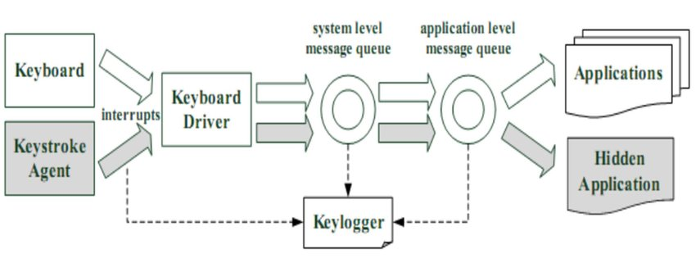
MODELLING
13/06/2024 Final Review
9

Slide 10
RESULTS
This project developed a keylogger program with a focus on ethical applications. Targeting parents, businesses, educators, and IT professionals, it offers functionalities like:
Discreet monitoring of user activity.
Customizable filtering for specific data.
Secure storage of captured keystrokes.
User-friendly interface and detailed reporting.
Solution: https://github.com/05komal/Key-Logger.git
3/21/2024 Annual Review
10

