Slide 1
MID-TERM EVALUATION
NEWS APPLICATION
VIKASH KUMAR DUBEY 23FS20MCA00042
Under the guidance of
Divya Sharma
MASTER OF COMPUTER APPLICATIONS (MCA)
DEPARTMENT OF COMPUTER APPLICATIONS
MANIPAL UNIVERSITY JAIPUR
JAIPUR 303 007, RAJASTHAN, INDIA
2023-25

Slide 2
Outline
Introduction
Motivation
Process Model
Software Requirement Specification
Data Flow Diagram
Output
Conclusion
Future scope

Slide 3
Motivation
In todays fast paced world , people struggle to access reliable, up-to-date news from a single platform
Existing platforms often lack personalization, real-time updates, or user interaction features
To build a platform that delivers real-time, curated news efficiently.
To offer admin-controlled content and user engagement through likes/dislikes.
To apply full-stack development skills using the MERN stack and Socket.IO for real-time updats
Strengthen backend logic and JWT-based authentication mechanisms.
Enhance skills in React, MongoDB, and WebSockets.
Learn how to manage dynamic content and live interactions in a production-level app.

Slide 4
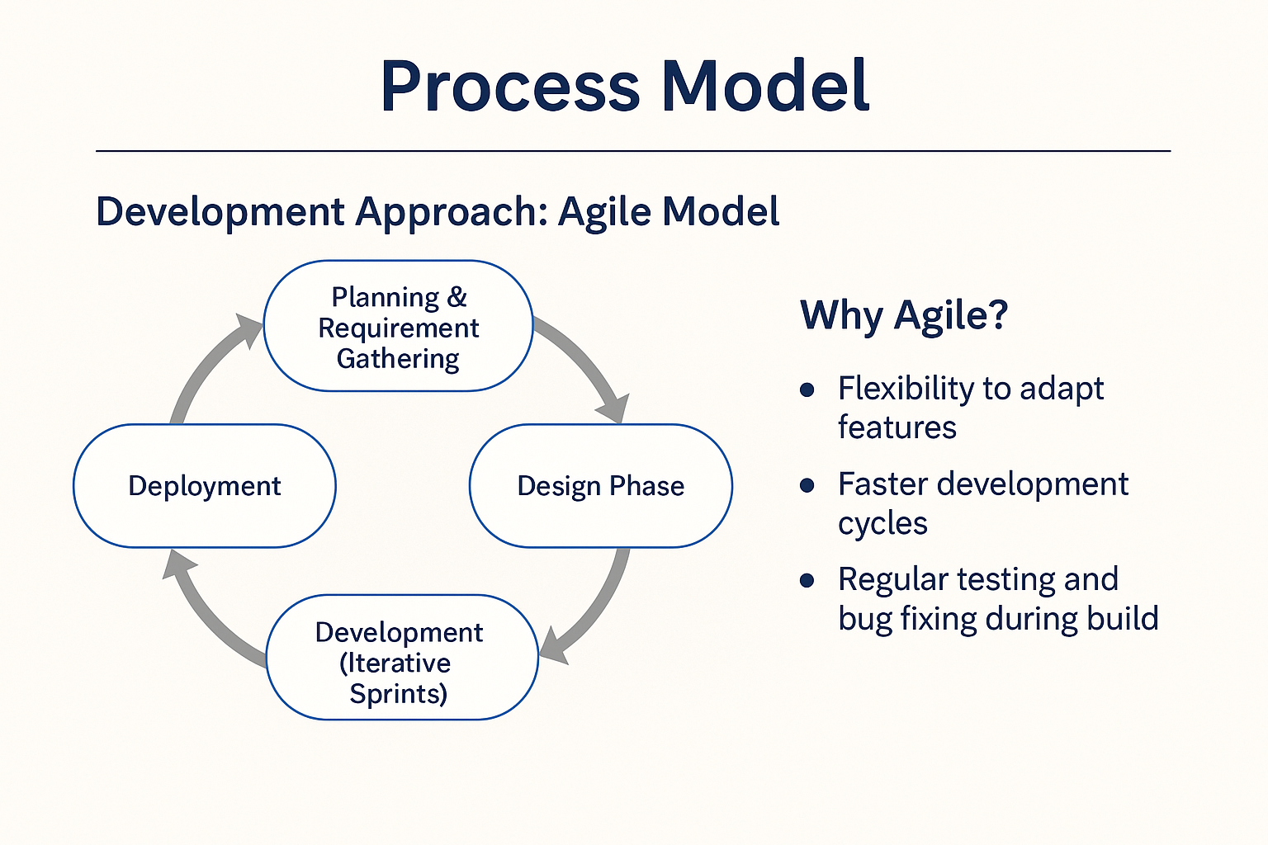
Process Model

Slide 5
Software Specification Requirement
Functional Requirements
User Auth (JWT): Register, login, logout
Admin Control: Add/edit/delete news
User Feed: View and react (like/dislike) to news
Search/Filter: Find news by keywords/categories
Real-Time Updates: Via Socket.IO
Non-Functional Requirements
Performance: Fast load times
Scalability: Handles growth in users/content
Security: Password hashing, JWT protection
Usability: Mobile-friendly, intuitive UI
Reliability: Stable with minimal downtime

Slide 6
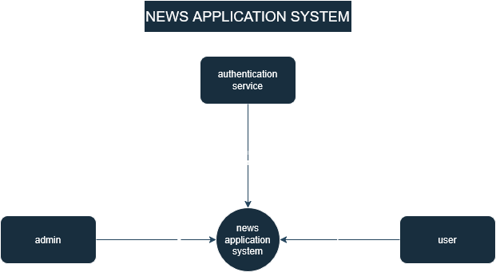
Data Flow Diagram
Level 0

Slide 7
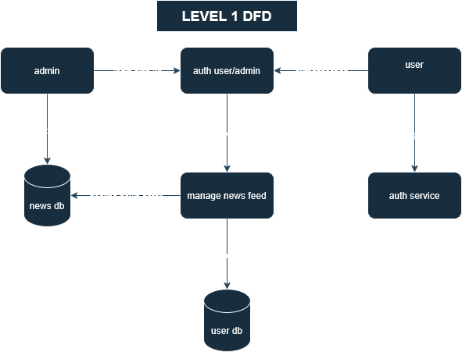
Level 1

Slide 8
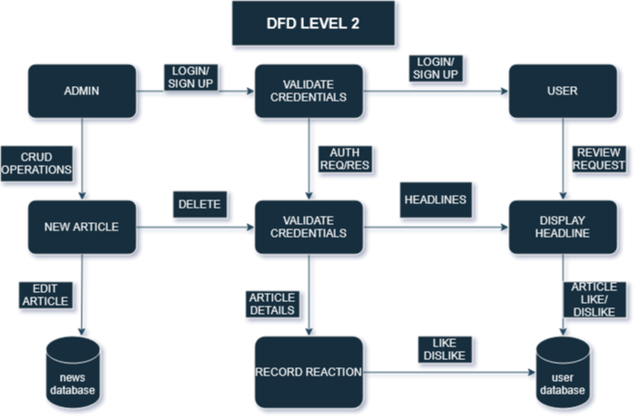
Level 2

Slide 9
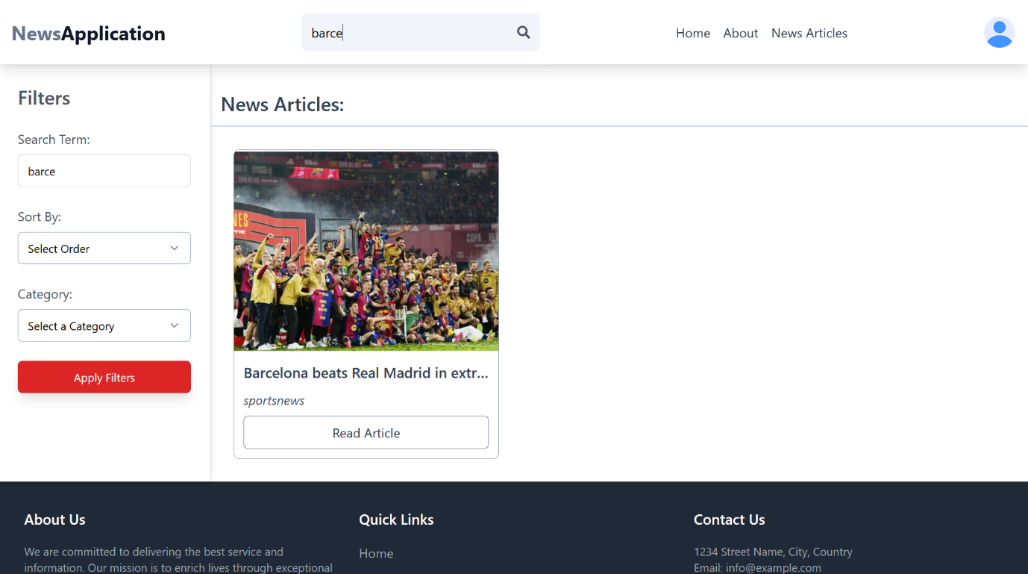
Screenshot

Slide 10
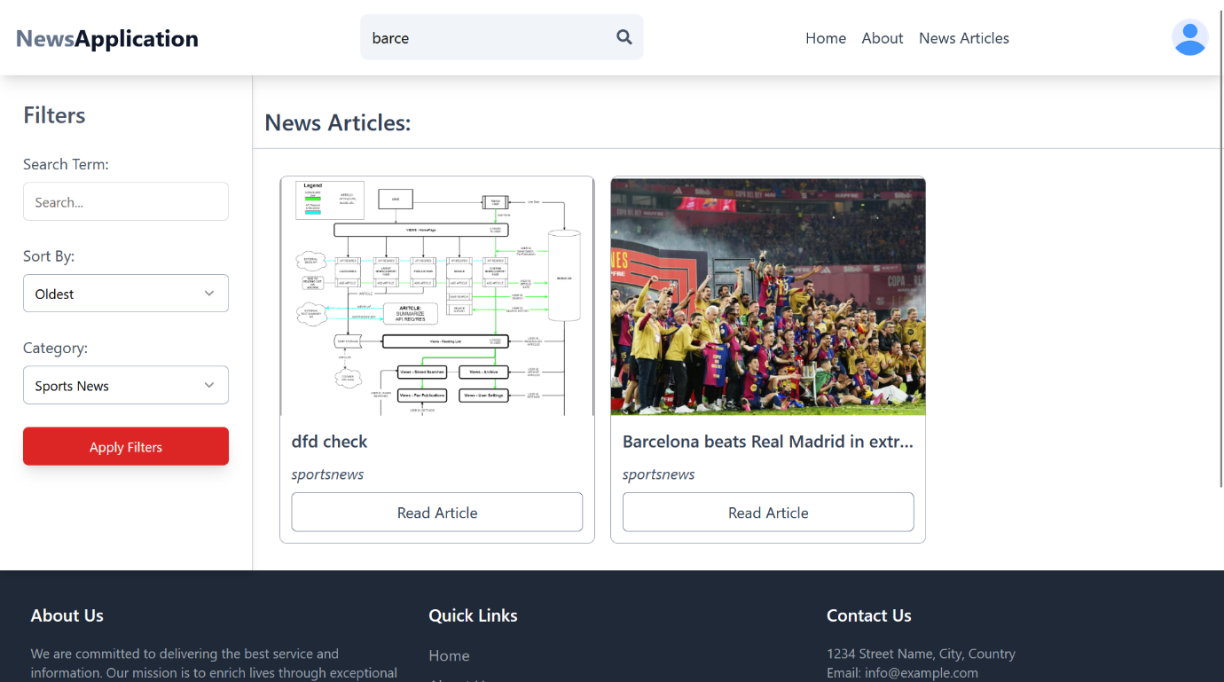

Slide 11
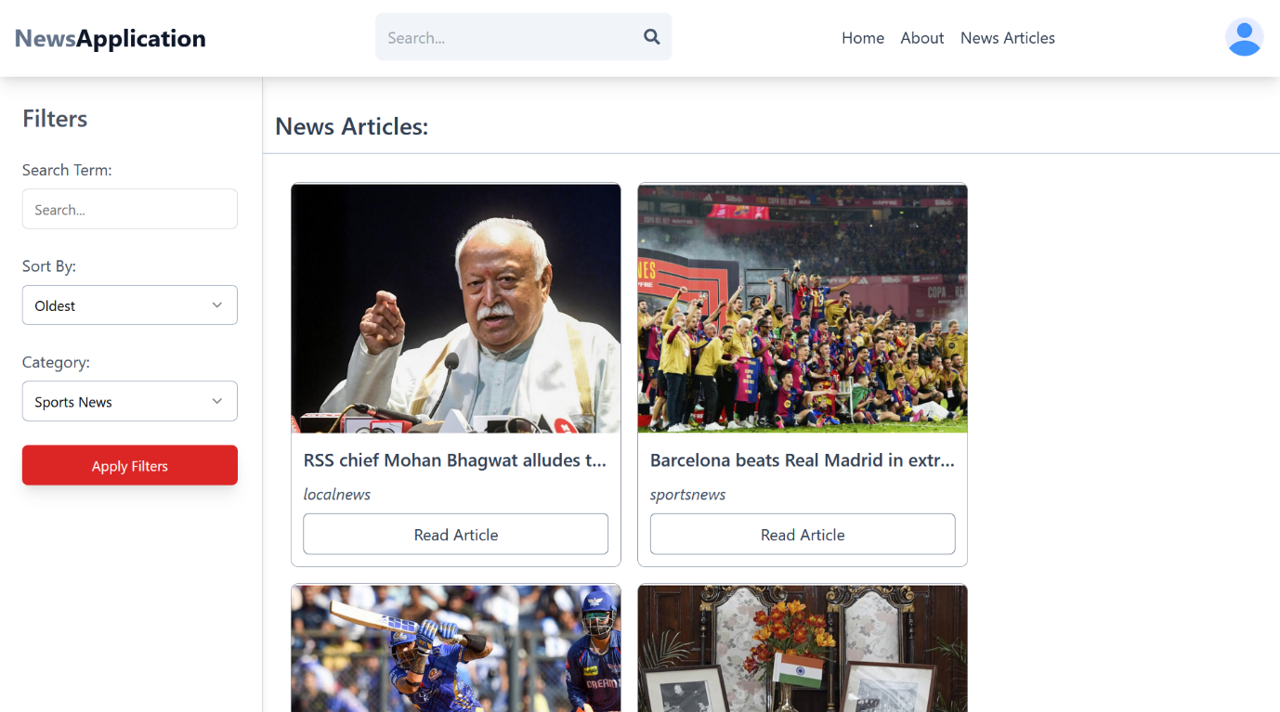

Slide 12
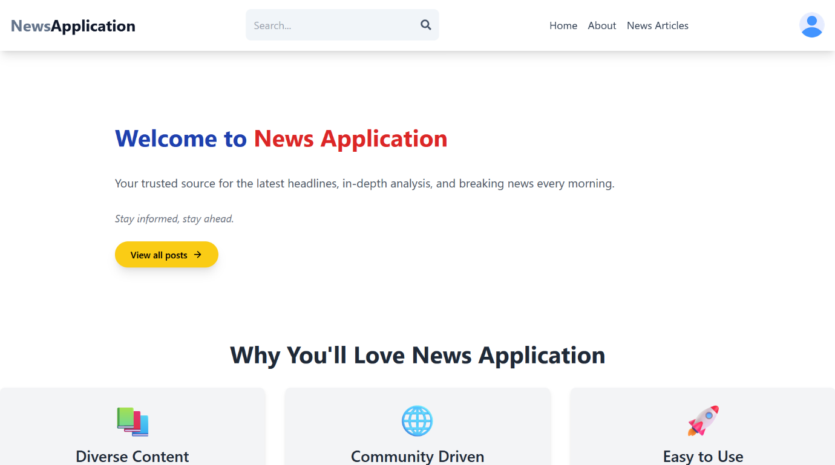

Slide 13
Conclusion
Learned Full-Stack Development through a real-world use case.
Implemented secure user authentication and admin content control.
Achieved real-time interactivity using Socket.IO.
Improved understanding of scalable and responsive design.
Project demonstrates how technology can enhance news delivery and user engagement

Slide 14
Future Scope
Category-Based News Curation
Add auto-categorization using machine learning or APIs.
Multilingual Support
Deliver news in multiple languages to reach a broader audience.
Push Notifications
Notify users about breaking news or custom alerts.
User Comments & Discussions
Enable interaction through comments on news posts.
Analytics Dashboard (Admin)
Track views, reactions, and user engagement in real time

