Slide 1






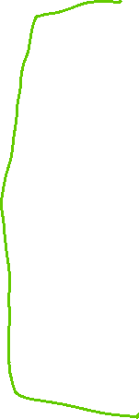







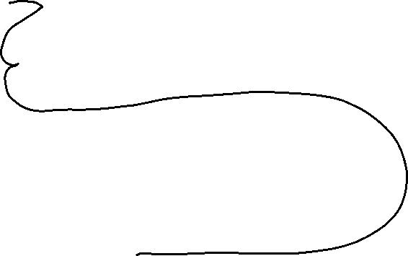


















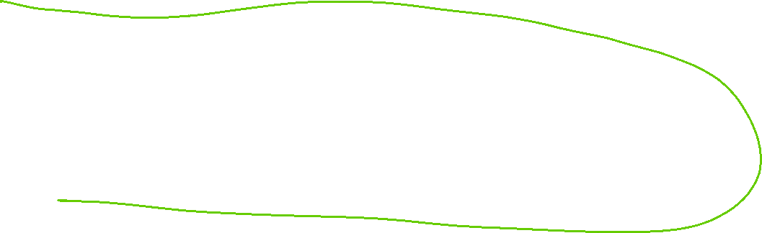
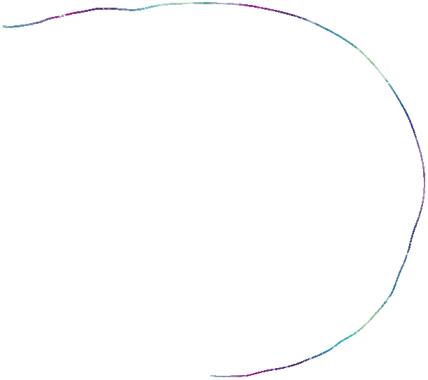

Slide 2
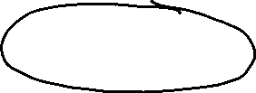















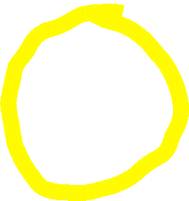




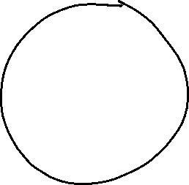







Slide 3






















Slide 4

















Slide 5




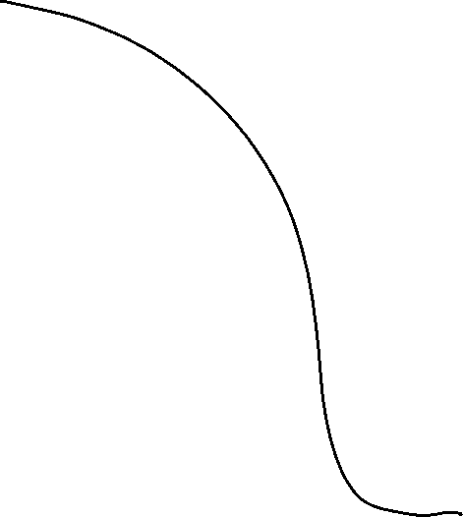


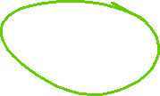

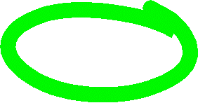
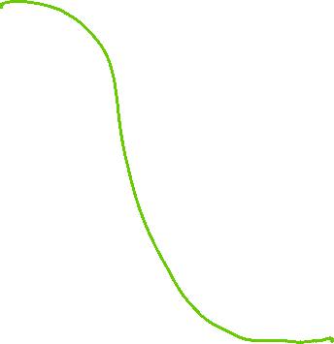









Slide 6

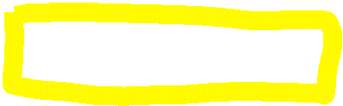








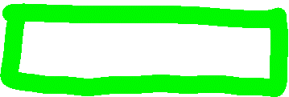

















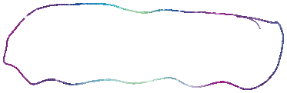





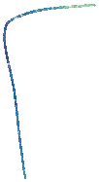

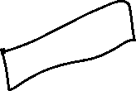













Repository Pattern

Slide 7








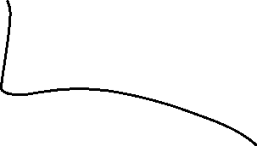









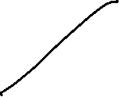
















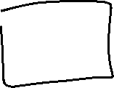


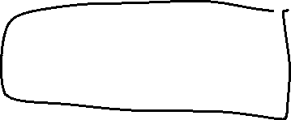



Slide 8

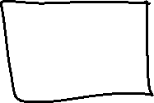





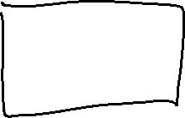
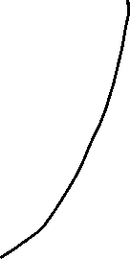




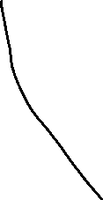




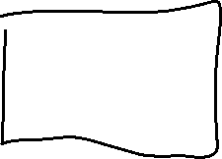
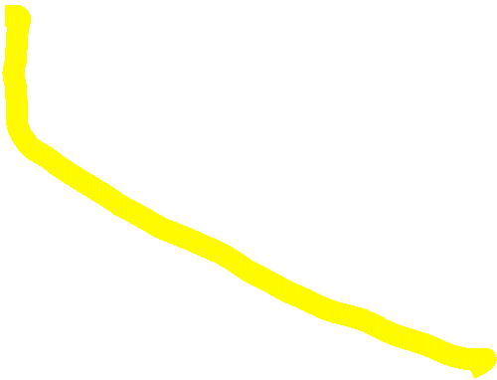
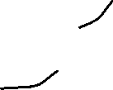



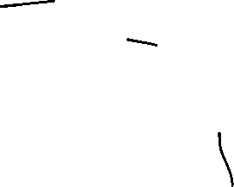
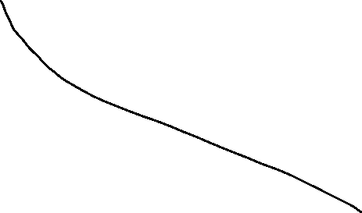
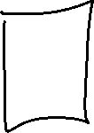

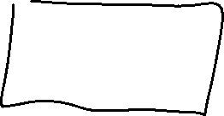


Slide 9








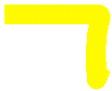


UI
(Views – Controllers)
Models(Library Project)
Business Logic (Library Project)
Context (Db Access)/Repository (Library Project)

Slide 10




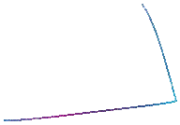


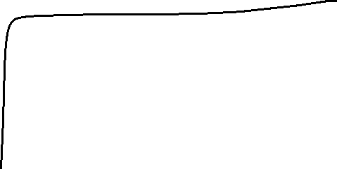





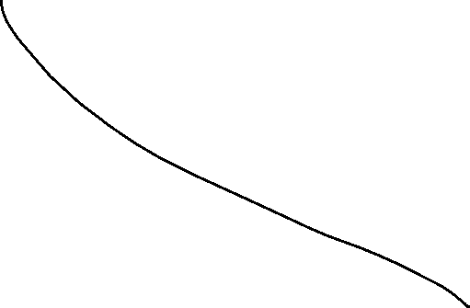




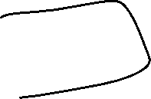














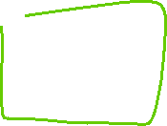











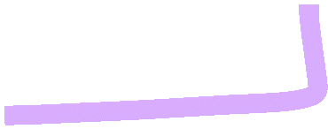



Slide 11



















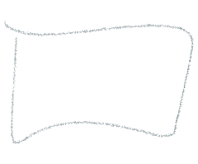



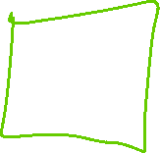







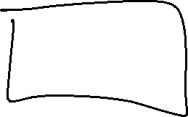













Slide 12
User on his computer
Angular Front-end Website(.js, .html, .css)
Interwebs
API – checks is the request is valid
Components in a FE with API structure.
EF Context
Azure Database only allows connection with apps that have the connection string

Slide 13
businesslayer
elephantSql
businesslayer
Repo layer(Azure)
API
MvcLayer
Angular uses Httprequest obj to package, serialize, etc
Models layer
elephantSql
Angular

Slide 14
App Root Module
/Players (component)
Click a button to show players list
/Admin
*ngIf=“playerlist” View players (component)
*ngFor = “player of players”
login (component)

Slide 15







App (Root) Module
<router-outlet></router-outlet>
playerservice
Button on home component that routes to playerlist
Landing page is the home component
A Button on home component that routes to playerlist
playerlandingpage
/playerlist (component)
Chosen player data transferred to playerDetails
Playerdetails
Only displays when player != null.
Addplayercomponent
Only displays when

Slide 16






















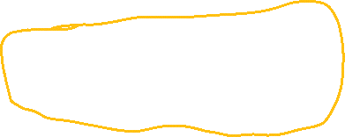











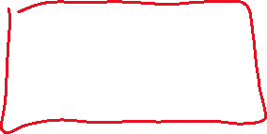
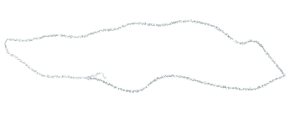




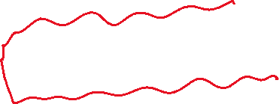













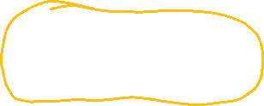
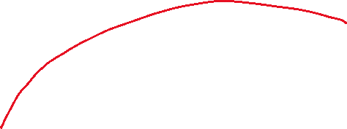










Friend can run the app in a container built from the image.

Slide 17






























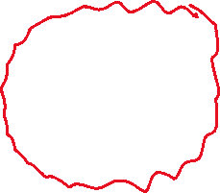















Slide 18










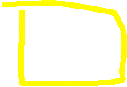








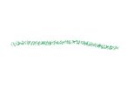























































Docker Compose
Each container has it’s own ports. These parts are mapped to a publicly available port. Any other app wanting access to the app running inside the container uses the public port. Docker engine transmits the daa to the containers port.

Slide 19
What is a Stack?
A stack is a First in last out data structure (FILO)
-- PrintStack() will ‘unwind’ the stack
Unk2 – Peek() tells me who is on top of the stack
Unk – Push() adds to the top of the stack only.
Maya - Pop() take the last added name off the stack
Hopie
Ethan
Arely
Mark

