Slide 1
C# Inheritance
Brian Corbett

Slide 2
What is Inheritance?
One of the 4 pillars of Object-Oriented Programming (OOP)
When a child class (derived class) reuses members of a parent class (base class)
The child class can also extend or modify behavior inherited from the parent class

Slide 3
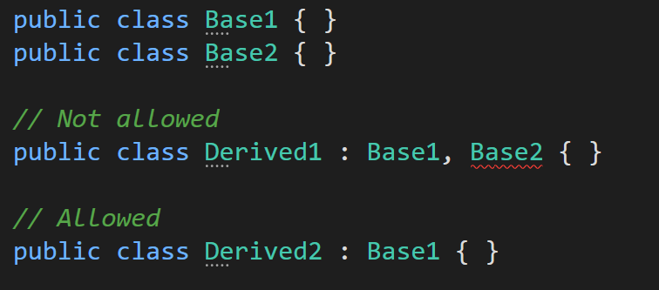
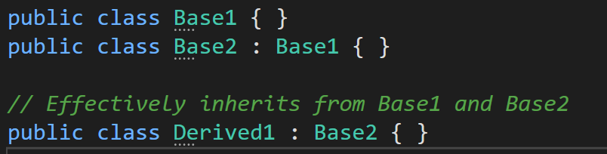
How to use C# Inheritance
A derived class can only inherit directly from one base class
Multiple Inheritance
Single Inheritance
Inheritance is transitive
Multilevel Inheritance

Slide 4
How to use C# Inheritance
One class can serve as a superclass, meaning it is the base class from which more specialized classes are derived. Hierarchical Inheritance
The C# Exception class is a good example:
Exception
SystemException
IndexOutOfRangeException
ArgumentException
ArgumentNullException
ArgumentOutOfRangeException
ArithmeticException
DivideByZeroException
OverflowException
ApplicationException

Slide 5
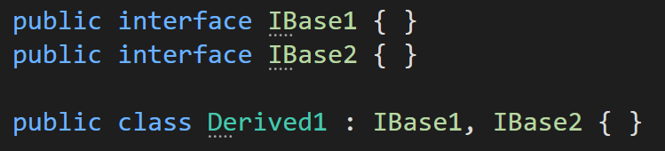
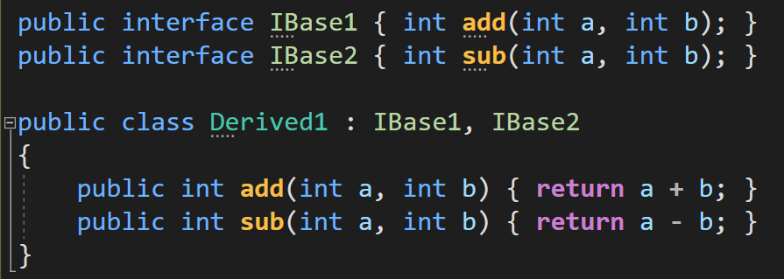
How to use C# Inheritance
A class can inherit from multiple interfaces
A class would then need to implement each method declaration in all of the interfaces
Structs, enums, and delegates do not support class inheritance

Slide 6
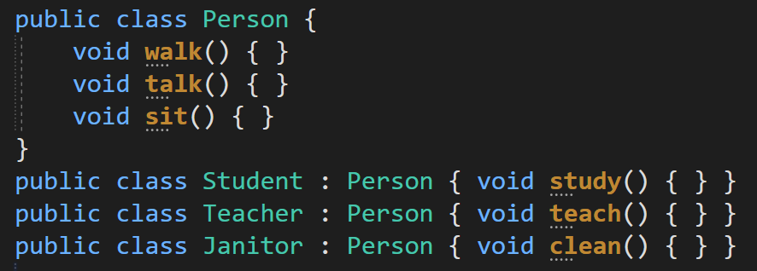
How to think about C# Inheritance
It’s best to use inheritance when the base class and derived class have an ‘is a’ relationship
Derived is a Base → Car is a Vehicle
The derived class should be a more specialized implementation of the base class

Slide 7
C# Inheritance and Access Modifiers
Private members of a base class are only visible to a derived class if it is nested in the base class
Protected members of a base class are only visible to any derived class
Public members of a base class are visible to and are public in a derived class
Sealed classes cannot be inherited from
Base class constructors are not inherited by a derived class; each class must define their own constructor

Slide 8
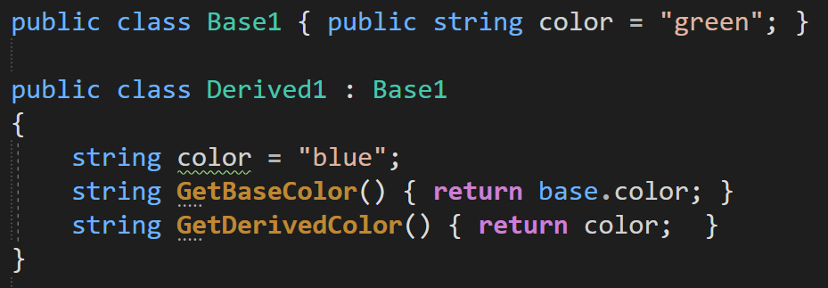
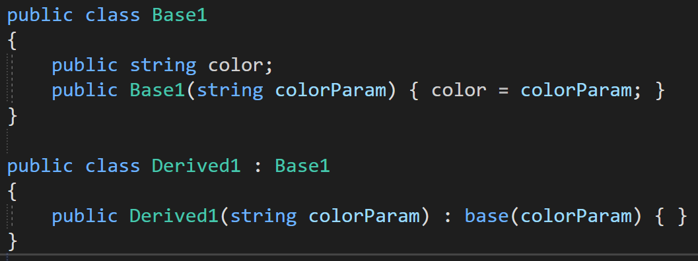
How to call the base class constructor - base()
To refer directly to a base class from a derived class, use the base keyword
It’s also possible to call a base class’s constructor explicitly with the base keyword
Hiding a base class member

Slide 9
References
https://www.geeksforgeeks.org/inheritance-in-c/
https://docs.microsoft.com/en-us/dotnet/csharp/fundamentals/
object-oriented/inheritance#:~:text=
Week 1 - .NET Object Oriented Programming PDF

