Slide 1
Console application for Golfs-a-lot
By
Brian Corbett

Slide 2
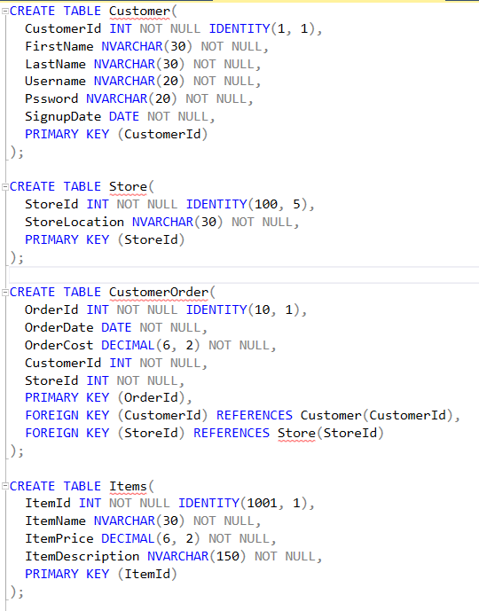
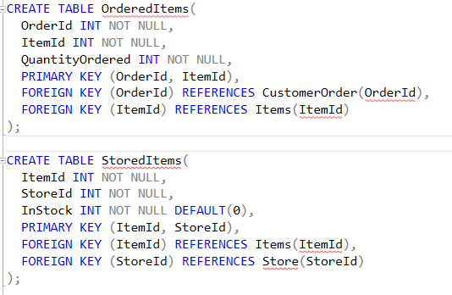
Database in 3NF

Slide 3
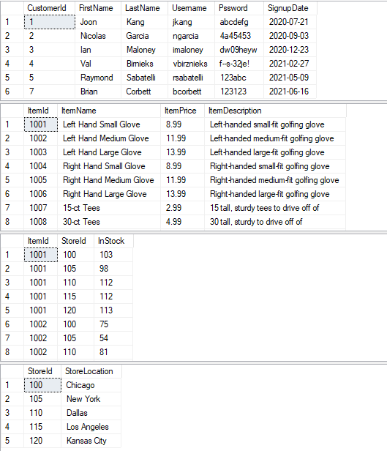
Seed database

Slide 4
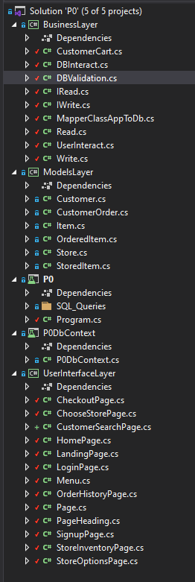
Repository pattern

Slide 5



Initial Customer table

Slide 6
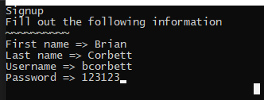
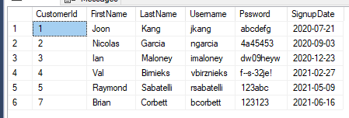
Signup new customer and modified Customer table

Slide 7

Signup info is cleaned, and validated
Cleaning

Slide 8
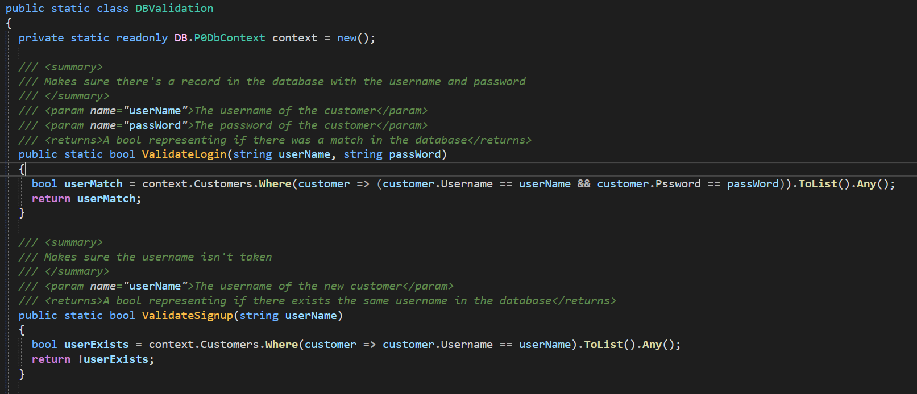
Validating

Slide 9

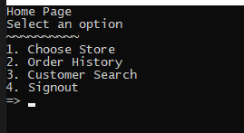
Login with new account

Slide 10





Customer search

Slide 11

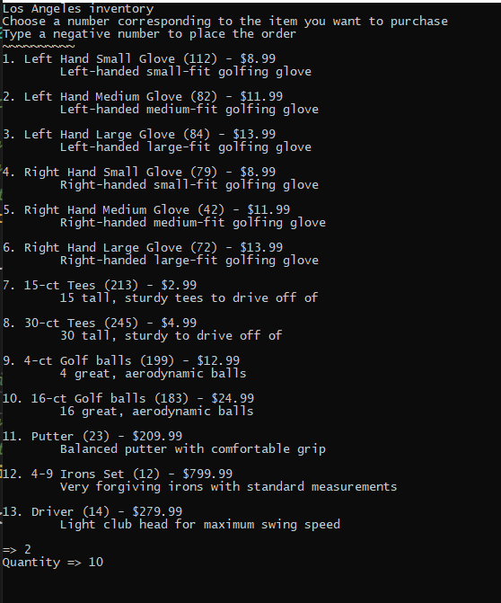
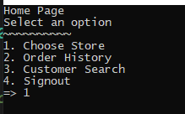
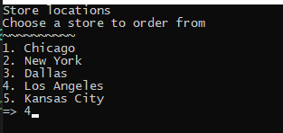
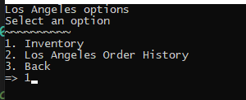
Initial Orders table

Slide 12

Ordering items

Slide 13



Order history

