Slide 1
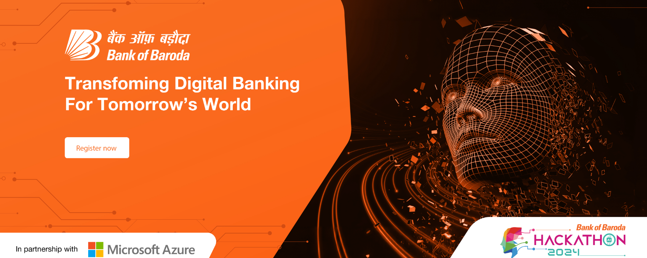

Idea Submission Bank of Baroda Hackathon 2024
Team “ARC”
Project Title:-ARC:- Advanced Risk Calculator System.
Team ARC is a group of problem-solvers determined to revolutionize credit risk assessment in the Indian banking sector.
GitHub Repository
Date : 30/06/24

Slide 2
Problem Statement?
Why did you decide to solve this Problem statement?
We decided to work on this problem statement because one of the most loss incurring operations of a bank includes the credit /loan granting division due to a host of reasons such as common negligence, collusion ,political connections, inability of human brain to make a sound decision on the basis of multiple contrasting factors and so forth. Hence, high profile cases of loan defaults are rampant in our country. Therefore,it is of paramount importance that we establish a system, preferably automated ones which can prevent such slip ups or warn the upper management if there’s some anomaly when it comes to credit granting. That’s exactly what we aim to solve!
We plan to create an artificial neural network(ANN) which would take into consideration various parameters such as college of graduation, highest degree, current salary, relationship status, parent's earning, land owned,stock-portfolio owned and so on and give an overall score .The higher the score, the higher the chance that the loan in consideration will not be a bad one.
The salient features are:-
Enhancing Risk Management Capabilities: It's critical for the banking sector to ensure stability and compliance.
Leveraging Generative AI: Provides advanced predictive insights, enabling proactive risk mitigation.
Improved Decision-Making: Effective risk management reduces financial losses and increases stakeholder’s trust.

Slide 3
Pre-Requisite
What are the alternatives/competitive products for the problem you are solving?
Traditional Models: Current similar pre-existing models are using logistic regression or decision trees algorithm.
Machine Learning Platforms: SAS Risk Management, IBM Risk Analytics, and Oracle Financial Services Analytical Applications comes under such pre-existing models.
Fintech Solutions: Fintech companies like PolicyBazaar offering predictive analytics for credit scoring and risk assessment.
A quick google search would lead to these products/solutions but what exactly makes our solution different is that no Indian bank has actively used an in-house ML model on a regular basis to enhance their decision making skills ensuring both data safety and performance.

Slide 4
Tools or resources
Azure tools used:-
Azure Machine Learning: For building, training, and deploying the ANN model.
Azure Data Lake Storage: For storing and processing large datasets.
Azure Synapse Analytics: For integrating big data and advanced analytics.
Azure Cognitive Services: For additional AI capabilities, such as anomaly detection.
Azure Security Center: For ensuring the security and compliance of the solution.

Slide 5
Our Solution: An in-depth view.
Methodology:
Collect and preprocess data from bank branches present pan India.
Train our Artificial Neural Network (ANN) model to predict credit scores based on input parameters.
Continuously updating the model with new data and the result of loans granted previously using the model to ensure there's a corrective active feedback mechanism.
Architecture:
Data ingestion through Azure Data Lake Storage.
Data processing and model training in Azure Machine Learning.
Real-time risk assessment using Azure Synapse Analytics.
Seamless integration with server side of current digital banking systems for actionable insights for lenders.
Scalability:
Utilize Azure's scalable infrastructure to handle increasing data volumes and user requests.
Deploy the solution across multiple regions for global reach which can also also grow to a SAAS .

Slide 6
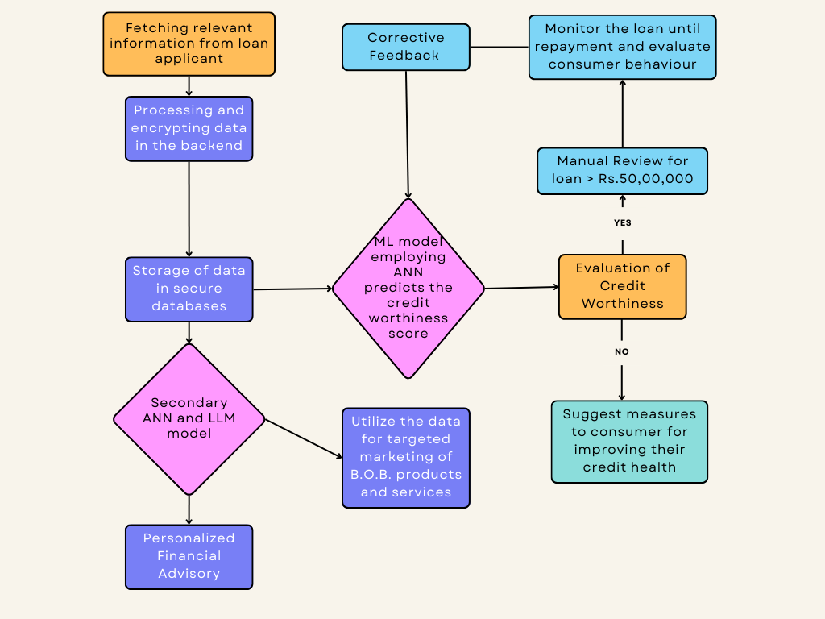
Process Flow Diagram

Slide 7
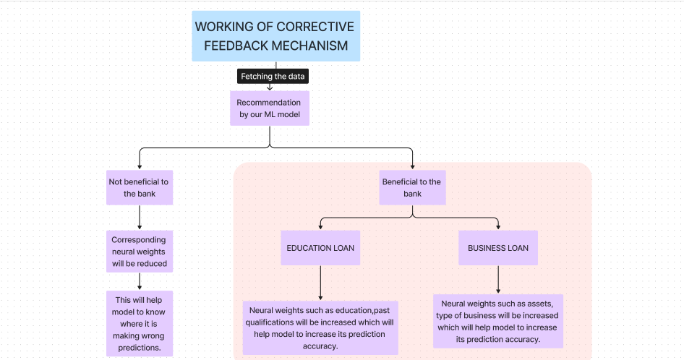
ANN Logic behind our Model

Slide 8
Key Differentiators & Adoption Plan
Key differentiators:
Use of ANN over traditional ML models: for more accurate risk predictions.
Highly tailor-made for Indian customers: Both in terms of the training dataset and the parameters included such as crisis scenarios, fuel prices, local inflation rate, and India's position in conflict situations.
Self improving AI model: We are using GEN-AI to enhance credit granting decisions through a corrective feedback mechanism. The bank will evaluate whether previously approved loan was beneficial, allowing us to continuously refine our model.
Other features:
Seamless integration with existing banking apps through Azure Cloud Solutions.
Scalable and secure infrastructure provided by Azure.
Adoption Strategy:
Pilot the solution with select bank branches.
Demonstrate success through case studies, ROI analysis and reduced % of bad loans.
Launch the service on a pan India level after its effectiveness is confirmed.

Slide 9
Product Impact & Viability.
Expansion Potential: Our model can be extended to beyond credit risk to include more market related parameters like repo rates.inflation rates,fuel prices ,war situations etc to make even more informed predictions.
User expansion: Can be used as a SaaS by different partner financial institutions and regulatory bodies to monitor lending activities by bank officials.
Killing two birds with the same stone: We can use the insights by our model to fuel similar ANN and LLM models which will be able to generate personalized financial advisory (Challenge 5) and personal content and marketing strategies (Challenge 6).The output of our main ANN model can be used by our secondary ANN and LLM models to generate personalized content and financial advisory.

Slide 10
Business Potential and Relevance
Credit Scoring and Loan Approval:Fast,highly accurate credit score and good loan maximization.
Fraud Detection: Enhanced detection of fraudulent loan requests by the model.
Reduction in losses from Bad loans: due to more informed lending.
Software as a Service: We can extend our services to other financial institution to generate revenue.
Provide insights into the national money lending landscape: Anonymised Data collection to help government and financial regulatory organisations to monitor money lending activities.
Personalised data driven financial advisory and marketing:boosting customer engagement with the banking apps leading to improved customer conversion rates and drastic decline in customer acquisition costs(CACs).

Slide 11
Uniqueness of Approach and Solution
Comprehensive Risk Assessment: Our model seemingly integrates multiple kinds of data including income, qualifications, college, highest degree, and assets and so on to evaluate loan eligibility.
Real time analysis : It boasts real-time prediction capabilities and it is helpful in providing immediate loan recommendations.
Feedback Mechanism: Our system’s Adaptive learning approach makes our model unique. After the pre-defined loan tenure, the bank will provide feedback to the model whether granting the loan was beneficial. This information helps the model learn from past outcomes leading to increased accuracy.
Double edged Sword: Assess your credit scores along with targeted marketing of B.O.B. products saving time and computation effort.
By combining these elements, our GEN-AI solution ensures more accurate, data-driven lending decisions, adapting over time to improve risk assessment and customer satisfaction.

Slide 12
User Experience
Improved Decision Accuracy: The use of generative AI allows us to improve model’s predictive accuracy by feedback mechanism and ultimately offering a more reliable model for lending loans.
Reduced Financial Losses: From the bank's perspective, our solution significantly reduces financial losses by enhancing loan decision accuracy, minimizing defaults, and optimizing overall risk management. This not only leads to more secure lending practices but also increases the trust of investors.
Increased Customer Trust and Satisfaction:
Our solution enhances the user experience by providing personalized, data-driven loan recommendations based on comprehensive risk assessments.
With real-time analysis and feedback mechanisms, customers will receive tailored advice and most viable product recommendations, that evolve over time, ensuring more accurate decisions and it will also guarantee a smoother loan application process.
Processing time
Reduce loan approval time by more than 50%, from an average of a month to 15 days.
Real-time loan status updates via SMS and app notifications

Slide 13
Scalability
Automatic Scaling: Leverage Azure's cloud infrastructure.
Optimized ANN Model: For performance and efficiency in use of compute power.
Distributed Computing: To handle large datasets and high user demand by use of Azure’s distributed Cloud servers .
Scalability Testing:To ensure the system can handle peak loads across India. We will conduct stress tests simulating 5x normal transaction volume.

Slide 14
Ease of Deployment and Maintenance
User-Friendly Platform: Azure provides ease of deployment and management for the bank officials .
Automated Updates: Model updates and maintenance using Azure Machine Learning.
Comprehensive Support: Documentation and support from Azure.
Automatic updation of ANN weights : using corrective feedback mechanism ensuring seamless improvement of the model.

Slide 15
Security Considerations
Data Anonymity: Dataset fed to the model will be nameless and it will not be possible to associate any data with any individual.
Data encryption: At rest and in transit. Data is stored in databases with industry standard hashing and encryption protocols.
Regulatory Compliance: With industry standards (e.g., GDPR, PCI DSS).
Security Audits: Regular assessments and vulnerability checks by ML and cyber security experts.
Access Control: Role-based access control and multi-factor authentication.

Slide 16
Thank You Bank of Baroda for the opportunity!
Team ARC
Hemant Porwal
Krish Kahnani
Snehanshu Pal
Aditya Krishna Jaiswal (LEADER)

