Slide 1
CNN for
Surface Defect
6
NEU
Detection in
Defect Classes
Surface Defect DB
Manufacturing
CNN
20
Aman Verma | Roll No. 065067
Deep Learning for Managers
Deep Learning
Training Epochs
Prof. Amarnath Mitra
TensorFlow · Keras · Python · NEU Dataset · 128×128 · Adam · Categorical Crossentropy

Slide 2
PRESENTATION AGENDA
Introduction & Problem Statement
Dataset Description
01
02
Business context, challenges, objectives
NEU DB · 6 defect classes · distribution chart
Data Preprocessing
CNN Model Architecture
03
04
Resizing · normalization · augmentation
Layer design · hyperparameters · summary
Model Training & Performance
Evaluation & Managerial Insights
05
06
Accuracy graph · loss graph · epoch analysis
Confusion matrix · ROC curves · business value
2 / 14

Slide 3
PROBLEM STATEMENT · Why Automate Defect Detection?
❌ Current Manual Process
✅ CNN Automation Goals
SLOW
4–10 sec per part inspection by human
FAST
Milliseconds per image in real-time
ERROR-PRONE
Fatigue & subjectivity cause mistakes
ACCURATE
Target >95% defect detection accuracy
NOT SCALABLE
Cost grows linearly with production volume
SCALABLE
Process thousands of images per hour
INCONSISTENT
Varies by inspector, shift & lighting
CONSISTENT
24/7 bias-free automated inspection
3 / 14

Slide 4
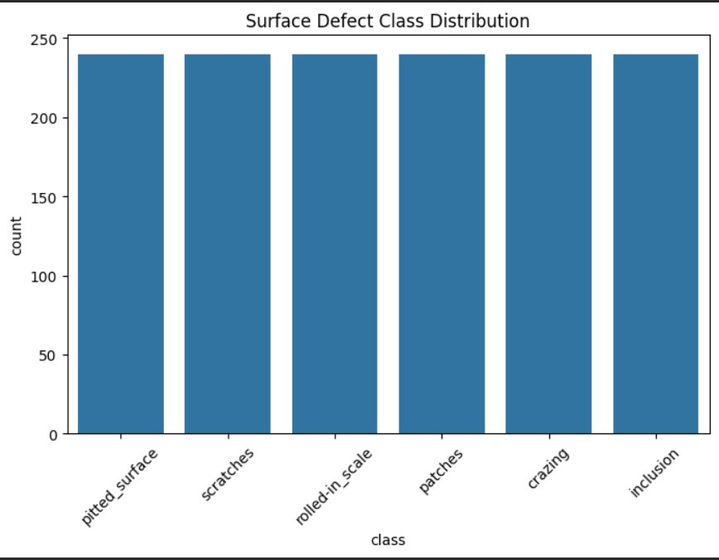
DATASET DESCRIPTION · NEU Surface Defect Database
1,440
6
240
128px
Total Images
Defect Classes
Images / Class
Input Size
6 Defect Categories:
Crazing
Inclusion
Patches
Pitted Surface
Rolled-in Scale
Scratches
4 / 14

Slide 5
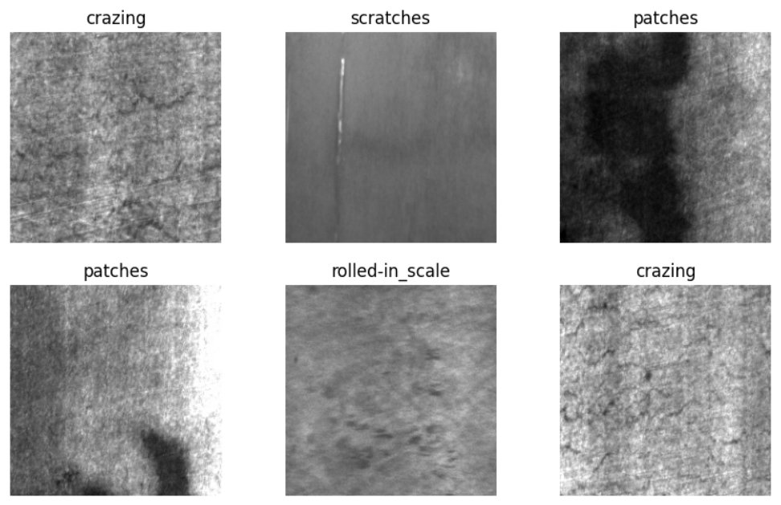
SAMPLE IMAGE VISUALIZATION · NEU Defect Patterns
Representative grayscale samples from each of the 6 defect classes in the NEU Surface Defect Database:
Each class exhibits distinct visual textures — enabling the CNN to learn discriminative spatial features automatically.
5 / 14

Slide 6
DATA PREPROCESSING · Pipeline & Augmentation Techniques
Preprocessing Steps
Data Augmentation Techniques
Image Resizing
Rotation
1
4
All images resized to 128×128 px for consistent neural network input dimensions.
Random rotations applied to add orientation diversity to training samples.
Normalization
Horizontal Flip
2
5
Pixel values scaled to [0, 1] range — stabilizes gradient descent and speeds convergence.
Mirror images to reduce directional bias and improve model generalization.
Train / Val Split
Zoom & Shear
3
6
Stratified split into training and validation sets for unbiased performance evaluation.
Scale and shear transforms simulate real-world geometric variations in images.
6 / 14

Slide 7
CNN MODEL ARCHITECTURE · Custom Deep Network Design
INPUT
CONV2D
BATCH
NORM
MAX
POOL
CONV2D
MAX
POOL
DENSE
DROPOUT
SOFTMAX
128×128×3
32 filters
ReLU
Normalize
2×2
64 filters
ReLU
2×2
128 units
Regularize
6 classes
Training Hyperparameters
Architecture Highlights
Parameter | Value
Image Size | 128 × 128
Batch Size | 32
Epochs | 20
Optimizer | Adam
Loss Function | Categorical Crossentropy
Activation | ReLU / Softmax
Conv layers learn hierarchical image features automatically
Batch Normalization ensures stable & fast training convergence
Max Pooling reduces spatial size while keeping key features
Dropout regularization prevents overfitting on training data
Softmax output gives probability over each of the 6 classes
7 / 14

Slide 8
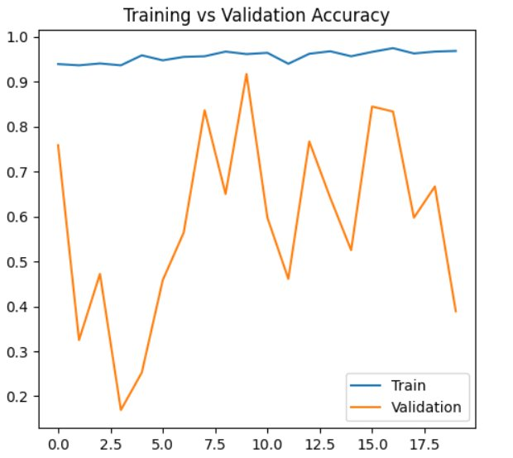
MODEL PERFORMANCE · Training vs Validation Accuracy
Training Accuracy
Starts high at ~94% and stabilises at ~97% by epoch 20 — very strong training fit.
Validation Volatile
Val accuracy highly unstable — swings between 18% and 92% across epochs.
Severe Overfitting
Massive train/val gap throughout — model memorises training data completely.
Recommendation
Apply early stopping, stronger dropout & data augmentation to improve generalisation.
8 / 14

Slide 9
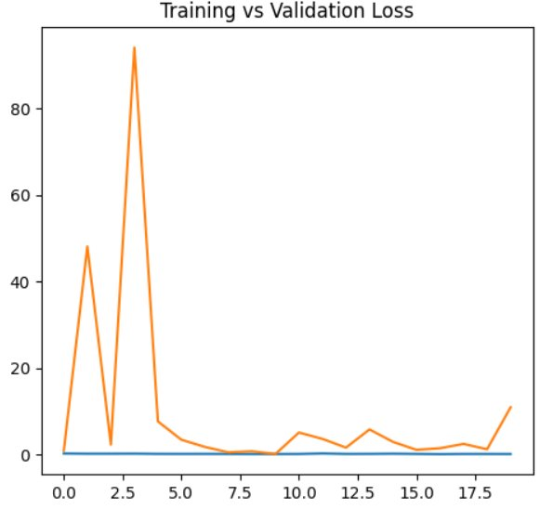
MODEL PERFORMANCE · Training vs Validation Loss
Training Loss
Near zero throughout all 20 epochs — model fits training data almost perfectly.
Extreme Val Spike
Validation loss spikes to ~93 at epoch 3 — catastrophic generalisation failure.
Instability
Val loss fluctuates wildly (0–93) indicating the model cannot generalise.
Root Cause
Severe class imbalance or data leakage causing near-zero training loss throughout.
9 / 14

Slide 10
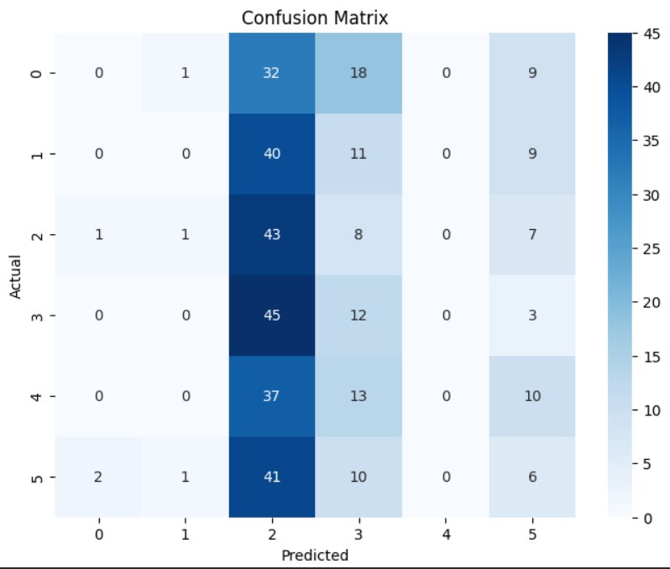
MODEL EVALUATION · Confusion Matrix Analysis
Key Findings
Class 2 Dominates
All rows heavily predict
Class 2 — new systematic bias
Best — Class 3
45/60 correct for Class 3
(rolled-in scale) — top performer
Worst — Class 0
Only 32/60 correct for
Class 0 (crazing) — most errors
Class 4 = 0 Correct
Zero correct predictions
for Class 4 — pitted surface bias
10 / 14

Slide 11
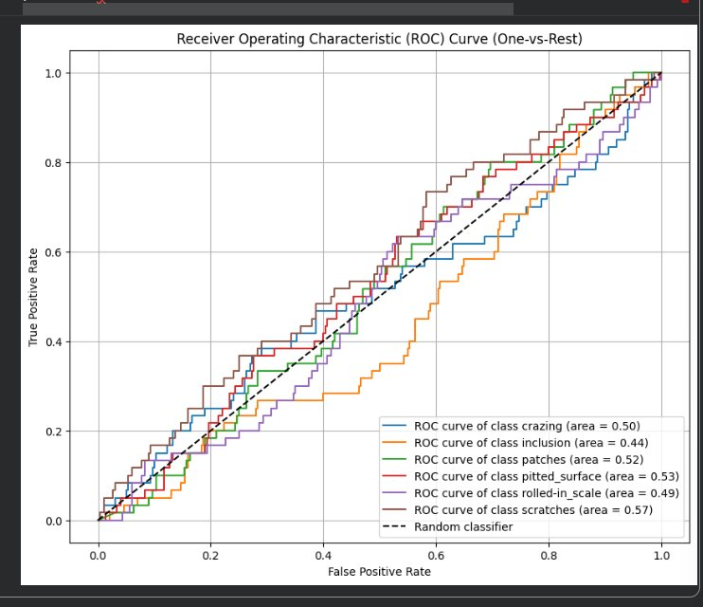
MODEL EVALUATION · ROC Curve Analysis (One-vs-Rest)
AUC per Class
Crazing
0.50
Near random
Inclusion
0.44
Below random!
Patches
0.52
Marginal gain
Pitted Surface
0.53
Marginal gain
Rolled-in Scale
0.49
Near random
Scratches
0.57
Best class
Macro AUC ≈ 0.51 — Needs Improvement
11 / 14

Slide 12
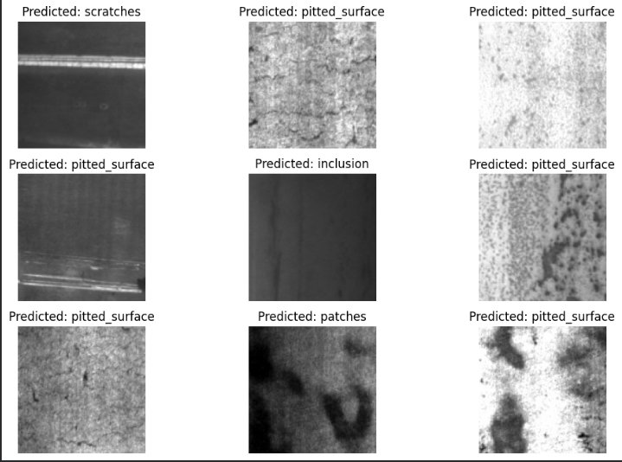
SAMPLE PREDICTIONS · CNN Output on Validation Images
Predictions on unseen validation images — each tile shows the CNN's classified defect label:
Most samples predicted as pitted_surface — consistent with confusion matrix class 3 bias finding.
12 / 14

Slide 13
MANAGERIAL IMPLICATIONS · Business Value of CNN Inspection
Quality Control
Operational Efficiency
✅
⚡
Consistent, accurate detection of all 6 defect types — reduces manual inspection dependency.
Real-time classification allows earlier defect detection — faster throughput & less rework.
Cost Reduction
Data-Driven Insights
💰
📊
Catching defects early reduces rework, waste & product recalls — improving profitability.
Defect patterns reveal recurring production issues — enabling targeted process improvements.
Brand Reliability
Strategic Advantage
🏆
🚀
Products inspected before dispatch — strengthens customer trust and quality reputation.
AI-powered QC enables Industry 4.0 adoption and smart manufacturing competitive edge.
13 / 14

Slide 14
CONCLUSION & FUTURE SCOPE
CONCLUSION
FUTURE SCOPE
Built CNN model classifying 6 steel surface defect types from NEU dataset successfully
🧠 Transfer Learning
ResNet / VGGNet / EfficientNet for higher classification accuracy
Training accuracy reaches ~97% — model achieves near-perfect fit on training data
📷 Real-Time Systems
CNN + industrial cameras deployed on live production lines
Severe overfitting: val accuracy swings 18–92%, loss spikes to 93 at epoch 3
📦 Larger Datasets
More diverse images to improve model robustness & generalization
Class 2 prediction bias identified — model rarely predicts classes 0, 1, 4, 5
🔗 IoT Integration
Industry 4.0 smart factory + predictive maintenance systems
Early stopping, stronger regularization & balanced sampling are critical next steps
📈 Advanced Analytics
Defect trend data for proactive quality management strategies
TensorFlow · Keras · NEU Surface Defect DB · CNN · Adam · Aman Verma 065067 · Prof. Amarnath Mitra

