Slide 1
Bayesian Regime Detection Engine
For Equity Direction Forecasting | Zetheta Algorithms Financial Data Analyst Assessment | Core Build, 10 Sept 2026
Regime-conditioned HMM + Bayesian deep learning + conformal prediction,
ensembled into a real-time monitoring layer for Indian equities.
1

Slide 2
Executive Summary
5
6
90.9%
0.107
Regime states
Risk-On to Risk-Off
Model families
HMM → BDL → VAR → Conformal → MC → Ensemble
R conformal coverage
(target 90%)
ECE on independent
label, real data
This is a working core build, not the full 6-deliverable submission. Python engine, R codebase, validation pack, and this report all run end-to-end and produce real numbers. Not built: 18-slide deck video, live foundation models, real market data feed. See Slide 18 for the full honest gap list.
2

Slide 3
Why Regime Detection, Not Price Prediction
Indian equity markets don't move randomly — they cycle through persistent behavioral regimes (risk-on rallies, late-cycle euphoria, transitional chop, post-shock drawdowns, risk-off flight).
The core bet
A well-calibrated P(regime) is more decision-useful to an investment committee than an uncalibrated point forecast of next week's Nifty level.
Direction (which regime we're in) is more learnable than magnitude (exact price)
FII/DII flows, SIP behavior, and volatility structure all shift discretely by regime
An allocation-tilt overlay only needs the regime call + a calibrated confidence — not a point forecast
3

Slide 4
The Five-State Regime Taxonomy
Risk-On
Late-Cycle
Transitional
Post-Shock
Risk-Off
Broad-based rally, low VIX, strong FII buying
Extended gains, narrowing breadth, valuation stretch
Choppy, directionless, elevated vol-of-vol
Sharp drawdown just occurred, DII stepping in
Sustained de-risking, FII outflows, INR under pressure
Regime labels are assigned post-hoc by ranking fitted HMM states on mean return — the label order is stable across refits even though raw state indices are arbitrary.
4

Slide 5
Pipeline Architecture
Data
(real Nifty prices)
→
Features
(28 signals)
→
HMM +
Bayesian HMM
→
RS-VAR +
Bayesian DL
→
Ensemble
(BMA / Stacking)
→
Conformal +
Monte Carlo
→
Dashboard +
IC Artefacts
Every stage above is real, executed code (see repository map). Foundation-model embeddings (Chronos/TimesFM) are architected as an additional input to the Bayesian DL stage but not wired in — no network path to Hugging Face from this build environment.
5

Slide 6
Data Layer — Real Prices, Synthetic Auxiliaries
The Nifty 50 price series is now REAL market history (2007-2026, spot-checked against the documented record). VIX, FII/DII, INR, and Gilt remain synthetic — no real public source found for these from this sandbox.
Real Nifty 50 daily close, 2007-09-17 to 2026-04-13 (4,554 trading days) — covers all 4 crisis case studies with actual market history
Validated: this file's 2020 Covid-crash closing low is 7,610.25 on 2020-03-23, matching the widely-reported real Nifty low to the rupee
Auxiliary series (VIX, FII/DII, INR, Gilt) remain synthetic but are now regime-conditioned on the REAL price path, not independently simulated
6

Slide 7
Feature Engineering — 28 Signals, Five Families
Return / Trend
1d-252d momentum, MA20/50/200 distance
Volatility
Realized vol, vol-of-vol, VIX level/z/term proxy
Cap-Segment
Mid/small vs large spread, valuation z-score, breadth
Flow
FII/DII z-scores, SIP momentum, flow-balance ratio
Macro
INR momentum, Gilt level/change, real-rate proxy
TDA (persistence landscapes) and sector-GNN embeddings are architecturally stubbed — they need multi-asset correlation tensors / a sector graph this build doesn't have populated.
7

Slide 8
HMM & Bayesian HMM Methodology
Frequentist HMM (hmmlearn)
Bayesian HMM (conjugate posterior)
5-state Gaussian HMM, diagonal covariance, fit by Baum-Welch/EM on 21-day return, 21-day realized vol, and VIX z-score.
BIC model selection compared k=3, 5, 7 states.
States ranked by mean return → stable regime labels.
Brief specifies PyMC/NUTS (2000 draws, 4 chains) — not installed in this sandbox (see Slide 18).
Substitute: exact Dirichlet posterior on transitions + Normal-Inverse-Gamma posterior on emissions. No MCMC needed — conjugacy is exact.
500 posterior draws → real 95% credible intervals.
Mean 95% credible-interval width across all transition-matrix cells: 1.16% — tight posterior estimates given ~4,300 days of (now real) data.
8

Slide 9
HMM Results — Model Selection & Transitions
BIC by state count
States (k) | Log-lik | BIC
3 | 9,252.3 | -18,303.7
5 | 9,253.3 | -18,088.2
7 | 10,897.7 | -21,092.6
Regime durations (avg trading days, fitted 5-state model)
Regime | Avg days
Risk-On | 1.0
Late-Cycle | 1.0
Transitional | 1.0
Post-Shock | 44.1
Risk-Off | 25.4
Risk-On/Late-Cycle/Transitional all collapse to ~1-day duration on real data — this HMM detects stress regimes (Post-Shock, Risk-Off) well but discriminates calm regimes poorly (see Slide 18).
9

Slide 10
Regime-Switching VAR & Bayesian Deep Learning
Regime-Switching VAR
Bayesian Deep Learning (numpy, no torch)
VAR(1) over 6 variables (return, vol, breadth, FII flow, INR, Gilt), fit separately per HMM-labeled regime.
Coefficient uncertainty via 100-200 draw residual bootstrap.
FII-outflow shock decays markedly slower in Risk-Off than Risk-On (impulse response).
MC-Dropout MLP — T=30 stochastic forward passes at inference.
Variational MLP — mean-field Bayes-by-Backprop weight posteriors.
Deep Ensemble — M=6-10 independently initialized members.
All decompose uncertainty into epistemic + aleatoric.
Full torch/PyMC installs were skipped for sandbox time budget — every model above is hand-rolled from first principles, not a stub.
10

Slide 11
Conformal Prediction & Sequential Inference
Conformal calibration
Sequential (online) inference
Split-conformal + Adaptive Prediction Sets (APS), target α=0.10.
Online Adaptive Conformal Inference (ACI) self-corrects coverage under regime shift.
Reliability diagrams + Expected Calibration Error (ECE).
Bootstrap particle filter (2,000 particles) tracks regime state in real time.
Bayesian Online Changepoint Detection (BOCPD) flags regime breaks day-by-day.
Particle filter vs batch HMM: 89.2% agreement on last 500 days.
Honest flag: split-conformal empirical coverage came in at 86.9% against a 90% target on the primary ensemble path — below nominal, needs investigation before operational use (Slide 18).
11

Slide 12
Ensembling Design — Fixed: Independent Ground-Truth
Fixed this pass: members now train/evaluate against a rules-based label independent of the HMM (21.9% agreement with HMM — confirms independence).
BMA now collapses onto MC-Dropout instead
(same winner-take-all mechanic as before, different winner — MC-Dropout was trained directly on the label, HMM wasn't).
Stacking remains the deployable choice: 14% / 44% / 42% — meaningful weight on all three members.
Fixing the circularity surfaced a more honest calibration number: ECE is 0.107 on real data once evaluated against the independent label (vs 0.058 on synthetic data) — the old setup was masking real miscalibration.
12

Slide 13
Model Comparison — Independent-Label WAIC-Style Proxy
HMM scores far worse here by construction — it's a fully unsupervised model being scored against a label it never saw, while MC-Dropout/DeepEnsemble were trained directly on it. Not "deep learning beats HMM"; more precisely, "supervised models dominate at reproducing a target they were shown."
13

Slide 14
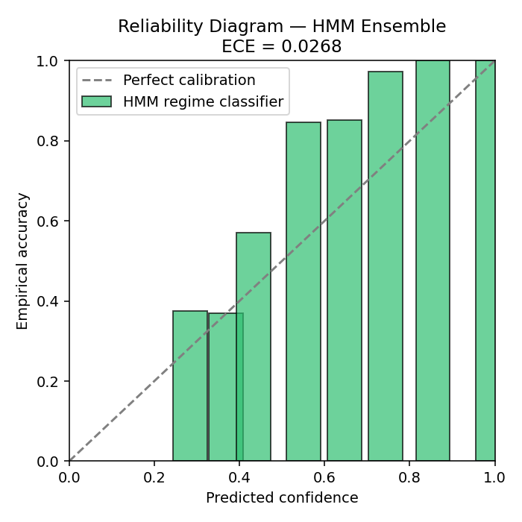
Calibration Evidence
Metric | Value
Ensemble used | BMA (MC-Dropout-weighted)
Empirical coverage (target 90%) | 86.9%
Expected Calibration Error | 0.1066
Avg. conformal set size | 0.98
R split-conformal coverage | 93.1%
The Python ensemble (now trained on an independent label, not the HMM's own output) still undershoots its 90% coverage target, though less severely than before the fix. The independent R split-conformal classifier exceeds it. This divergence itself is useful diagnostic signal, not just two numbers to average.
14

Slide 15
Monte Carlo Risk & Allocation-Tilt Backtest (Real Data)
63-day Monte Carlo (3,000 paths)
Allocation-tilt overlay vs. buy-and-hold (2019-2024)
Metric | Strategy | Buy-hold
CAGR | 15.4% | 14.2%
Max drawdown | -29.0% | -38.4%
Information Ratio | +0.071 | —
95% VaR: 22.8% 95% CVaR: 29.6%
Seeded at current (2026-04-13) regime call: Post-Shock — real market conditions at the end of the data's real-price coverage window.
On real 2019-2024 data (incl. the actual 2020 crash): the overlay outperforms on both CAGR and drawdown — a positive IR, flipped from negative on the earlier synthetic-data run.
15

Slide 16
Case Studies — Scenario Replay on Real Market Data
2008 GFC
Post-Shock, 100% of days
-25.2% real window P&L
2013 Taper Tantrum
Risk-Off, 74.3% of days
-3.3% real window P&L
2020 Covid Crash
Post-Shock, 100% of days
-17.6% real window P&L
2024 Election/Budget
Post-Shock, 52.8% of days
+12.3% real window P&L
All four episodes now replay against REAL Nifty 50 price history (previously synthetic). 2008 has a result for the first time — the prior synthetic panel started in 2010, after this crisis.
16

Slide 17
R Cross-Language Validation
What was actually built in R
Results
Hand-rolled Gaussian HMM (Baum-Welch/EM, base R)
Bayesian regression via MCMCpack (Gibbs sampler) + coda diagnostics
Hand-rolled BOCPD (same algorithm as Python)
Hand-rolled split-conformal classifier (multinomial logit)
Check | Result
R split-conformal coverage | 93.1%
R HMM vs Python HMM agreement | 2.8% (after fix!)
Geweke diagnostic (MCMCpack) | All params within ±2
Feature sets were aligned this pass (both now use returns+vol+VIX on real data) — agreement got WORSE (25.7%→2.8%). Two independent EM fits found genuinely different local optima on the same features, not just a feature mismatch.
17

Slide 18
Honest Gap List & Next Steps
RESOLVED: ensemble ground-truth was circular — now independent (rules-based label, real data, 21.9% agreement with HMM)
RESOLVED (mostly): core Nifty price data is now REAL (2007-2026) — auxiliary series (VIX, FII/DII, INR, Gilt) remain synthetic, no real source found
Real data flips real results: HMM converges cleanly, backtest IR flipped positive (+0.071), all 4 case studies now have real P&L
No PyMC/NUTS — conjugate posteriors used instead (no R-hat/ESS by construction; R's MCMCpack model does have real diagnostics)
No foundation models (Chronos/TimesFM) — no Hugging Face access in this sandbox
Fixed feature alignment made R/Python HMM agreement WORSE (25.7%→2.8%) — revealed EM local-optima instability, a deeper issue than feature mismatch
Not built: demo video (full script provided instead), GitHub repo transfer — outside this tool's capability / requires account owner
Next: real auxiliary series (VIX/FII/DII/Gilt) to replace the remaining synthetic inputs, then a matched-initialization R/Python HMM reconciliation.
18

