Slide 1
Pyomo
ANIRUDH A
ECOM EXPRESS PVT LTD

Slide 2

Pyomo
Pyomo is an object model for describing optimization problems.
Pyomo objects exist within coopr.pyomo name space.
How is it different from python? Unlike Python, the type declaration has to be given by the coder while writing the program and semi colons may be used.
Installation of Pyomo : -
conda install -c conda-forge pyomo
Importing pyomo:-
from pyomo.environ import *

Slide 3
Pyomo models
Concrete models: -
Immediately constructed.
Data must be present/available when components are declared.
Straightforward logical process; easy to script.
Abstract models: -
2-pass construction
model first, then data
Familiar to modelers with experience with AMPL
Pyomo stores the basic model declarations, but does not construct the actual objects. Details on how to construct the component are hidden in functions, or rules

Slide 4
Pyomo basics
Defining the model :-
model = ConcreteModel()
model = AbstractModel()
Declaring Variables :-
model.x=Var(within = NonNegativeReals)
model.y=Var(bounds=(0,None))
model.z=Var(initialize = 1.0, bounds = (-2,2))

Slide 5
Pyomo basics
Defining the Objective Function : -
model.abc=Objective(expr= (2-model.x)**2 + 100*(model.y)**2, sense= maximize)
Default sense is ‘minimize’.
Defining Constraints :-
model.constr=Constraint(expr = model.x+ 5*model.y <= model.z)
Here, ‘expr’ can be an expression or a function.
model.constr= Constraint(expr=(None, model.x+model.y,10))
3-tuple: (LB, expr, UB)

Slide 6
Pyomo basics
Constraints as lists :-
model.xyz=ConstraintList()
model.xyz.add(30*model.a + 15*model.b + model.c <=10)
Similarly we can add constraints to the list. They become indexed.
Indexed Variables :-
model.a=Var(IDX)
model.b=Var(IDX_A,IDX_B)
These indices can be any iteratable objects like lists, sets, etc.

Slide 7
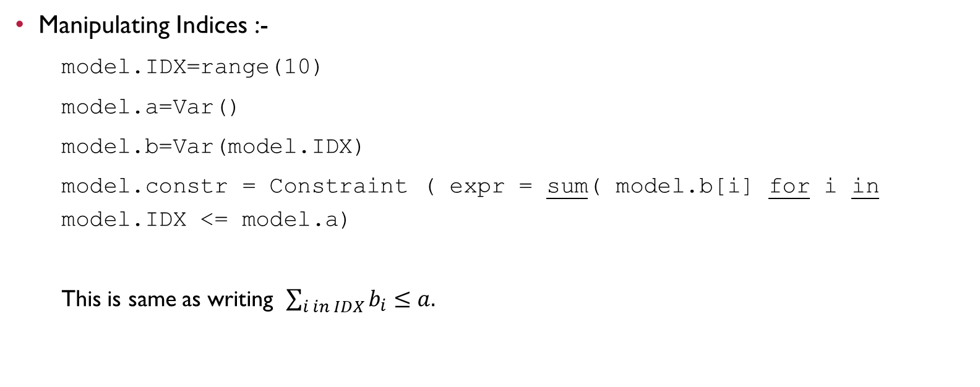
Pyomo basics
Manipulating Indices :-
model.IDX=range(10)
model.a=Var()
model.b=Var(model.IDX)
model.constr = Constraint ( expr = sum( model.b[i] for i in model.IDX <= model.a)
This is same as writing $\sum_{i in IDX}{b_{i}}$ $≤a.$

Slide 8
Pyomo basics
Solving the models :-
pyomo.exe
Pyomo <model_file> [<data_file>….][options]
Helper functions :-
display(model) – displays the entire model
display(model.x) – displays the set up of variable x
value(model.x) – displays the value of variable x

Slide 9
Pyomo basics Sequence function
It generates sequences(lists) that are an arithmetic progression of integers.
Syntax: - sequence(start, stop, step)
‘Up to but not including’ rule is NOT followed.
Eg1: sequence(10)
1,2,3,4,5,6,7,8,9,10
Eg2: sequence(2,5)
2,3,4,5
Eg3: sequence(4,10,2)
4,6,8,10

Slide 10
Pyomo sets
Set (pyomo) != set (python)
Sets are also iteratable.
model.IDX= Set(initialize = [1,2,5])
Unlike indices, Sets can be initialised from any iterable.
Manipulating sets :-
model.IDX= Set(initialize = [1,2,5])
model.IDX2= model.IDX* model.IDX
This creates a virtual 2D matrix Set.
Similarly we can use union, intersection, difference etc.

Slide 11
Pyomo sets
Range sets :-
model.IDX= Set(initialize = range(5))
This gives [0,1,2,3,4]. (Like in Python)
model.IDX= RangeSet(5)
This gives [1,2,3,4,5].
model.IDX= RangeSet(0,4)
This gives [0,1,2,3,4].

Slide 12
Indexed constraints (abstract modelling)
model.IDX= Set(initialize = range(5))
model.a=Var(model.IDX)
model.b=Var()
def c4_rule(model,i):
return model.a[i]+model.b <=1
model.c4 = Constraint(model.IDX, rule=c4_rule)
model.IDX2 = model.IDX * model.IDX
def c5_rule(model,i,j,k):
return model.a[i] + model.a[j] + model.a[k] <=1
model.c5 = Constraint (model.IDX2, model.IDX, rule =c5_rule)

Slide 13
Importing data
Data can be imported from “.dat” files. External data overrides the “initialize= ” declaration.
Scalar numeric values:-
model.a_par=Param(initialize=42)
Indexed numeric values:-
model.a_par=Param(IDX, initialize=data, default=0)

Slide 14
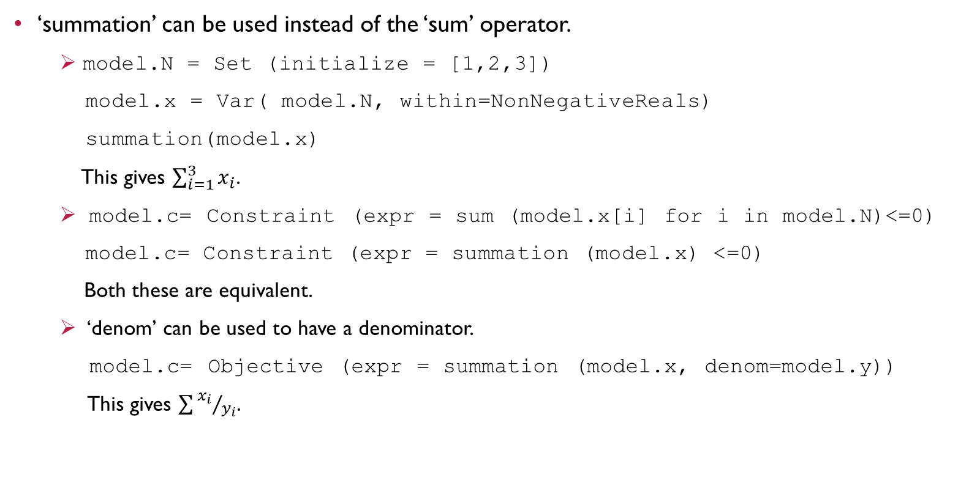
Summation operator
‘summation’ can be used instead of the ‘sum’ operator.
model.N = Set (initialize = [1,2,3])
model.x = Var( model.N, within=NonNegativeReals)
summation(model.x)
This gives $\sum_{i=1}^{3}{x_{i}}$.
model.c= Constraint (expr = sum (model.x[i] for i in model.N)<=0)
model.c= Constraint (expr = summation (model.x) <=0)
Both these are equivalent.
‘denom’ can be used to have a denominator.
model.c= Objective (expr = summation (model.x, denom=model.y))
This gives $\sum{{x_{i}}/{y_{i}}}$.

Slide 15
Generalised dot product
When used between 2 arrays, the ‘summation’ operator acts as a ‘dot product’ .
Model.a= Objective (expr=summation (model.x, model.y))

Slide 16
Advanced component indexing
model.A=Set(initialize=[1,2,3])
model.B=Set(initialize=[(1,1),(2,2),(3,3)])
model.Z=Param(model.B, initialize=1.0)
model.Y=Param(model.A, model.B, initialize=1.0)
Here, parameter Z is indexed by set B which contains 2- tuples. Y is of dimension 3 similarly and is indexed by sets A,B. Internally, elements of A,B are combined to form a 3-tuple. (AKA flattening the index set)

Slide 17
Model data
Set, Param components define abstract data declarations by default.
2 methods of data declaration: -
Using data command file
Using ModelData object.
A data command file consists of a sequence of commands that specify set and parameter data, or specify where such data is to be obtained from.
Commands to declare data: -
Set, param, import, namespace, include, data and end

Slide 18
Model data
Like C++, we use semi-colons to denote model data.
Include command: -
Used to execute data commands from other files.
include ex1.dat;
Executes the commands from ex1.
Data and end command: -
Just for compatibility purposes.
Set Command
Import command

Slide 19
Set command
Set <name> := [<value (numeric/string)>]… ;
Eg1: Set A:= ; #denotes an empty set
Eg2: Set A:= 1 2 3 ;
Eg3: Set A:= 0 ‘hi’ hello ‘100’;
Set of tuple data: -
Eg: model.A =Set(dimen=3)
Set A := (1,2,3)(4,5,6);
Set A := 1 2 3 4 5 6 ;

Slide 20
Set command
Set Arrays: -
Syntax: Set <name><index (number/string)> := [<value>]...;
Eg: model.A = Set()
model.B = Set(model.A)
Set A := 1 aaa ‘ab’; #the indices.
Set B[1] := 1 2 3 4 5 6 ;
Set B[aaa] := aa bb cc ;
Set B[‘ab’] := “aa bb cc”;

Slide 21
Import command
To load data from an external data source (like CSV files, ASCII table files, spreadsheets etc).
Eg: Specifying data for an indexed parameter: -
A Y
A1 3.3
A2 3.4
A3 3.5
import Y.tab : [A] Y ; #This loads the parameter data.
This file specifies values of parameter Y indexed by set A.

Slide 22
Import command
For indexed data: -
import Y.tab : A=[A] Y ;
Single column data: -
The ‘format’ option denotes that relational data is being interpreted.
A
A1
A2
A3

Slide 23
Import command
Eg: import A.tab format=Set :A ;
A B
A1 1
A2 2
A3 3
…
Syntax Options: -
format – relational tables
password – for passwords (similarly query, range)
user – username
using – process data source
import ABC.tab format = Set :Z ;
data from ABC gets loaded to Z

Slide 24
Import command
By default, relational tables are interpreted as columns of 1 or more parameters with the associated index columns.
This can be changed using the ‘format’ option.
import Z.tab format = param: P ;
import Z.tab format = array: P ;
import Z.tab format = set: P ;
import Z.tab format = set_array: P ;

Slide 25
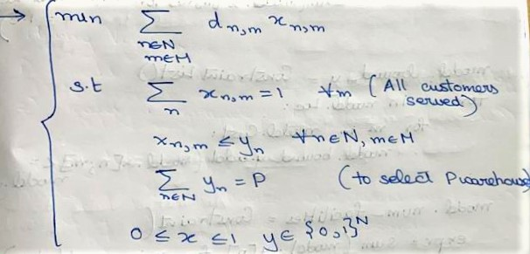
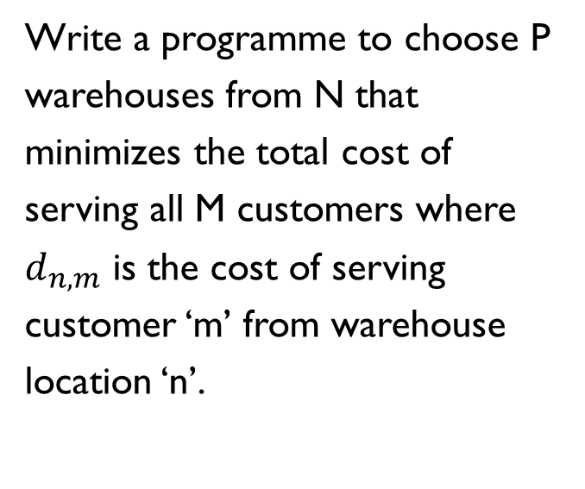
The first pyomo code
Write a programme to choose P warehouses from N that minimizes the total cost of serving all M customers where $d_{n,m}$ is the cost of serving customer ‘m’ from warehouse location ‘n’.

Slide 26
Solution
from pyomo.environ import *
#enter sample values or take them as an input.
#define the adjacency matrix as a dictionary.
N=3
M=4
P=3
d = { (1,1): 1.7, (1,2): 7.2, … , (3,4): 9.3 } #Could also be generated randomly or taken as an input

Slide 27
Solution
model= ConcreteModel()
model.loc = range (N)
model.cust = range (M)
model.x = Var(model.loc, model.cust, bounds= (0.0,1.0)) #Location x customers – 2 indices
model.y = Var(model.loc, within= Binary)
model.obj = Objective(expr= sum(d[n,m]*model.x[n,m] for n in model.loc for m in model.cust) #Double summation – across locations and customers.

Slide 28
Solution
model.single_x= ConstraintList()
for m in model.cust:
model.single_x.add(sum(model.x[n,m] for n in model.loc)==1.0)
model.bound_y=ConstraintList()
for m in model.loc:
model.bound_y.add(model.x[n,m]<=model.y[n])
model.num_facility=Constraint( expr= sum(model.y[n] for n in model.loc)==P)

Slide 29
TSP, VRP and PDP
TSP :- "Given a list of cities and the distances between each pair of cities, what is the shortest possible route that visits each city and returns to the origin city?“
If there are more than 1 vehicles, we call it a VRP (vehicle routing problem).
One important variant of the VRP is the Pickup and Delivery Problem (PDP). Unlike the classical VRP, where all customers require the same service type, a central assumption in the PDP is that there are two different types of services that can be performed at a customer location, a pickup or a delivery.
My plan: -
TSP VRP add time window add capacity constraints PDP

Slide 30
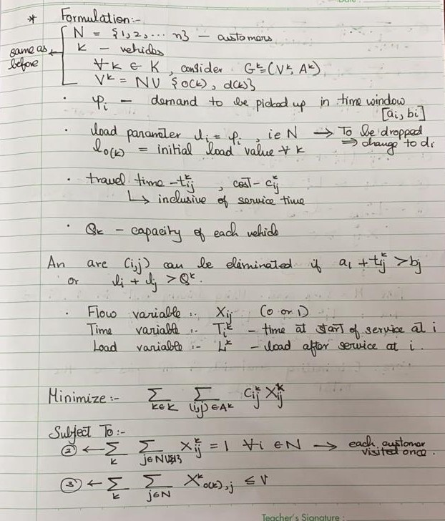
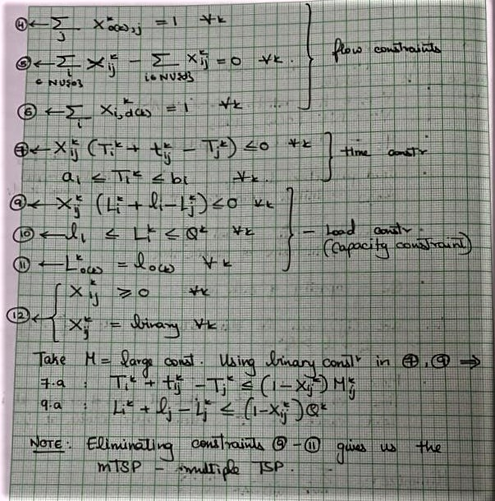
Problem set-up of vrp

Slide 31
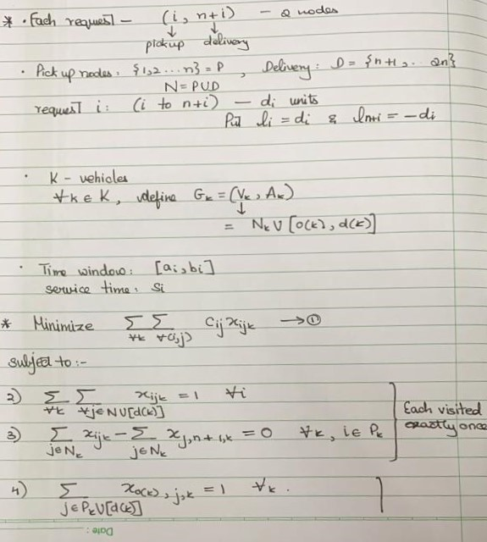
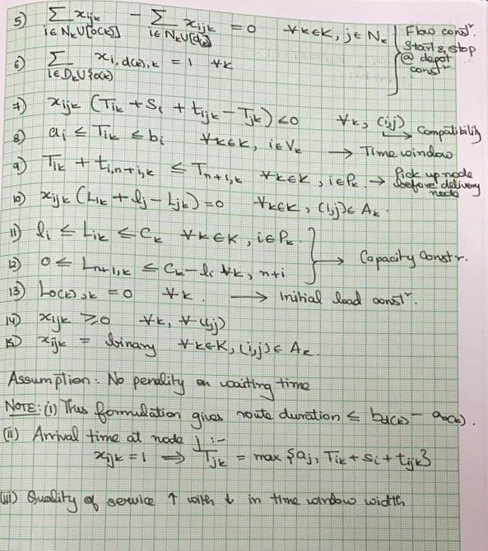
Problem set-up of PDP

Slide 32
references
Pyomo documentation
https://www.youtube.com/watch?v=cjMkVHjhSBI
Pyomo – Optimization Modelling in Python (Springer Publications)
https://nbviewer.jupyter.org/github/jckantor/ND-Pyomo-Cookbook/blob/master/notebooks/index.ipynb

Slide 33
Topics to explore
Non Linear Programming in Pyomo
Stochastic modelling using Pyomo
Scripting and Algorithm Development

Slide 34
Thank you

