Slide 1
WebOS Architecture
HEMANTH K M

Slide 2
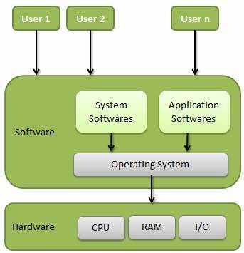
What is An OS?
An operating System is system software that manages computer hardware , software resources and provides common services for computer programs.
Necessary Managers For An OS:
Memory manager.
Process manager.
Device manager.
File manager.
Network manager.
Etc…

Slide 3
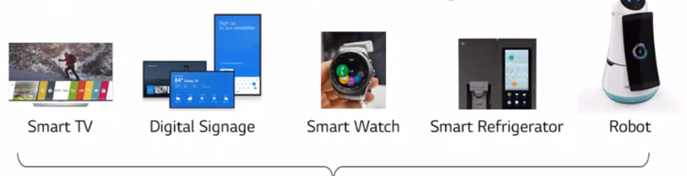
What is Web OS?
WebOS is web-centric and usability-focused software platform for smart devices, which has proven its performance and stability in over 70 million LG Smart TVs. Since its adaptation to display products, webOS has come a long way and evolved into a software platform applicable to a broader range of products.
WebOS Platform
On Feb 2013, LGE purchased webOS from HP
Originally webOS is used for consumer TV
webOS platform is also used for other devices
  Commercial TV, Signage, Robot, Watch, etc.…
Key Features and benefits
Support for a wide array of development technologies
Extensible and pluggable architecture
Integration with up-to-date open source technologies
Open platform applicable to diverse verticals

Slide 4
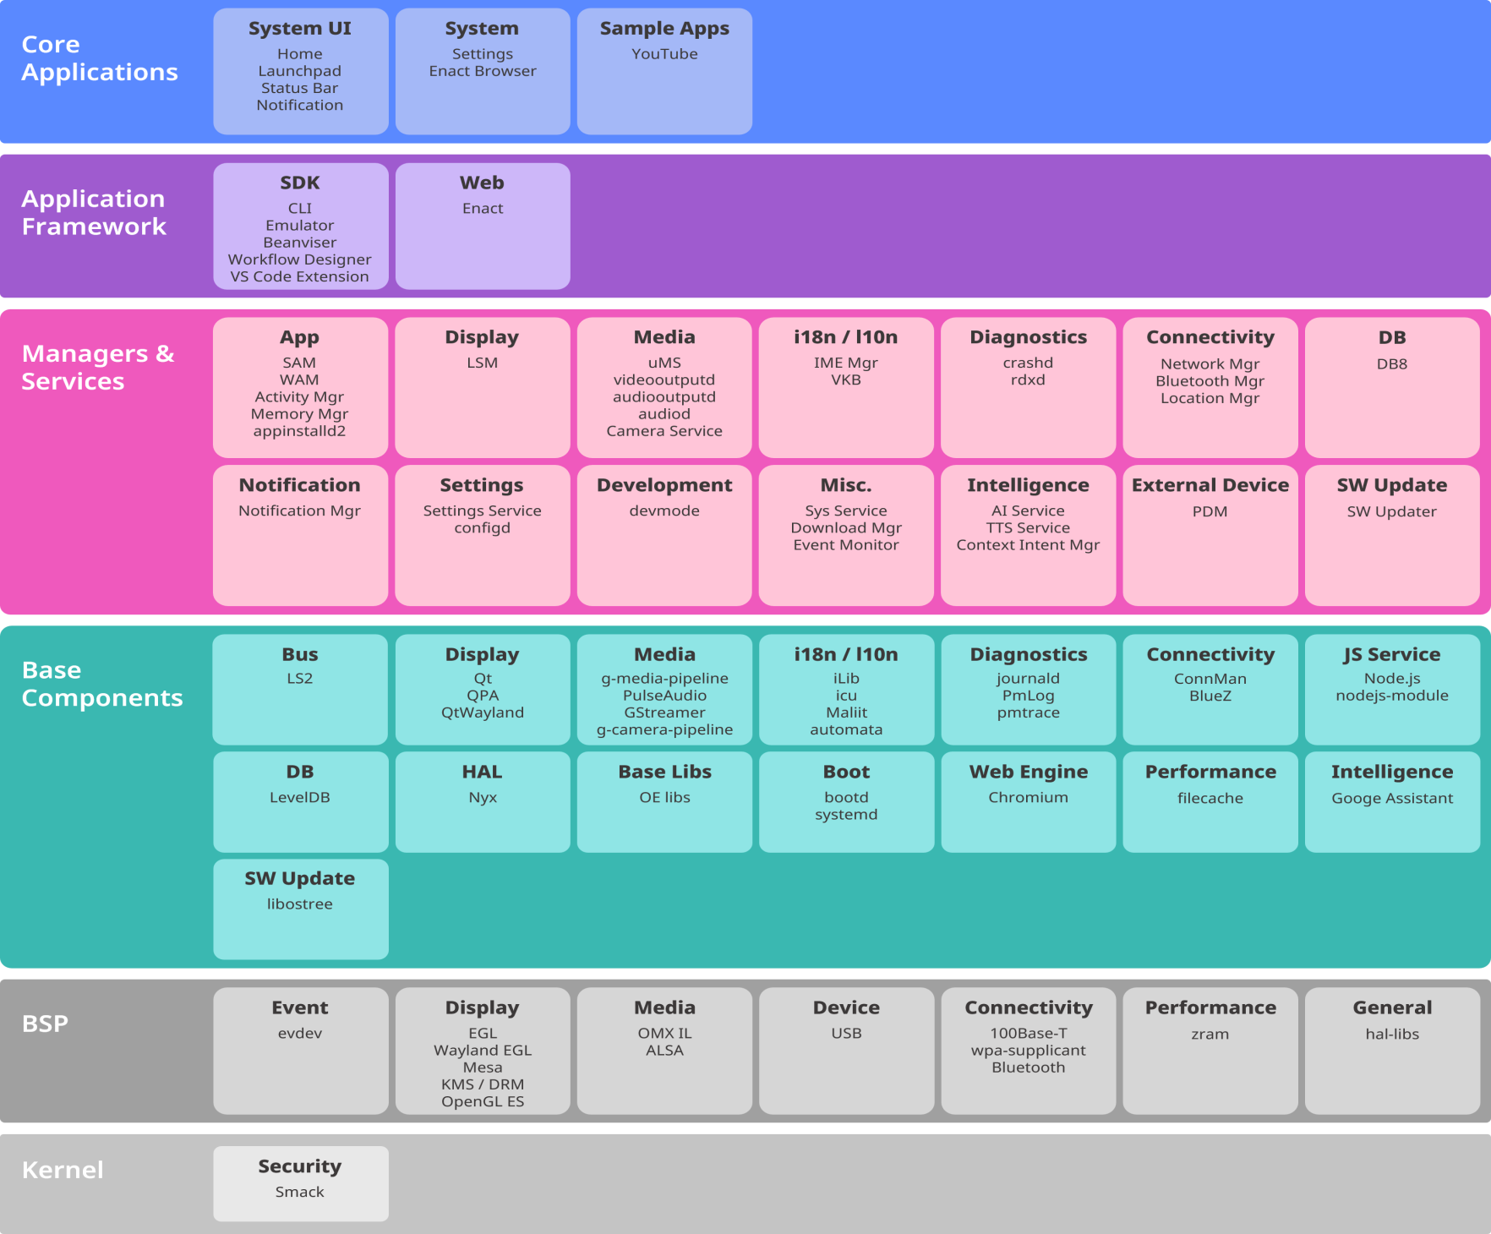
WebOS Architecture

Slide 5
WEBOS OSE consists of a set of layers:
Core Applications
Application Framework
Managers & Services
Base Components
BSP/Kernel.

Slide 6
Core Applications
WebOS OSE has core applications as the top layer and this layer includes system UI and system app.
System UI includes apps that are related to the basic user interface, such as app bar, and notification.
These apps are usually implemented using QML. (Qml (qt modeling language) is a user interface markup language. It is a declarative language for designing user interface–centric applications.)
System app includes settings app and web browser. Settings app is used to control the system properties and implemented using enact. As a web browser, enact browser is used.
Browser Features :
Basic navigation via address bar, backward/forward button
History
Bookmark
Most visited sites
Recently closed sites
Preferences
Startup page selection
Search engine selection
Some customized layout options

Slide 7
Application Framework
SDK
Web
CLI
Emulator
Beanviser
Workflow designer
VS code Extension
Enact
To help developers create better apps and services, webOS OSE provides enhanced options and environments
Notes:
The web app framework Enact and Software Development Kit (SDK) are provided.

Slide 8
SDK
The SDK provides a development environment for web apps and services. The SDK for webOS OSE provides tools such as Command-Line Interface, Emulator, Beanviser , and Workflow Designer.
Command-Line Interface
Command-Line Interface (CLI) of webOS Open Source Edition (OSE). It provides a collection of commands used for creating, packaging, installing, and launching apps or services in the command line environment.
Key Features :
Creating Apps and Services
  Provides standard templates for webOS OSE apps and services
  Provides a list of available templates
  Generates an app or a service and configures basic information
Packaging Apps and Services
  Packages the source code and generates a package file (.ipk) to run on the target device
  Provides a feature to exclude sample and test code directories from an app or a service

Slide 9
Managing Target Devices
  Provides a list of target devices
  Adds, modifies, and removes target devices
Installing Apps and Services
  Installs the app and service on the target device
  Provides a list of apps installed on the target device
  Removes selected apps from the target device
Launching and Closing Apps
  Launches selected apps
  Closes apps that are running
  Provides the list of apps running on the target device
Debugging Apps and Services
  Enables Web Inspector for debugging web apps
  Enables Node’s Inspector for debugging JavaScript services
  Provides web app information
  Provides JavaScript service information
  Shows or saves logs of webOS OSE apps and services

Slide 10
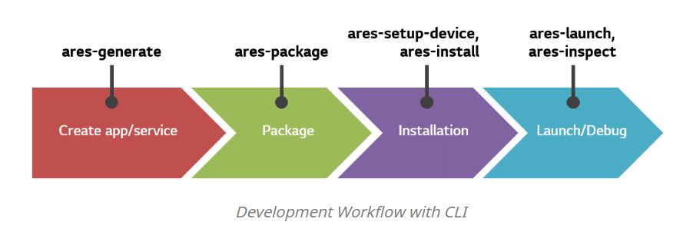
Providing Target Device Information
  Provides system information
  Provides screen capture
  Supports monitoring device’s resource usage
CLI Workflow
webOS OSE CLI provides features for developing web apps throughout the whole development process. The figure below shows some of CLI commands that can be used during each stage of the development process.

Slide 11
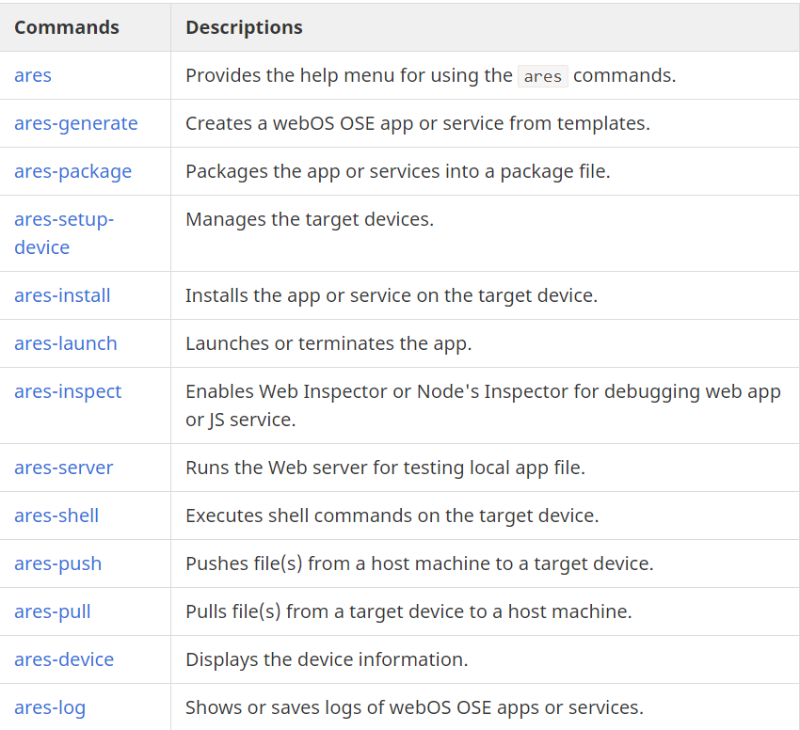
The following table shows the available CLI commands.

Slide 12
Emulator
Emulator is created as a virtual machine image when you build webOS OSE platform source code with qemux86 option configured
Beanviser :
Beanviser is a performance monitoring and diagnostics tool that remotely communicates with a webOS device and evaluates apps running on the device.
It provides the following benefits:
Real-time analysis of an app’s performance.
Easy-to-read graphical representations of data that help you visualize performance of apps.
Historical data which can be saved and imported to Beanviser.
Logs for debugging the apps.
Key Features:
Beanviser provides a comprehensive set of features:
Monitoring:
  System CPU and Memory
  Process CPU and Memory
Diagnostics:
  journald Logs
  GStreamer Logs (Available from Beanviser v2.0.0)
  Traffic on webOS service bus

Slide 13
When to Use Beanviser?
With Beanviser you can evaluate how your app performs in a live environment and check for issues before the app is deployed for commercial purposes. Therefore, it is recommend that you let Beanviser evaluate the app for a few days, to give you a real-life view into the operation of the app.
Workflow Designer
Workflow Designer is a GUI-based utility which allows you to add AI logic to your web app, without actually modifying its source code. This makes your web app context-aware and therefore provides a better experience to your customers. For example, without updating the source code of your app, you can configure it to perform operations on voice instructions.
Some of the main benefits of Workflow Designer are:
Reduces time spent in developing AI logic in the web app.
Developer does not need in-depth understanding of AI engines.
Does not increase the code size and complexity.

Slide 14
Enact:
An app development framework built atop React that’s easy to use, performant and customizable.
Easy to Use
Enact builds atop the excellent React library, and provides a full framework to the developer. The recent boom of web technologies and related tools has led to a plethora of options available. In fact, getting started might be the most difficult part of building a modern web application.
Performant
Beyond initial setup, Enact continues to provide benefits. It was built with performance in mind, and conscious decisions were made to ensure that applications remain performant as they grow in size and complexity. This ranges from the way components are rendered to how data flows through application.
Customizable
Enact has a full set of customizable widgets that can be tuned and tweaked to the particular style of each project. Using our experience in building full UI libraries for a broad swath of devices ranging from TVs to watches, we have created a widget library whose components can easily be composed to create complex views and applications.
Adaptable
Enact was designed to produce native quality applications for a wide variety embedded web platforms

Slide 15
Managers & Services
System and Application Manager
System and Application Manager (SAM) oversees the behavior of apps. SAM manages each app throughout its lifecycle, including the installation, launch, termination, and removal of the app.
Web Application Manager
Web Application Manager (WAM) is responsible for launching and managing web apps. In addition, WAM performs CPU usage optimization, status monitoring and recovery processing, and access privileges management, all based on the running status of web apps.
WAM handles basic routines such as launching, closing apps as well as the following features of web applications.
Running lists
Life cycles
Current status of applications
Application crash
Activity Manager
Activity Manager is responsible for managing and executing activities requested from services. An activity is requested along with a specific condition, and it is triggered when the condition is met. You can configure the activity to perform tasks such as automatic execution of specific services, callback requests, and so on.

Slide 16
Luna Surface Manager
Luna Surface Manager (LSM) is a component that works as a graphics and window manager. LSM displays graphical elements on the screen, manages the composition of these elements, and performs the event handling for input devices such as keyboard and pointer. LSM is also responsible for the management of System UI, such as App Bar and Notification. LSM is implemented using Qt, and System UI is implemented using QML.
uMediaServer
uMediaServer (uMS) is a module that works as a server for the webOS media framework. uMS provides interfaces for media playback, manages resources, pipelines, and their policies, and manages the lifecycle of the media player.
DB8
DB8 is an embedded JSON database that supports data storing and retrieving in the structure of a key-value store. webOS OSE uses LevelDB as the backend database. The default service associated with DB8 is com.webos.service.db. The com.webos.service.tempdb service, which allows you to configure temporary storage in memory, is also provided.
Notes:
Use of Chromium in webOS OSE : https://www.webosose.org/blog/2019/11/15/how-chromium-helps-webos-ose-build-an-ecosystem/

Slide 17
Base Components
Base Components layer includes the following key components.
LS2
LS2, also called Luna Bus, is a system bus used by webOS OSE as the IPC mechanism used between components in webOS. It is composed of:
Client library - Provides API support to register on the bus and communicate with other components.
Central hub daemon - Provides a central clearing house for all communication. Utilities for monitoring and debugging the bus are included.
LS2 API is a JSON-based API provided by webOS platform services. You can use LS2 API to create apps or services that use webOS platform features.
Provides access to the webOS system settings such as:
Backup options
Getting device information
Getting and modifying the date and time settings
Setting ringtones
Wallpaper
Local formats

Slide 18
Web Engine
webOS OSE uses Chromium as the web engine. A web engine is the module that loads and parses a web app (or web page) consisting of HTML, CSS, and JavaScript, and performs all tasks required to represent the web app on the screen, such as layering and rendering. Currently the web runtime environment of webOS OSE is implemented according to the multi-process model of Chromium. Therefore, each web app is run as a separate independent process.
Node.js
JS services provide a way for apps to work, even when the application is not running. The typical characteristics of a JS service on webOS OSE are as follows:
Written in JavaScript and created using Node.js.
Runs in the background.
Provides additional access to platform features such as low-level networking, file system access, and binary data processing. These features are normally not available to web apps.
Performs tasks for one or more apps.
Examples of JS Services
Downloading attachments in the background for an email reader
Uploading images to a picture-sharing website from an app
Performing a long-running computation or file operation

Slide 19
JS Service Types
In a webOS system, JS services are categorized by the packaging/delivery method as follows:
External JS Service
  The JS service is installed on the webOS target device.
  This approach helps 3rd party developers to create a JS service running on webOS devices.
Built-in JS Service
  The JS service is built into the webOS image.
  This approach is used by platform developers and contributors to add a JS service that enhances the functionality of the platform.
uMediaClient
Provides access to the functionality offered by the webOS media server.
Note: Instead of using the raw luna uMS API service, the uMediaClient API service can be used to control playback of audio/video files and streams

Slide 20
BSP/Kernel
BSP/Kernel layer consists of several components to support Raspberry Pi 4.
evdev
event processing
Mesa
graphics support
100Base-T
wpa supplicant
Bluetooth
connectivity.

Slide 21
THANK YOU

