Slide 1

IILM UNIVERSITY
Greater Noida
Web Development Intern
Internship Completion Presentation
Student Name
Drishti Thakur
Enrollment Number
25SCS1003002554
Program & Semester
B.Tech (AI & ML), 3rd Semester
Organization
Prodigy Infotech

Slide 2
AGENDA
What This Presentation Covers
01
About Prodigy Infotech
05
Task 02 — Stopwatch Web Application
02
Internship Overview & Objectives
06
Task 03 — Tic-Tac-Toe Game
03
Tools & Technologies Used
07
Key Learnings & Skills Gained
04
Task 01 — Interactive Navigation Menu
08
Challenges, Conclusion & Acknowledgment
IILM University · Web Development Internship
2

Slide 3

THE ORGANIZATION
About Prodigy Infotech
Prodigy Infotech is a Mumbai-based EdTech and IT services company offering 100% remote, task-based virtual internships for students and freshers.
Rather than theory-heavy modules, interns are given real, project-style tasks to complete independently — building a practical, resume-ready portfolio in the process.
Domains offered include Web Development, Data Science, Machine Learning, Android Development, and Cybersecurity, with a completion certificate awarded on finishing the assigned tasks.
Mode
100% Remote / Virtual
Format
Task-based, self-paced
Typical Duration
4 weeks (extendable)
On Completion
Certificate + portfolio project
IILM University · Web Development Internship
3

Slide 4




OVERVIEW
Internship Overview & Objectives
Role
Objective
Approach
Outcome
Web Development Intern — building browser-based projects with HTML, CSS & JavaScript.
Apply core front-end concepts through independent, hands-on task-based projects.
Each task was planned, built, tested in-browser, and version-controlled with Git.
Three complete, deployable web projects and a stronger front-end foundation.
IILM University · Web Development Internship
4

Slide 5






TECH STACK
Tools & Technologies Used
HTML5
CSS3
JavaScript
Semantic page structure
Styling, layout & animation
Interactivity & logic
Git
GitHub
VS Code
Version control
Hosting & submission
Development environment
IILM University · Web Development Internship
5

Slide 6

TASK 01
Interactive Navigation Menu
A fixed navigation bar that stays pinned across every page and visually reacts to the user — transparent over the hero, then solid with a blurred background once scrolled.
Fixed position — visible on every page of the site
Top of page (transparent)
Background & shadow change on scroll (JS class toggle)
Animated underline on link hover
Responsive hamburger menu for mobile screens
After scrolling (solid + shadow)
Active-page link highlighting
IILM University · Web Development Internship
6

Slide 7
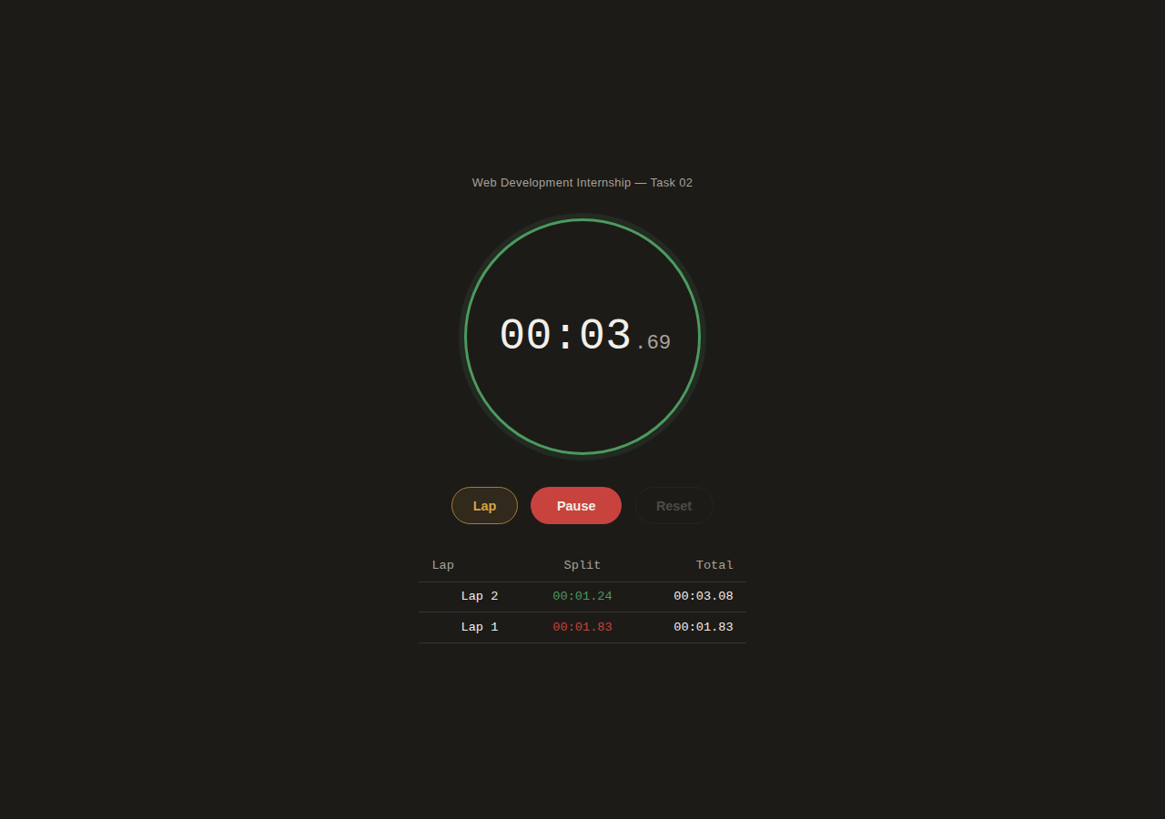
TASK 02
Stopwatch Web Application
A precision stopwatch with start, pause, reset, and lap tracking — timed with performance.now() and requestAnimationFrame so it never drifts.
Start / Pause toggle with accurate elapsed-time tracking
Lap recording with per-lap split & running total
Fastest / slowest lap auto-highlighted
Reset available only once paused (real stopwatch behavior)
Dial color shifts with state — idle, running, paused
IILM University · Web Development Internship
7

Slide 8
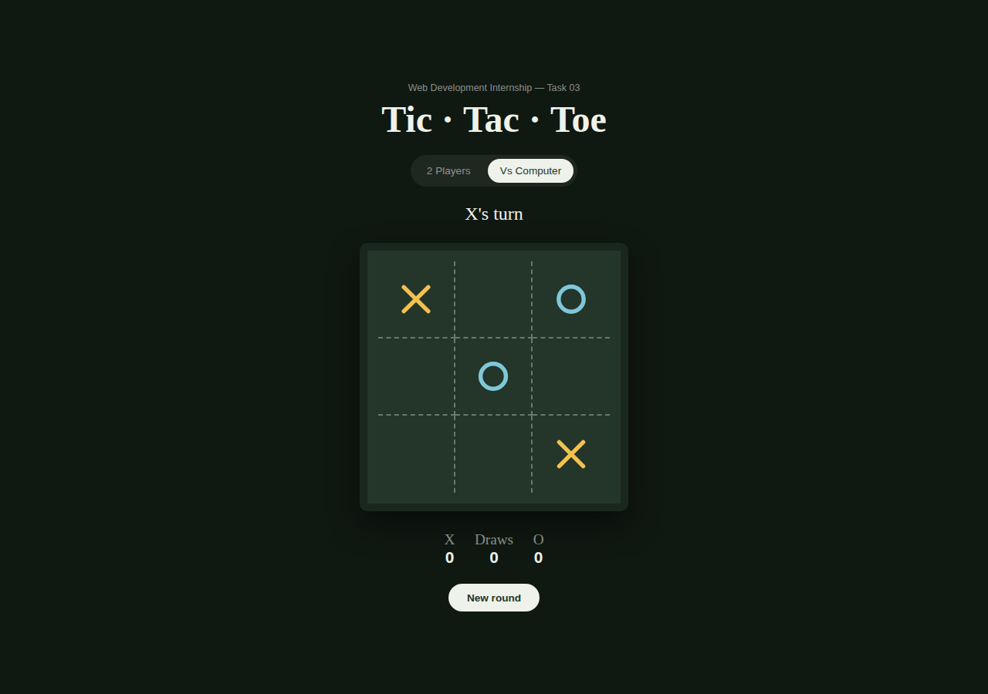
TASK 03
Tic-Tac-Toe Game
A two-mode Tic-Tac-Toe game — play locally with a friend, or challenge a built-in computer opponent driven by simple decision-making logic.
2-Player and Vs Computer modes
Win detection across all 8 possible lines
Heuristic AI: win > block > center > corner > random
Animated line drawn across the winning row
Score tracking (X / O / Draws) saved between visits
IILM University · Web Development Internship
8

Slide 9



TAKEAWAYS
Key Learnings & Skills Gained
DOM & Event Handling
Precise Timing
Game Logic Design
Wiring up clicks, scroll listeners, and state changes with vanilla JavaScript.
requestAnimationFrame and performance.now() are more reliable than setInterval.
Structuring win-checks and simple AI decision-making from scratch.
Responsive Layout
UX Details Matter
Git & GitHub Workflow
Building interfaces that adapt cleanly from desktop down to mobile.
Small touches — animated hovers, state-based color — make projects feel finished.
Organizing, committing, and publishing project code professionally.
IILM University · Web Development Internship
9

Slide 10
REFLECTION
Challenges & How They Were Solved
CHALLENGE
SOLUTION
Timer drift with setInterval on the stopwatch
Switched to requestAnimationFrame with timestamp math for frame-accurate timing
Keeping one navigation bar consistent across pages
Reused identical HTML/CSS/JS across pages rather than rebuilding per page
Designing a computer opponent without over-engineering
Used a simple, explainable win/block/center/corner heuristic instead of full minimax
IILM University · Web Development Internship
10

Slide 11
Conclusion
This internship gave me hands-on experience turning core HTML, CSS, and JavaScript concepts into three complete, working web applications — strengthening both my technical foundation and my ability to plan and finish a project independently.
Thank You
Drishti Thakur · B.Tech (AI & ML), 3rd Semester · IILM University, Greater Noida
Web Development Intern — Prodigy Infotech

