Slide 1
♻E-Waste Generation Using ResNet50 for Sustainable Recycling Solutions

Slide 2
Learning Objectives
Understand the use of transfer learning in computer vision.
Train a deep learning model (ResNet50) for image classification.
GOAL
Build a simple interactive UI with Gradio for real- time prediction.
Apply AI to solve environmental challenges related to e-waste.
Source: Dataset collected and organized manually (10 e-waste categories) https://www.kaggle.com/datasets/akshat103/e-waste-image-dataset

Slide 3






Programming & Development:
Tools and Technology used
Python – Core language
Jupyter Notebook – Code execution & visualization.
Machine Learning Frameworks:
TensorFlow / Keras – Model building & training ResNet50 – Transfer learning for image classification
Web Deployment:
Gradio – Real-time interactive UI
Version Control & Hosting:
GitHub – Project repository and collaboration

Slide 4









Methodology
Preprocessing & augmentation
Model Building using ResNet50
Data set preparation
train/validation/ test split
Gradio UI Deployment
Training with EarlyStopping
Evaluation & Accuracy Visualization

Slide 5
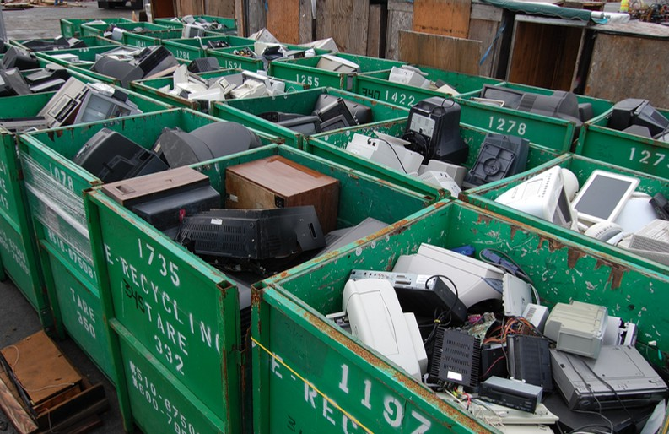
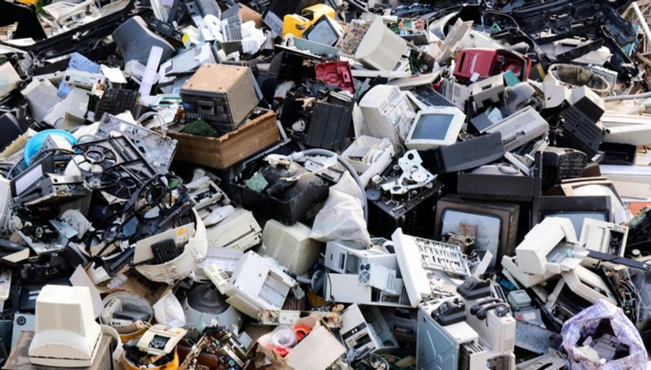

Problem Statement:
India generates over 3.2 million metric tons of e-waste every year. Manual sorting methods are inefficient and prone to error.
This leads to improper recycling and environmental harm.
An automated, intelligent system is needed for effective classification.

Slide 6

Solution:
To address the inefficiency of manual e-waste sorting, a deep learning model using ResNet50 is developed to automatically classify e-waste images into predefined categories. This model is integrated with a Gradio-based user interface to enable real-time predictions and promote smarter recycling practices.

Slide 7
Screenshot of Output:
The Gradio interface allows real-time image upload and accurately classifies the e-waste item with confidence.

Slide 8

Conclusion:
This project successfully demonstrates how deep learning and Gradio can automate e-waste classification, promoting faster sorting and supporting sustainable recycling efforts.

