Slide 1
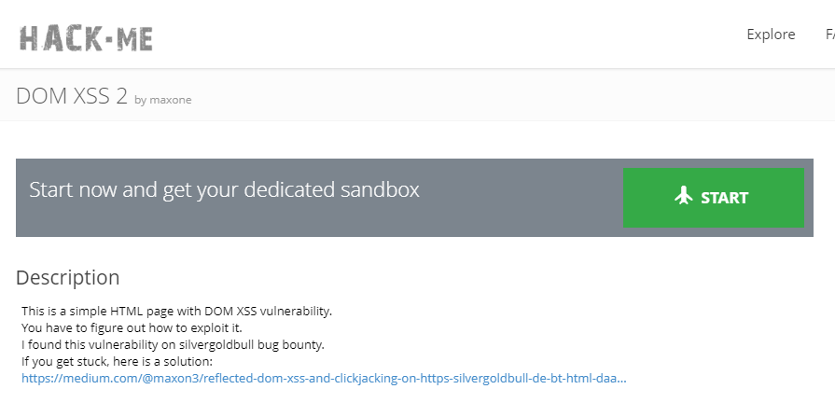
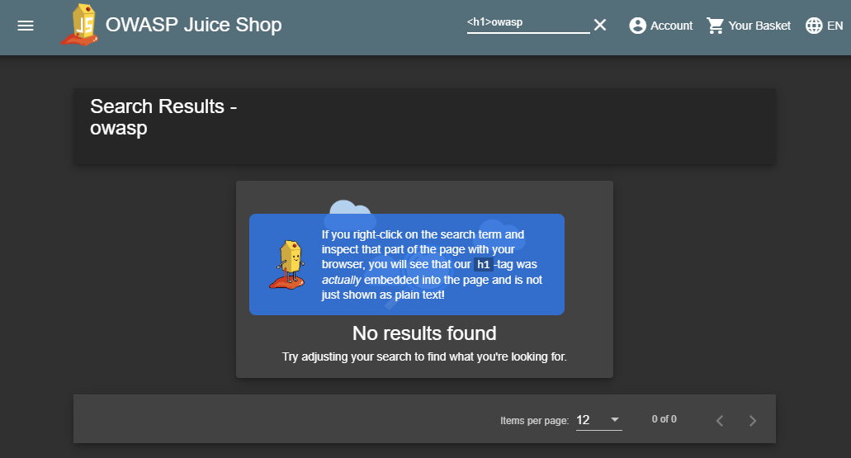







Lesson X
Lesson 1
Lesson 2
…
Inventory
L2
...
L3
Coding Lesson
(built-in)
Hack.me
Lesson
(ext.)
…
Juice Shop Tutorial
(hosted)
Learning Progress
Solution Webhooks
DOM XSS?
Learning Platform
User Profile

