Slide 1
.gltf (JSON)
Node hierarchy, materials, cameras
.bin
Geometry: vertices and indices
Animation: key-frames
Skins: inverse-bind matrices
.png
.jpg
…
Textures

Slide 2
scene
*
node
*
1
1
*
skin
camera
mesh
*
*
*
accessor
material
animation
*
1
*
bufferView
texture
1
1
1
buffer
image
sampler

Slide 3
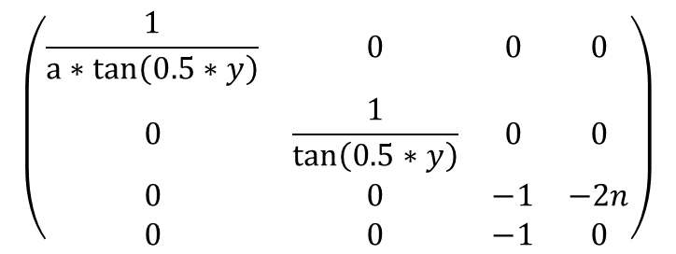
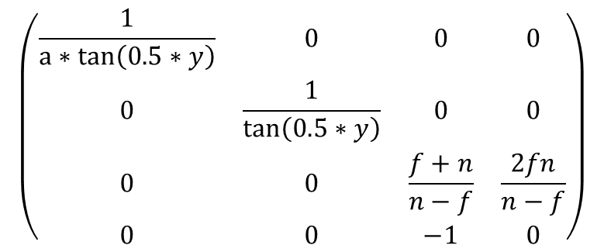
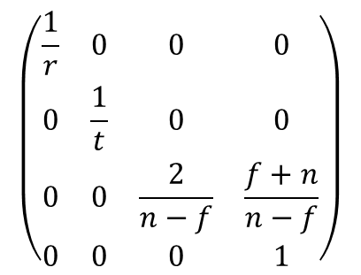
$$\left(\begin{matrix}\frac{1}{a∗tan\left(0.5∗y\right)} & 0 & 0 & 0 \\ 0 & \frac{1}{\tan\left(0.5∗y\right)} & 0 & 0 \\ 0 & 0 & \frac{f+n}{n−f} & \frac{2fn}{n−f} \\ 0 & 0 & −1 & 0\end{matrix}\right)$$
$$\left(\begin{matrix}\frac{1}{r} & 0 & 0 & 0 \\ 0 & \frac{1}{t} & 0 & 0 \\ 0 & 0 & \frac{2}{n−f} & \frac{f+n}{n−f} \\ 0 & 0 & 0 & 1\end{matrix}\right)$$
$$\left(\begin{matrix}\frac{1}{a∗tan\left(0.5∗y\right)} & 0 & 0 & 0 \\ 0 & \frac{1}{\tan\left(0.5∗y\right)} & 0 & 0 \\ 0 & 0 & −1 & −2n \\ 0 & 0 & −1 & 0\end{matrix}\right)$$

Slide 4
Todo Add BRDF Equations
https://github.com/KhronosGroup/glTF/issues/810

