Slide 1
The Imitation Game for Petroleum Engineers
Understanding the Behavior of Oil Wells through Deep Learning
June 10th 2015

Slide 2
Introduction of QRI

Slide 3
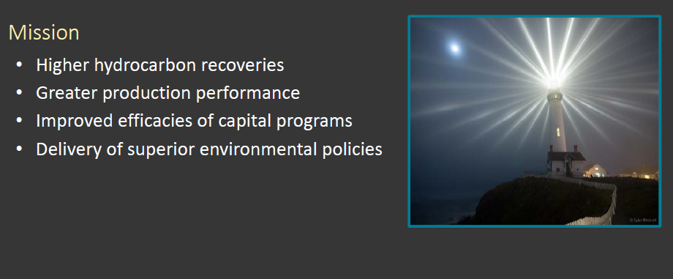
Quantum Reservoir Impact

Slide 4
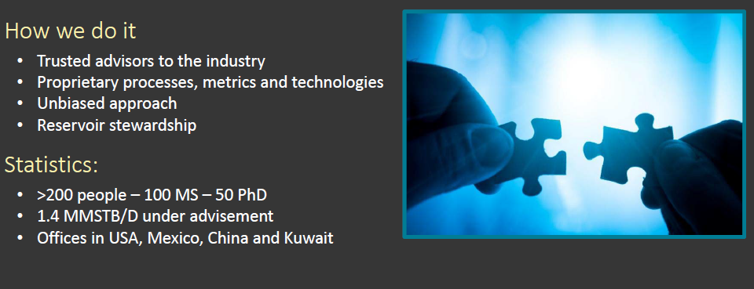
What We Do: Value Creation

Slide 5
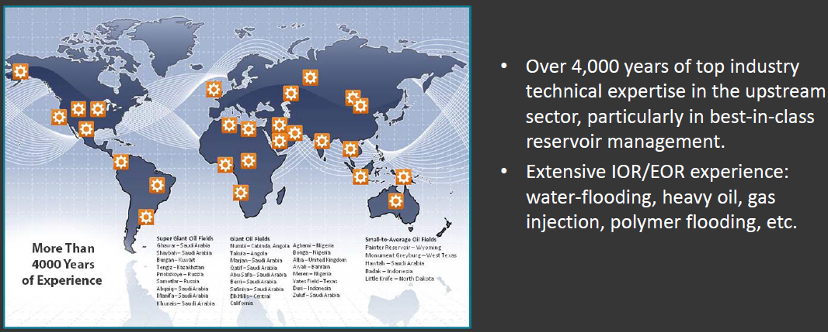
Our Professional Experiences

Slide 6
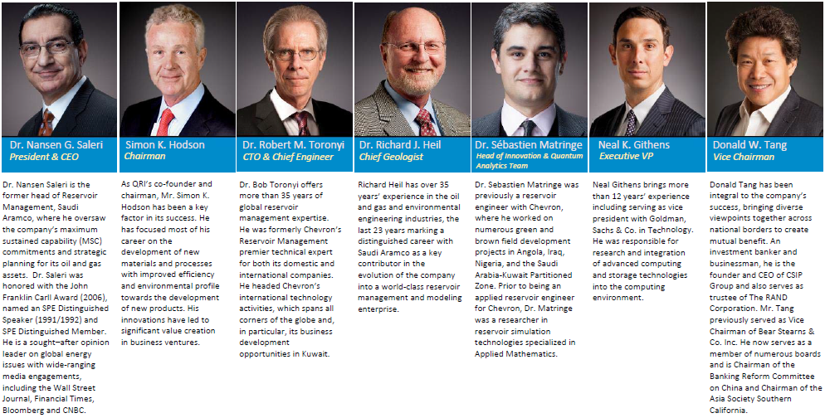
QRI Leadership

Slide 7
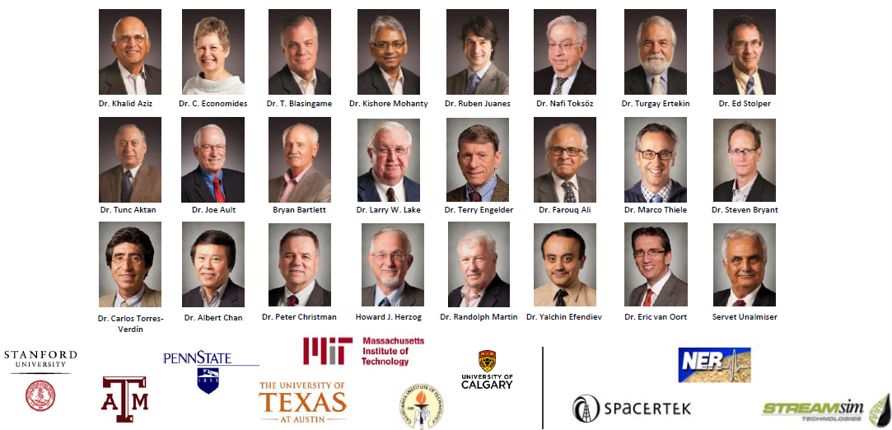
QRI Scholars & Associates

Slide 8
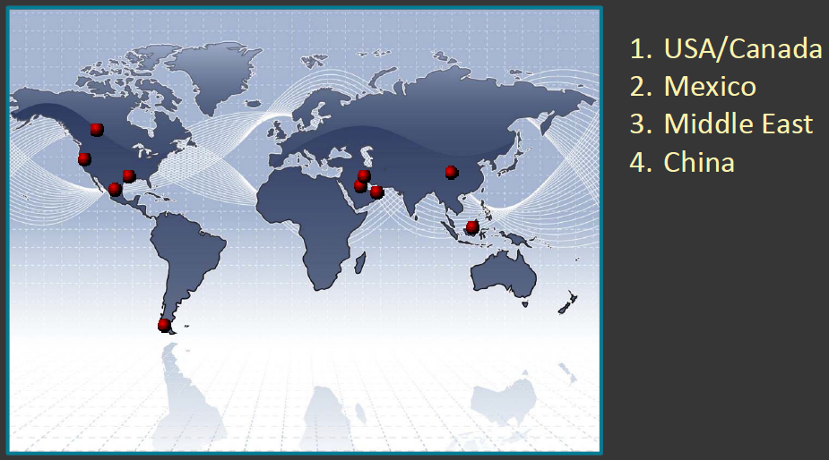
Global Presence: 4 Major Geographical Theaters

Slide 9
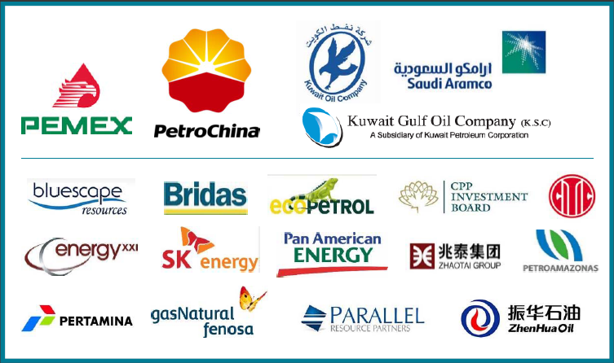
Global Reach

Slide 10
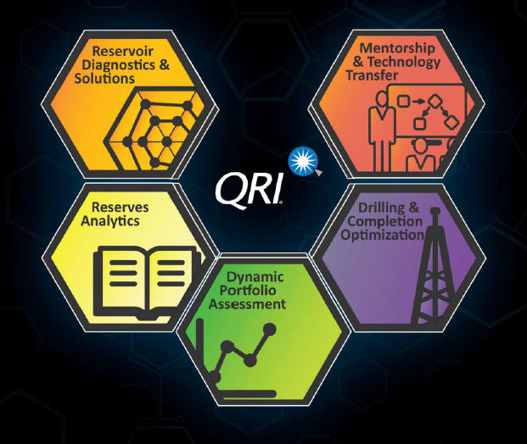
Products & Services

Slide 11
Project Description

Slide 12
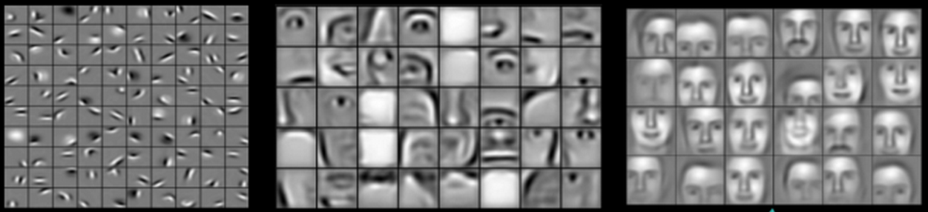
Background
Deep Learning:
More hidden layers in network architecture
Hybrid of unsupervised and supervised learning
Example:
Application to Petroleum Industry:
Complex behaviors of oil wells
Efficiency and accuracy of interpretation
Drawbacks of existing models

Slide 13
Objectives
Develop a machine learning tool to
Identify historical production events

Slide 14
Objectives
Develop a machine learning tool to
Identify historical production events

Slide 15
Objectives
Develop a machine learning tool to
Forecast the production trends in next one year
??

Slide 16
Current Approach

Slide 17
Current Workflow
Detect production events
Regress behavior between events
Extrapolate latest behavior forward to estimate ultimate recovery

Slide 18
Event Detection
Principle:
Wells go through events (repairs, pump upgrades, change of target, etc)
These events effect the production behavior
Workflow:
Define shut-in periods, identified start and end as events
Choose bandwidth h (kernel size)
Detect events for bandwidth h with polynomial kernel regression
Eliminate events that are too close to each other (redundant)
Change bandwidth h and repeat

Slide 19
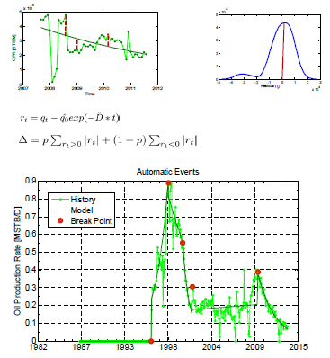
Regression
Exponential curve as basic functional form
Quantile regression used to provide robustness to outliers
Regression performed between each event
Production behavior extrapolated past the last event to provide “Expected Ultimate Recovery”

Slide 20
Example results

Slide 21
Project Relevance and Applications

Slide 22
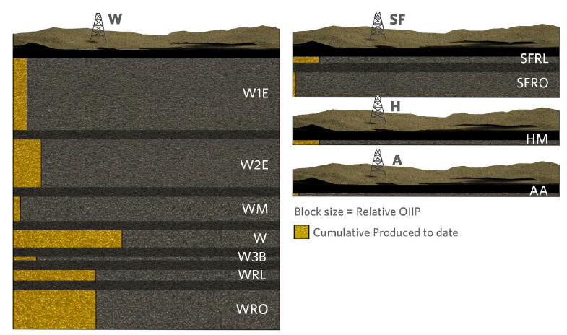
Case Study A: Middle East Portfolio

Slide 23
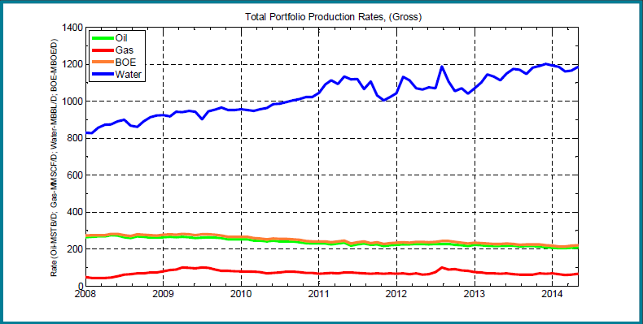
Portfolio Production Rates

Slide 24
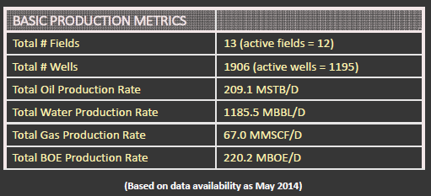
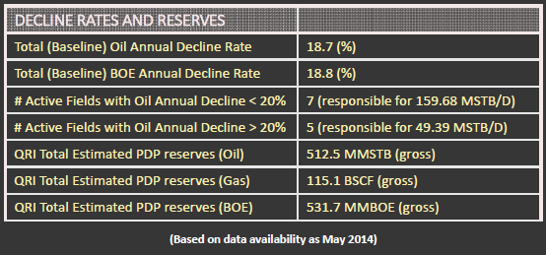
Summary of Portfolio Content
Insights from Automated Decline Curve Analysis

Slide 25
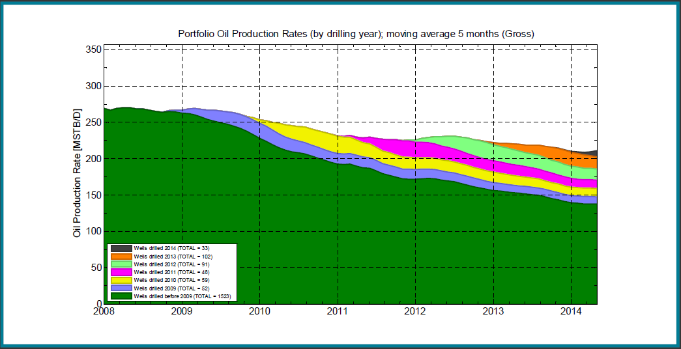
Portfolio: Production Rate by Year Oil
Viewing the inherent decline of the portfolio

Slide 26
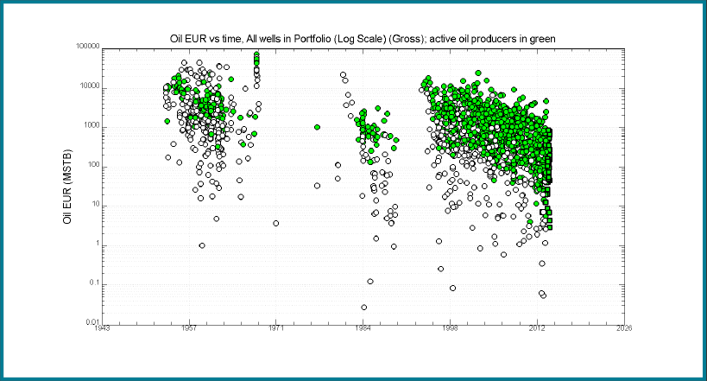
Portfolio: Well EURs Oil
Over time, the wells drilled are less and less profitable

Slide 27
Automated DCA Relevance
Accelerate the speed of oil well profile diagnosis/forecast
Quickly identify the remaining opportunities in the field
Significantly increase the capital efficiency
Minimize the risk of making multibillion-dollar decisions
Improve reservoir management practices for conventional reservoirs

Slide 28
Case Study B: Who would you acquire?
The value of additional information
Production
Drilling Activity
EUR per Well
Time
Time
Without Automated DCA
With Automated DCA

Slide 29
Proposed Approach

Slide 30
Data Mining Process and Techniques to Consider
Data Mining Process
Data pre-processing
data gathering, exploration/visualization, imputation, weighting, filtering, clustering, transformation/reduction
Unsupervised feature learning
extract fundamental features of raw data
Supervised machine learning
to understand the well behaviors and forecast the production in time
Techniques to Consider
Hierarchical Temporal Memory (HTM)
Stacked Autoencoders and Restricted Boltzmann Machines (RBM)
Recurrent Neural Network (RNN)
…

Slide 31
Data
DATE: the last day of the month.
FIELD: name of the oil field.
FORMATION: name of the formation.
WELL_NAME: name of the oil well.
OIL: monthly oil production rate. Unit: STB/Day.
WATER: monthly water production rate. Unit: STB/Day.
GAS: monthly gas production rate. Unit: SCF/Day.

Slide 32
Conclusions

Slide 33
Conclusions
Fast and automated production analysis provide deep insights into the value of a portfolio of wells that most companies cannot obtain
Current QRI approach:
Based on heuristics and statistics
Works well and delivers intended results
Has limitations: a bit slow, limited to 1D time series
Vision: Deep learning could be a solution for the future
Once trained, the tool could deliver very fast interpretation
Different types of events could be identified
More complex information could be added later on

Slide 34
Thank You

