Slide 1
Our way towards modularity
Leveraging Liferay as an OSGi container
Miguel Ángel Pastor Olivar
Core Software Engineer

Slide 2
About me
Write software at the Liferay platform team
Phd student on distributed systems and cloud computing (currently on standby)
Scala enthusiast (support for writing plugins, more to come)
Email: miguel.pastor@liferay.com
Twitter: @miguelinlas3

Slide 3

Notes:
The goal of this slide is to present how complex large systems can be, highlighting some of the following points
– Large systems are extremely complex to develop and maintain
– Highly coupled systems
– Cloud computing: Multiple deployments are co-located
– Footprint and performance
– Distributed development
Once we have presented the previous problems we should introduce the general concept of modularity. Something like:
– Systems composed of relatively small self-contained units
– Clear interfaces between them

Slide 4
Complexity in large systems
Large systems are extremely complex to develop and maintain
Highly coupled systems
Cloud computing: Multiple deployments are co-located
Footprint and performance
Distributed development

Slide 5
Cost
Unmanageable
Complexity
Notes:
Following the idea of the previous slide we can do a quick overview of how complexity and cost are related in modular and monolithic systems.

Slide 6
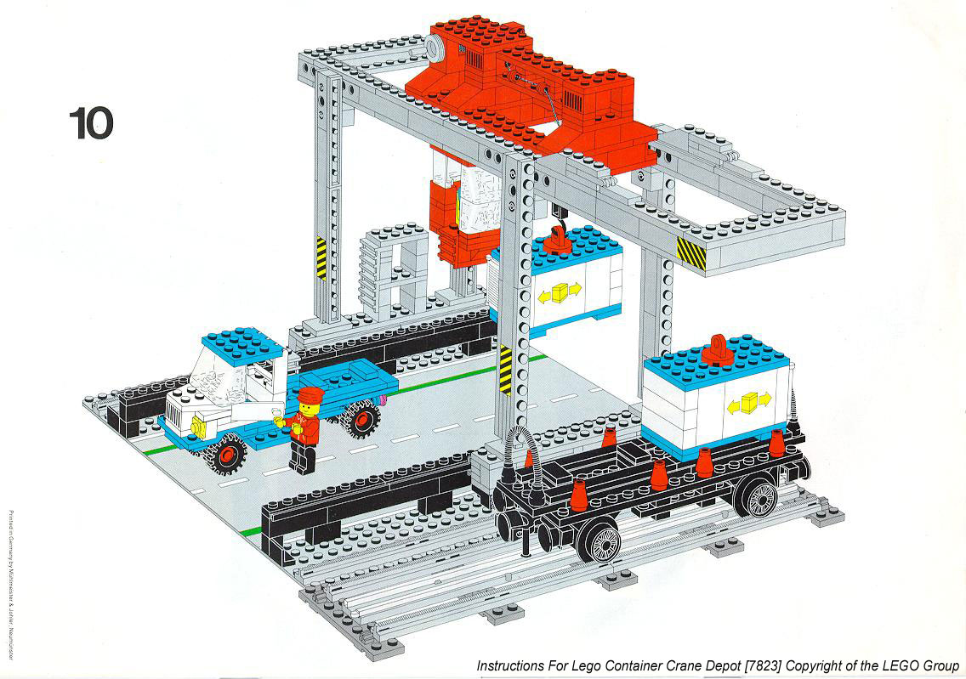
Notes:
The goal of this slide is to bring up some of the benefits that modularity give us. The idea is to highlight two kind of benefits: the internals ones, for us, and the external ones, for our developers/users
For “inside” benefits:
– Decoupled and highly focused components
– Easier development process
– Simplify current implementations/patterns
– Easier to implement new features
– Highly focused teams
– Easier distributed development
For “outside” benefits:
– More frequent delivery of new features or improvements
– Less bugs due to higher degree of focus
– Quicker and simpler delivery of patches for bugs and security issues
– Robustness
– Footprint
At this point we have showed up some of the problems we are currently facing and how modularity can help us to solve many of them.
Note that until this point we haven't mentioned OSGi at all (even Liferay neither ) ). General problems and a generic solutions

Slide 7
Looking for … (I)
Decoupled and highly focused components
Easier development process
Simplify current implementations/patterns
Easier to implement new features
Highly focused teams
Easier distributed development

Slide 8
Looking for … (II)
More frequent delivery of new features or improvements
Less bugs due to higher degree of focus
Quicker and simpler delivery of patches for bugs and security issues
Robustness
Footprint

Slide 9

Notes:
The purpose of this slide is to do an extremely quick and general presentation about the main features of OSGi: what it is, main benefits
– Reduce complexity developing bundles
– Dynamism: Real world is dynamic; deal with it!
– Deployment mechanism: determine how components are installed and managed
– Dynamic updates:do not bring down the whole system
– Versioning: multiple versions of the same component
– Small and fast: about 300K jar file
– Non intrusive: runs everywhere.
– Widely used: Eclipse, Glassfish, JBoss, Virgo RT, . . .
One thing I want to highlight is that WE DON´T WANT to reinvent the wheel.

Slide 10
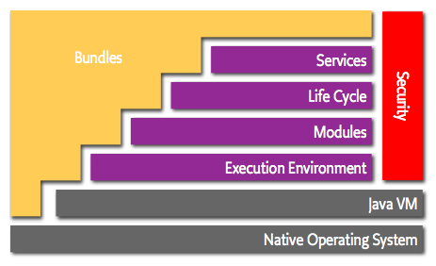
Notes:
The goal of this slide is just to do a quick presentation of the global OSGi's architecture. A brief summary for every single layer should be enough
– Bundles:OSGI components
– Services:Connecting in a dynamic way. POJOs.
– Life-cycle:How to install, start, stop, update and uninstall bundles
– Modules: About encapsulating and importing/exporting code
– Security: All aspects related to security
– Execution environment: What methods and classes are available

Slide 11
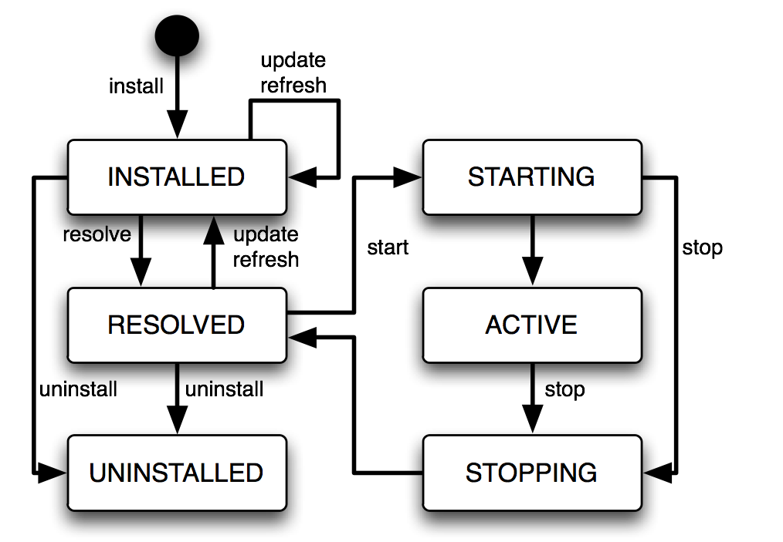
Notes:
Just a quick tour over the new Lifecycle we can get for free

Slide 12

Notes:
The goal is to present how we have tried to apply all the previous concepts to the Liferay plaform doing a brief summary of the general architecture of the solution. Something like this
Embedded OSGI framework Ideally should be “agnostic”: Felix and Equinox are supported
HTTP Service implementation
Backwards compatible
Always enabled
Done as plugins (except the embedded OSGi container) so it is completely non intrusive.
The idea of this slide is to present the overall of the architecture built-in inside Liferay but without going too much deep in the stack (I tend to think most of the people gets bored when you go too deeper)
Make especial emphasis on how we can benefits of the deployment aspects of this approach

Slide 13
Architecture overview (I)
Application Server + Liferay
App
Embedded OSGi container
App
App
App
App
App
App

Slide 14
Architecture overview (II)
Embedded OSGi container
Log Service
Http Service
App
App
Web Extender
JSP Support
App
App
JSTL Support

Slide 15
Complete with a couple of graphics of a detailed view of the architecture:
One for a high level overview of the approach
One with a more detailed explanation of how it works (not sure it this is interesting)

Slide 16

Notes:
This is something Ray and I should discuss: I think many of the stuff mentioned have already been discussed but we should agree anyway :)
– Put in place the JSP support once we have already done it. This will allow you to write your UI using the JSP: but right now you can already use other alternatives like Vaadin (perfect fit within OSGi), Freemarker,…
– Trying to apply some of the concepts previously shown in the Liferay Core:
– Powerful registry mechanism;
– Easier extensibility and reuse of components
– Get all the benefits from having smaller components like: less bugs, easier to maintain/rewrite, focus, distributed teams, …
Some of the features I would like to have:
– Small self-contained modules, so you can remove dependencies with the traditional big application servers
– Previous point will allow us to get a huge increase of our architecture's versatility
– The previous point will allow us to move Liferay's resiliency and scaling to the next point: horizontal scaling (distribution), applying some of the Hystrix concepts to our services, …
– Many more … we need to discuss

Slide 17
Looking to the future (I)
JSP support
Already done, not ready for release
Vaadin (perfect match), Freemarker
Web Application Bundle specs
Already done, not ready for release
Improving the core
Powerful registry mechanism
Easier extensibility and reuse of components
Development focus, distributed teams, ...

Slide 18
Looking to the future (II)
Small self-contained modules
Previous points lead us to
Increase Liferay architecture versatility
Resiliency and scaling: moving to the next point
… we still have many things to discuss

Slide 19

Notes:
Hands-on on how to write some example applications:
We can use some of the apps we have already builtin since, IMHO, they can be used for teaching purposes.
This will help us not only to show how write the apps but to show the current abilities of the Plugins SDK related with all this new stuff
My idea;
Show the metrics application in order to expose how you can modularize your application
Show how to write a new command for the console
Build a new hook (OSGi based of course ☺ )

Slide 20


