Slide 1

Analyzing Gender Pay Gap: Insights from UK Company Data
Notes:
Show the topic of the whole slide deck.

Slide 2
content
Dataset Description
Data Analysis and Visualization
Challenges and Opportunities
Notes:
Show an outline of my presentation.

Slide 3
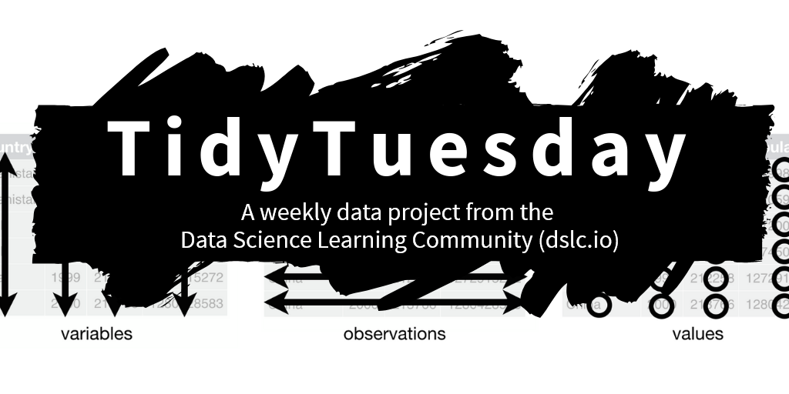
Dataset
Source: TidyTuseday
Topic: Gender Pay Gap
- a widely discussed and ongoing social issue
Dataset Dimensions: 48711 rows × 27 columns
https://github.com/rfordatascience/tidytuesday/blob/main/static/tt_logo.png
Notes:
Explain the origin of my data and the size of dataset. Explain why I wanted to perform some data analysis on it.

Slide 4
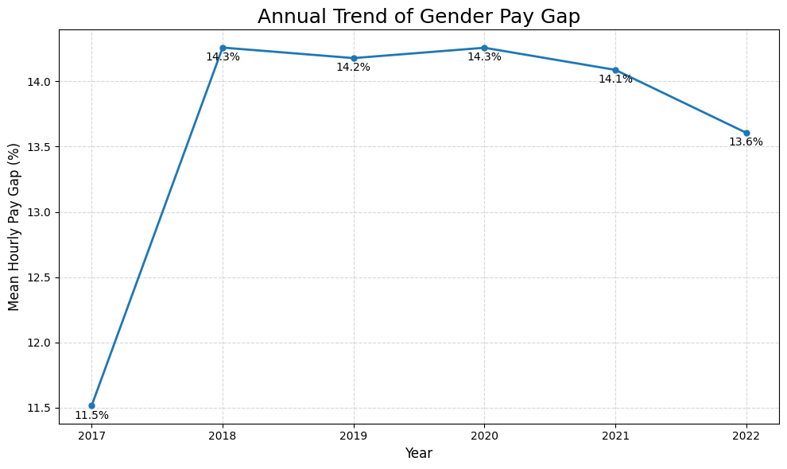
UK Gender Pay Gap: A Five-Year Review
2017 to 2018:
Gender pay gap increased rapidly from 11.5% to 14.3%
2018 to 2021: Pay gap remained stable around 14%, with minor fluctuations
2022: The gender pay gap dropped to 13.6%, the lowest level since 2017.
Notes:
The trend of the gender pay gap from 2017 to 2022 shows that the gap still persists, and the rate of reduction remains very slow.
Although the 2022 decline is a positive sign, the pace of change remains insufficient for achieving equality soon.

Slide 5
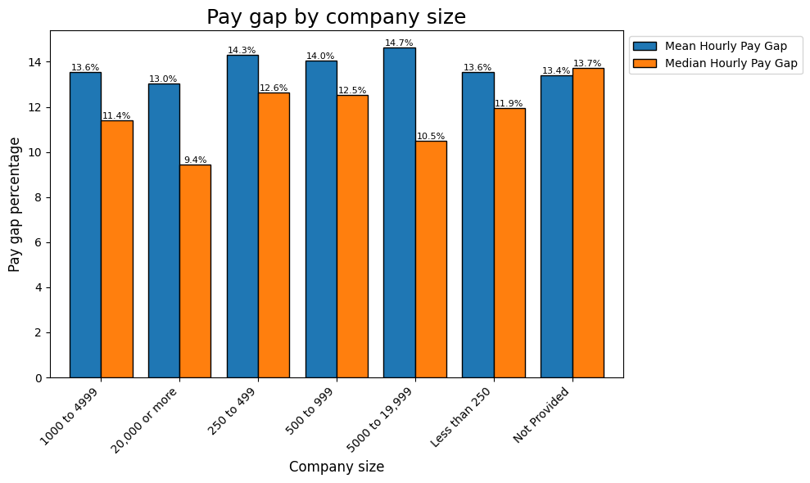
Company Size and Gender Pay Gap
Largest gap found in companies with 5,000-19,999 employees (Mean: 14.7%)
Companies with undisclosed size show highest median gap at 13.7%
Smallest gap in companies with 20,000+ employees (Mean: 13.0%, Median: 9.4%)
Notes:
As shown in the graph, both the mean and median percentage differences between male and female hourly pay are positive, indicating that regardless of company size, female hourly pay is generally lower than male hourly pay. However, there is no clear relationship between company size and pay gap.

Slide 6
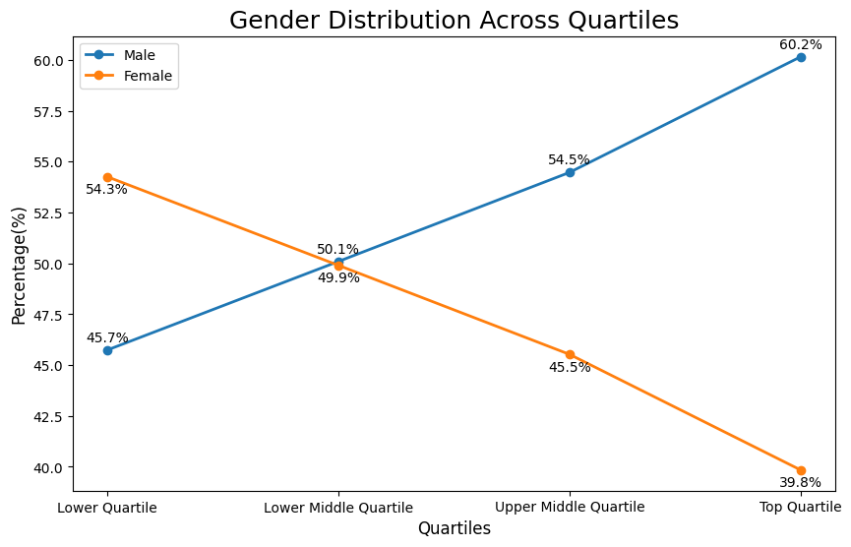
Gender Representation Across Pay Quartiles
Lower quartile: Female dominance (54.3%)
Middle quartiles: Near equal representation (~50%)
Upper middle quartile: Male majority (54.5%)
Top quartile: Significant male dominance (60.2%)
Notes:
The data reveals a gender imbalance across pay quartiles. While women are more represented in lower-paying positions (54.3%), their presence steadily decreases as we move up the pay scale, dropping to just 39.8% in the top quartile, indicating a significant lack of women in higher-paying roles.

Slide 7
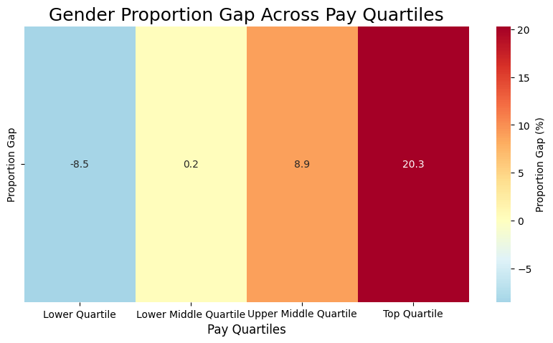
Balance point: Lower Middle Quartile
Significant shift:
Lower Quartile (-8.5%)
Upper Middle Quartile (+8.9%)
Maximum disparity: Top Quartile (+20.3%)
Notes:
To supplement the previous slide: through enhanced color contrast, this heatmap clearly illustrates the gender proportion gap across different pay quartiles. This demonstrates that as pay levels increase, significant gender disparities persist in higher-paying positions. This clearly indicates a worrying trend of women's underrepresentation in higher-paying positions.

Slide 8
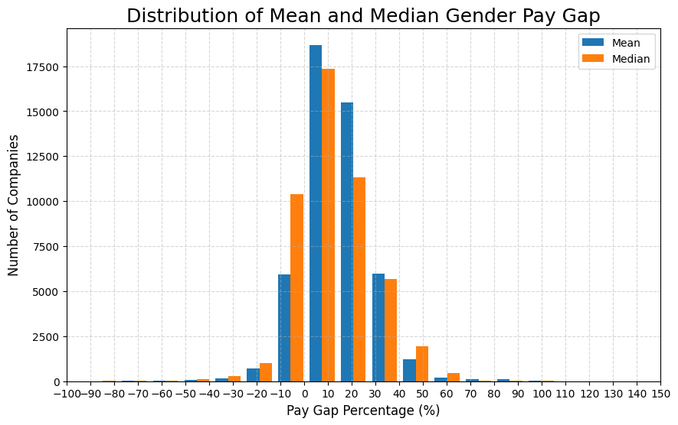
Distribution of Gender Pay Gaps
Concentration of pay gap: Most companies have mean and median pay gaps concentrated between 0% and 20%.
Predominance of positive gaps: Positive pay gaps indicate that men are paid more than women in most companies
Notes:
This chart illustrates the distribution of gender pay gaps across companies. Most pay gaps are concentrated between 0% and 20%, indicating moderate disparities in the majority of cases. The predominance of positive values suggests that men are generally paid more than women. This indicates that pay inequality is widespread but varies in severity across companies.

Slide 9
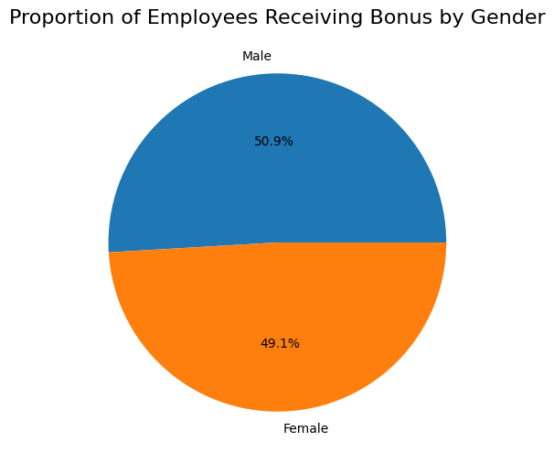
Gender Distribution in Bonus Recipients
Male employees: 50.9% receive bonuses
Female employees: 49.1% receive bonuses
Nearly equal distribution between genders
Notes:
This chart shows the proportion of male and female employees receiving bonuses. The data shows that men and women have almost equal chances of receiving a bonus. This suggests that bonus policies may have achieved some level of gender equality.

Slide 10
Challenges and Opportunities
Challenges:
Large dataset
Challenges in data manipulation: A large amount of missing data
Identifying valuable perspectives for visualization
Writing clean and efficient code
Opportunities:
Exploring advanced visualization chart styles (e.g., Violin Plot)
Exploring more visualization perspectives
Notes:
Explain the challenges encountered during coding and areas for improvement.

Slide 11
Thank You.

