Slide 1
🌱
FOOD DONATION WEBSITE
FOOD
RESCUE
Save Food.
Share Happiness.
A digital platform to share surplus food and help people in need.
PROJECT PRESENTATION

Slide 2
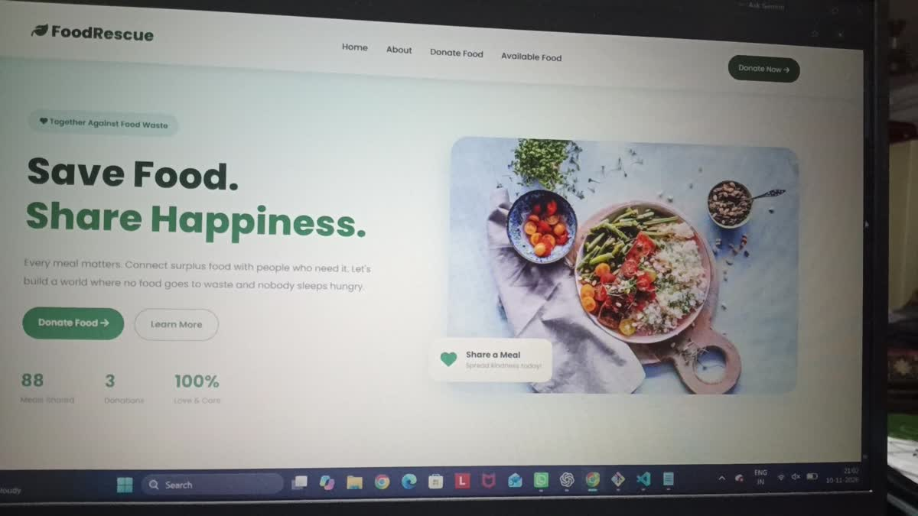
Project Overview
02
What is FoodRescue?
FoodRescue is a food donation website designed to encourage people to share extra food instead of wasting it.
Provides a simple way to donate surplus food.
Shows food donations available on the website.
Promotes kindness, community support and responsible food use.
Homepage shown in the uploaded website demo

Slide 3
Problem Statement & Aim
03
Problem
Aim
Edible food may be thrown away while people nearby need meals. Donors may not have a simple way to share extra food.
To create an easy-to-use website where people can share surplus food details and make those donations visible to others.
Main message
Small actions can create a big positive change.

Slide 4
Home Page – Save Food, Share Happiness
04
Displays the FoodRescue name and navigation menu.
Introduces the purpose with a clear headline.
Provides a Donate Food action for visitors.
Uses food imagery and a green theme to support the message.
Website home page captured from the demo video

Slide 5
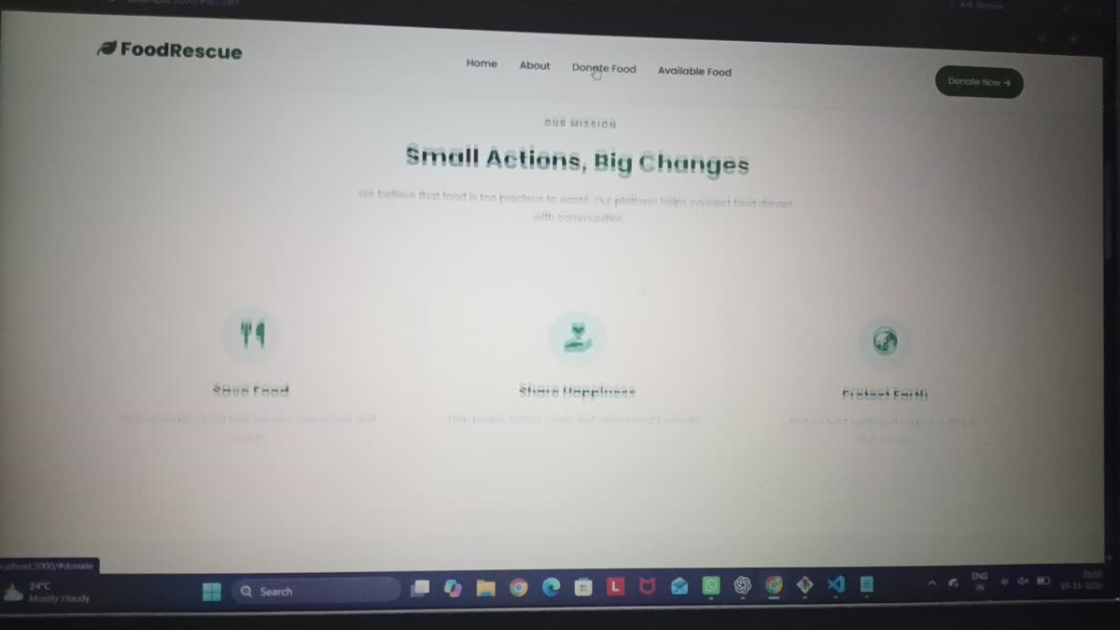
Impact & Awareness
05
Impact counters visible in the homepage demo
Demo statistics
The homepage displays 88, 3 and 100% as impact figures. These are the values visible in the recorded demonstration.
The website also highlights three ideas:
Save Food • Share Happiness • Protect Earth

Slide 6
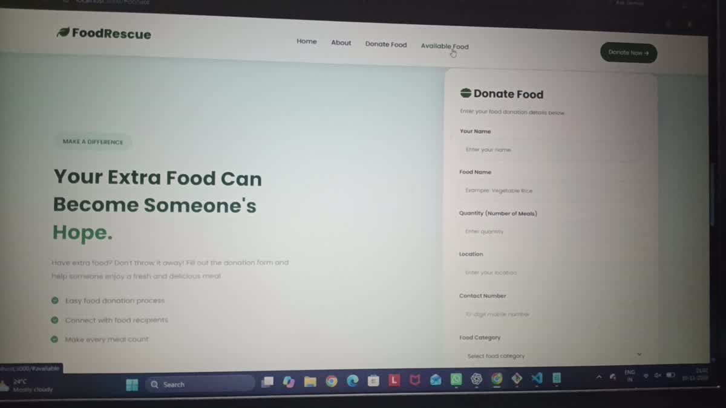
Donate Food – Donation Form
06
The donor can enter food and contact details.
The form is the main entry point for a new donation.
Clear labels help users understand what information is needed.
A simple form makes participation easier.
Donation form as shown in the uploaded video

Slide 7
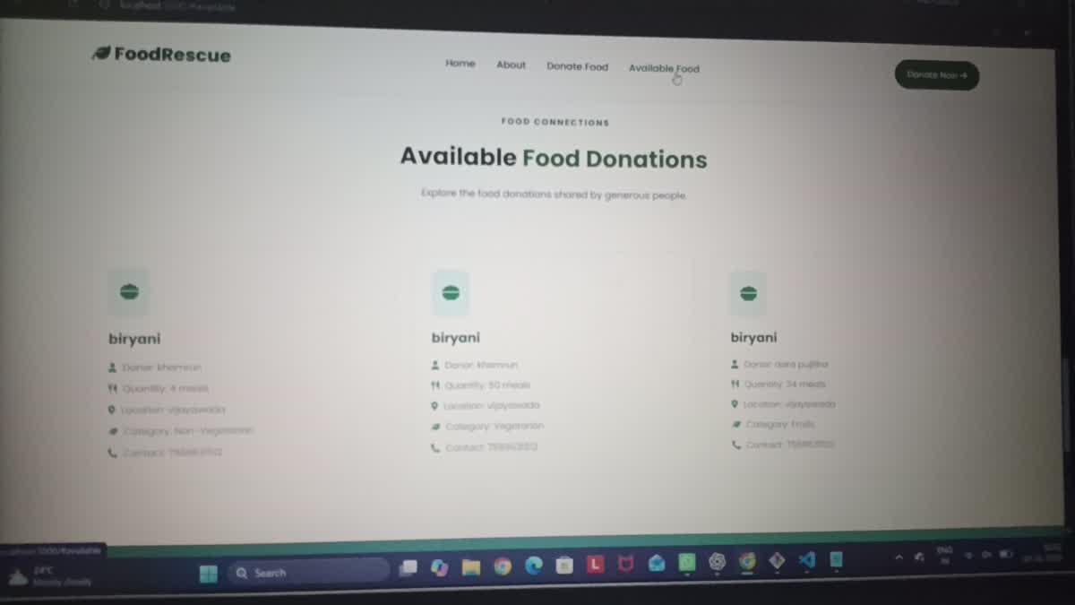
Available Food Donations
07
Displays food donations in separate cards.
The demo shows Biryani donation entries.
Visitors can review the listed food information.
This section helps make available donations visible.
Available donations page captured from the demo video

Slide 8
How a User Interacts with FoodRescue
08
01
Visit website
Open the FoodRescue home page.
02
Choose Donate Food
Go to the donation form.
03
Enter details
Provide information about the extra food.
04
Submit donation
Send the donation details through the form.
05
View available food
Check the donations displayed on the website.
User journey summarized from the pages shown in the video.

Slide 9
Benefits & Future Improvements
09
Benefits
Future scope
Conclusion
• Encourages food sharing.
• Raises awareness about food waste.
• Simple website flow.
• Makes donation information visible.
• Add secure user accounts.
• Store donations in a database.
• Add pickup and delivery coordination.
• Add donation status and expiry details.
FoodRescue shows how a simple website can support food donation awareness and help connect surplus food with people who may need it.
THANK YOU
Questions & Discussion

