Slide 1
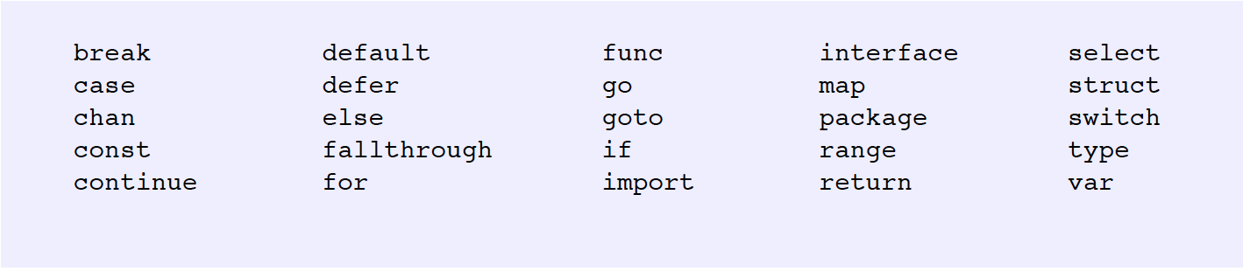
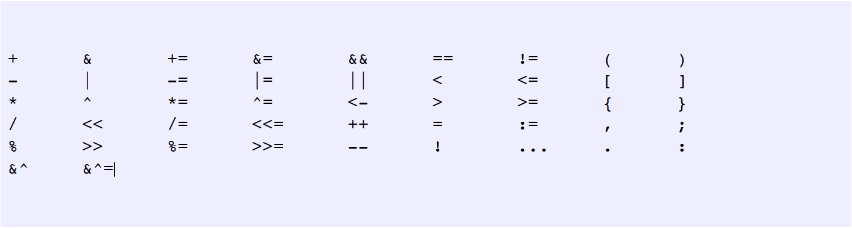
Keywords provide the core functionality of any programming language. Keywords
are reserved words and we can't use them to name anything else in our programs.
Lexical elements - Keyword
Operators provide character sequences that allow us to perform all sorts of
operations within our programs. Some of these operations include declaring and
executing blocks of code, performing mathematical calculations, manipulating
memory, and applying conditional logic.

Slide 2
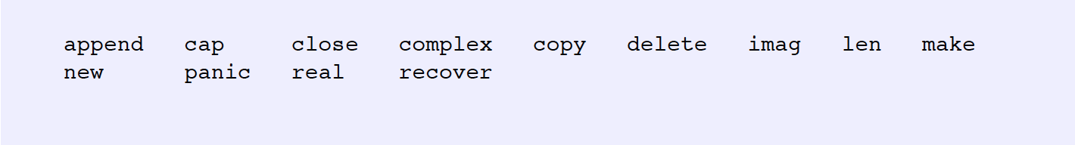
Built-in functions are pre-declared and provide extended functionality to the language. The functionality for using Go's internal data structures, handling memory allocations, de-allocations and exception handling are supported with the built-in functions. Don't confuse the built-in functions with keywords. These are not keywords, they are functions that have been implemented by the Go language team and are globally available to us.
http://golang.org/pkg/builtin/

Slide 3
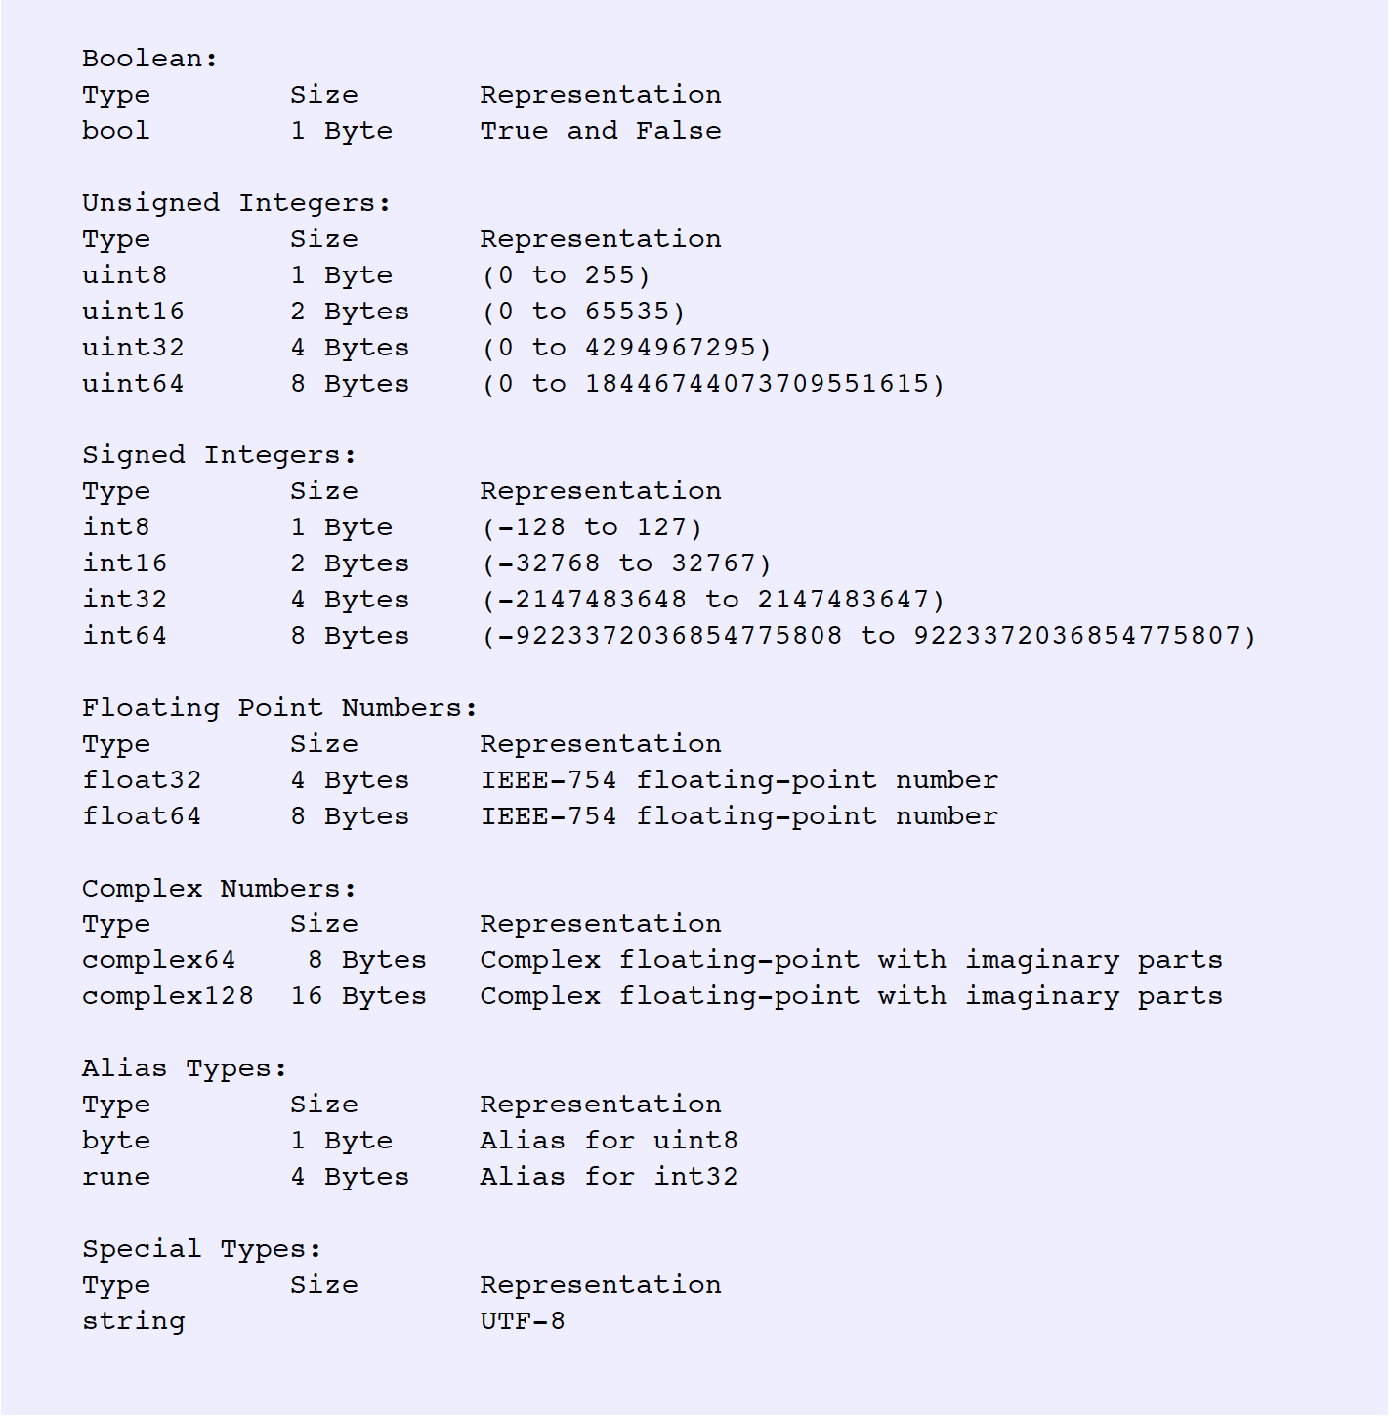

Slide 4
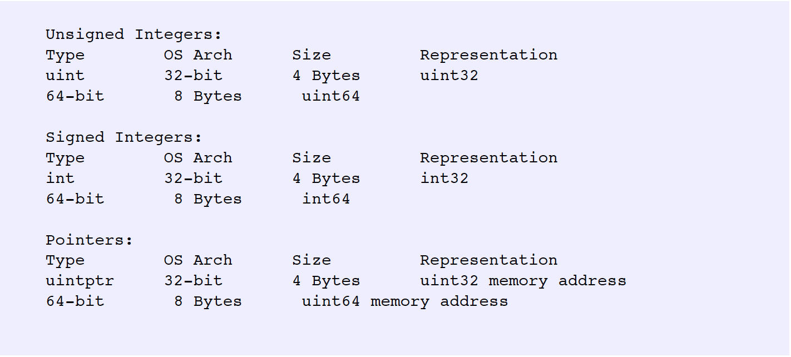
There are pre-declared numeric types in the language as well. These types take
their memory size and representation based on the architecture of the operating
system we are building our programs against. Many Go programmers use these
types when possible because using an integer size that matches the size of a
Word efficient. We can take advantage of this efficiency without
requiring code changes for each platform we build our programs against.

Slide 5
Variables Code
All variable are initialized to at least there default value
When declaring the variable to a default value use the keyword var
Use short variable declaration operator when declaring and initing.
Convert values to specific types. There is no casting in Go.
Constants Code
When declaring a constant use the keyword const.
Constants require direct initing.
Can’t use the short variable declaration operator
http://www.goinggo.net/2014/04/introduction-to-numeric-constants-in-go.html

