Slide 1
Computer Vision 電腦視覺 OpenCV 安裝及開發環境設定
Instructor: Chien-Wu Tsai

Slide 2
OpenCV Installation
Installation in Windows
How to build applications with OpenCV inside Visual Studio 2017
Image Watch: viewing in-memory images in the Visual Studio debugger
Load and Display an Image
Load, Modify, and Save an Image

Slide 3
Installation in Windows
兩種安裝方式
Installation by Using the Pre-built Libraries
Installation by Making Your Own Libraries from the Source Files
參考網站：https://cv-tricks.com/how-to/installation-of-opencv-4-1-0-in-windows-10-from-source/
較複雜，自行嘗試。

Slide 4
Installation by Using the Pre-built Libraries
步驟：
複製QT到C:\Qt
複製opencv到C:\opencv
設定系統環境變數
OPENCV_DIR=C:\opencv\build\install\x64\vc16
將以下路徑加到Path環境變數
C:\Qt\5.15.0\msvc2019_64\bin
%OPENCV_DIR%\bin

Slide 5
How to build applications with OpenCV inside Visual Studio 2017
參考網站：https://docs.opencv.org/4.1.0/dd/d6e/tutorial_windows_visual_studio_opencv.html
步驟：
在Visual Studio 2019，新增一個空白C++專案
選擇 x64 Debug專案組態
加入使用OpenCV API的原始檔
opencvEx1.cpp
設定OpenCV標頭檔目錄
$(OPENCV_DIR)\..\..\include
設定OpenCV函式庫目錄
$(OPENCV_DIR)\lib
加入OpenCV函式庫
opencv_highgui420d.lib、opencv_imgcodecs420d.lib、opencv_imgproc420d.lib、opencv_core420d.lib
建置專案並執行

Slide 6
Image Watch使用(1)
參考網站：
IMAGE WATCH HELP
Image Watch: viewing in-memory images in the Visual Studio debugger
Image Watch is a watch window for viewing in-memory bitmaps when debugging native C++ code.
Support for OpenCV image types
cv::Mat
cv::Mat_<>
CvMat
_IplImage

Slide 7
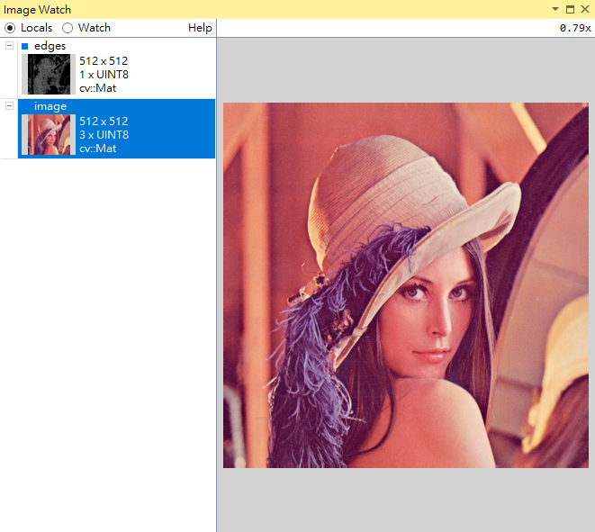
Image Watch使用(2)
Download the Image Watch 2019 installer
開啟OpenCV專案，並設定中斷點
選擇View > Other Windows > Image Watch

