Slide 1
Salary Prediction for New Employee using Linear & Polynominal Regression
Presented by: Ms. Trupti Sultane

Slide 2
1. Introduction
Purpose: To determine the appropriate salary for a new Regional Manager with 2 years of experience.
Data Source: Position_Salaries.csv
Roles Considered: Various managerial and consultant roles.

Slide 3
2. Data Overview
Description of Data:
Columns: Position, Level, Salary
Position | Level | Salary
Business Analyst | 1 | 45,000.00
Junior Consultant | 2 | 50,000.00
Senior Consultant | 3 | 60,000.00
Manager | 4 | 80,000.00
Country Manager | 5 | 1,10,000.00
Region Manager | 6 | 1,50,000.00
Partner | 7 | 2,00,000.00
Senior Partner | 8 | 3,00,000.00
C-level | 9 | 5,00,000.00
CEO | 10 | 10,00,000.00

Slide 4
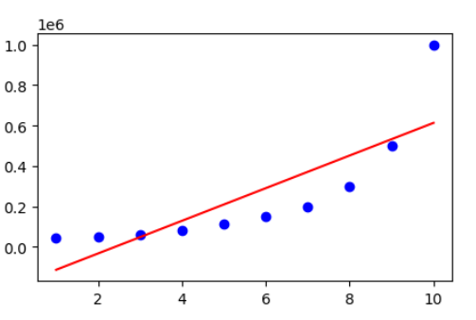
3. Methodology
Linear Regression: The linear regression formula is y = a + bx, where y (Salary) is the dependent variable, x (Level) is the independent variable.

Slide 5
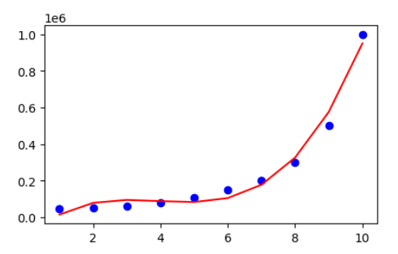
Polynomial Regression : For a polynomial regression of degree 3, the formula is: y=β0+β1x+β2x2+β3x3+ϵ, where y is the dependent variable (Salary), x is the independent variable (Level), β0​ is the intercept, β1​,β2​,β3​ are the coefficients for the linear, quadratic, and cubic terms, respectively, ϵ is the error term.

Slide 6
4. Model Diagnostics
Metrics for Linear Regression
Mean Absolute Error (MAE)
Mean Squared Error (MSE)
R-squared (R²)
Metrics for Polynomial Regression
Mean Absolute Error (MAE)
Mean Squared Error (MSE)
R-squared (R²)
Comparison of Metrics:
Metrics | Linear Regression | Polynomial Regression
Mean Absolute Error (MAE) | 128454.5455 | 34790.20979
Mean Squared Error (MSE) | 26695878787.8787 | 1515662004.6620
R-squared (R²) | 0.669 | 0.98

Slide 7
5. Results
Salary Prediction : Based on the linear regression model, the predicted salary for a new Regional Manager with a level of 6.5 can be calculated as:
Salary = 50,000x - 5,000 Salary = 50,000(6.5) - 5,000 Salary = 325,000 - 5,000 Salary = 320,000
Using the polynomial regression model, the predicted salary can be calculated as:
Salary = 0.0003x^2 + 10.333x - 15.333 Salary = 0.0003(6.5)^2 + 10.333(6.5) - 15.333 Salary = 0.0003(42.25) + 67.1575 - 15.333 Salary = 0.12675 + 67.1575 - 15.333 Salary = 52.04125 Salary = 320,415
Model Performance : Both models predict a salary around 320,000 for a new Regional Manager with a level of 6.5. However, the polynomial regression model provides a more precise prediction of 320,415.

Slide 8
6. Conclusion
In conclusion, this project aimed to develop a model to predict the salary of a new Regional Manager with a level of 6.5 based on the provided salary data. Two models were built: linear regression and polynomial regression. Both models were visualized, and their performance was evaluated using metrics such as Mean Squared Error (MSE), Mean Absolute Error (MAE), and R-squared. The results showed that both models performed reasonably well, with the polynomial regression model providing a more accurate prediction of 320,415. Additionally, it was suggested that incorporating factors such as industry experience, education, and skills could further improve the accuracy of the salary prediction model. Overall, this project demonstrated the application of linear and polynomial regression techniques in predicting salaries based on job level, and the potential for further refinement by considering additional factors.
Thank You!

