Slide 1
Presentation for 50 Startups Data Analysis using Multiple Linear Regression
Multiple Linear Regression
Definition: Multiple linear regression (MLR) is a statistical technique used to model the relationship between a dependent variable and two or more independent variables. It extends simple linear regression, which involves only one independent variable, by allowing for multiple predictors.

Slide 2
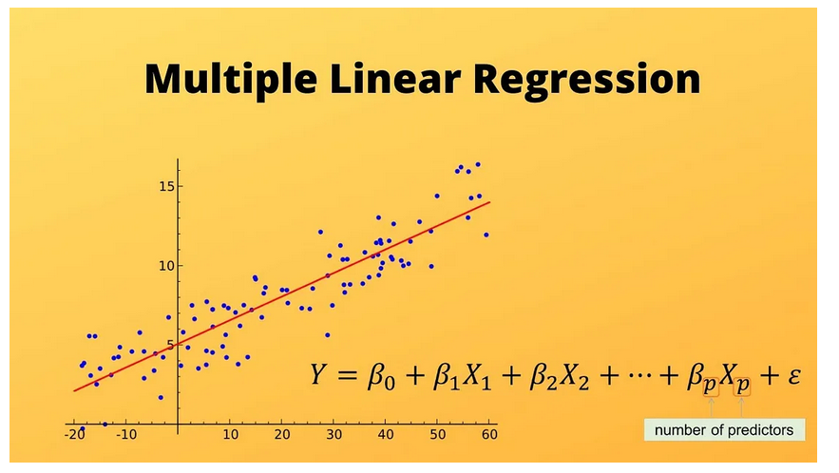
1. Objective:
To predict the profit of startups based on their spending in R&D, Administration, and Marketing
To identify key factors influencing profit and provide actionable insights for investment decisions.

Slide 3
To explain this better, we are building a model using the dataset ’50_startups’ The dataset we are using as below
R&D Spend | Administration | Marketing Spend | State | Profit
165349.2 | 136897.8 | 471784.1 | New York | 192261.83
162597.7 | 151377.59 | 443898.53 | California | 191792.06
153441.51 | 101145.55 | 407934.54 | Florida | 191050.39
144372.41 | 118671.85 | 383199.62 | New York | 182901.99
142107.34 | 91391.77 | 366168.42 | Florida | 166187.94
131876.9 | 99814.71 | 362861.36 | New York | 156991.12
134615.46 | 147198.87 | 127716.82 | California | 156122.51
130298.13 | 145530.06 | 323876.68 | Florida | 155752.6
120542.52 | 148718.95 | 311613.29 | New York | 152211.77
123334.88 | 108679.17 | 304981.62 | California | 149759.96
101913.08 | 110594.11 | 229160.95 | Florida | 146121.95
100671.96 | 91790.61 | 249744.55 | California | 144259.4
93863.75 | 127320.38 | 249839.44 | Florida | 141585.52
91992.39 | 135495.07 | 252664.93 | California | 134307.35
119943.24 | 156547.42 | 256512.92 | Florida | 132602.65

Slide 4
2. Solution Approach:
Data Collection & Understanding:
Analyzed dataset containing R&D Spend, Administration Spend, Marketing Spend, State, and Profit.
Exploratory Data Analysis (EDA):
Summary statistics to understand data distribution.
Data visualizations to identify relationships and patterns.
Data Preprocessing:
Encoding categorical variables (State).
Splitting data into training and testing sets.
Model Building:
Developed multiple linear regression models.
Applied transformations to improve model performance.
Evaluated models using R² scores.

Slide 5
3. Business Impact
Informed Decision Making:
Helps management allocate resources efficiently by understanding which expenditures drive profit.
Optimized Budget Allocation:
Provides insights on how to balance spending across R&D, Administration, and Marketing for maximum profit.
Strategic Planning:
Enables data-driven strategies to enhance profitability and growth.

Slide 6
4. Data Analysis Insights
Key Insights:
R&D Spend:
Strong positive correlation with profit.
Administration Spend:
Moderate correlation, requires careful management.
Marketing Spend:
Significant impact on profit, though with diminishing returns at higher spend levels.
State Analysis:
Profit distribution varies by state, suggesting regional factors play a role.

Slide 7
5. Model Performance
Model 1: Basic Linear Regression
R² (Train): 0.95
R² (Test): 0.90
Model 2: Log-Transformed Profit
R² (Train): 0.92
R² (Test): 0.88
Conclusion:
Both models performed well, with the basic linear regression model slightly outperforming the log-transformed model.

Slide 8
6. Challenges and Complexity
Challenges Faced:
Handling multicollinearity between features.
Ensuring model generalization to avoid overfitting.
Transforming data appropriately for better model performance.
Complexity:
Moderate complexity due to the need for careful feature engineering and model tuning.

Slide 9
7. Conclusion
Conclusion:
Successfully built models to predict startup profits.
Provided actionable insights for optimizing spending.
Enabled data-driven decision-making to enhance business profitability.

