Slide 1
Linear Regression Modelling
Simple Linear Regression
One of the most interesting and common regression technique is simple linear regression. In this, we predict the outcome of a dependent variable based on the independent variables, the relationship between the variables is linear. Hence, the word linear regression.

Slide 2
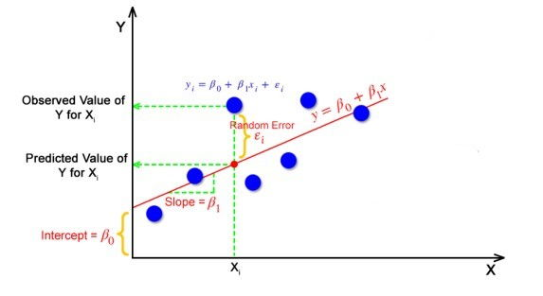
1. Objective:
The goal of the linear regression algorithm is to get the best values for B0 and B1 to find the best fit line. The best fit line is a line that has the least error which means the error between predicted values and actual values should be minimum

Slide 3
To explain this better, we are building a model using the dataset ‘Salary’ . The Objective of our model is to predict the Salary Hike on the basis of Experiance. The dataset we are using as below
YearsExperience | Salary
1.1 | 39,343.00
1.3 | 46,205.00
1.5 | 37,731.00
2 | 43,525.00
2.2 | 39,891.00
2.9 | 56,642.00
3 | 60,150.00
3.2 | 54,445.00
3.2 | 64,445.00
3.7 | 57,189.00
3.9 | 63,218.00
4 | 55,794.00
4 | 56,957.00
4.1 | 57,081.00
4.5 | 61,111.00
4.9 | 67,938.00
5.1 | 66,029.00
5.3 | 83,088.00
5.9 | 81,363.00

Slide 4
2. Solution:
A linear regression line has an equation of the form Y = mx+b, where m is the slope of the line, b is the y-intercept, and x is the independent variable.
To implement the linear regression, following are the steps we need to follow:
Loading the Data
Exploring the Data
Assigning the Values to Variables
Generate The Model
Model Evaluation
Checking The accuracy Of the Model
Let us get into the details of each of the steps to implement linear regression.

Slide 5
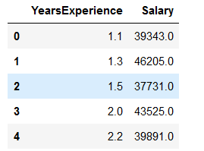
Loading the Data
import pandas as pd
data=pd.read_csv("E:/Top Mentor/3.Class 18.11.23/batch89assignmentsandsolutions/Project - 1&2_ Simple_Reg/delivery_time.csv")
Checking the data.
data.head(5)
Output:
We can see that we have two variables in the data, both variable are numerical data. In this dataset, we get the variable ‘YEarsExperiance’ as our dependent variable, and ‘Salary’ is independent variables.

Slide 6
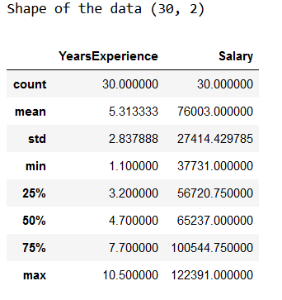
Exploring the Data
print("Shape of the data",data.shape)
data.describe()
Output:
So we have 30 rows and 2 variables or features which is the shape of the data and you can also see the distribution of the numerical variables through the basic statistics measures.

Slide 7
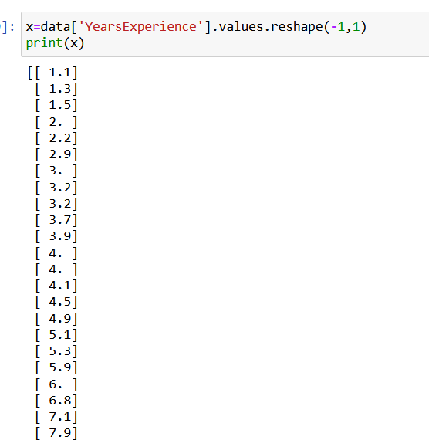
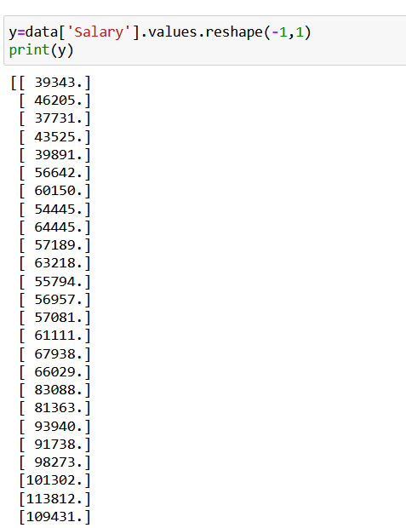
Assigning the Values to Variables
x=data['Delivery Time'].values.reshape(-1,1)
y=data['Sorting Time'].values.reshape(-1,1)
Output:

Slide 8
Generate The Model
from sklearn.linear_model import LinearRegression
model=LinearRegression()
model.fit(x,y)
print('Model is loaded')

Slide 9
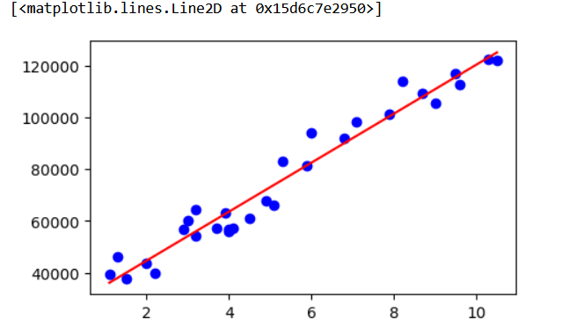
Model Evaluation
To evaluate our model, we must make some predictions on the data using our model to evaluate our model.
import matplotlib.pyplot as plt
plt.figure(figsize=(5,3))
plt.scatter(x,y,color=‘blue')
plt.plot(x,model.predict(x),color=‘red')
Output:

Slide 10
Checking The accuracy Of the Model
from sklearn.metrics import r2_score
r2_score(y,model.predict(x))
Output :
0.9569566641435086
This brings us to the end of the Project where we have built a model using Linear Regression

Slide 11
3. Business Impact
The motive of the building of the model is to predict the salary of an employee on the basis of experience he has. This model will help the companies to assign proper salary to the candidate they are going to recruit in the company. It will also help to save cost of the company by predicting the correct salary hikes.

