Slide 1
Summer Project – Small Volume Ink System
Vincent Wong - 01/09/16

Slide 2
Project Overview
New ink system
- Deliver ink at variable pressure and flow rate
- Provide ink conditioning such as temperature/filtration
- Minimum amount of ink required to operate
- Provide diagnostic metrics

Slide 3
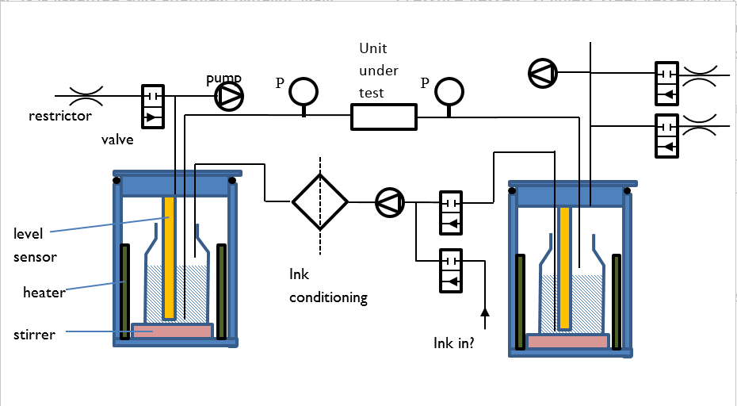
Project Overview
Proposed solution

Slide 4
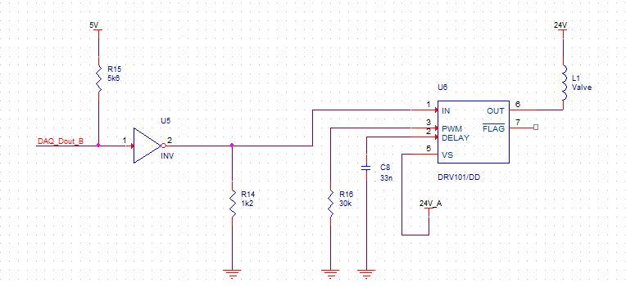
Valves

Slide 5
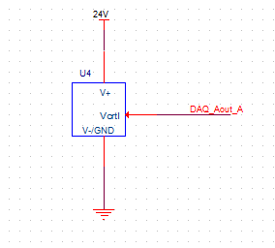
Pump (NF30)

Slide 6
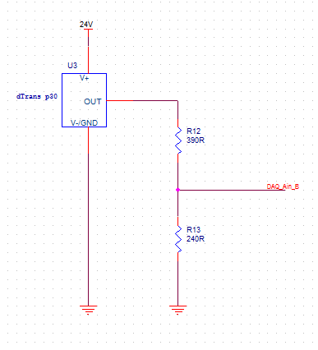
Pressure Sensor

Slide 7
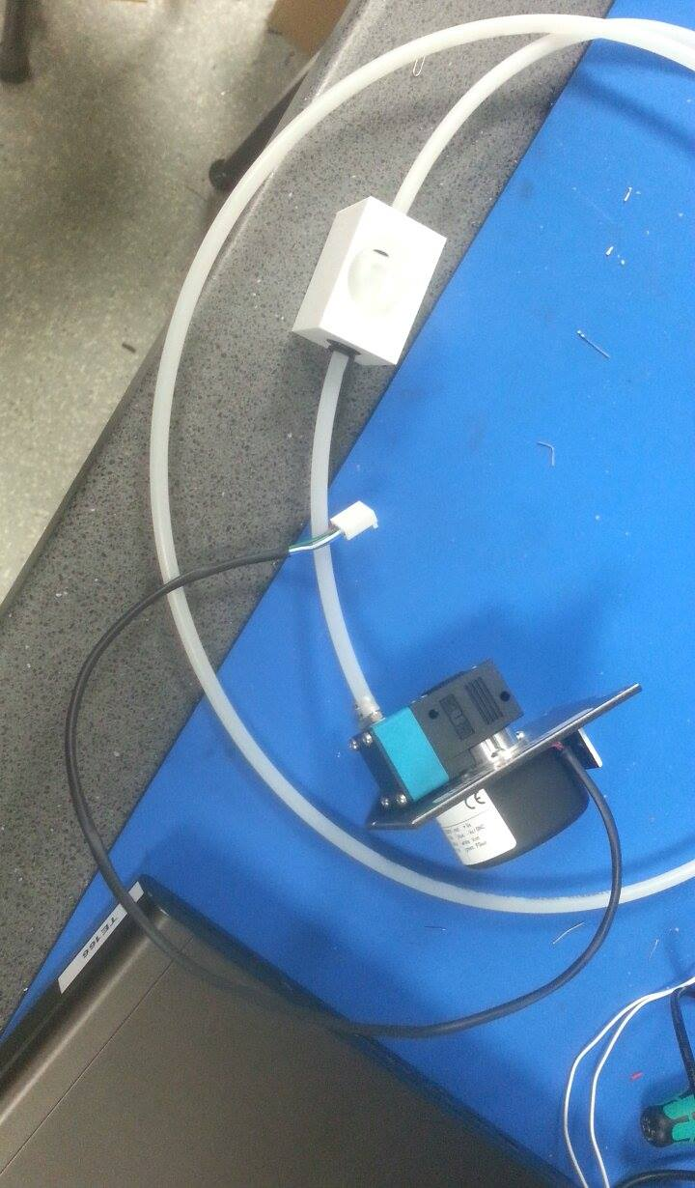
Pressure Sensor

Slide 8
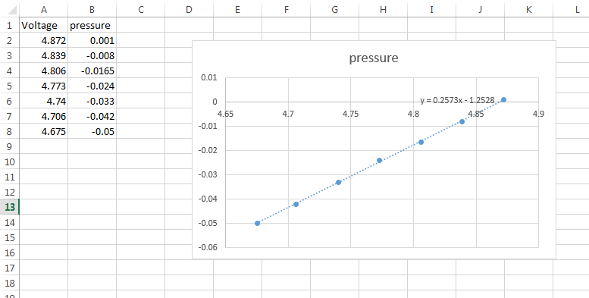
Pressure Sensor

Slide 9
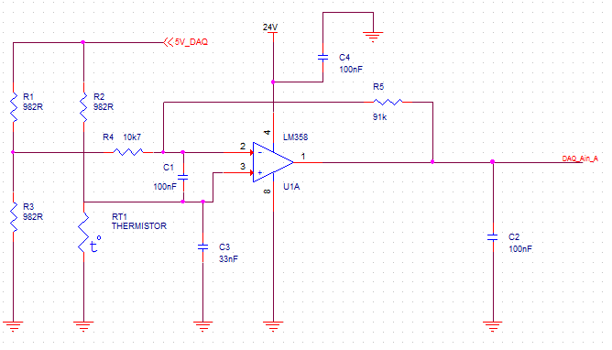
Temperature Sensor

Slide 10
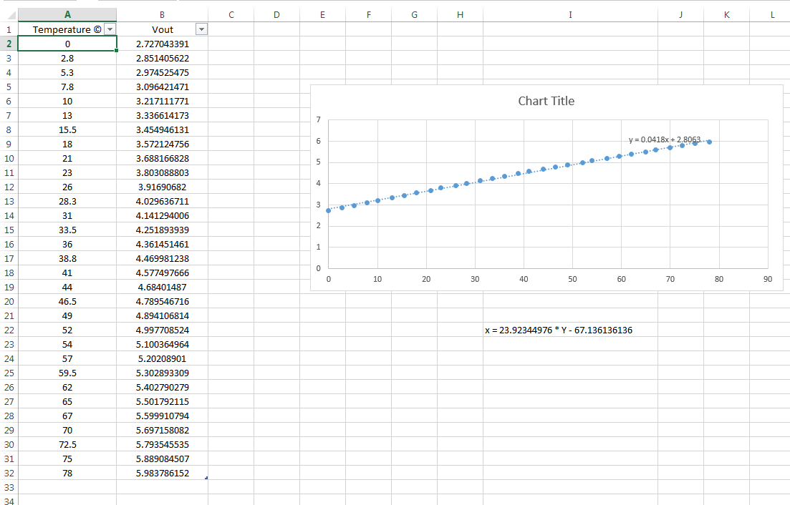
Temperature Sensor

Slide 11
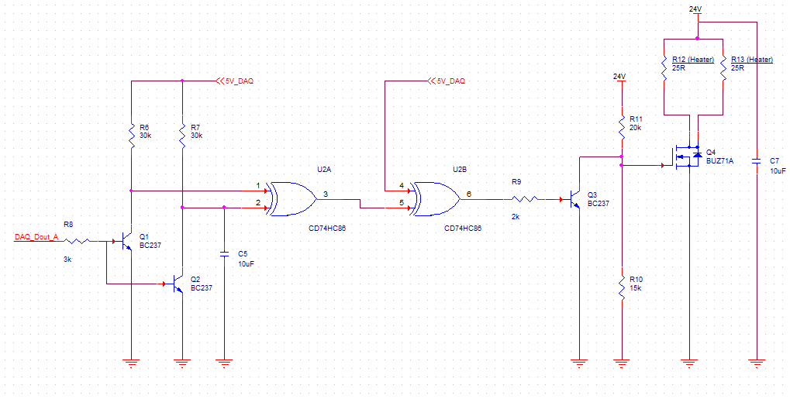
Heater

Slide 12
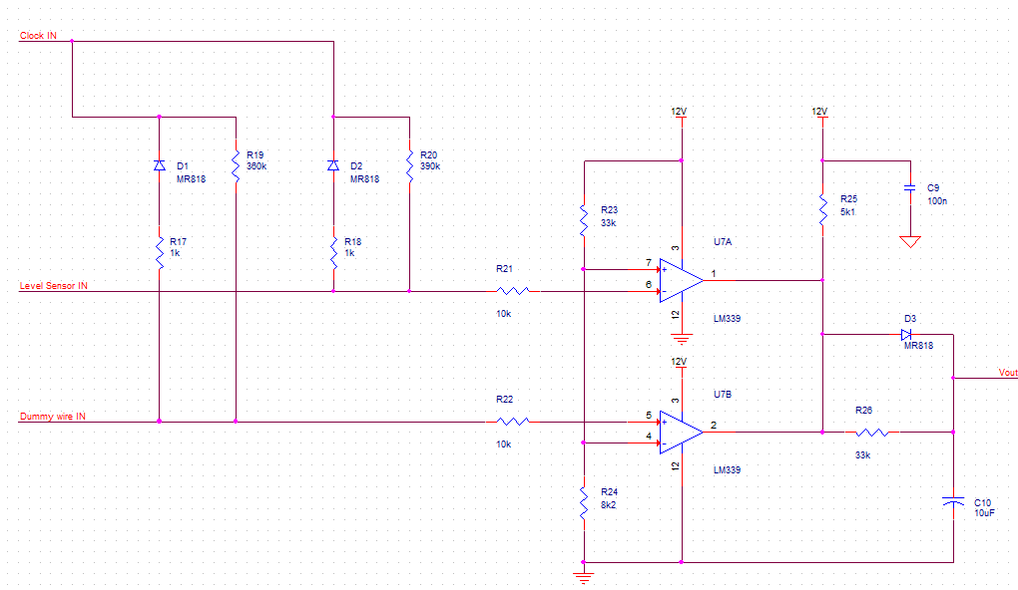
Level Sensor

Slide 13
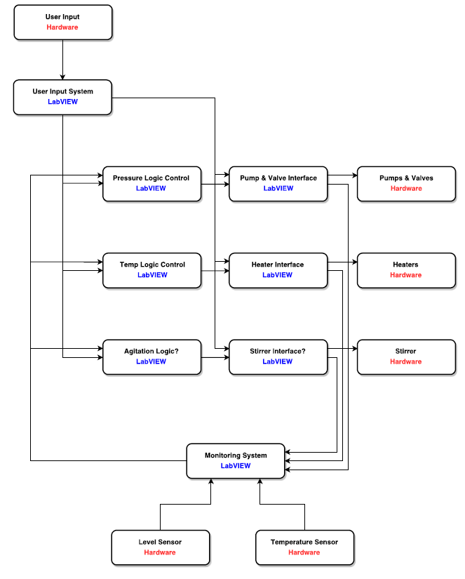
Software Architecture

Slide 14
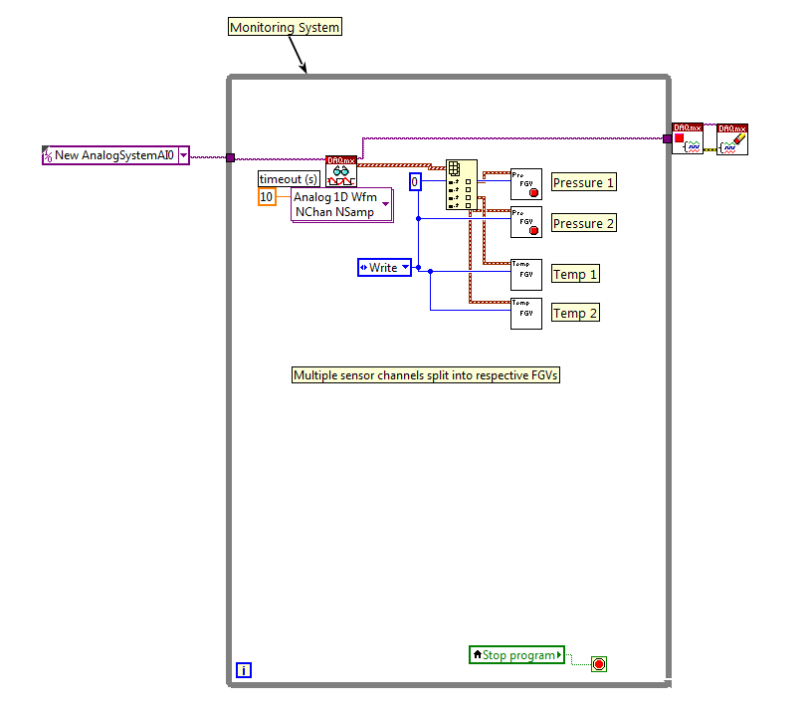
Software Integration

Slide 15
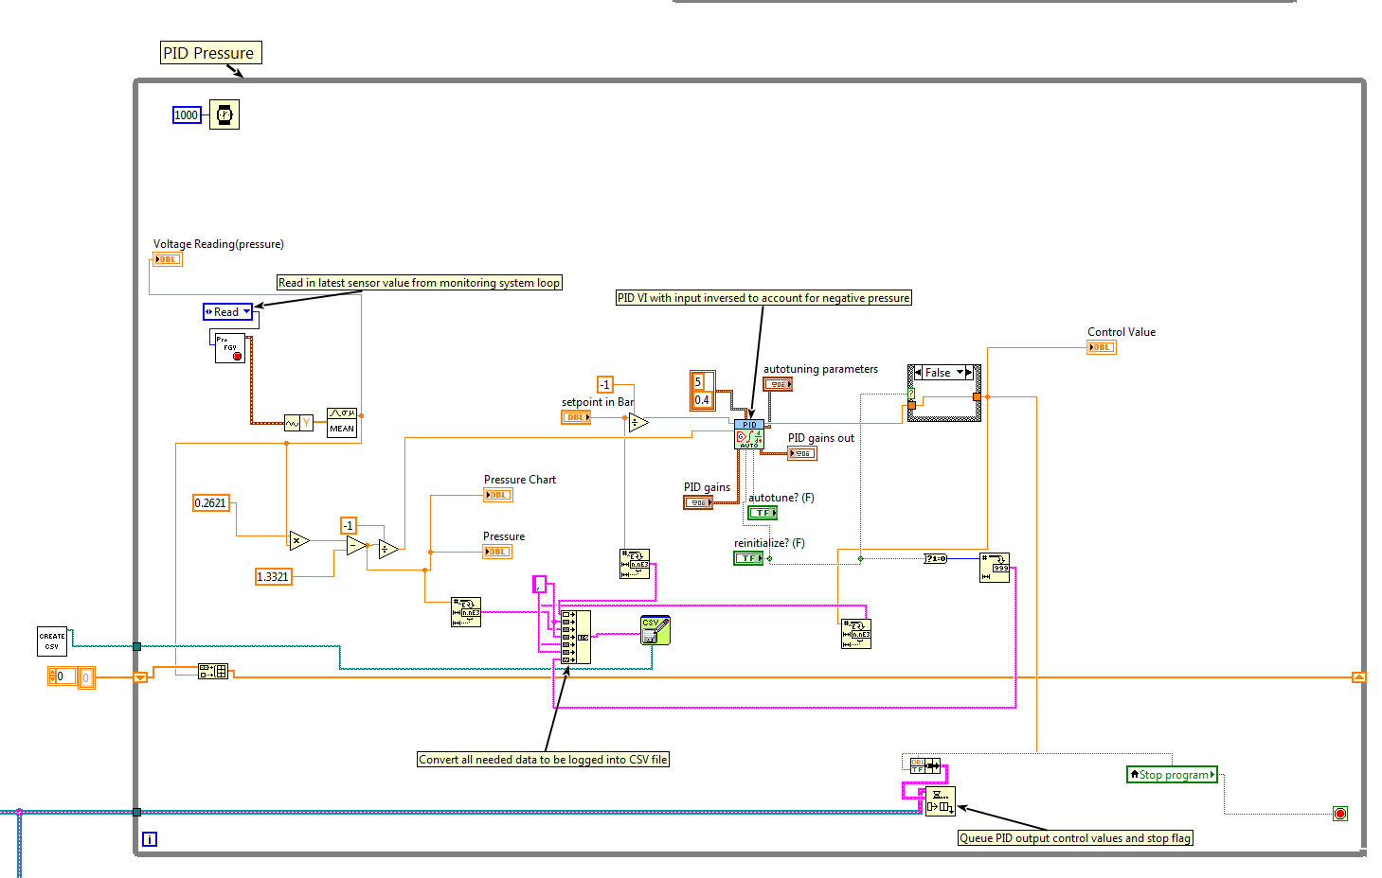
PID Control

Slide 16
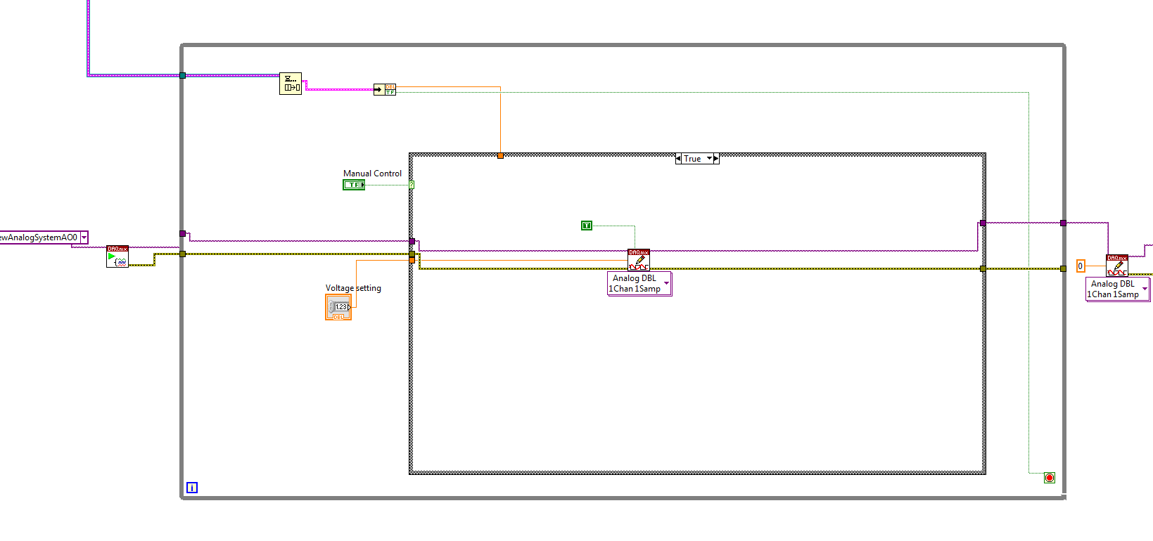
Software Integration

Slide 17
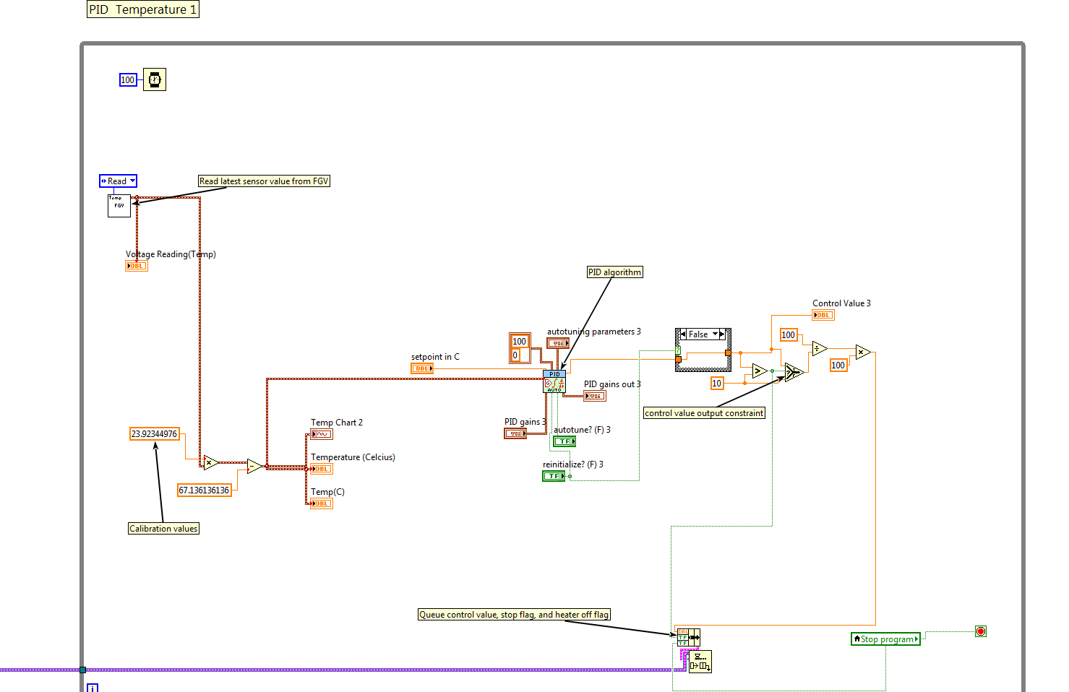
Software Integration

Slide 18
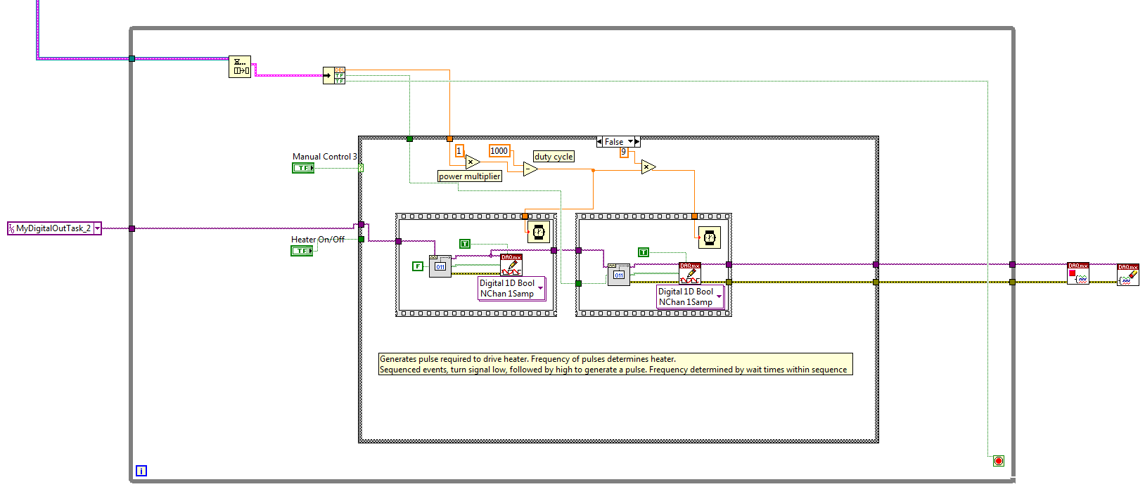
Software Integration

Slide 19
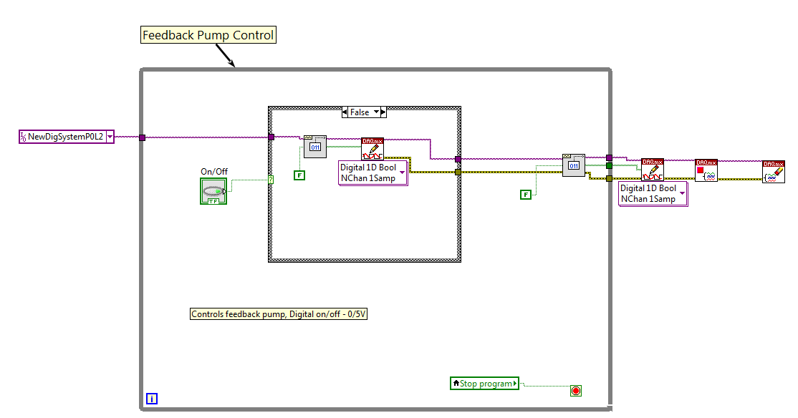
Software Integration

Slide 20
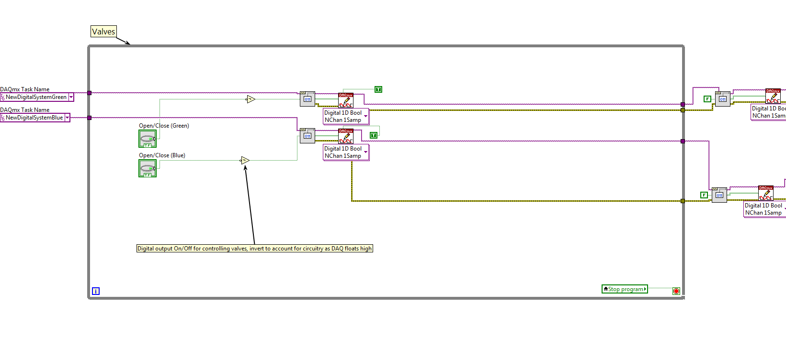
Software Integration

Slide 21
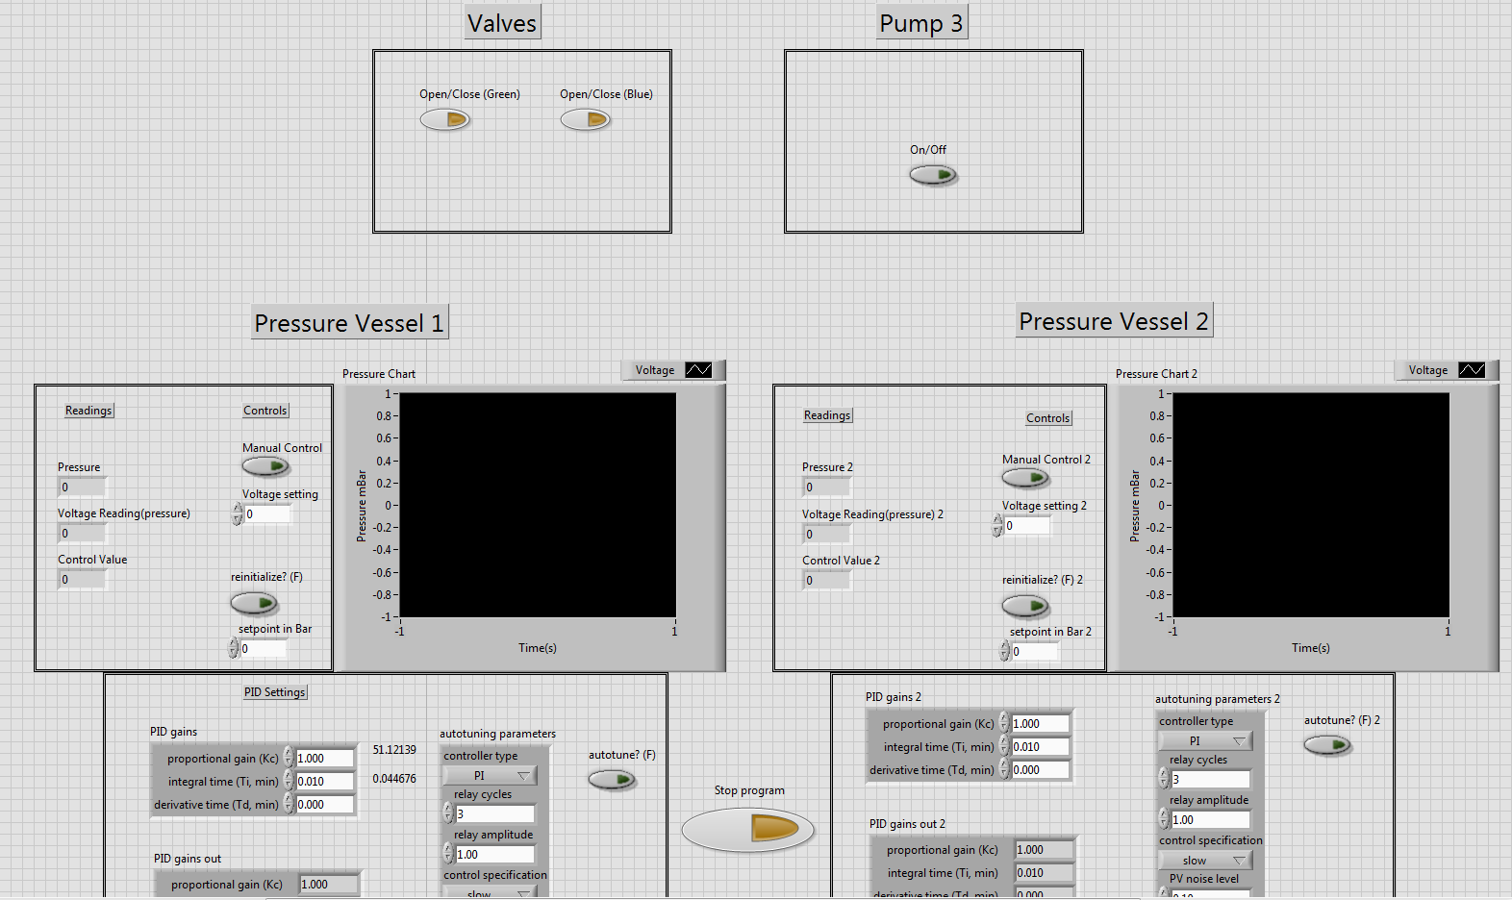
Software Integration

Slide 22
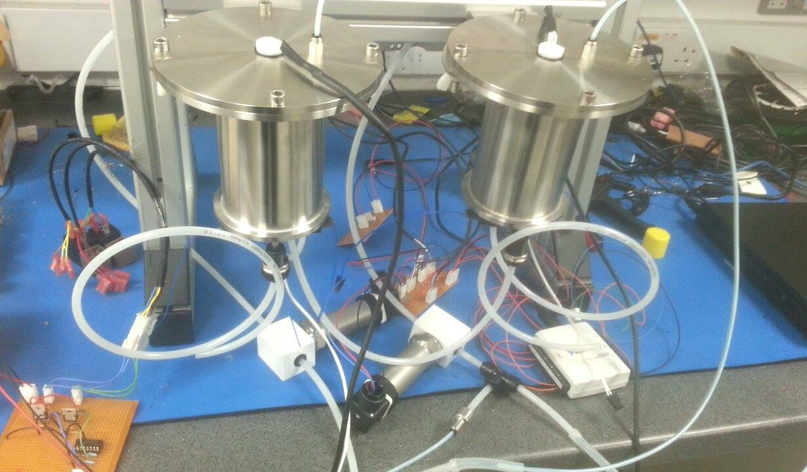
Hardware Integration

Slide 23
Next Steps
Temperature – Overheating
Level Sensor
Valves
Routines, prime, flush etc.
UI – Abstract/Simplify
Ink Conditioning - Filtration etc.

