Slide 1
.NET
Free. Cross-platform. Open source.
A developer platform for building all your apps.
www.dot.net

Slide 2
What is .NET?
Notes:
So what is .NET?

Slide 3

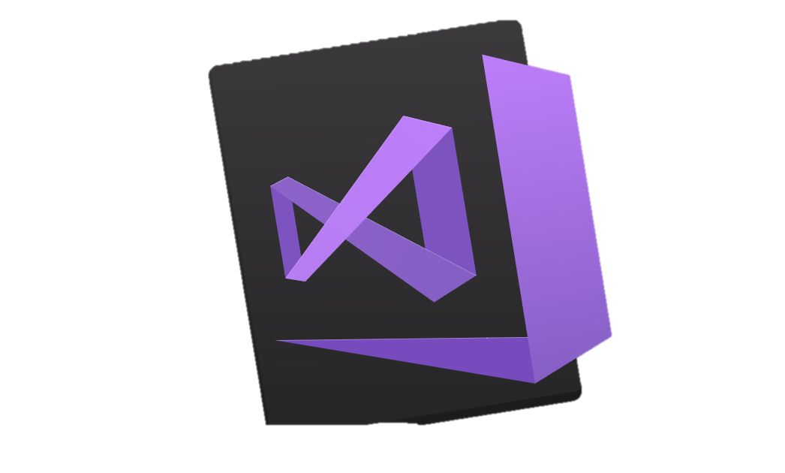


.NET is a software development platform
DESKTOP
WEB APPS, CLOUD SERVICES
MOBILE
GAMES
IoT
ARTIFICIAL INTELLIGENCE
TOOLS
VISUAL STUDIO
.NET STANDARD
VISUAL STUDIO FOR MAC
LIBRARIES
VISUAL STUDIO CODE
INFRASTRUCTURE
COMMAND LINE INTERFACE
RUNTIME COMPONENTS
COMPILERS
LANGUAGES
Notes:
You can build anything with .NET. It is an entire software development platform that takes care of a lot of the heavy lifting for you when you want to build an application. Applications frameworks help you build the specific types of apps or workloads and enable you to literally build any app for any platform with any operating system. Each .NET workload shares a common infrastructure and .NET Standard library. This means not only are your .NET skills portable, but your actual code is portable no matter what you’re building. This makes it easy to share reusable components (called libraries) across the breadth of applications people build.
Additionally, there are a broad set of development tools that makes it really productive to write, debug, build and manage code bases.
See: www.dot.net

Slide 4
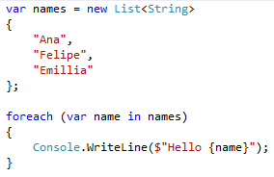

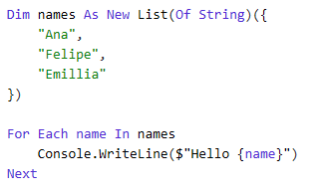
You can write code with many .NET languages
C# (c-sharp)
C# is a simple, modern, object-oriented, and type-safe programming language
Its roots in the C family of languages makes C# immediately familiar to C, C++, Java, and JavaScript programmers
F# (f-sharp)
F# is a cross-platform, open-source, functional programming language for .NET
It also includes object-oriented and imperative programming
Visual Basic
Visual Basic is an approachable language with a simple syntax for building type-safe, object-oriented apps
Notes:
(Speak to slide bullet points.)

Slide 5
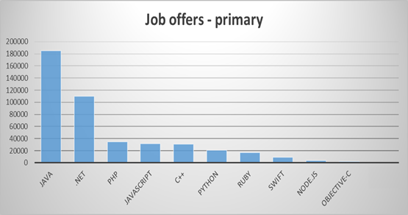
.NET is a sought after job skill
#2 demanded primary technology
(LinkedIn)
Notes:
Everybody wants to have a successful career and that means finding a job. There are a LOT of .NET jobs available since it’s been around for over 15 years. And in general, there are a huge amount of programming jobs.

Slide 6
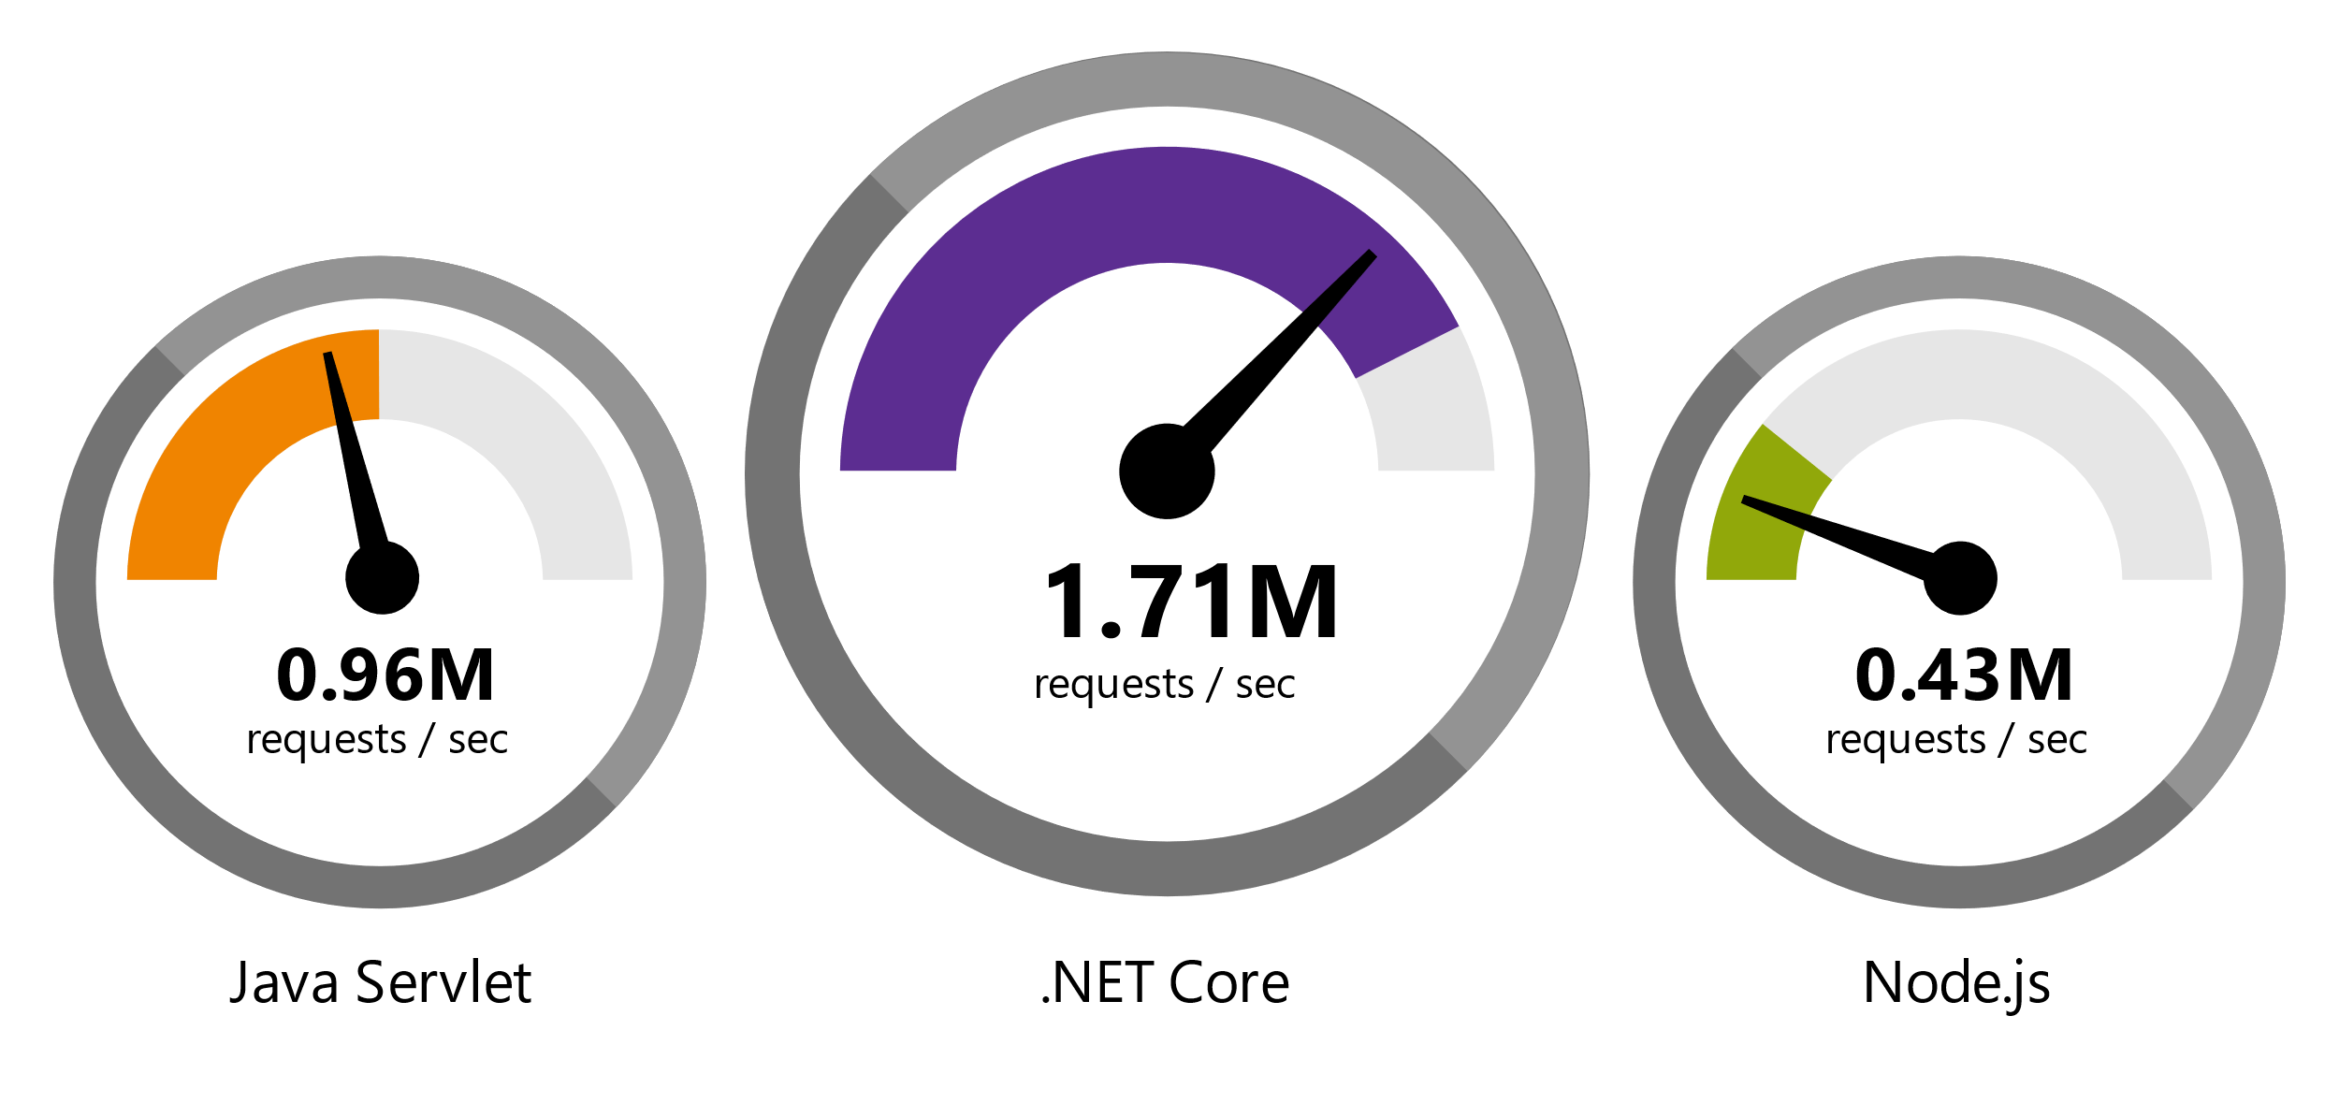
.NET is Fast. Really Fast!
Data sourced from official tests available at TechEmpower Round 14.
“Using the same-size server, we were able to go from 1,000 requests per second per node with Node.js to 20,000 requests per second with .NET Core.“ — Raygun
https://www.microsoft.com/net/customers
Notes:
.NET is fast. Really fast! That means applications provide better response times and require less compute power. StackOverflow serves 5.3M page views a day on just 9 servers!
The popular TechEmpower benchmark compares web application frameworks with tasks like JSON serialization, database access, and server side template rendering - .NET performs faster than any other popular framework.
https://www.techempower.com/benchmarks/#section=data-r14&hw=ph&test=plaintext
The community has played a crucial role in performance work for the .NET stack.
https://blogs.msdn.microsoft.com/dotnet/tag/performance/

Slide 7
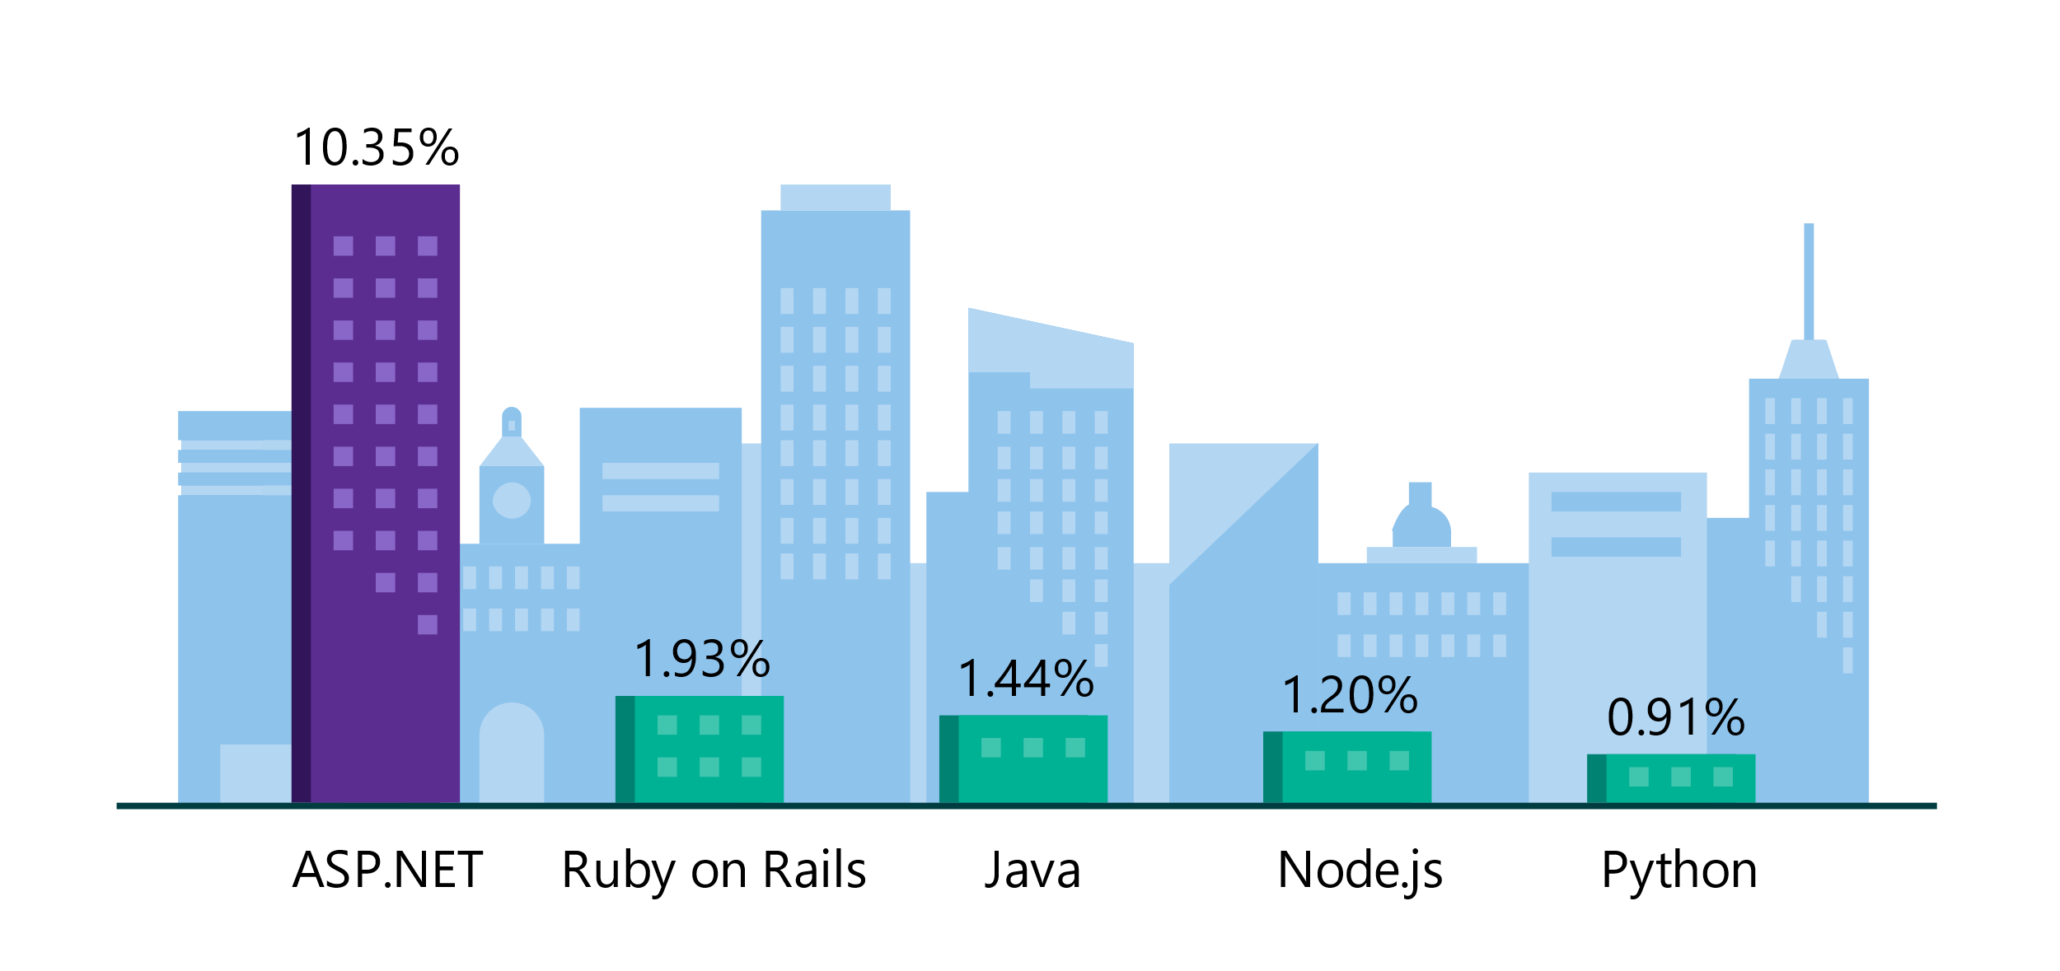
Platform of choice for the top 100K websites
More websites have been developed with ASP.NET than Ruby, Java, Python, Node.js, and Go combined.
Companies like Raygun, GoDaddy, and Tencent choose .NET for better performance, increased flexibility, and higher compatibility.
Data sourced from SimilarTech
Notes:
https://www.similartech.com/categories/framework
ASP.NET is the name of the web framework for .NET. As you can see there are more top websites developed with .NET than these other technologies. Only PHP has more.

Slide 8

We didn’t build this alone.
Notes:
Of course, we couldn’t do any of this this without the open source community.
Open source is about accepting people’s diverse opinions and combined intelligence to build something amazing. There are thousands of people all over the world contributing to the .NET platform.

Slide 9
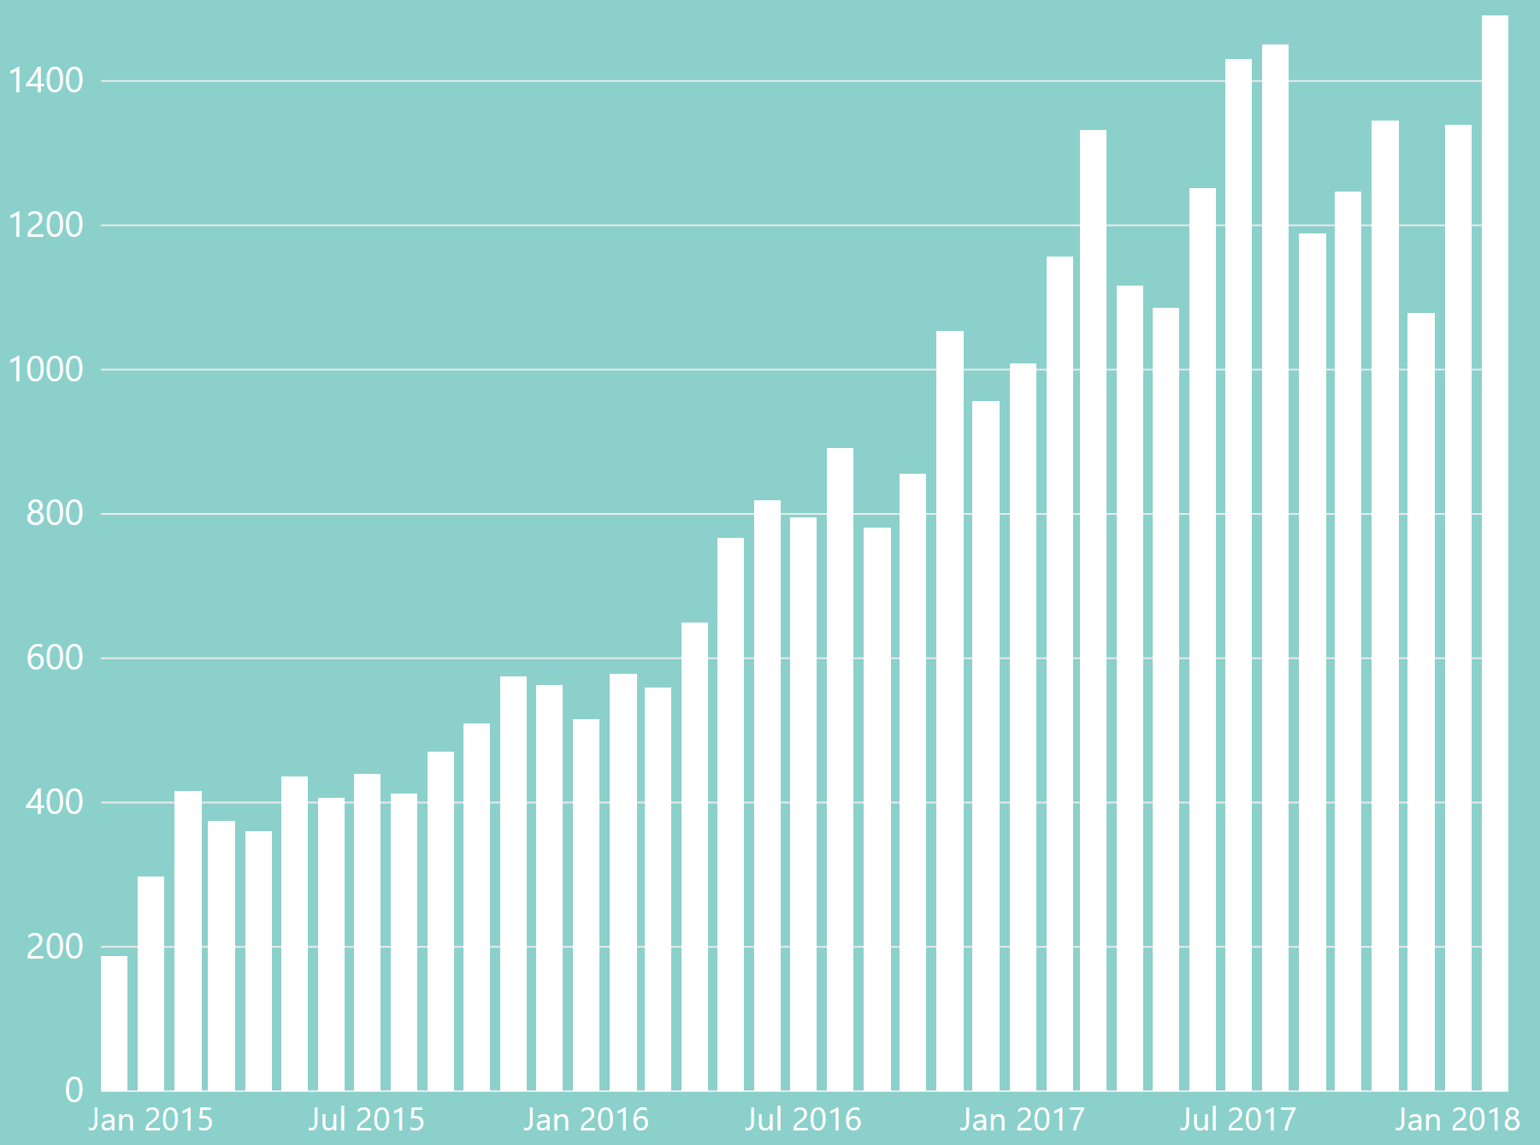
.NET is Open Source
Community Accepted PRs
“Samsung is embracing .NET because it is a completely open source project.” — Samsung
".NET is open source; that allows us to contribute back to it if we have any performance issues which Microsoft review and together we make a better product.“ — Illyriad Games
16,000+ Community Contributions from 3000+ Companies outside Microsoft
Notes:
We’ve seen companies taking a bet on .NET because it’s a completely open source project. More than 16,000 contributors* from 3300 companies have contributed to .NET Core and related open source repositories, with over half of the contributions coming from outside Microsoft.
Samsung is a big partner and are releasing their new Smart TVs that support .NET. They plan to expand to all their IoT devices too. Illyriad Games, specifically Ben Adams, contributed many performance enhancements to the platform. They build a MMO with hundreds of thousands of concurrent users so performance is super important to them. These enhancements not only benefit them but everyone that uses .NET.
*contributor = Submitted a Pull Request or Created an Issue

Slide 10
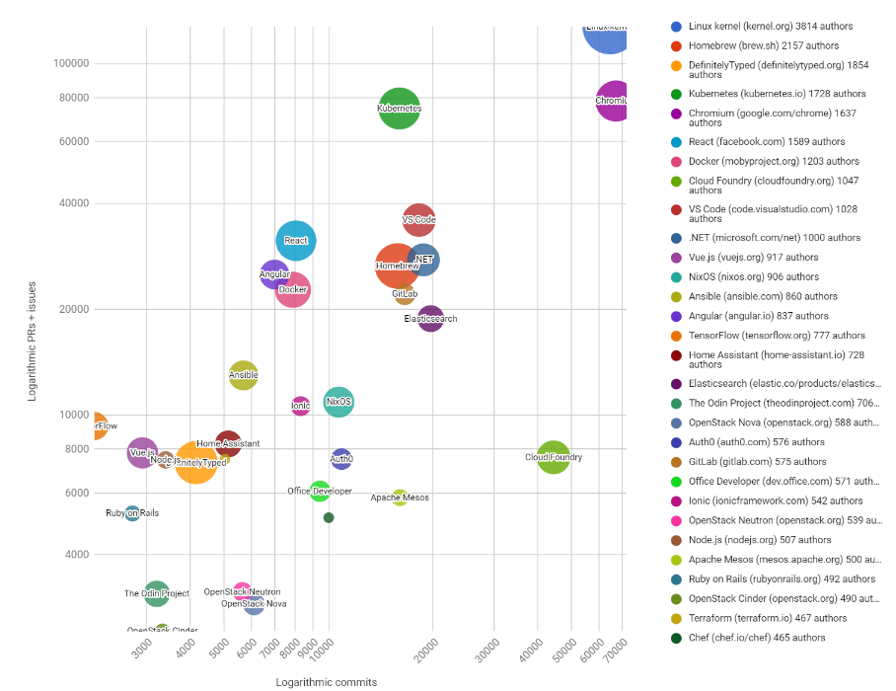

.NET named Top 30 Highest Velocity OSS Projects
https://www.cncf.io/blog/2017/06/05/30-highest-velocity-open-source-projects/
Notes:
Jim Zemlin, Executive director of Linux foundation said “There are 10’s of millions of open source projects, invest in the ones with sustainable ecosystems”. .NET is one of those projects. June 5th 2017, CNCF released an analysis of the top 30 highest velocity open source projects today. This is a logarithmic scale to measure OSS project velocity with commits on the X axis and PRs and issues on the Y axis, with # of authors indicated by the size of the circle. The farther upper right the more activity a project has. Linux Kernel is #1, followed by Chromium, Kubernetes and VSCode. Notice .NET is the #1 application framework.
Updated live: https://cdn.rawgit.com/cncf/velocity/d6f852d9/charts/top_30_bubble_chart_2017.html

Slide 11

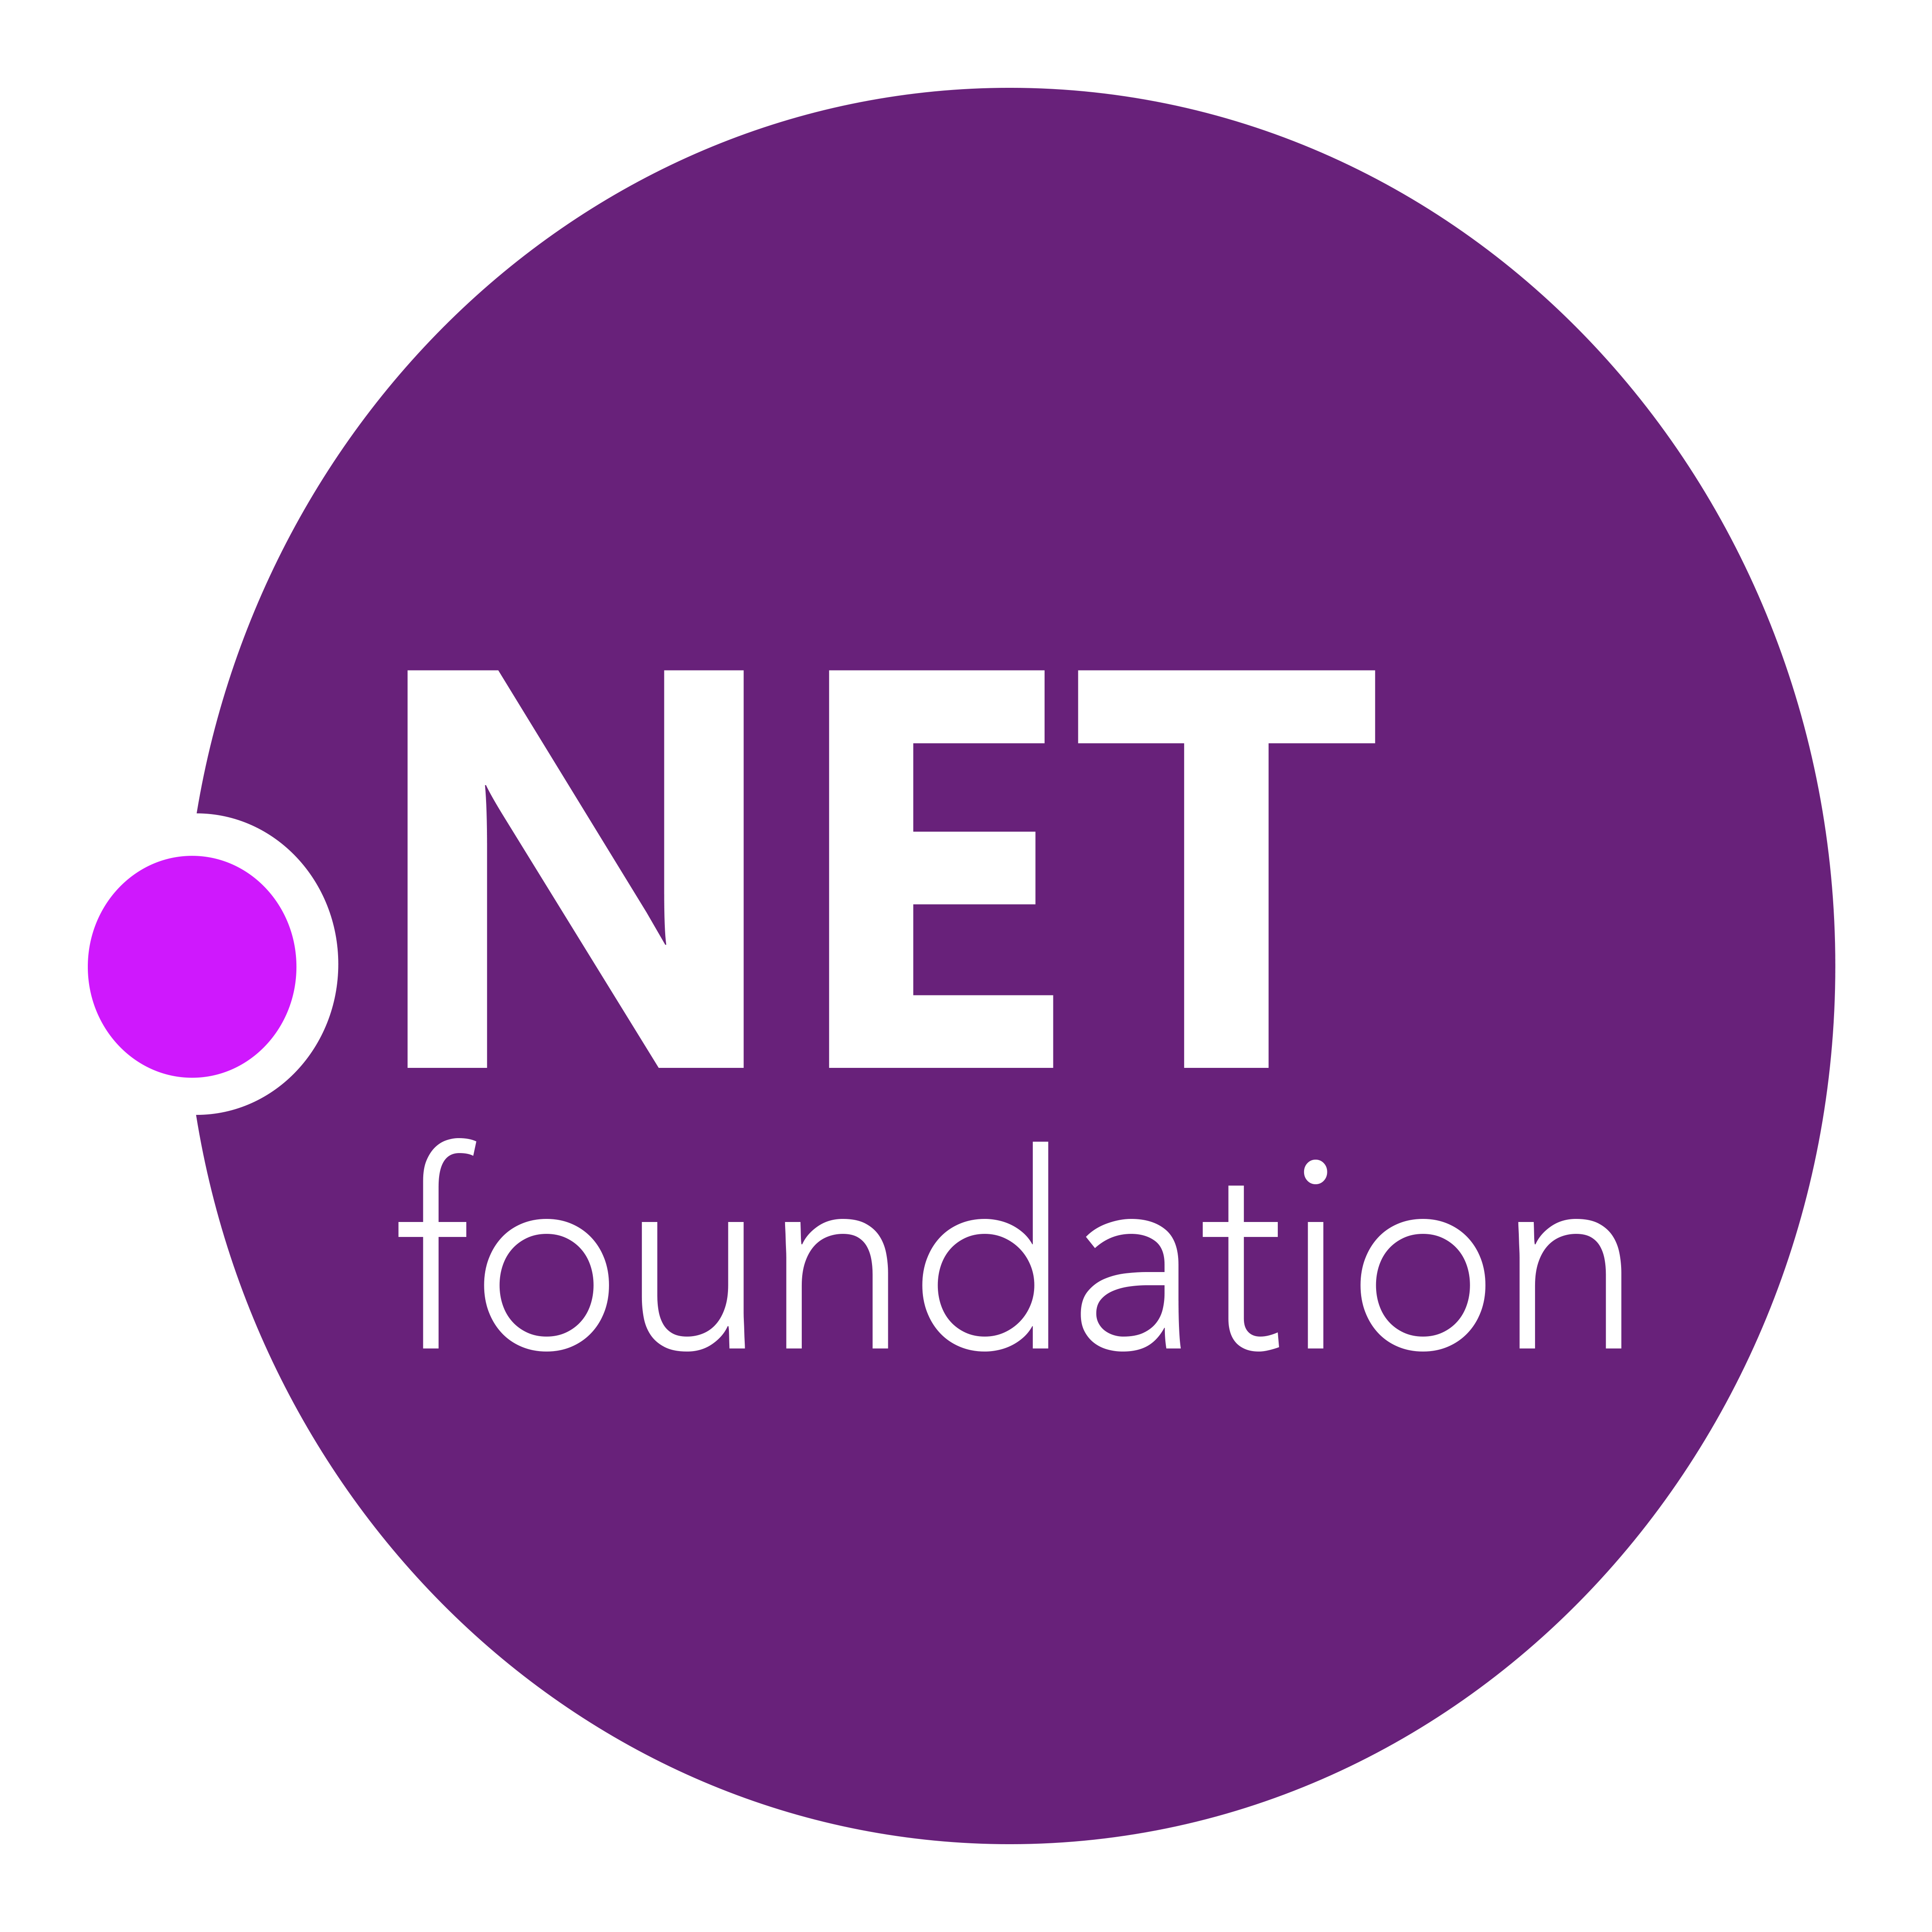
.NET Open Source Journey
2001- ECMA-335
2002- .NET 1.0 for Windows released, Mono project begins
April 2014- .NET Compiler Platform (“Roslyn”) Open Source .NET Foundation founded
Nov 2014- .NET Core Cross-plat, Open Source
2008- ASP.NET MVC (web platform) Open Source
.NET
Aug 2017- .NET Core 2
2016- Mono project joins .NET Foundation
Notes:
This didn’t happen overnight. Here’s a little history of .NET open source…..
Dec 2001-Feb 2002.
A new platform is born. Along with HP, Intel and others, the ECMA-335 standard was created that defined a common language infrastructure to support multiple programming languages. C# and Visual Basic.NET were released and F# came later in 2007, but there are over 20 other .NET languages today. Visual Studio .NET was released and included C#, VB, C++ development all in one box. This was the first IDE that was truly integrated across multiple languages.
Mono project begins. The CLI spec gave others the ability to create their own .NET implementations. Even though Microsoft built the first .NET Framework for Windows-only, the spec was intentionally portable across OSes and chipsets. The Mono project began, spearheaded by Miguel de Icaza, with the goal to implement Microsoft's new .NET development platform on Linux and Unix-like platforms. Later, Miguel started Xamarin which focused on cross-platform, native, mobile development with C#, built upon Mono. This allows developers to use C# and .NET to build apps for iOS and Android. Unity games development also emerged from Mono.
2008.
ASP.NET MVC web development stack is released to CodePlex as open source. This was the first application development framework from Microsoft to be released as open source. The underlying runtime and compilers were still closed however.
2014.
Hell freezes over & pigs fly. Early 2014 at Microsoft’s BUILD conference, Anders Hejlsberg, the father of C#, releases the .NET Compiler Platform “Roslyn” as open source on stage. Later in November, .NET Core project begins in the open. The technology world is shocked, and the .NET community is excited. .NET Core is a new cloud-native implementation of .NET that is geared for cross-platform, hyper-scale services as well as small IoT devices. It’s meant to bring .NET into the next 15 years of computing. And the community has been extremely supportive.
2016.
Mono comes home. In early 2016, Microsoft finally acquires Xamarin and brings Miguel de Icaza into Developer Division. Mono joins the .NET foundation and is officially supported and contributed to by Microsoft. The Microsoft community officially meets the Mono community.
2017.
.NET Core 2.0 Released. Our cross platform and open source implementation of .NET finally releases to the world with unified tooling support across multiple operating systems and editors.

Slide 12

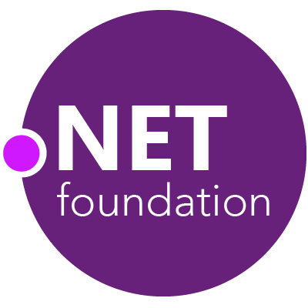
Steeltoe
.NET Core
Microsoft Web Protection Library
MSBuild
DotNetNuke
ASP.NET AJAX Control Toolkit
ASP.NET Core
SourceLink
Microsoft Azure WebJobs SDK
Salesforce Toolkits for .NET
nUnit
MVVM Light Toolkit
IronPython
Mailkit
WorldWide Telescope
Nancy
Open XML SDK
.NET SDK for Hadoop
MvvmCross
MEF
Mimekit
xUnit
ASP.NET Web Pages
NuGet
IdentityManager
Couchbase Lite for .NET
iOS
macOS
Entity Framework
.NET ECOSYSTEM
WCF
ILMerge
Xamarin.Mobile
ASP.NET SignalR
.NET Micro Framework
Open Live Writer
Mono
Xamarin.Auth
Xamarin SDK
Orchard CMS
OWIN Authentication Middleware
ProtoBuild
IdentityServer
Microsoft Azure SDK for .NET
.NET Compiler Platform ("Roslyn")
Prism
ASP.NET Web API
Cake
Orleans
Kudu
Cecil
LLILC
Umbraco
System.Drawing
ASP.NET MVC
Notes:
The .NET Foundation is our center of gravity for open development and collaboration around the .NET ecosystem. The .NET Foundation has over 60 projects and hundreds of repos under its stewardship. Open Source Software foundations provide protection, support, services and best practices for helping each project be successful and to grow the ecosystem of people and software.

Slide 13
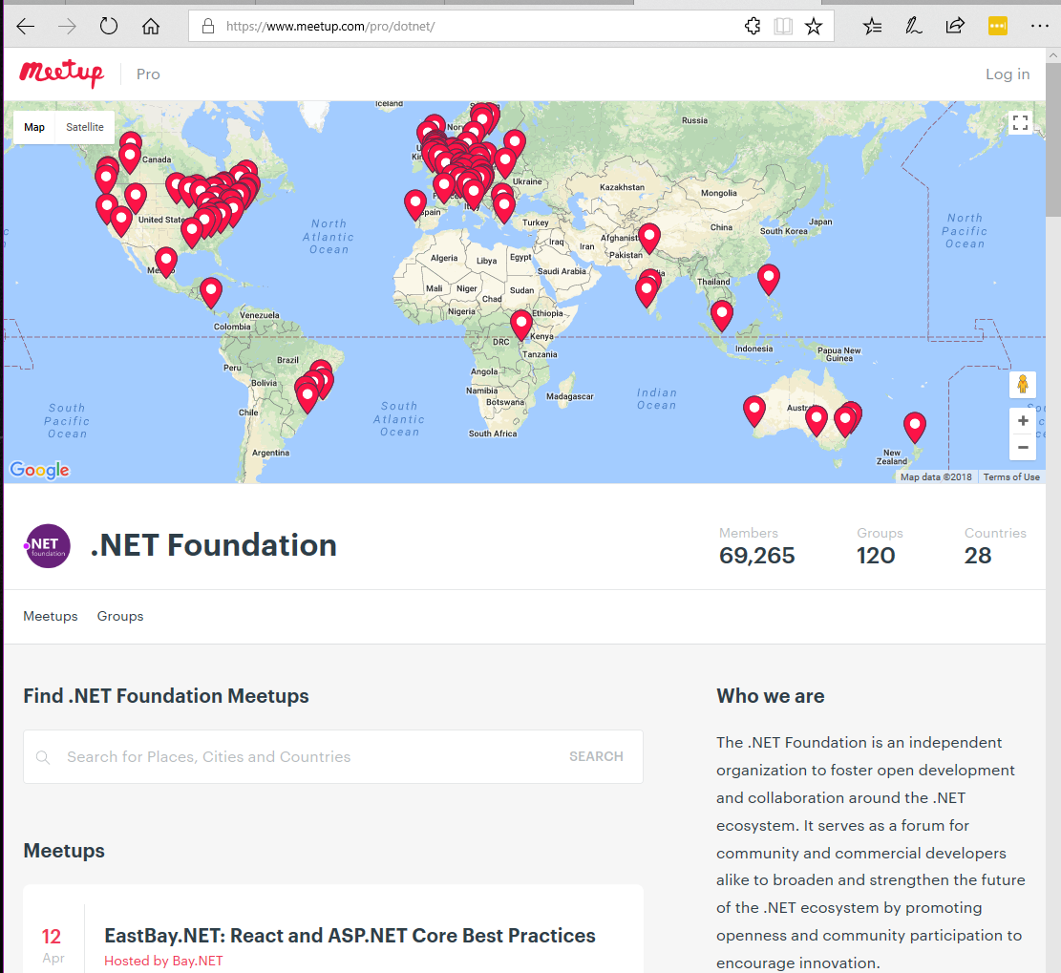
Meetups
These User Groups have presentations on all sorts of .NET topics
120 groups and counting worldwide, just on meetup.com
A lot of UGs aren’t on meetup.com
Notes:
We’re a huge community and the .NET Foundation is key to help foster it. We have over 4 million developers worldwide and .NET has grown its developer base by 1 million over the last year. There are meetups all over the world that speak on all sorts of .NET topics and application development. Here are the ones on meetup.com.

Slide 14




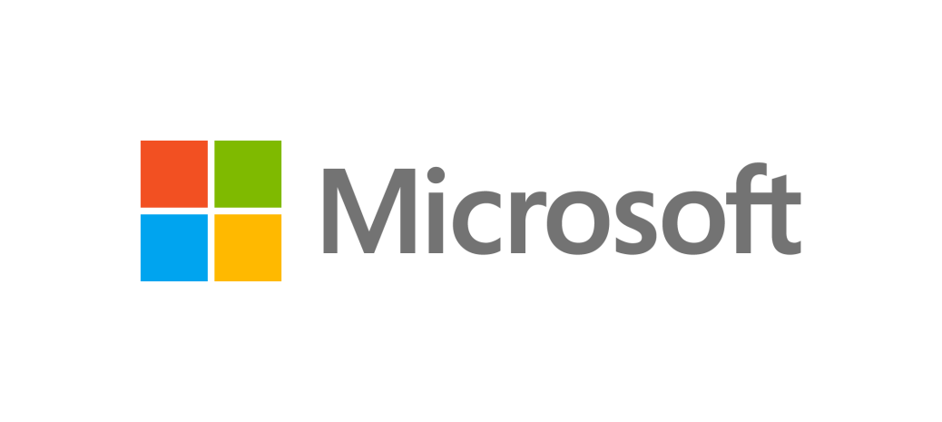

TECHNICAL STEERING GROUP MEMBERS
These companies are helping to drive the future of .NET
Notes:
And it’s not just individual developers, it’s large companies that are invested in the future of .NET. .NET is bigger than Microsoft. The technical steering group of the .NET Foundation is responsible for guiding .NET into the future together with industry partners.

Slide 15






RayGun
"Using the same-size server, we were able to go from 1,000 requests per second per node with Node.js to 20,000 requests per second with .NET Core."
- John-Daniel Trask, CEO and Co-Founder
AstroReality, Quantum Technologies
"We think .NET Core is mature, very powerful, and a great choice for advanced modern apps."
- Zerlot Ma, Cofounder and CEO
Jet.com Inc.
"The event-driven, microservices paradigm eliminated a lot of the overhead that comes with a service-oriented architecture."
- Mike Hanrahan, CTO
Tencent
“The cross-platform capabilities of .NET Core were very important to us. Also, Microsoft designed .NET Core with a microservice architecture in mind, and that fits right in with our redesign plans.”
- Shanyou Zhang: Senior Software Architect
Age of Ascent, Illyriad Games
"Our game microservices are built using ASP.NET Core which gives us superior performance. ASP.NET is open source, that allows us to contribute back to it if we have any performance issues which Microsoft review and together we make a better product."
- Ben Adams, CTO and Co-founder
NetEase
".NET Core doesn't just help us get to market faster, it also enables our developers to focus on the core logic and what really matters, our players' experience. They don't have to deal with the communication gap and different ways of implementing the algorithm on the back and front end. They can just work on finding better ways to implement their ideas."
- Feng Zhou, Product Director
United Parcel Service (UPS)
"Xamarin allowed us to develop a single code base in C# and deploy the application to two completely different mobile phone ecosystems."
- Scott Hildebrand, Application Development Manager
GoDaddy
“Services can be developed more quickly, perform faster in production, and scale better if they’re written using .NET Core with C#.”
- Jeremiah Gowdy: Principal Software Architect
And many more: microsoft.com/net/customers
Notes:
Our customers have been embracing the productivity in our platform, languages and tools for 15+ years. We’re now gaining existing customers as well as new ones on our cloud-native, cross-platform, and device-native approaches with these new architectures. Here are just a few. There are many more (and their stories) on our website.

Slide 16

This is our mascot, dotnet-bot

Slide 17
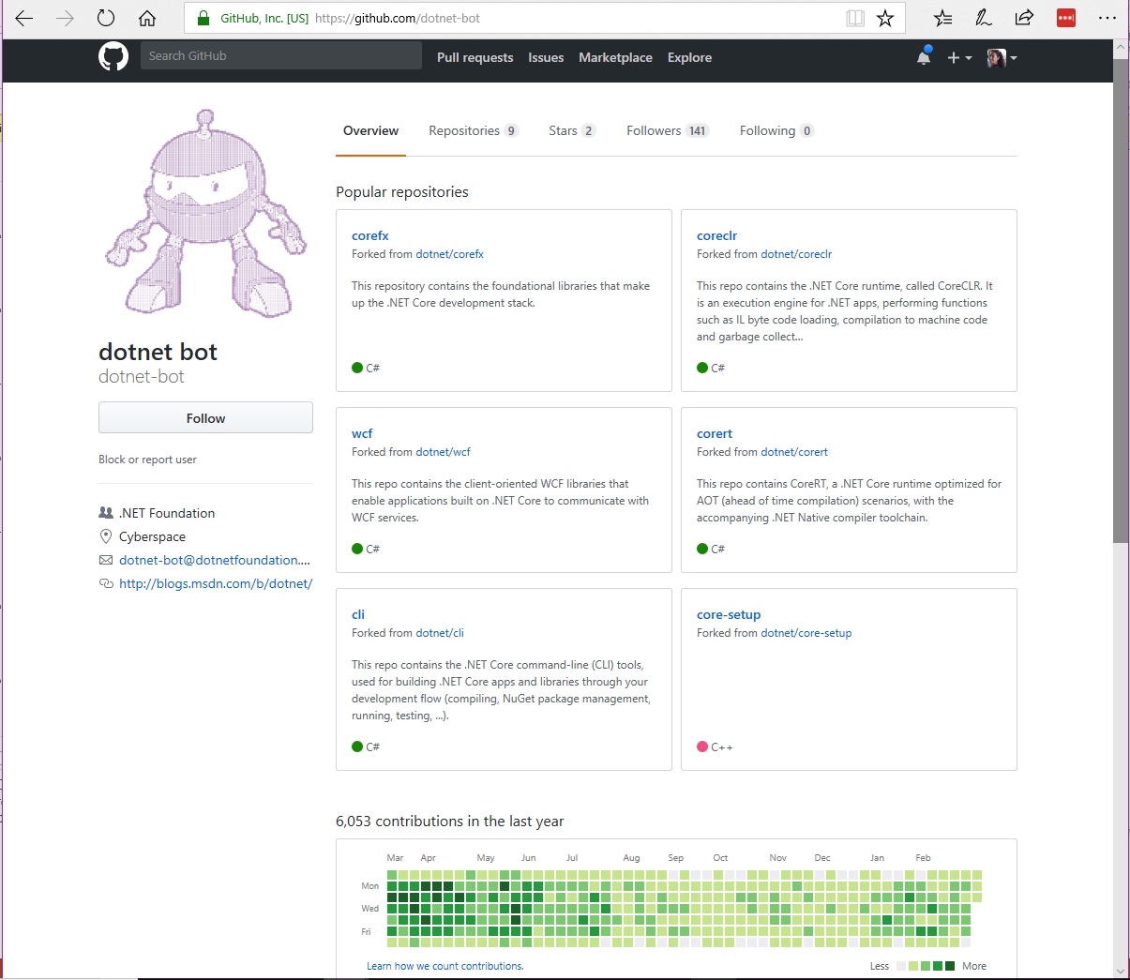
You can find dotnet-bot on GitHub
Notes:
Dotnet-bot helps us check the contributions (called Pull Requests) to make sure they are the developer’s original work. Dotnet-bot does this by checking if people have signed a contributor license agreement. This makes sure that the code that is submitted isn’t stolen from another product or company.

Slide 18
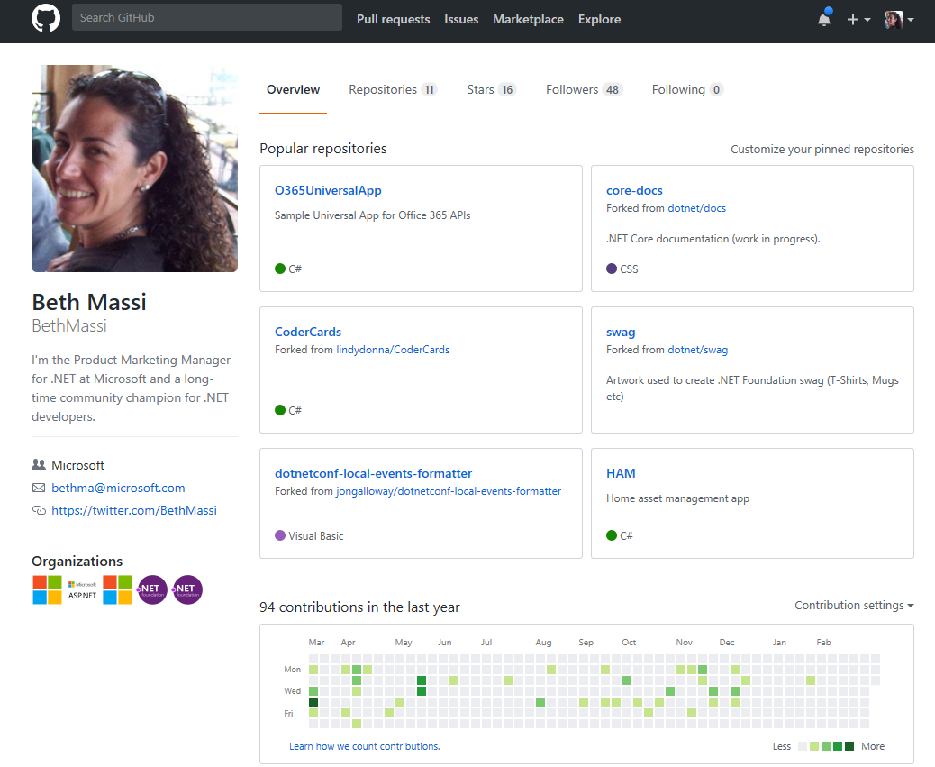
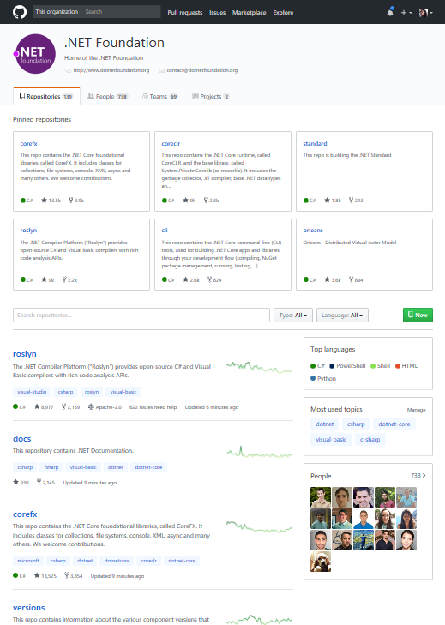
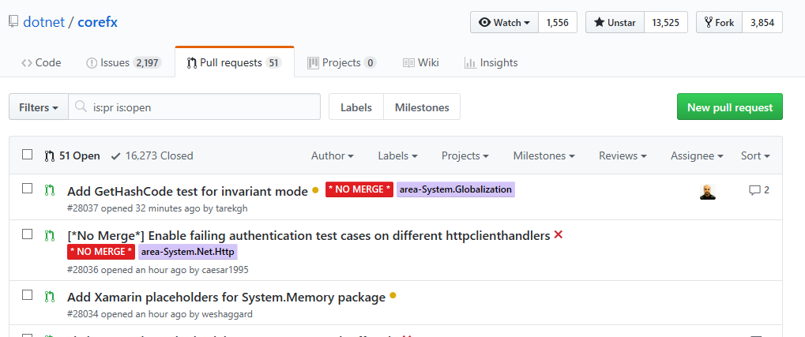
GitHub is where open source happens…
Notes:
I encourage you to look through GitHub – there are millions of open source projects there, some big, some small. To give you a sense of the size of .NET, take a look at how many PRs we’ve had, open discussions happening in issues, and stars (or likes) we’ve got.

Slide 19
.NET Core Growth
Over Half Million Active* .NET Core 2.0 Developers!
.NET CORE ADOPTION
* Active = unique monthly developers with 2+ days of development per month.
Notes:
And our usage is growing. As of February 2018, if we take a look at just the cross-platform, web workload (.NET Core) you can see we are already over a half million active developers per month. Active means unique developers with 2+ days of development per month.
On average we’re seeing double digit percentage growth of .NET Core MoM since 2.0 release in August. Metric includes .NET Core CLI + .NET Core in Visual Studio, 2day+ Active.
.NET all up across other workloads is also growing rapidly.

Slide 20
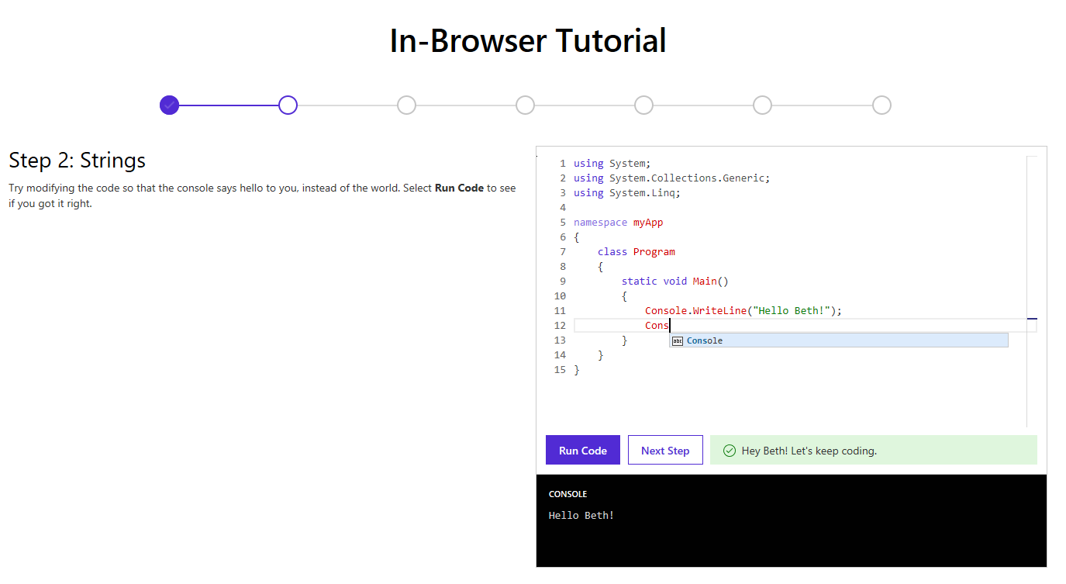
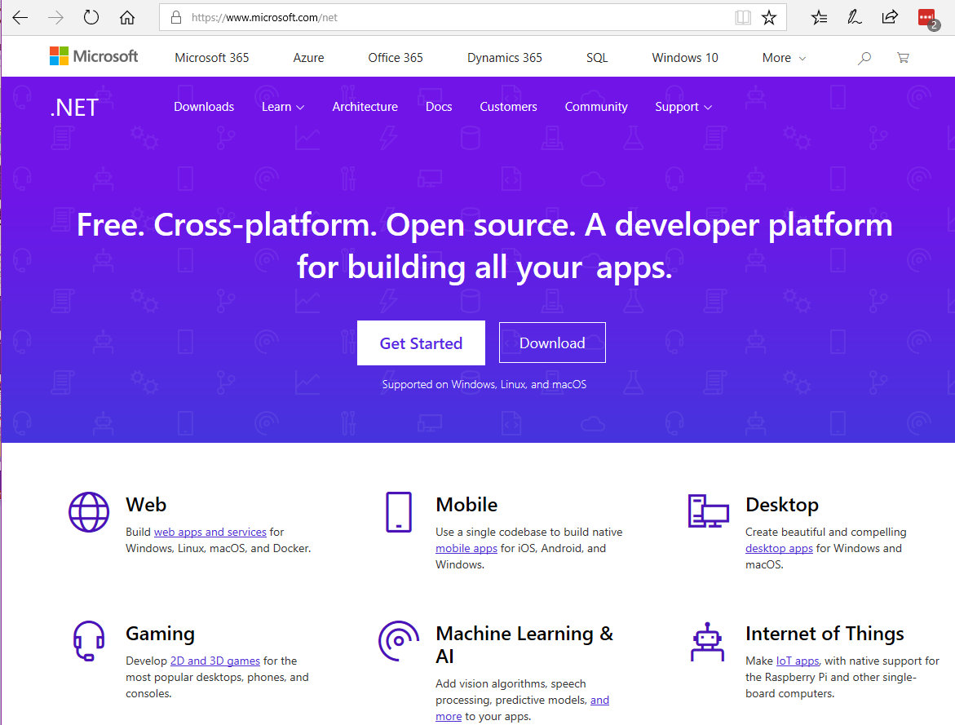
Learn how to program with C#
www.dot.net
Notes:
So you want to learn .NET? Start with a language. We make it easy to get started learning right in your browser.

Slide 21
Demo Get started with .NET in your browser
Notes:
In-Browser tutorial:
www.dot.net → Get Started → Select In-browser tutorial
https://www.microsoft.com/net/learn/in-browser-tutorial/1
-- Have the class walk through some of the lessons.

Slide 22
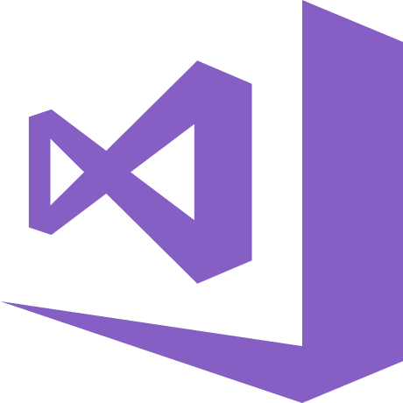
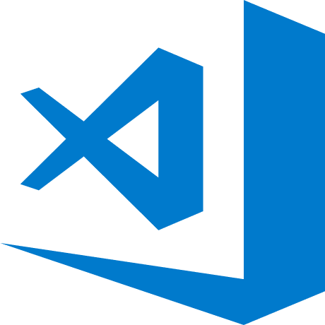
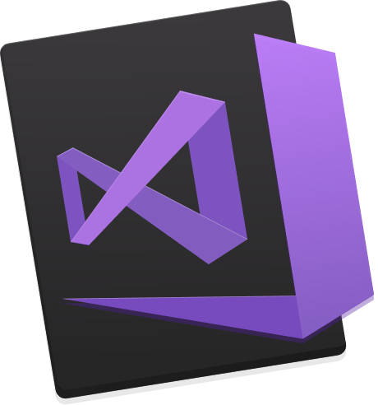
Make it easier with some free tools www.VisualStudio.com
Visual Studio
A fully-featured, integrated development environment (IDE) for developing .NET apps on a Windows PC development machine.
Visual Studio Code
Open source, cross-platform editor with .NET support.
Visual Studio for Mac
A fully-featured IDE for developing .NET apps on a Mac OS development machine.
Notes:
We also have free tools that can help you build your apps.

Slide 23
Demo Get started with .NET on your computer
Notes:
Machine demo:
Setup – install dotnet SDK
->> . Got to www.dot.net/core – walk through the setup instructions for your operating system
->> . [Optional] Install an editor like Visual Studio Code (any OS) or Visual Studio (Windows) from www.visualstudio.com
Open terminal/command prompt
>dotnet new
Show all the templates you can use
>dotnet new web
Creates a web application
>dotnet run
Starts web app. Navigate a browser to localhost:5000 to show “Hello World”
> CTRL+C to stop web server
>code .
Open VSCode
Run through this tutorial:
https://docs.microsoft.com/en-us/dotnet/core/tutorials/with-visual-studio-code

Slide 24
.NET
THANK YOU
Free. Cross-platform. Open source.
A developer platform for building all your apps.
www.dot.net

