Slide 1
Hospital Patient Trends Insight
Name: Akhilesh Kumar Singh
Email:akhileshcuians@gmail.com
Phone:8960837471
Experience: 0 yrs (Fresher)

Slide 2
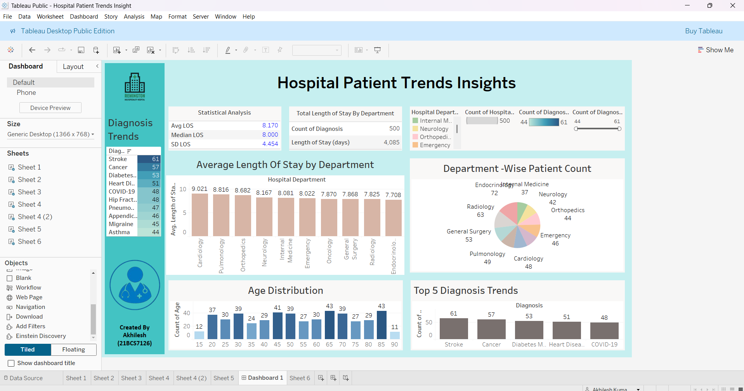
Screenshots

Slide 3
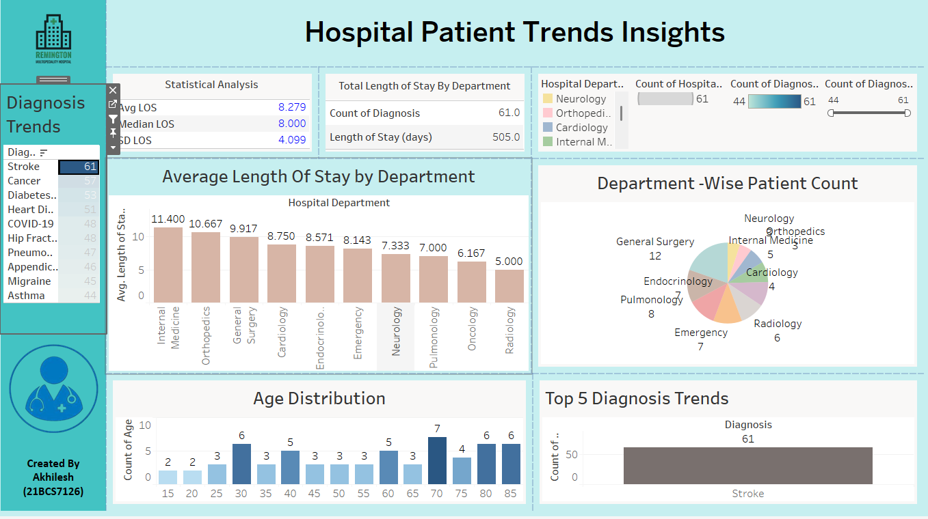
Screenshot Of Stroke trends

Slide 4
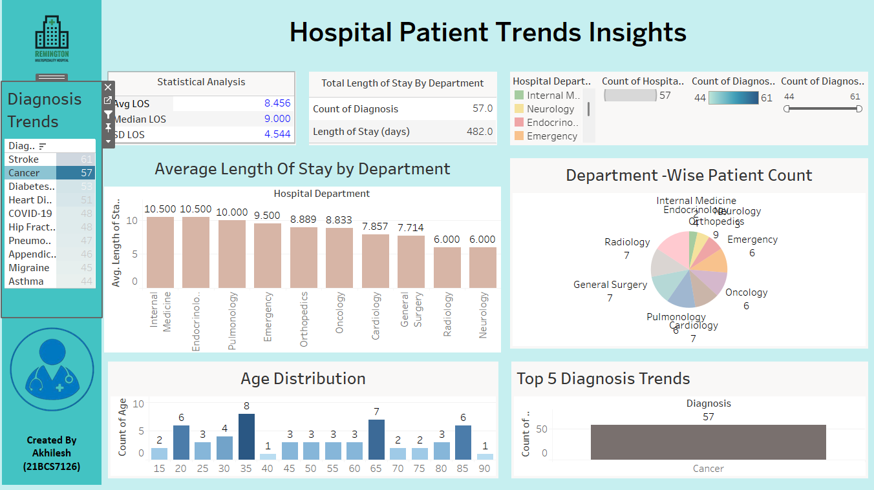
Screenshots of Cancer trends

Slide 5
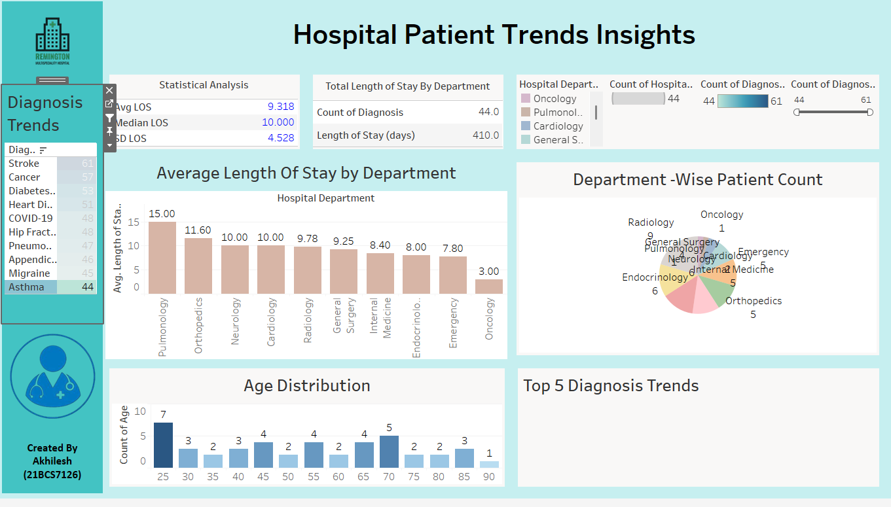
Screenshots of Asthama trends

Slide 6
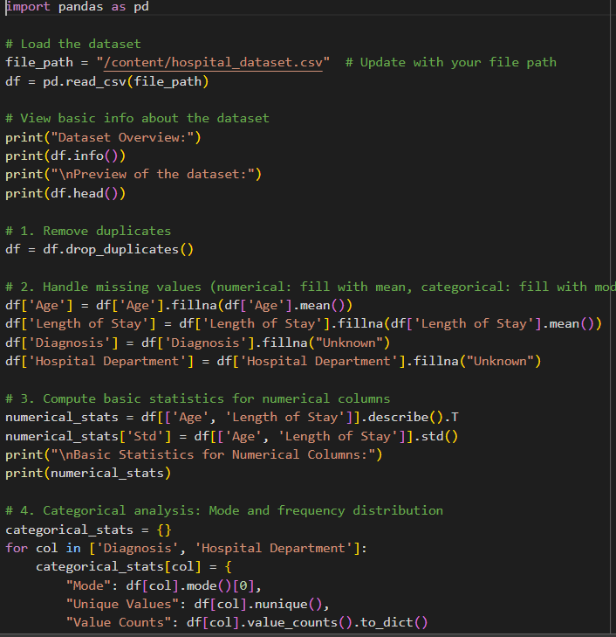
Codebase Environment
From this data set is downloaded of 500 rows with random data

Slide 7
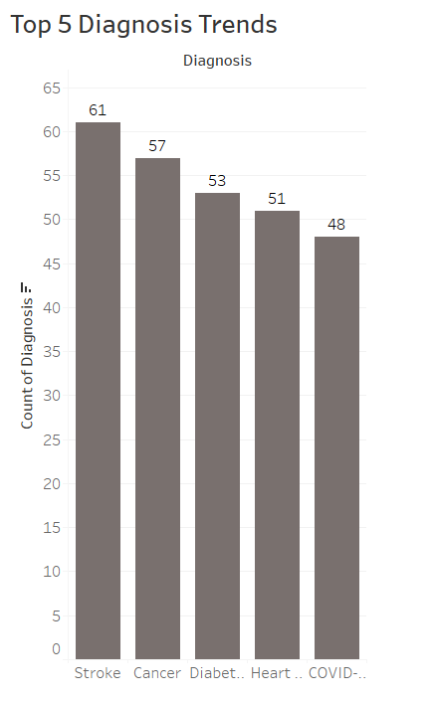
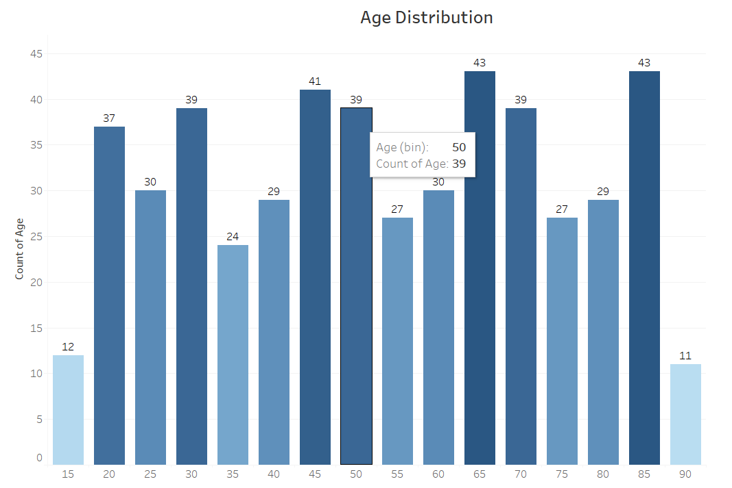
Codebase Environment

Slide 8
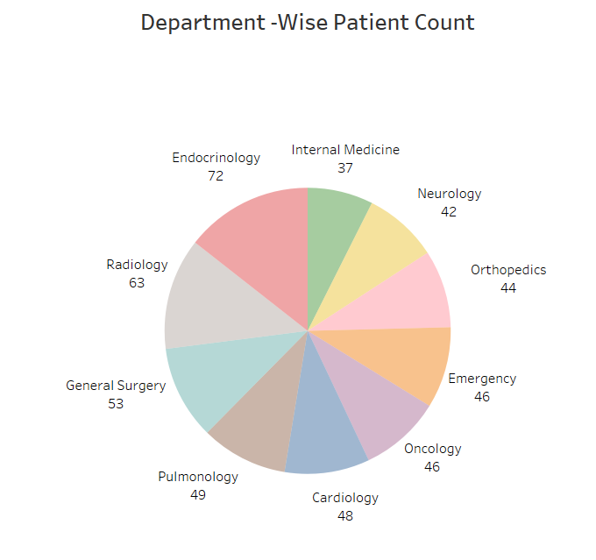
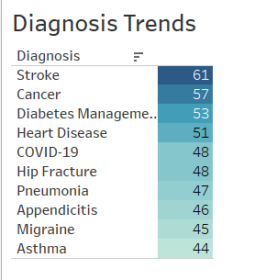
Codebase Environment

Slide 9
Challenges
1. Understand the Data:
Learn what each column means and identify the important ones.
Understand the purpose of the analysis to know which data is most critical.
2. Check Missing/Inaccurate Data:
Count how much data is missing or wrong and note where the problem is.
Look for patterns in missing data (e.g., specific rows or columns).
Use visual tools like heatmaps or charts to highlight missing values.

Slide 10
Challenges
3. Group Missing Data:
Some data is missing randomly.
Some is missing because of other data.
Some is missing for unknown reasons.
Identify if missing data is related to certain patient groups or variables.
4. Fix Missing Data:
Delete: Remove rows or columns if very little data is missing and it’s not important.
Fill Values: Fill missing data with:
Average, most common value, or similar data.
Predictions using other data.

Slide 11
Challenges
5. Fix Wrong Data:
Check if data fits expected values (e.g., valid age range, correct date formats).
Correct mistakes (e.g., typos, formatting issues) or replace wrong values.
Standardize data to ensure consistency (e.g., units, date formats).
Remove duplicate records to avoid errors.
6. Handle Outliers:
Identify values that are too high or low to be realistic.
Decide whether to keep, correct, or remove outliers based on context.

Slide 12
Challenges
7. Test and Validate:
Run checks to ensure the cleaned data makes sense and matches expectations.
Test the data in small analyses to confirm it works properly.
8. Document and Share:
Write down all changes, methods, and assumptions for transparency.
Share the cleaned dataset and explanation with stakeholders or experts for review.

