Slide 1
Marks Drawrings
Supplemental material

Slide 2
Feature Branch1
1main
Merge Conflict!! ☹
Feature Branch2

Slide 3


















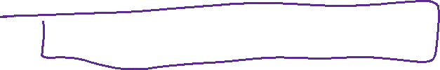







Slide 4
RPS OOP Planning
Player | Gamepieces | Game(results of the game) | Round
Fname | Rock | Array(List) of rounds | P1choice
Lname | Paper | Overall winner | P2choice
DoB | scissors | Date & Time played | P1
Gender |  | Number of ties | p2
Wins |  | P1 | Round winner
losses |  | p2

Slide 5

















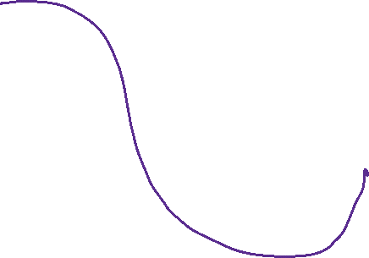











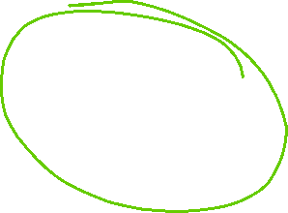

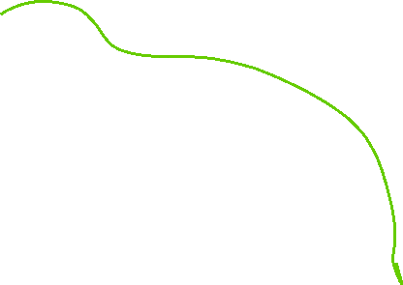
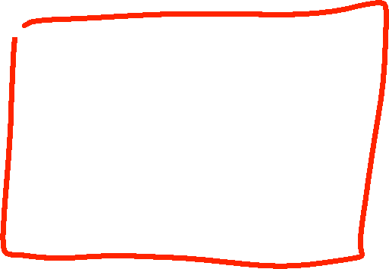




















Slide 6
N.E.R.T.I.E.
Nutrition
Exercise
Rest
Time
Iteration / Isolation
Extension

Slide 7













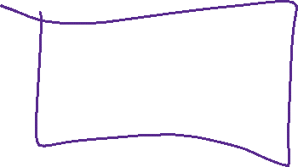












What is a Stack?

Slide 8


















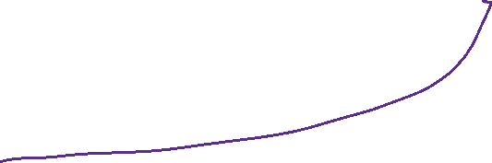


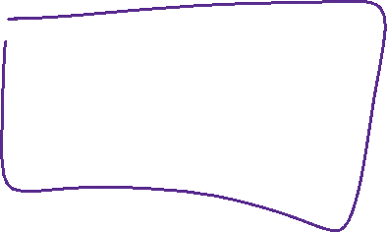















What is a QUEUE?

Slide 9
























What is a Dictionary?

Slide 10


































What is a Hash Set?

Slide 11































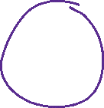

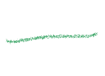













What is a Singly-Linked List?

Slide 12










What is a Doubly-Linked List?

Slide 13
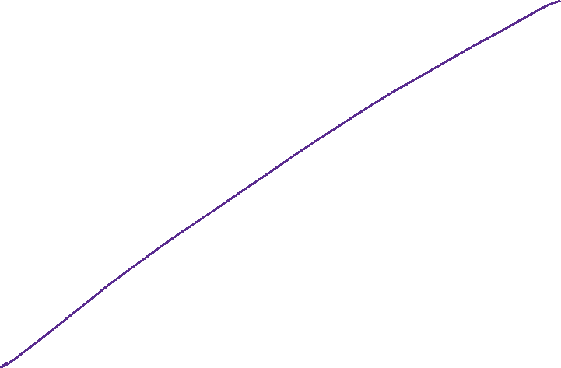
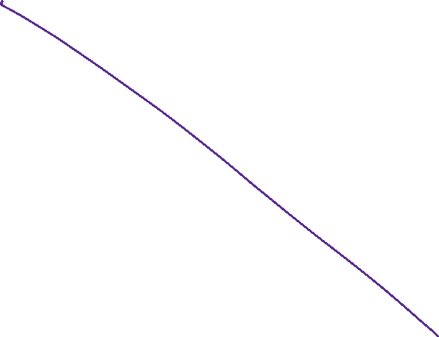
What is a Map? No such thing in C#

Slide 14






Ordered List

Slide 15

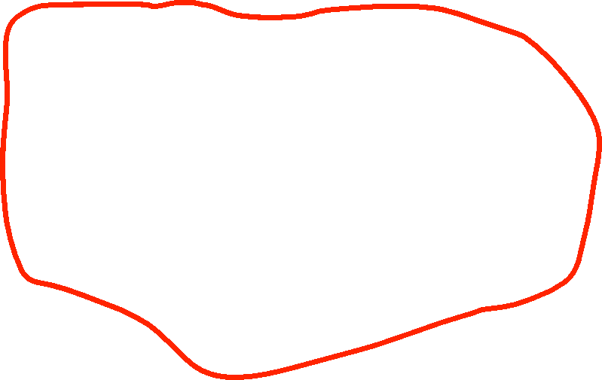




Structure of RpsConsole.
GamePlay.cs
Has methods that the Program class calls
Program.cs
Game.cs
Player.cs
List<Round>

Slide 16
Marks sample Db Schema
Orders
PK is the Order #
FK references Customer who created the order.
Date of the order
Total amount
FK references the address for the order.
Customers
PK is the customer account #
Fname
Lname
Remarks
1-N
Junction Table
PK is the association number
FK referencing the Customer
FK referencing the Address
N-N
Addresses
PK to uniquely ID the address
Street and number
Apt/Suite #
City
Zip code
Country Code (int) max 999Date

Slide 17








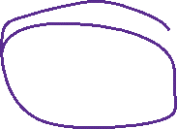
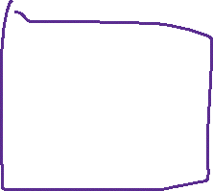



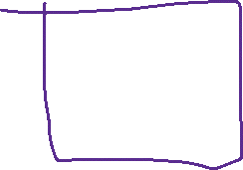


TRIGGER
inserted

Slide 18
Repo Pattern RPS Console structure
Program.cs
Ui layer
1.User gives you info.
You call a method in the Bus. Layer.
2. Bus Layer will do some logic and call a method in the Repo Layer to insert into the Db.
BusinessLayer
Logic Layer
Models
3. Repo layer method will create the connection and insert the data.
RepoLayer
Mapper

