Slide 1
OOP Inheritance and Polymorphism
Group 3 (Alicia, Ian, Josh, and Larry)

Slide 2
But before we proceed, “What is OOP”?
Object-Oriented Programming (OOP) is based on the concept of "objects", which can contain data in the form of fields (attributes/properties), and code in the form of procedures (methods). In OOP, computer programs are designed by making them out of objects (classes) that interact with one another. (1)
There are 4 pillars to OOP: Abstraction, Encapsulation, Inheritance, and Polymorphism.
Abstraction : Abstraction is the process of showing only essential/necessary features of an entity/object to the outside world and hide the other irrelevant information. For example to open your TV we only have a power button, It is not required to understand how infra-red waves are getting generated in TV remote control. (2)
Encapsulation : Encapsulation means wrapping up data and member function (Method) together into a single unit i.e. class. Encapsulation automatically achieve the concept of data hiding providing security to data by making the variable as private and expose the property to access the private data which would be public. (2)
As for the other two, they will be the focus of our presentation.
(1) https://www.linkedin.com/pulse/4-pillars-object-oriented-programming-pushkar-kumar#:~:text= (2) https://en.wikipedia.org/wiki/Object-oriented_programming

Slide 3
What is a Class?
“Class -A type that is defined as a class is a reference type,-Classes are declared by using the class keyword followed by a unique identifier,-Although they are sometimes used interchangeably, a class and an object are different things,-Classes fully support inheritance, a fundamental characteristic of object-oriented programming"
https://docs.microsoft.com/en-us/dotnet/csharp/fundamentals/types/classes

Slide 4
Inheritance
What is inheritance?
“Inheritance is one of the core concepts of object-oriented programming (OOP) languages. It is a mechanism where you can to derive a class from another class for a hierarchy of classes that share a set of attributes and methods.”
“You can use it to declare different kinds of exceptions, add custom logic to existing frameworks, and even map your domain model to a database.”
https://stackify.com/oop-concept-inheritance/

Slide 5
Inheritance in C#
“Inheritance enables you to create new classes that reuse, extend, and modify the behavior defined in other classes. The class whose members are inherited is called the base class, and the class that inherits those members is called the derived class. A derived class can have only one direct base class.”
https://docs.microsoft.com/en-us/dotnet/csharp/fundamentals/object-oriented/inheritance

Slide 6
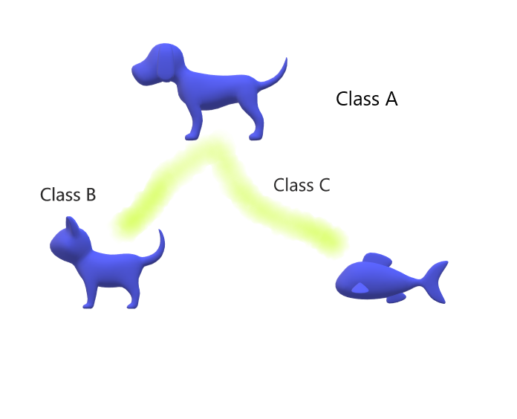
Inheritance
Animal Class
Cat Class
Fish class
By Josh Zidek

Slide 7
Inheritance pros and cons
Advantages of Inheritance in OOPS
The main advantage of the inheritance is that it helps in reusability of the code. The codes are defined only once and can be used multiple times. In java we define the super class or base class in which we define the functionalities and any number of child classes can use the functionalities at any time.
Through inheritance a lot of time and efforts are being saved.
It improves the program structure which can be readable.
The program structure is short and concise which is more reliable.
The codes are easy to debug. Inheritance allows the program to capture the bugs easily
Inheritance makes the application code more flexible to change.
Inheritance results in better organisation of codes into smaller, simpler and simpler compilation units.
Disadvantages of Inheritance in OOPS
The main disadvantage of the inheritance is that the two classes(base class and super class) are tightly coupled that is the classes are dependent on each other.
If the functionality of the base class is changed then the changes have to be done on the child classes also.
If the methods in the super class are deleted then it is very difficult to maintain the functionality of the child class which has implemented the super class’s method.
It increases the time and efforts take to jump through different levels of the inheritance.
https://www.ianswer4u.com/2017/09/oops-inheritance-advantages.html

Slide 8
Polymorphism
“Polymorphism is one of the core concepts of object-oriented programming (OOP) and describes situations in which something occurs in several different forms. In computer science, it describes the concept that you can access objects of different types through the same interface. Each type can provide its own independent implementation of this interface.”
https://stackify.com/oop-concept-polymorphism/

Slide 9
Polymorphism in C#
“In c#, Polymorphism means providing an ability to take more than one form, and it’s one of the main pillar concepts of object-oriented programming after encapsulation and inheritance. Generally, polymorphism is a combination of two words, poly, and another one is morphs. Here poly means “multiple” and morphs means “forms” so polymorphism means many forms. In c#, polymorphism provides an ability for the classes to implement different methods called through the same name. It also provides an ability to invoke a derived class's methods through base class reference during runtime based on our requirements. In c#, we have two different kinds of polymorphisms available, those are Compile Time Polymorphism and Run Time Polymorphism. In c#, Compile Time Polymorphism means defining multiple methods with the same name but with different parameters. Using compile-time polymorphism, we can perform different tasks with the same method name by passing different parameters.In c#, the compile-time polymorphism can be achieved by using method overloading, and it is also called early binding or static binding. In c#, Run Time Polymorphism means overriding a base class method in the derived class by creating a similar function. This can be achieved by using override & virtual keywords and the inheritance principle. Using run-time polymorphism, we can override a base class method in the derived class by creating a method with the same name and parameters to perform a different task.In c#, the run time polymorphism can be achieved by using method overriding, and it is also called late binding or dynamic binding.”
https://www.tutlane.com/tutorial/csharp/csharp-polymorphism

Slide 10
Polymorphism pros and cons
IMPORTANT POINTS ABOUT POLYMORPHISM
A functionality can behave differently for different instances
The behavior depends on the type of data used in the operation
Polymorphism is used for implementing inheritance.
ADVANTAGES OF POLYMORPHISM
It helps programmers reuse the code and classes once written, tested and implemented. They can be reused in many ways.
Single variable name can be used to store variables of multiple data types(Float, double, Long, Int etc).
Polymorphism helps in reducing the coupling between different functionalities.
DISADVANTAGES OF POLYMORPHISM
One of the disadvantages of polymorphism is that developers find it difficult to implement polymorphism in codes.
Run time polymorphism can lead to the performance issue as machine needs to decide which method or variable to invoke so it basically degrades the performances as decisions are taken at run time.
Polymorphism reduces the readability of the program. One needs to identify the runtime behavior of the program to identify actual execution time.
https://www.ianswer4u.com/2017/09/oops-polymorphism-advantages.html

Slide 11
How do Inheritance and Polymorphism work together!
“Inheritance allows you to create class hierarchies where the case class gives it’s behavior and attributes to a derived class. You are then free to modify or extend its functionality. Polymorphism ensures that the proper method is executed based on the calling object’s type.”
https://www.nerd.vision/post/polymorphism-encapsulation-data-abstraction-and-inheritance-in-object-oriented-programming#:~:text=Inheritance%20allows%20you%20to%20create,on%20the%20calling%20object%27s%20type

Slide 12
Define Key Terms
What are the Four Pillars of OOP?
Abstraction: Showing the user only the essential parts of the program
Encapsulation: Restriction of direct access to abstracted data
Inheritance: Where one class (child) acquires the properties and behaviors of another class (parent)
Polymorphism: The implementation of an inherited method in (a) different way(s).

